Slide 1
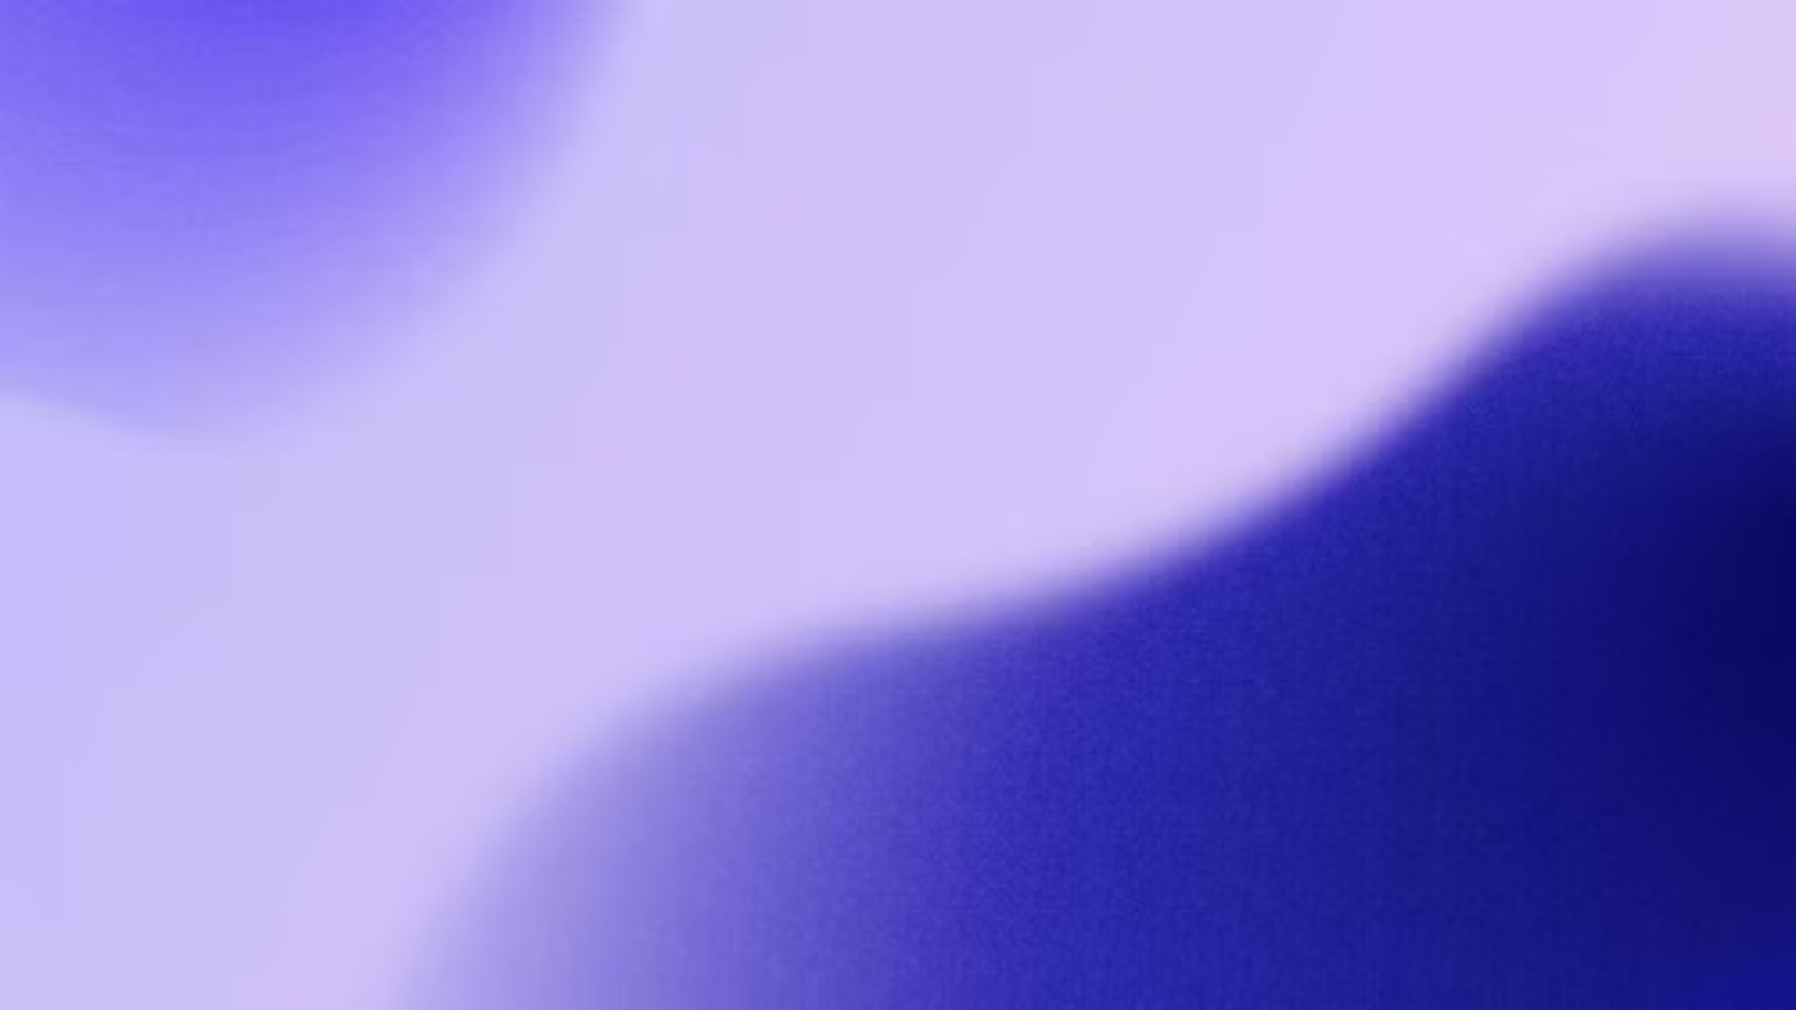
GestureCanvas: Intuitive Digital Drawing
GestureCanvas is an innovative application that transforms any digital surface into a dynamic workspace, empowering users to draw, write, and erase with intuitive hand gestures. This cutting-edge technology enhances interactivity in education, meetings, and creative sessions.
Notes:
Good afternoon, respected teachers, seniors and batchmates. I Khushi Kumari and my partner Ahmad Faraz are excited to introduce you GestureCanvas an innovative application that transform any digital surface into a dynamic workspace which allow users to draw, write and erase with intuitive hand gestures. This cutting edge technology increases education, meetings and creative sessions.

Slide 2
Why We Created GestureCanvas
1
Engage Audiences
2
Boost Collaboration
3
Enhance Learning
We wanted to build a tool that would captivate participants and keep them actively engaged, whether in educational settings, meetings, or creative sessions.
Our goal was to enable seamless, real-time collaboration by empowering multiple users to interact intuitively using gesture-based controls.
We envisioned transforming static presentations into dynamic, hands-on learning experiences that would help educators deliver more impactful lessons.
Notes:
We created gesture canvas to address three main goals:
To engage audience, we wanted a tool that captivates the participants and keep them actively engaged in educational settings or meetings.
To boost collaboration, our goal is to allow multiple users to intuitively use hand gesture-bases controls
To enhance learning, we aim to transform static presentations into dynamic and helping teachers to deliver more impactful lessons.

Slide 3
The Challenge of Traditional Drawing Tools
Clunky Controls
Lack of Responsiveness
Unintuitive Interaction
Existing digital drawing tools often rely on complex menus, buttons, and controllers that disrupt the creative flow and make it difficult to interact naturally.
Many digital drawing apps suffer from lag or delayed reactions, hampering the user's ability to create content fluidly and spontaneously.
Traditional digital drawing tools force users to adapt to the technology, rather than the technology adapting to the user's natural hand movements and gestures.
Notes:
Traditional digital drawing tools like mousepad or mouse bases apps have several limitation:
Like lack of responsiveness, or unintuitive controls or clunky controls in which users don’t have complete control to showcase their creativity properly.

Slide 4
Our Proposed Approach
Intuitive Gestures
Adaptive Functionality
Empower users to control the drawing tools using natural hand movements and finger gestures, eliminating the need for complex menus or controllers.
Allow users to intuitively adjust brush sizes, colors, and other settings through simple gestures, adapting the tools to their needs in the moment.
1
2
3
Responsive Design
Ensure the app responds instantly to user input, creating a seamless and fluid drawing experience with no perceptible lag.
Notes:
To overcome these challenges:
We designed an app which is responsive, can be easily controlled with just hand gestures and have many diIerent options like to draw with diIerent colors, increase the size of paint brush or eraser, etc.

Slide 5
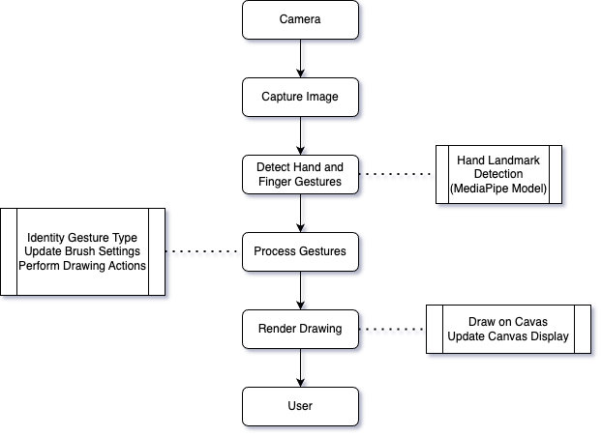
Data Flow Diagram
Notes:
This data flow diagram states that first the data is being inputted by the camera, then it captures what is recorded, then it detects hand and finger gestures using MediaPipe’s Hand Landmark Model, then it process the gestures then it renders the data which is drawn on the canvas and it is being displayed to the user.

Slide 6



Use Index and Middle Fingers to Select Tools
Brush
Eraser
Tool Settings
Use your index finger to draw with the selected brush color and size.
Employ your index finger to erase digital content with precision.
Utilize your index and middle fingers to adjust brush size and color options.
Notes:
In this prototype app, we implemented to gestures only, one finger to draw or erase and two fingers to select different options like change of colors of brush, increasing and decreasing the size of brush or eraser and selecting eraser or brush.

Slide 7

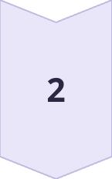
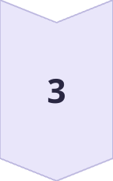
Transform Any Digital Surface into a Dynamic Workspace
Connect
Seamlessly integrate GestureCanvas with a variety of digital devices, including interactive whiteboards, tablets, and touchscreen displays.
Collaborate
Enable multiple users to work together in real-time, sharing ideas and annotations on the same digital canvas.
Create
Unleash your creativity and bring your digital concepts to life, whether you're sketching, diagramming, or annotating.
Notes:
For future, we are planning to introduce a feature in which diIerent users can interact at the same time, sharing their ideas and annotations on the same digital canvas.
Now my partner will demonstrate the app we made and show its diIerent features and uses.

