Slide 1
Socially Relevant Project
Title : Ecoshare
- A Platform for efficient food donation and recycling of wastes
Team Members:
Sugadharshanan H – 2022115002
Shewak N – 2022115087
Arun Prasath S - 2022115117

Slide 2
Problem Statement
What is the issue?
Lack of efficient food donation allocation and inefficient waste recycling.
Current challenges NGOs face:
Unpredictable donations.
No urgency-based priority system.
No real-time tracking of food supply.
Our proposed solution:
AI-based smart food allocation system with ML-driven priority scoring.

Slide 3
Social Relevance
Real-world impact of food wastage other than hunger:
Environmental Cost: 8% of global carbon emissions come from food waste.
Economic Loss: Wasted food costs ~$1 trillion annually.
Case Study / Existing Initiatives:
Example: Zomato Feeding India’s food rescue program.
How our project makes a difference:
Ensures donations reach those in urgent need using ML-based dynamic priority allocation.

Slide 4
Objectives
Primary Goal:
✔ To develop an ML-powered system that ensures food donations reach the most urgent NGOs first.
🔹 Sub-objectives:
✅ Use ML to analyze NGO needs and assign priority scores.
✅ Automate donor-NGO matching to optimize resource allocation.
✅ Enhance proper recycling of Wastes.
✅ Provide a real-time tracking system for food deliveries.
4

Slide 5
Literature Survey / Background
UN Report (2021): 931 million tonnes of food wasted globally each year.
FAO (Food and Agriculture Organization): Over 828 million people suffer from hunger
India ranks high in food wastage and malnourishment simultaneously.
Highlights the need for efficient redistribution systems.

Slide 6
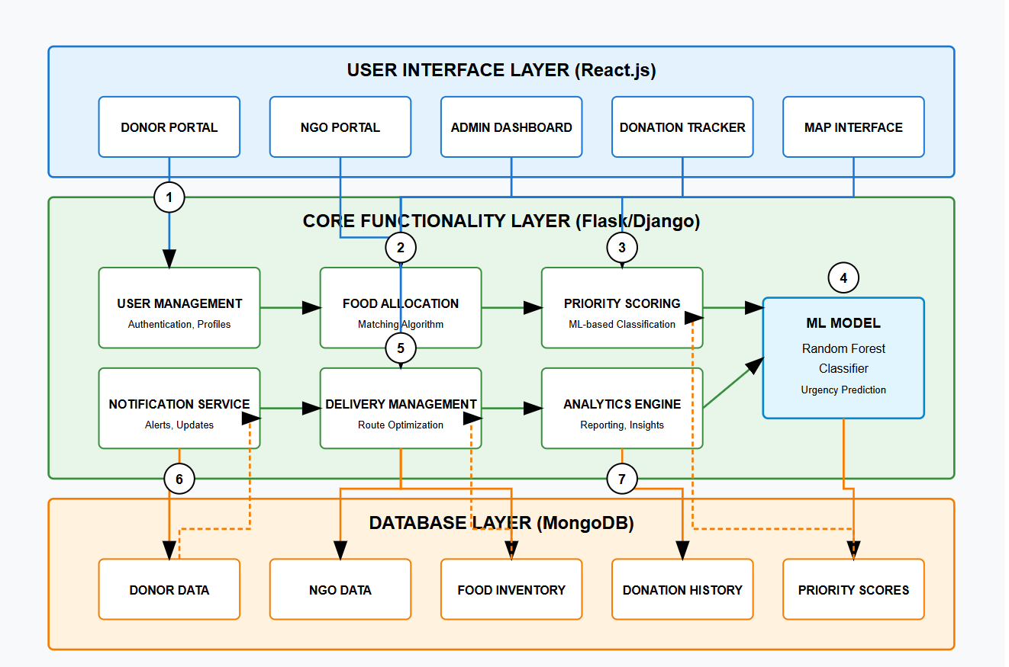
Architecture:

Slide 7
Technology Stack
Frontend : React.js,HTML,CSS, JavaScript
Backend : Flask(Python)
Database : MongoDB
Machine Learning : Decision tree/Random Forest model
API : Google maps API Location tracking
Deployment : AWS

Slide 8
Result / Outcome
✔ Automated priority-based allocation of food.
✔ Real-time tracking for donors & NGOs.
✔ Reduction in food wastage.
✔Recycling of Wastes.

Slide 9
Challenges Faced
Map Integration: Integrating interactive maps and converting addresses to latitude/longitude
using geocoding APIs.
Module Synchronization: Seamlessly coordinating frontend, backend, database, and ML model within
a single workflow.
Urgency Score Modeling: Designing and training an ML model with balanced feature weighting for
realistic urgency scoring.
Dynamic Matching Logic: Matching donors to NGOs in real-time using location filtering and urgency-
based prioritization.

Slide 10
Conclusion & Next Steps
We have successfully built a smart AI-driven food donation system.
Future Enhancements:
Deep Learning Model: Improve priority scoring accuracy.
Blockchain Integration: Ensure transparent tracking of donations.
Mobile App: Develop an app for NGOs & donors.

Slide 11
References & Citations
Proper citations for sources used in the presentation:
FAO Report on Food Waste (2022) – www.fao.org
Zomato Feeding India Initiative – www.feedingindia.org
ML Model References – "Random Forest Algorithm for Classification" (Scikit-learn Docs)
Google Maps API Docs – developers.google.com/maps

Slide 12
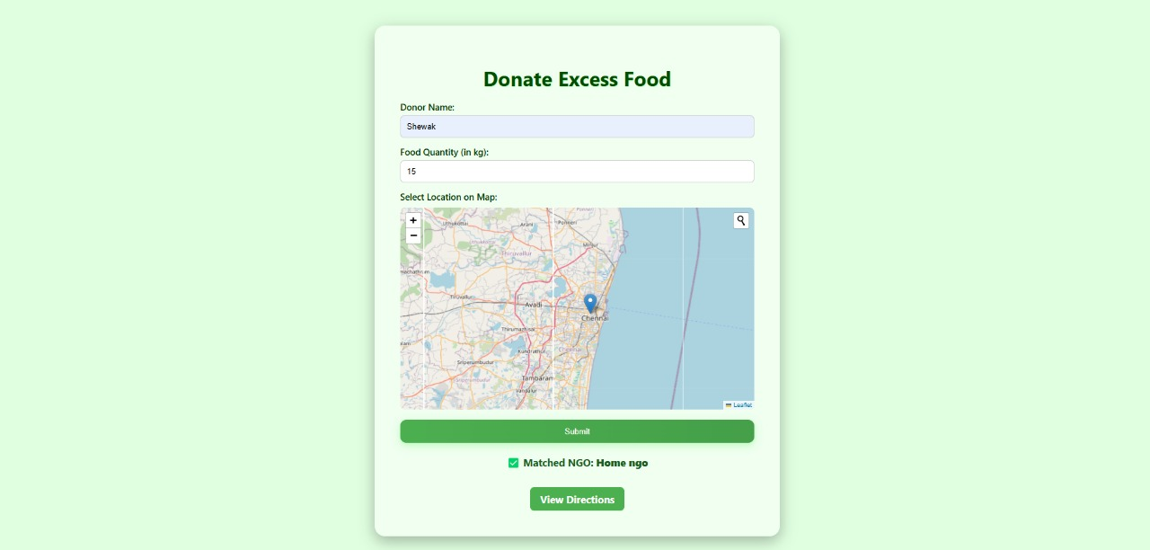
ScreenShots

Slide 13
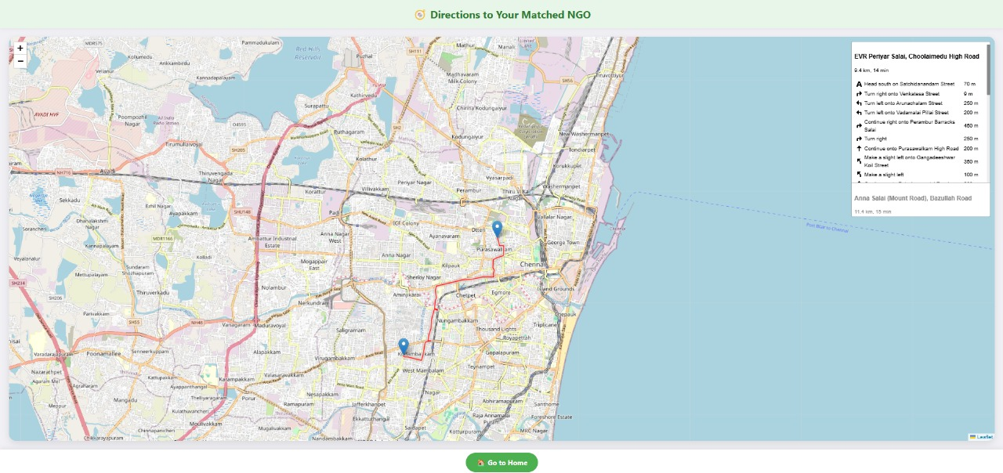

Slide 14
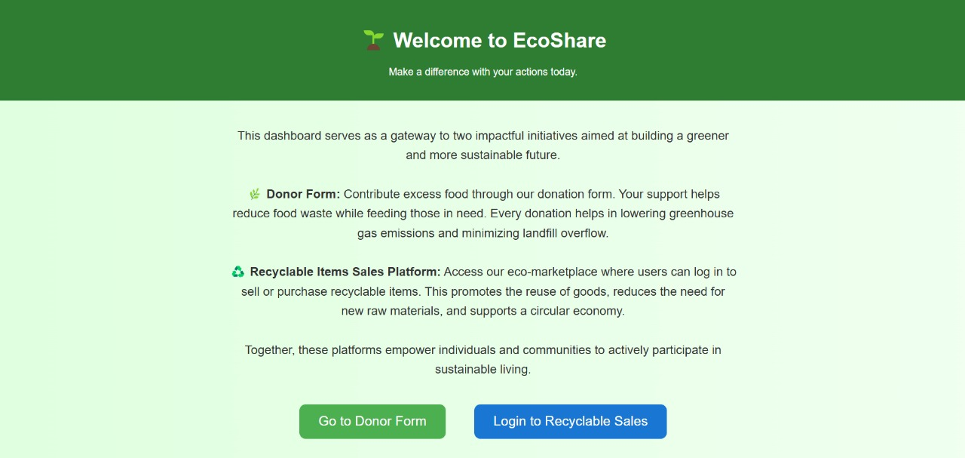

Slide 15
