Slide 1

UNITED STATES(US) MOVIES AND TV SHOWS DATA ANALYSIS
Presented By : Snehal Shewale

Slide 2
Problem Statement
Analyze a dataset of US-based streaming platforms to uncover viewer preferences, assess content ratings, and identify the most popular genres. We aim to understand the relationship between IMDb ratings, content runtime, and platform-specific content availability, providing insights into the ‘United States’ streaming landscape.

Slide 3
Introduction
In this analysis, we're taking a closer look at streaming platforms like Prime Video, Netflix, Hulu, and Disney+. Our aim is to find the platform with the most content and the one viewers prefer the most. We'll also reveal the top-rated IMDb Movies and TV shows and explore how their numbers have changed over time. This analysis is here to help you make better choices for your streaming entertainment.

Slide 4
Abstract
Find the most popular genres and languages in US streaming data.
See how ratings and content duration are related.
Compare the content available on different streaming platforms.
Discover popular genres, languages, and trends.
Analyze viewer ratings and relationships with other factors.
Identify which streaming service has the most content and how length affects ratings.
Checkpoint 1 - Data Analysis
Checkpoint 2 - Platform Analysis
Checkpoint 3 - Genre and Viewer Preferences Analysis
Checkpoint 4 - language Analysis
Objective
Data Analysis Goal
Checkpoints

Slide 5
Data Analysis- Process
Data Collection
Read data from MoviesOnStreamingPlatforms_updated.csv
1
Data Imputation & Data Cleaning
Finding empty values, Data imputation by KNN technique. Separation of the data in different parts.
2
Data Transformation
Grouping the data , filter, extract and converting into visualize form
3
Data Analysis and Plotting
Platform Analysis
Genre and Viewer Preferences Analysis
Use various library like seaborn and matplotlib for data visualization purpose
4

Slide 6
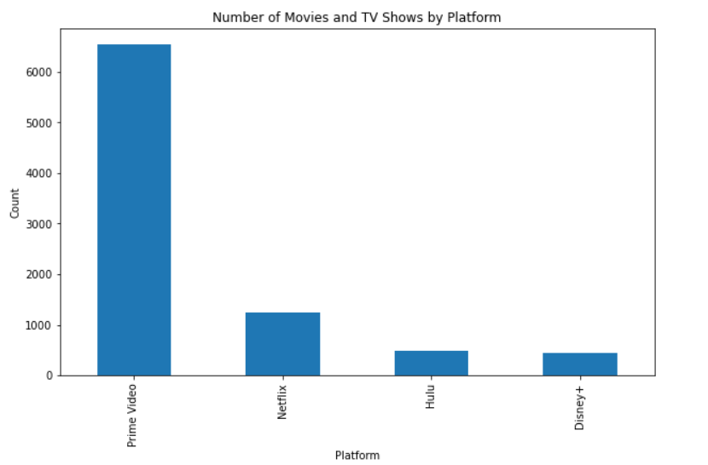
Platform Analysis
Prime Video: Offers the most movies (6534), covering a wide range of genres.
Netflix: Focuses on quality over quantity, with 1244 movies, known for its original content.
Hulu: Provides 478 movies and combines them with TV shows.
Disney+: Offers 439 family-friendly movies.
Sr. No | Platform | Movies count
1 | Prime Video | 6534
2 | Netflix | 1244
3 | Hulu | 478
4 | Disney+ | 439
Total Count | Platform count- 4 | 8695
Fig.1.1. Platforms Movies and Tv shows Count

Slide 7
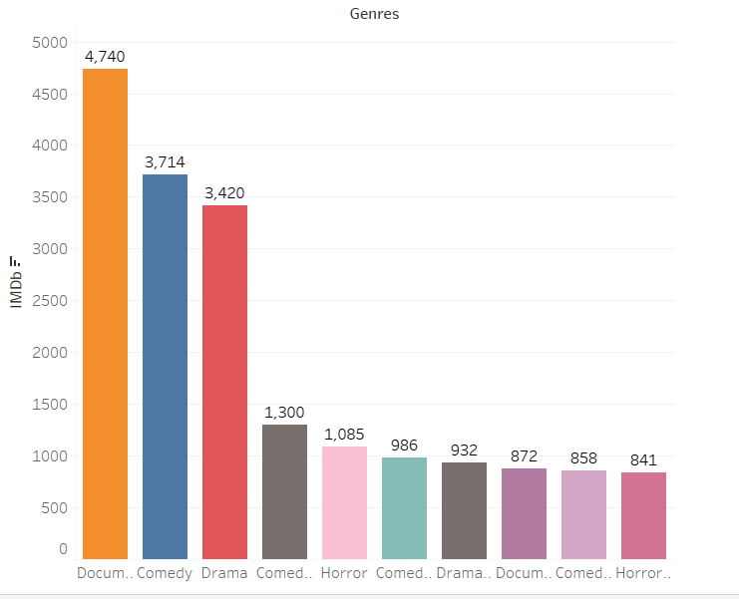
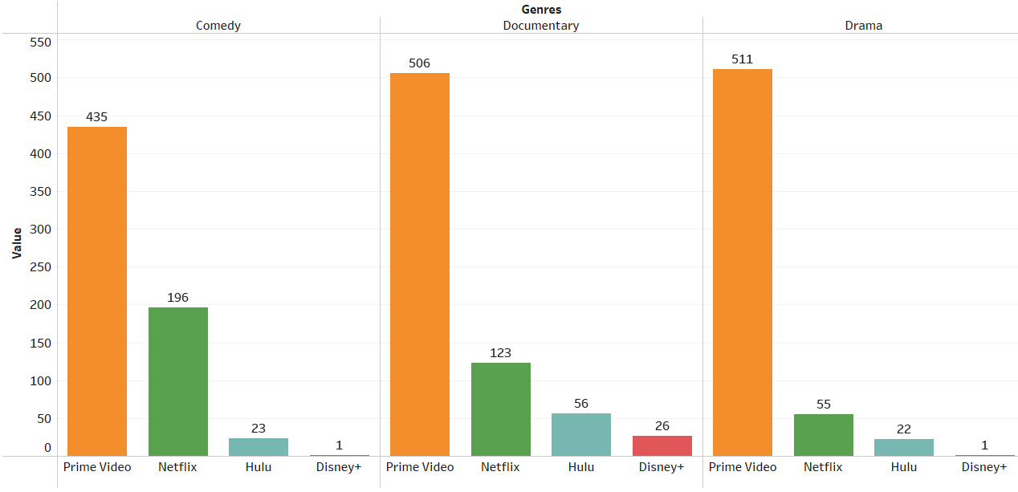
Genre and Viewer Preferences Analysis
Top 3 genres with the highest IMDb counts in the analysis:
Documentaries: Viewers appreciate the real-life stories and engaging narratives, giving documentaries the highest IMDb counts.
Comedies: Even though they are not the most common, comedies score well on IMDb due to their humor and entertainment.
Dramas: With their balanced storytelling, dramas maintain strong IMDb ratings, attracting a broad audience.
Fig.1.2. Genres IMDb Rating Count
Fig.1.2. Genres Distribution along with Platforms

Slide 8
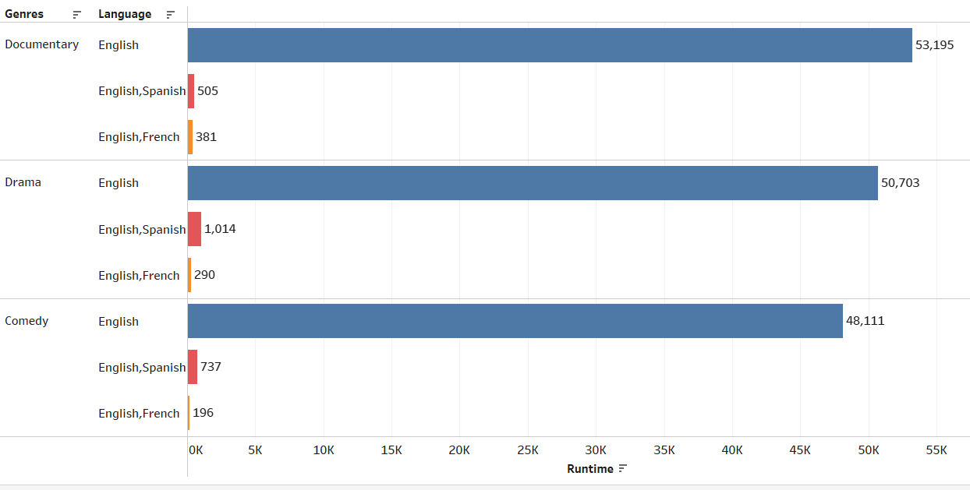
Language Analysis
In Documentary, Comedy, and Drama genres, you'll find content in English, English and Spanish, and English and French, reflecting the diverse language choices that cater to the preferences of US customers.
English: Most movies and TV shows are in English, the most widely used language.
English and Spanish: Some content is bilingual, offering English and Spanish.
English and French: For a more international audience, there's content available in both English and French, providing multilingual options.
Fig.1.3. Genres Language Anlalysis

Slide 9
Conclusion
Prime Video leads with a vast and diverse movie catalog, while Netflix focuses on quality over quantity, appealing to a loyal base.
Hulu offers a mix of movies and TV shows, and Disney+ targets a family-oriented audience.
Documentaries lead in IMDb counts, while comedies and dramas maintain strong ratings.
Multiple languages content in English, English and Spanish, and English and French caters to diverse US customer preferences.

Slide 10
Thank You

