Slide 1
ASSIGNMENT-Sales Pipeline Conversion in in SaaS Startup Name: Sheya Dey
Problem Statement The sales pipeline conversion percentage at TechnoServe (a tech SaaS startup) has dropped from 35% at the end of last fiscal (FY 2017-18) to 25% at present.
Assignment Objective
Understand the problem, come up with a hypothesis for low conversions faced by TechnoServe, and analyse the dataset provided to arrive at possible solutions to increase it.
Notes:
Problem Statement

Slide 2
Index
Contents
Page No.
Understanding Problem- Using 5W’s Framework
Understanding Problem- Using SPIN Framework
Formulating Hypothesis- 4P’s Framework
Formulating Hypothesis- 4P’s Framework (Issue Tree Model)
Formulating Hypothesis- 4P’s Framework(Product)
Formulating Hypothesis- 4P’s Framework(Price)
Formulating Hypothesis- 4P’s Framework(Promotion)
Formulating Hypothesis- 4P’s Framework(Place)
Generating Insights
Presenting Findings – Pyramid Principle
1
2
3
4
5
6
7-8
9
10-15
16

Slide 3
PART I : 1. Understanding the Problem Using 5W Framework
1
Who?
1.The Sales Team
2.The Marketing Team
What?
The leads that are generated versus converted is lower than expected. The conversion is around 25% of the total lead generated.
When?
The company’s sales pipeline conversion percentage has dropped from 35% at the end of the last fiscal (FY 2017-18) to 25% at present
Where?
The prospective customers. They are either not satisfied with the products or we’re not targeting the right audience at the right time,
How?
Marketing Related issue.
We’re are not targeting the right audience and marketing events has reduced.

Slide 4
PART I : 2. Understanding the Problem Using SPIN Framework
2
Situation
1.Which marketing channels do we use?
2. What is the strength of the marketing team?
3. How many marketing events are we launching every year?
4. What is the budget allocated to sales & marketing?
Problem
Do you think the social marketing leads are not working? If so why do you think that’s happening?
Is the budget allocated to the marketing campaigns low? What’s your thought about it?
Do you think the prospective customers are not satisfied with our products or the discounts they’re getting?
Implication
How is this issue affecting our generated revenue and hence the financial target?
Is this issue going to affect our market share?
Is this problem going to affect the future goals of our company?
Need-Payoff
If we solve the issue of marketing, is that going to enhance the conversion rate of prospective customers of the company?
Will the increased conversion rate help in increasing the generated revenue of the company?
Will the increased conversion rate help in increased awareness about the products and hence help in meeting future sales target as well?
Notes:
Provide at least three questions under each branch.

Slide 5
PART II : Formulating Hypotheses 4P’s Framework
3
Framework Used
I’ve used the 4P’s framework to formulate hypothesis for this problem.
Reason for using the selected framework
From the 5 Why’s answer we could get this could be a marketing related issue. The 4P’s framework help us to question the Product related issue, the Price related issues, the Promotion related issue and the Place or Distribution Channels related issues, which are the four legs of Sales & Marketing. This will cover all the probable aspects of the issue and we would be able to identify the root cause behind the Pipeline Conversion Downfall.
How you have used the framework here
At first I’ve added four probable causes behind the problem(i.e. Product, Price, Promotion, Place). Then I’ve added question to each segment to reach a probable root cause. In this way I’ve discovered whole of the sales & marketing domain and reached to different probable reasons and then assigned priority based marks to each segment.(P0- highest priority to P4-Lowest Priority)
Notes:
All the frameworks that are used should be mentioned.
A suitable reason is a must to provide here

Slide 6
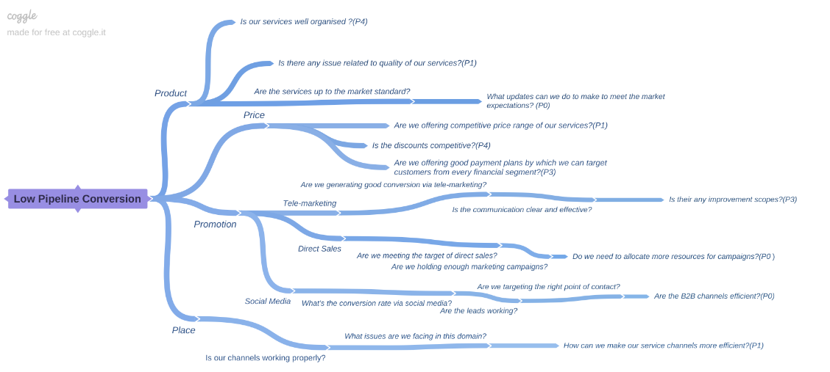
PART II : Formulating Hypotheses Using 4P’s Framework (Issue Tree Model Structure)
4
Provide the structure of the framework here
(You can attach the screenshot or multiple screenshots depending on the clarity of the image)

Slide 7
PART II : Formulating Hypotheses Using 4P’s Framework- (Product)
5
Branch 1- Product
In this branch the product or service quality has been discovered. The questions are structured in a way that’ll reveal all the probable root cause behind Low Pipeline Conversion Issue from this segment.
The quality of product or service offered by a company is very important for a simple reason, if the product or service is not up to the mark, the customer will not avail/buy it. It’ll directly affect on the sales hence the generated revenue of the company.
Sub-Branch 1- Structure of the Service- Here the question was if the service is well structured or well organized, because if the service is not well structured it’d be difficult for the provider as well as the salesperson to explain the service process to the customer resulting in the confusion & doubt of the customer.
Sub-Branch 2- Quality of the service- Here the question was if the services are of good quality. If the provided service aren’t of market standard then it’ll be very difficult for the sales person or marketing team to convince the customers to avail the service. The company has to analyze recent market trends & prioritize this segment.
Sub-Branch 3-Competitative Service- Is the provided service are up to the market standard? Is it fulfilling the market expectations? If not what are the updates the company should include in the service?
These are very important questions that’ll result in the enhanced quality of the product. Hence will result in better pipeline conversion percentage.

Slide 8
PART II : Formulating Hypotheses Using 4P’s Framework-(Price)
6
Branch 2-Price
The price of a product or service is very important for better sales performance. The company needs to structure the price range of it’s services in a way that doesn’t seem very high comparing to the competitors. Not every customer can afford a high priced service. So company should come up with a price range which seems affordable for customers from each financial background. Questions related to this segment is going to cover every aspect of the pricing structure.
Sub-Branch 1-Competitive Pricing Range- Most of the customers researches the price range of a particular service offered by different companies and avail the most affordable one. The company shouldn’t structure the price range in a way that seems way higher than the competitors as that will directly result in negative pipeline conversion. The question here is if the company is offering a competitive price range?
This issue should be given utmost priority as the result is quite simple & direct.
Sub-Branch 2-Discounts- Is the company giving competitive discounts? All most every company gives a certain amount of discounts over the final price. In this way even if the price range is a little towards the high end, the customer seems happy and satisfied . The company needs to ensure that it is giving at least close or equal discounts as it’s competitors.
Sub-Branch 3- Payment Plan- The company needs to target customers from every financial background. And if the price range is a little higher, there should be a good monthly or yearly payment plan to ensure the price seems affordable to every customer.
Notes:
Each branch must follow this naming pattern: Problem – Branch 1 – Sub-branch 1 – Sub-branch 2 – …… – Hypotheses
There must be minimum 10 hypotheses in total and at least 1 in each branch.

Slide 9
PART II : Formulating Hypotheses Using 4P’s Framework-(Promotion)
7
Branch 3- Promotion
Promotion or advertising of a particular product or a service offered by a company is important for a straight-forward reason, to raise awareness among the customers. Typically companies use many form of Promotions like, Social Media, Mass Communication, Human Relation etc.
The streams of promotions has been divided to separate segments to cover to whole domain efficiently.
Sub-Branch 1-Tele-marketing- The main components of tele-marketing are clear and effective communication. The salesperson needs to be very efficient in this domain, and has to have convincing qualities as well. So the main question for this branch was,
Is the team able to communicate effectively, is the communication clear and convincing? Is there any scope to improve the performance?
We already got to know because of cost cutting tele communication is playing a big part in the sales & marketing domain. The company should increase effectiveness of this domain as well to get better Pipeline- conversion results.
Sub-Branch 2- Social media- Social media channels also should be given utmost priority as they have the power the reach people from each and every background. They can prove to be a power for the company.
,

Slide 10
PART II : Formulating Hypotheses Using 4P’s Framework-(Promotion)
8
The questions were, firstly,
what’s the conversion rate via social media? As in are we working good in this domain? If not then what’re is issues we’re facing here? Are the leads working? Are we targeting the right customers at the right time? If not then are the channels efficient enough?
Social media channels in this century is a very useful way to increase awareness about a product or a service. If the efficiency of this team isn’t up to the level the company should give utmost priority to increase it , either by properly training the team or recruit more members.
Sub-Branch 3- Direct Sales- Companies generally arrange marketing campaigns to increase awareness about a product. This involves human presence and very effective way to understand the customers POV. If they are liking the service? Is the service up to the market standard? What type of updates can we include to satisfy customers better? Is the price range too high? All of the answers we can get easily from a offline campaign as well.
The questions asked in this domain were-
Are we meeting the target of direct sales? Why not? Are we not arranging enough marketing Campaigns? Is there a resource allocation issue? Do we need to increase allocation for marketing campaigns?
This questions can get us to the main root cause behind the inefficiency of direct sales. The company can then reach to a solution after getting the whole picture.

Slide 11
PART II : Formulating Hypotheses Using 4P’s Framework-(Place)
9
Branch 4- Place
Place as In distribution channels or location of the office is also essential component. Since the company provides technical solutions we need to make sure the distribution channels or offices are at important locations.
Sub-Branch 1- Distribution channels- The questions from this domain are to reveal the efficiency of the distribution channels. After all customers are going to reach out to company’s offices , it’s very important that we’ve office or outlets in every important area.
The questions were-
Are our channels working properly? What are the issues faced by the company in this domain? Is there any location related issue? How can we make our service more efficient? Is there any scope to improve?
All of the questions are to reassure if we’re good in this domain. If not, company needs to work on this issue as well.

Slide 12
PART III A : Generating Insights
10
Variable
1.
Technology Primary
B2B Sales Medium
Opportunity Status
2.
B2B Sales Medium
Opportunity Status
3.
Opportunity Status
Client Revenue Sizing
Technology Primary
4.
City
Technology Primary
B2B Sales Medium
Opportunity Status
Insights if any
1. The company has total conversion rate of 28% whereas the highest conversion rate is in Analytics category with 26%, 2nd Highest is ERP Implementation & the lowest two are Legacy Modernization & Technology Implementation with 20% conversion rate.
1. The highest performing sales medium is Enterprise sellers with 28% conversion rate & lowest performing is online Leads with only 6% conversion rate which is also an outlier cause other sales mediums’ conversion rate is between 28%-18%
1.In each of the category the highest conversion rate the company is getting from company which has a revenue sizing of 100K or less. The other revenue sized company has way less conversion rate.
1.Hyderabad & Kolkata has no marketing leads for analytics category.
2.Bengaluru & Delhi has to marketing for Legacy Modernization & Technical Business Solutions.
3.Very Less number of partner led marketing in analytics & Legacy modernization.
Pattern of Insight
1. Unknown Result
1.Unknown Result
2.Significant Outliers
1. Significant Outliers
2. Unknown Result
3. Abnormal Distribution
1. Unknown Result
2. Surprising Extremes

Slide 13
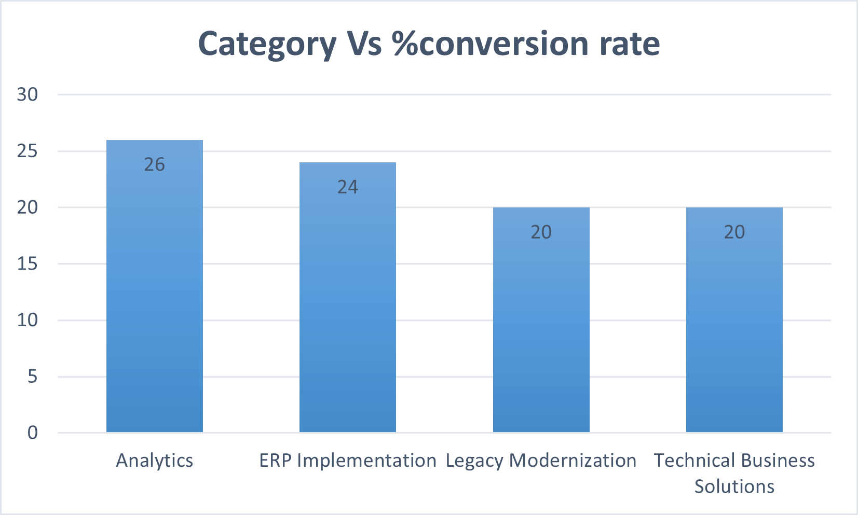
PART III A : Generating Insights Sales Pipeline Conversion at a SaaS Startup
11
Variable under consideration:
Technology Primary, B2B Sales Medium, Opportunity Status-
The company has total conversion rate of 28% whereas the highest conversion rate is in Analytics category with 26%, 2nd Highest is ERP Implementation & the lowest two are Legacy Modernization & Technology Implementation with 20% conversion rate.

Slide 14
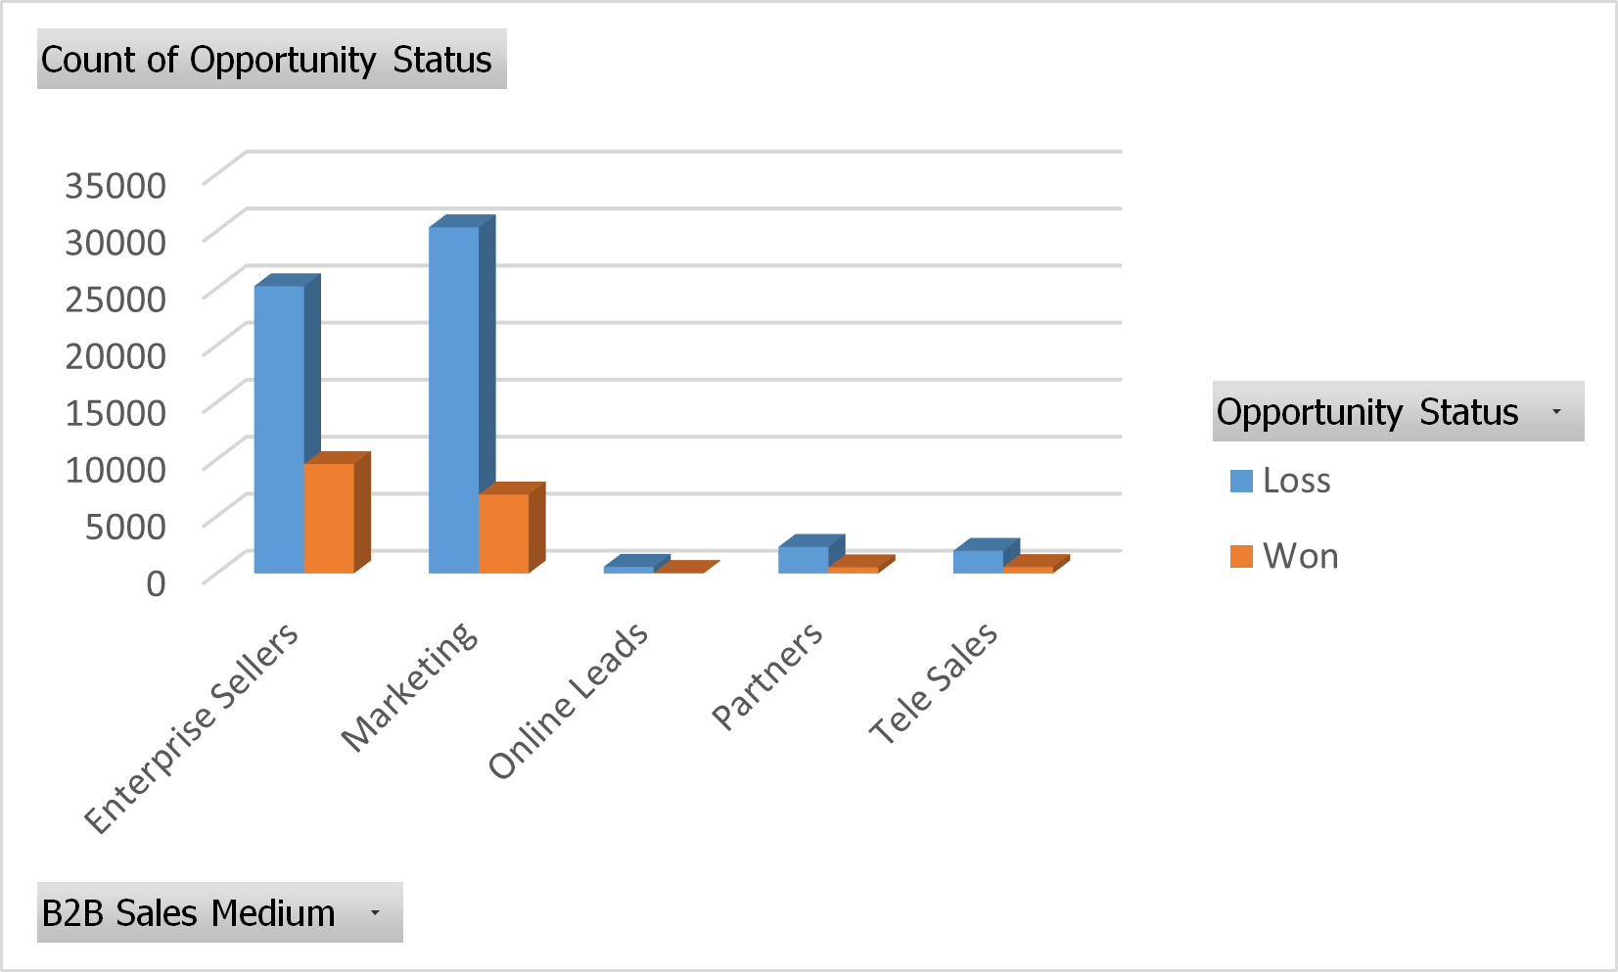
PART III A : Generating Insights Sales Pipeline Conversion at a SaaS Startup
12
Variable under consideration:
B2B Sales Medium & Opportunity Status
The highest performing sales medium is Enterprise sellers with 28% conversion rate & lowest performing is online Leads with only 6% conversion rate which is also an outlier cause other sales mediums’ conversion rate is between 28%-18%

Slide 15
PART III A : Generating Insights Sales Pipeline Conversion at a SaaS Startup
13
Variable under consideration
Opportunity Status, Client Revenue Sizing &Technology Primary
In each of the category the highest conversion rate the company is getting from companies which have a revenue sizing of 100K or less. The other revenue sized company has way less conversion rate. The company needs to focus more on companies having annual revenue of 100K or less. The company needs to retain these companies. Also priority should be given to the other revenue sized companies. Companies having revenue rates of More than 1M also have good conversion rates compared to the other 3 categories. Focus should be given on targeting these companies to increase their conversion rate.

Slide 16
PART III A : Generating Insights Sales Pipeline Conversion at a SaaS Startup
14
Variable under consideration:
City , Technology Primary, B2B Sales Medium & Opportunity Status
We found three major insights from this variables.
Hyderabad , Chennai, Kolkata &Pune has no marketing leads for Analytics category.
The company has no Online Leads or Partners in Chennai for ERP Implementation category. Also there’s no online lead from Kolkata & Pune for the same category.
Bengaluru ,Delhi, Mumbai has no marketing for Legacy Modernization. Also Chennai has no Telemarketing or partners for the same category,
Bengaluru ,Delhi, Mumbai has no marketing for Technical Business Solutions.
Very Less number of partner led marketing in Analytics & Legacy modernization.

Slide 17
PART III A : Generating Insights Sales Pipeline Conversion at a SaaS Startup
15
Recommendation
The company needs to retain companies having revenue 100K or less. This companies have much higher conversion rate than other revenue bracketed companies. Also focus should be given upon increasing conversion rates of other revenue sized companies.
2. Focus should be given on increasing and optimally using online leads.
3. Need to use enterprise sellers more efficiently.
4. The company needs to focus on its city based marketing channels. Some of the cities have no marketing leads at all. Without generating awareness among clients it’ll be nearly impossible to increase conversion rate.
Corresponding Insights
1. In each of the category the highest conversion rate the company is getting from companies which have a revenue sizing of 100K or less. The other revenue sized company has way less conversion rate
2. The conversion rate of online leads are very poor. In Legacy Modernization & analytics the company do not have online leads at all. And in ERP Implementation category & Technical Business Solutions the conversion rate is 7% & 5% respectively.
3. The enterprise sellers has the best conversion rate amongst all. The company needs to increase them more efficiently to increase the overall conversion rate.
4. Hyderabad , Chennai, Kolkata &Pune has no marketing leads for Analytics category. Bengaluru ,Delhi, Mumbai has no marketing for Technical Business Solutions. No online Leads or Partners in Chennai for ERP Implementation category. Very Less number of partner led marketing in Analytics & Legacy modernization.

Slide 18
PART III B : Presenting Findings Using Pyramid Principle
16
Optimizing Pipeline Conversion Rate
Retention
Optimization
Increase
Retention of 100k or less revenue companies.
Focus on increasing conversion rate of other revenue bracketed companies.
Using enterprising sellers more efficiently
Increase online leads
Increase city based on cities.

