Slide 1
Payment management UX review
Mero Telecom
September 2026
Assessment of the saved payment methods experience, with recommendations to reduce ambiguity and prevent accidental changes.

Slide 2
Payment management needs refinement
Executive assessment
Overall status
Needs refinement
The main usability risk
The screen has a clear heading, sensible spacing, masked card details, and a visible default state. Customers can understand the purpose of the section without payment expertise.
Three Link entries have the same label and no date or identifier. A customer cannot predict which method an action will affect.
Recommendation
Bottom line
Refine the list before treating it as a finished management experience. Put the default first, distinguish every row, and reduce the visual weight of Remove.
The experience is usable for a single card. It becomes confusing when Stripe returns several methods that look identical.
Notes:
Source: user-supplied Mero Telecom payment-management screenshot. Findings are qualitative UX observations based on the supplied interface.

Slide 3
Strengths and friction
The foundations are strong. The remaining issues concern identity, action priority, and feedback.
WHAT WORKS
Clear hierarchy
The heading, helper copy, and rows scan well.
Trust and privacy
Masked card details and Stripe language reassure customers.
Default-state protection
The badge and blocked removal reason help prevent billing disruption.
WHAT CREATES FRICTION
Indistinguishable Link entries
Three rows look identical, so actions feel risky.
Too many equal-weight actions
Set as default and Remove compete for attention on every row.
Split management model
In-app controls and Manage securely in Stripe overlap without explaining which path customers should prefer.
Notes:
Source: user-supplied Mero Telecom payment-management screenshot. Findings are qualitative UX observations based on the supplied interface.

Slide 4
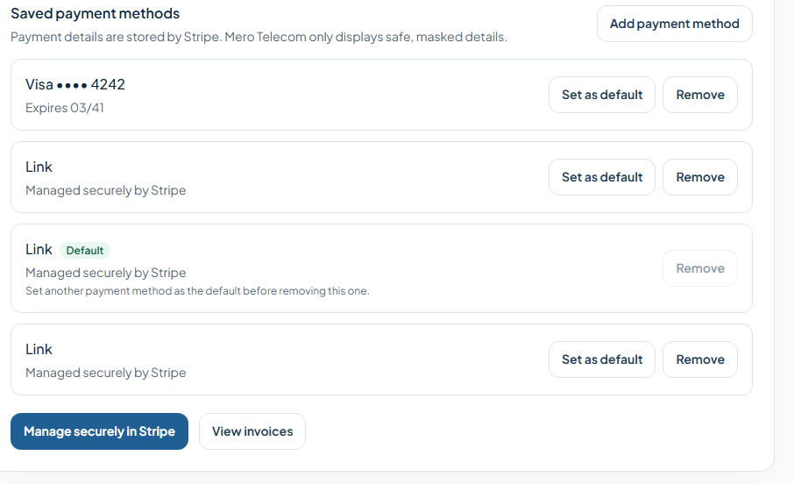
Recommended payment-method list
Make every method identifiable
Show card brand and last four digits, or label Link with an added date. Never render identical rows without a distinguishing detail.
Put the default first
Sort the active default to the top. Keep one primary action per row and give Remove lower visual emphasis.
Use one management model
Choose the in-app list or Stripe portal as the main path. Confirm successful changes when customers return.
Notes:
Source: user-supplied Mero Telecom payment-management screenshot. Findings are qualitative UX observations based on the supplied interface.

Slide 5
Prioritized improvement plan
Before launch
Next iteration
Later
Prevent mistakes
Default first. Distinguish Link rows. Confirm destructive removal.
Reduce action noise
Make the default state read-only. Move secondary actions into a compact menu on small screens.
Improve feedback
Show success and error confirmation. Add useful context such as Added or Last used.
Notes:
Source: user-supplied Mero Telecom payment-management screenshot. Findings are qualitative UX observations based on the supplied interface.

