Slide 1
Intra-Day Market Sentiment Prediction
Shay, Hannan, Niv

Slide 2
Goal
Given a stream of articles, we’d like to predict a recommendation for short term buy/hold/sell.
Assumptions:
Narrow on one market segment (AI stocks)
Rely on market sentiment (article stream)
Predict for medium term (90 minutes)
Capture market status (vix, AI stocks Index, stock price)

Slide 3


Slide 4
Data

Slide 5
Data
Total 5,506 articles
  Curated insights
  Sentiment (extracted with gemini-3.8-flash)
  Market features: vix, stock change, AIQ index.
Split:
  Training Set: 3173
  Validation Set: 1096
  Test Set: 1237

Slide 6
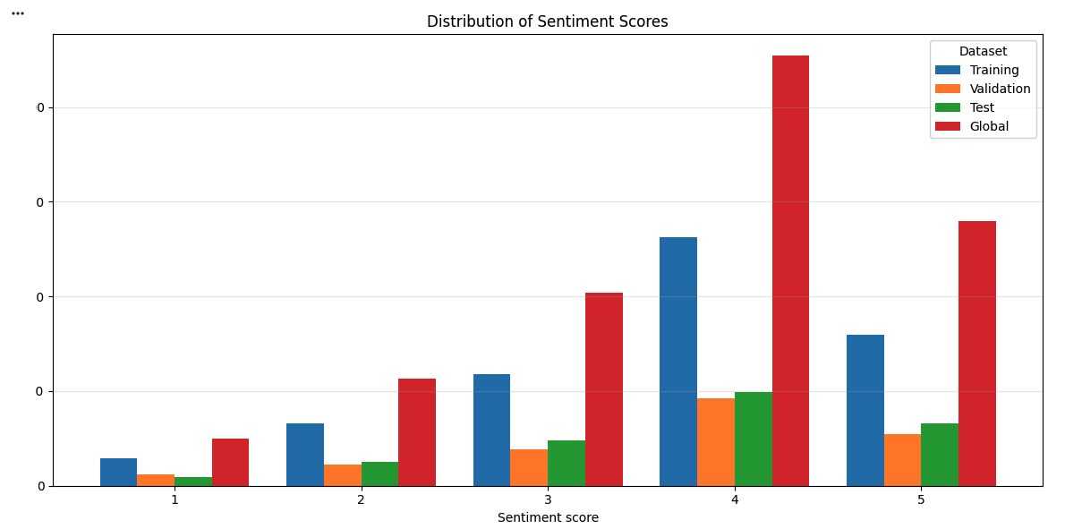

Slide 7
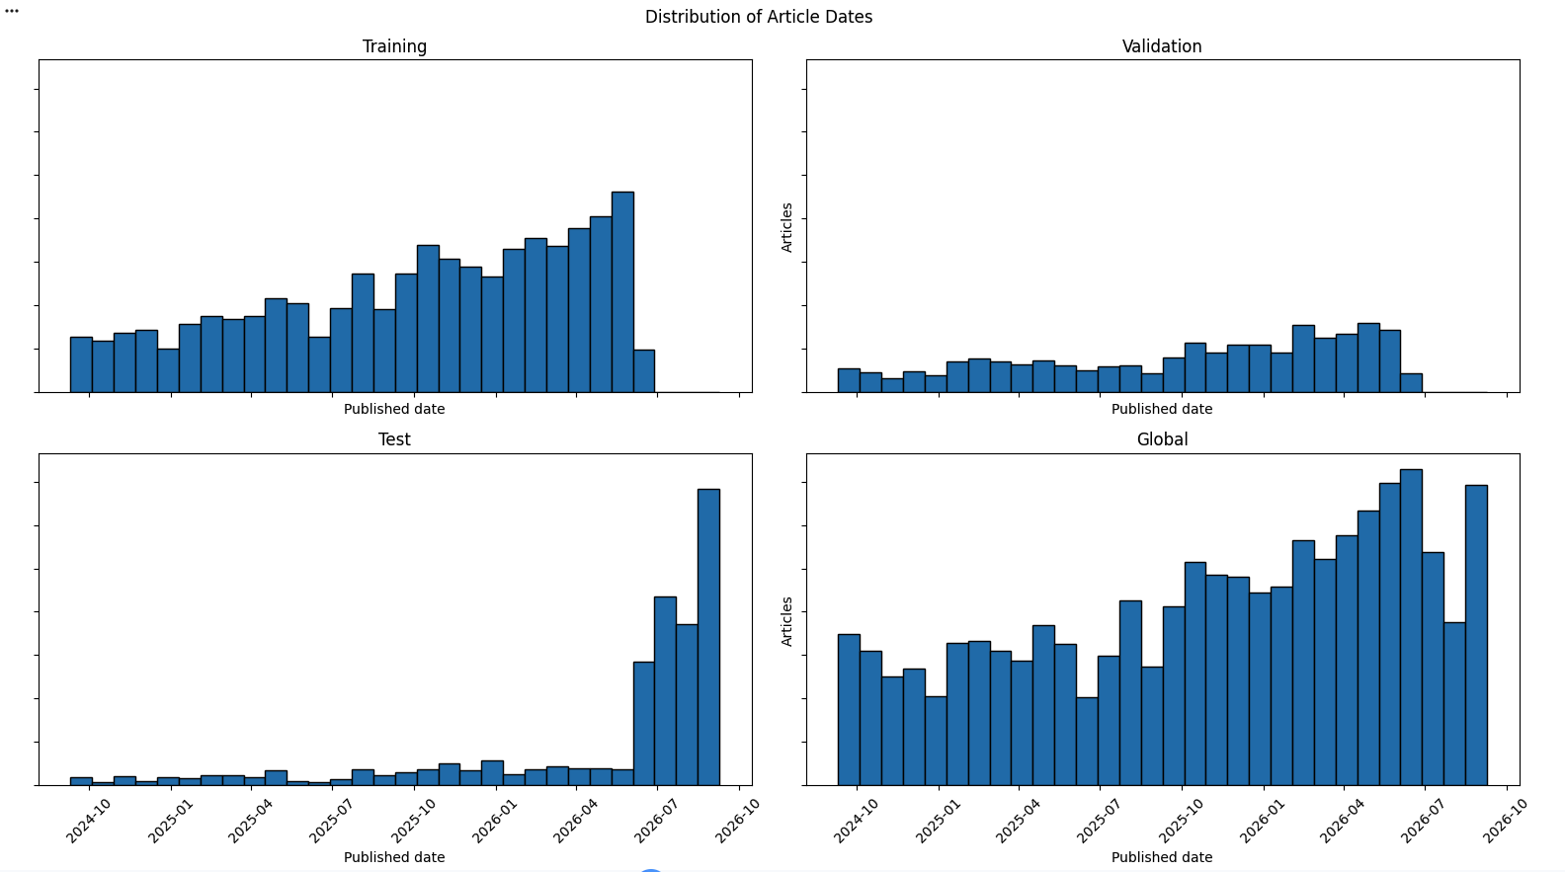

Slide 8
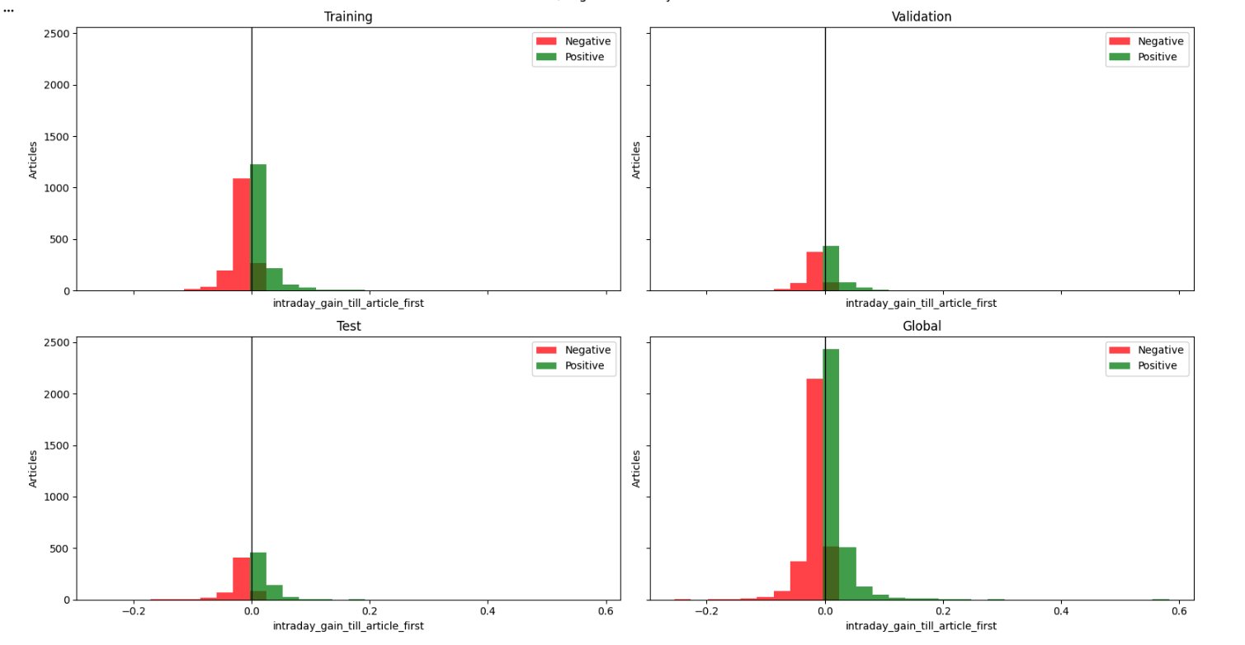
Intraday Gain Until Article

Slide 9
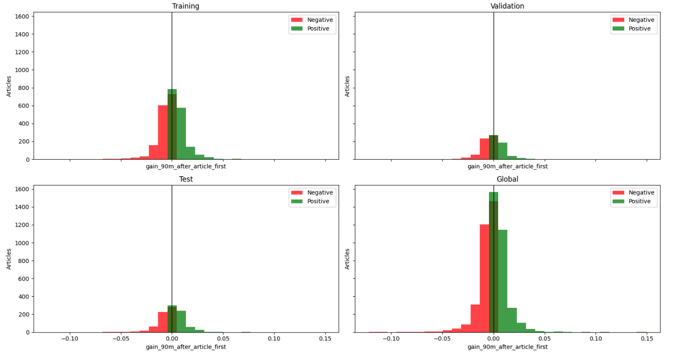
Gain 90m After Article

Slide 10
Sentiment vs. what happened next
LLM sentiment | next move DOWN | next move UP
Strongly negative | 50.80% | 49.20%
Negative | 49.82% | 50.18%
Neutral | 51.14% | 48.86%
Positive | 49.76% | 50.24%
Strongly positive | 50.14% | 49.86%
Every sentiment class is a coin flip — a property of the data, not of any model.
Notes:
This is the single most important data slide, and it needs no model at all.
We cross-tabulated the LLM's sentiment reading against which way the stock actually
moved in the next 90 minutes. If sentiment carried directional information, the
strongly-negative row and the strongly-positive row would look different.
They are identical. Every class is a coin flip -- one percentage point separates the
extremes, which on 5,506 articles is inside sampling noise.
Everything in the Results section is a consequence of this table. Pause here.

Slide 11
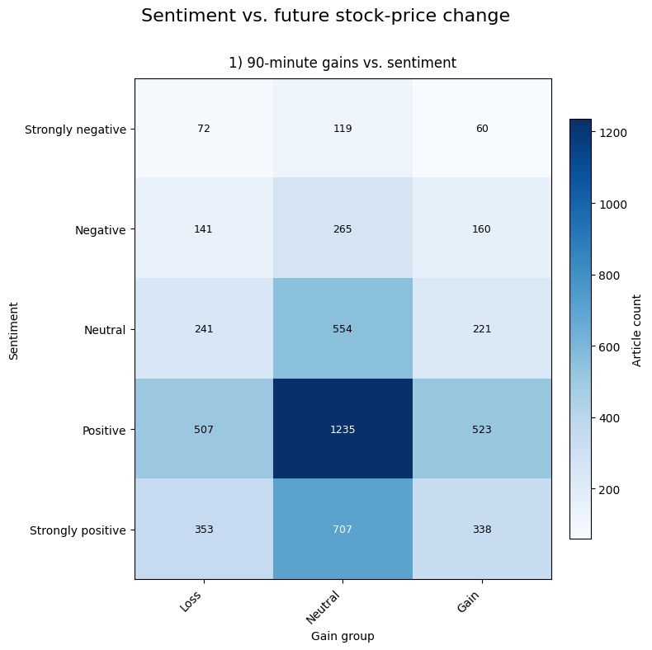
Is 90 minutes even the right horizon?
52% of articles move less than ±0.5%. Of the rest: 50.2% down / 49.8% up.
Notes:
One more data check before any model: is 90 minutes even the right thing to predict?
We bucketed the realised move into Loss, Neutral and Gain at a half-percent threshold.
The Neutral column dominates every row -- 52% of all articles are followed by a move
smaller than half a percent. More than half the corpus is "nothing happened", which is
a hard thing to regress against for reasons that have nothing to do with the model.
And of the articles that did move, the split is 50.2% down against 49.8% up. The loss
share wanders between 47% and 55% across the rows with no ordering by sentiment --
the strongly-negative row is 54.5% losses, the merely-negative row is 46.8%.
We have the script to extend this to 24-hour and 7-day windows; those columns are not
populated yet. Longer windows do move more -- whether they move predictably is open.

Slide 12
Architecture

Slide 13
Architectures
Encoder + NN - we train each separately, on the same dataset
Encode ++ NN - we train both encoder and NN together
Naive LLM - we pack all input as JSON and train LLM using LoRA to predict market movements.

Slide 14
Numerical Market Features
Encoder
vix
stock
…
index
(1…5)
NN
% change within 90m

Slide 15
“Recent news indicates that <article insights>.
Market status is:
{
Vix:
Stock:
AI index:
}
What is the expected gain/loss?
LLM
LoRA (...)
% change within 90m

Slide 16
Encoder Selection
Option | Architecture Type | Latency / Speed | Accuracy Potential | Complexity
Fine-Tuned Bi-Encoder | Dual-encoder (Sentence-Transformer) | Extremely Fast (Pre-computable embeddings) | Moderate-High (Depending on pooling and target proximity) | Medium (Requires labeled regression data and training loop)
Cross-Encoder with Hidden State | Single-encoder with joint cross-attention | Slow (Re-computes full sequence attention per object) | Highest (Full token-to-token interaction across article and object) | High (Requires custom extraction logic and head projection training)
LLM-Based Structured Extraction | Generative LLM API / Local Model + Projection | Slowest (Token generation + projection step) | Very High (Leverages zero-shot reasoning and multi-faceted breakdowns) | Low-Medium (Mainly prompt engineering and downstream mapping)
Aspect-Based Prompt Embeddings | Off-the-shelf instruction-tuned encoder | Fast (Inference only, no fine-tuning) | Moderate (Dependent on base model's zero-shot sentiment alignment) | Lowest (Zero training, configuration-only)

Slide 17
Results

Slide 18
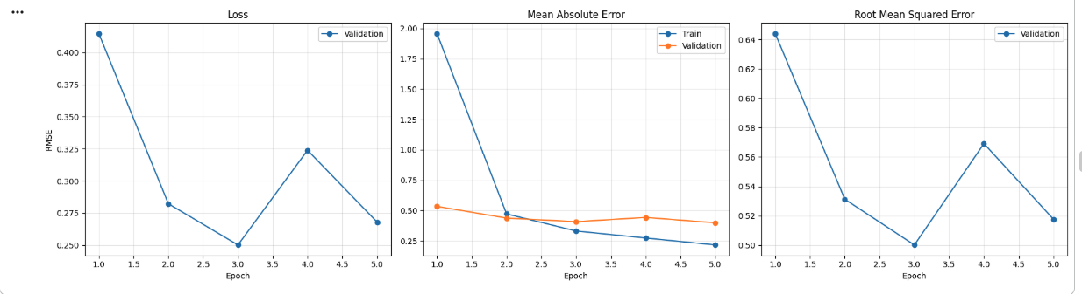
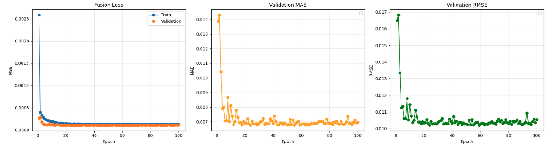
Encoder Only
Fusing Encoder+NN

Slide 19
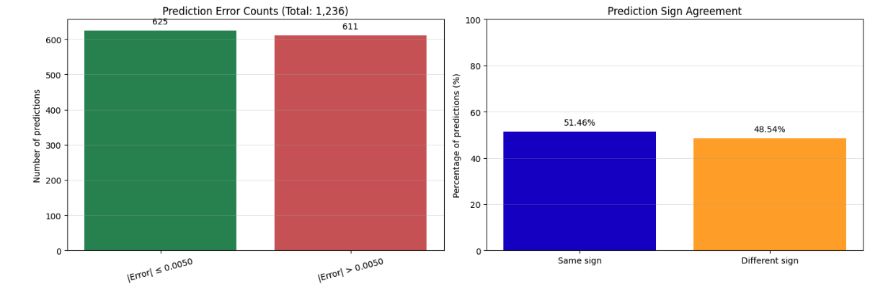
Encoder + NN (Separate)

Slide 20
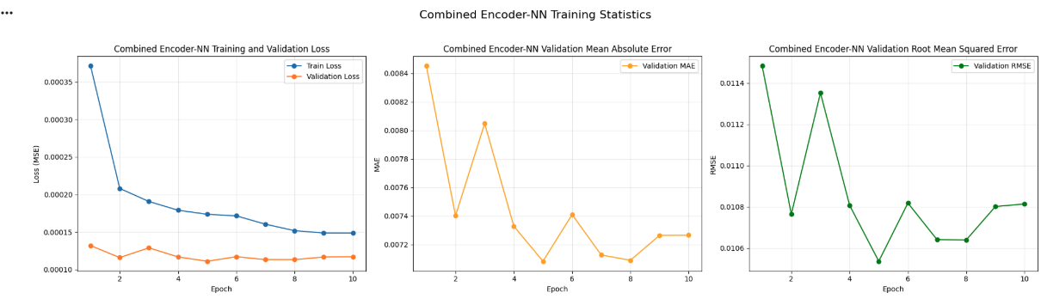
Encoder + NN Combined

Slide 21
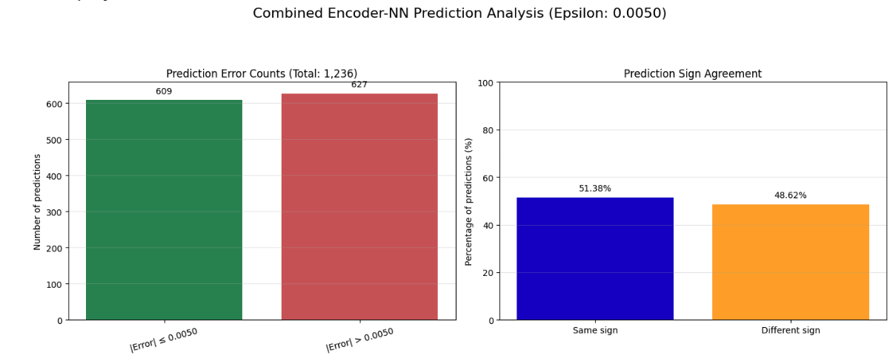
Encoder + NN (Together)

Slide 22
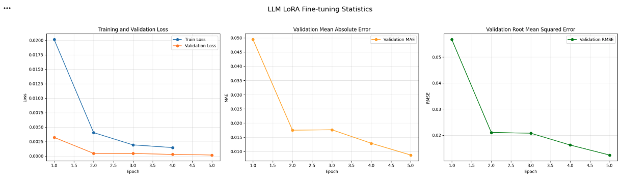
Fine-tuned LLM

Slide 23
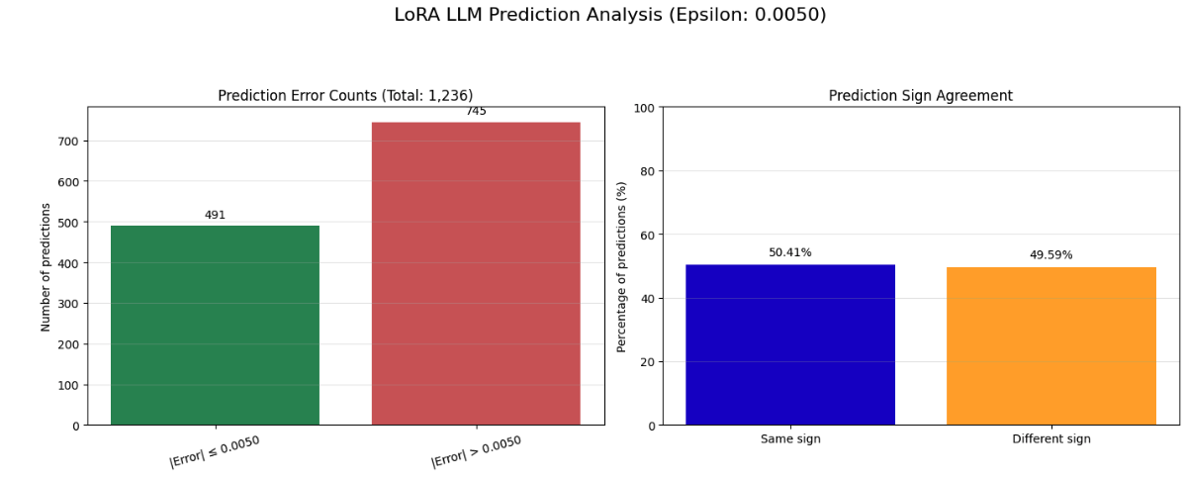
LoRA

Slide 24
Findings
Notes:
We ran five model families in total -- the three in this deck plus two more built as
standalone packages. This section consolidates all of them onto one axis.

Slide 25
R² ≈ 0 — no model beat predicting the average
Not on forecast. Not even on 30 minutes of hindsight.
Notes:
Leading with the conclusion.
R-squared of zero means your error is the same size as just guessing the mean every
time. Every model we built landed there or below.
The second line is the part that surprised us: we also asked the models to describe a
move that had ALREADY happened when the article was published. Still nothing.

Slide 26
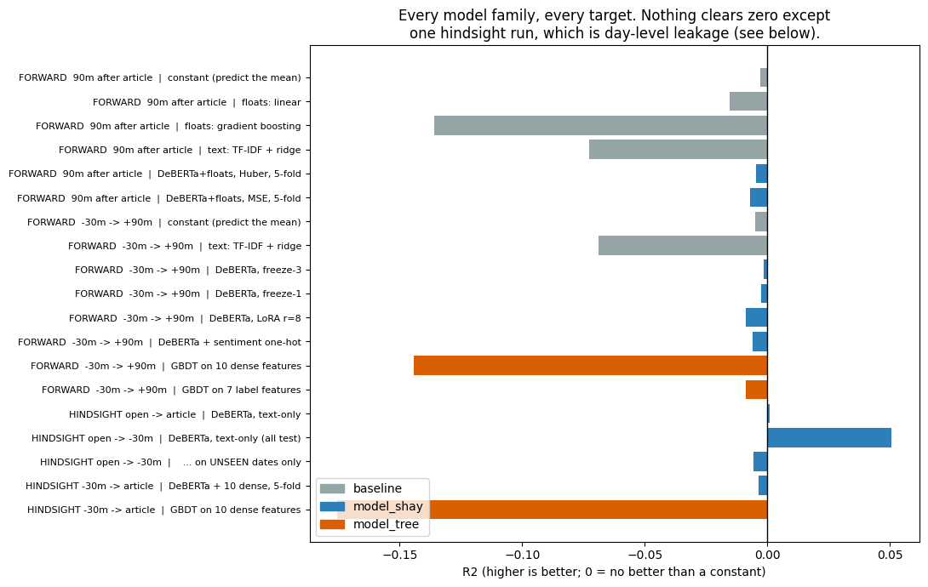
Every family, every target
Notes:
Everything on one axis. Zero means 'no better than a constant'.
Grey is baselines, blue the text model, orange the tree. Almost nothing clears zero,
and the FLEXIBLE models -- gradient boosting, TF-IDF -- are the worst. That is the
signature of fitting noise.
The one bar to the right is a hindsight run. It turns out to be leakage; two slides on.

Slide 27
Nothing beats the constant
 | model | test MAE | R²
— | constant (predict the mean) | 74.1 bps | 0.0000
2a | Encoder + NN (separate) | 78.5 bps | -0.0529
2b | Encoder + NN (combined) | 75.1 bps | -0.0049
2c | Fine-tuned LLM (LoRA) | 274.1 bps | -14.44 ※
2d | DeBERTa + market floats | 89.6 bps | -0.0015
2e | Tree on 10 features (no text) | ~98 bps | -0.1559
Best model = the constant, to three decimals. ※ 2c did not converge usefully
Notes:
The same thing as numbers, on one held-out split of 1,236 articles.
The constant predictor ignores every input and gets 74.1 basis points. Nothing beats
it. The best model matches it to three decimal places -- that is what converging to
'just predict the average' looks like.
The LoRA row is flagged, not ranked: its error is 3.7x the baseline, which means it
did not converge usefully rather than that it is meaningfully worse.

Slide 28
Does it call the direction?
model | correct direction | within ±50 bps
Encoder + NN (separate) | 48.38% | 578 / 1,236
Encoder + NN (combined) | 49.43% | 610 / 1,236
Fine-tuned LLM (LoRA) | 52.19% | 84 / 1,236
Two are below a coin flip. 52.19% is 1.5 SE from chance (SE = 1.42 pp).
Notes:
R-squared is about magnitude. For trading the question is simpler: does it get the
direction right?
Two of the three are below a coin flip. The third looks like an edge at 52% -- it
isn't. That is 1.5 standard errors from chance, and it comes from the model with by
far the worst magnitude error: 84 predictions within 50 basis points, against roughly
600 for the other two.

Slide 29
The models emit a constant
model | trainable params | R² | prediction spread
LoRA r=8 | 0.4M | -0.0086 | 2.8%
freeze-1 | 7.3M | -0.0025 | 2.7%
freeze-3 | 21.4M | -0.0015 | 2.6%
50× the capacity — the same flat line.
Notes:
Here is what the models actually do. We measured the spread of their predictions
against the spread of reality.
They output a nearly flat line -- predictions vary about 2.6% as much as the real
moves do.
And look at the capacity column: we varied trainable parameters fifty-fold and the
spread barely moved. This is not a capacity problem.

Slide 30
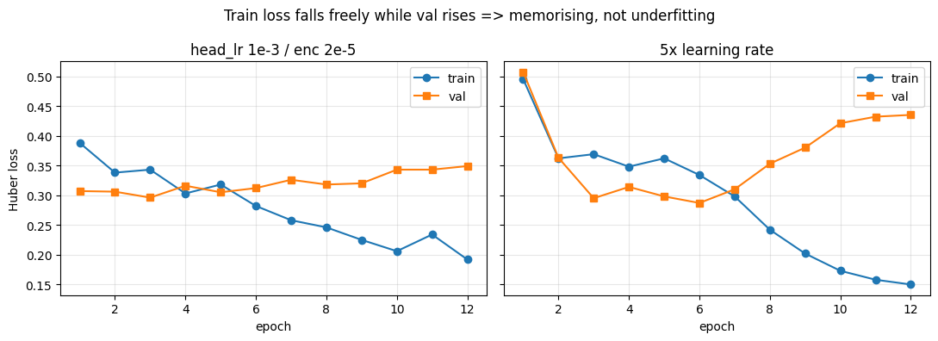
"You just didn't train it right"
Train loss halves while validation rises — it memorises, it does not underfit.
Notes:
The obvious objection.
Left panel, our settings: training loss falls by half while validation loss RISES.
That is memorisation, not underfitting -- the model is perfectly capable of learning,
it is learning the training set by heart.
Right panel, five times the learning rate: it memorises harder and generalises worse.
More learning rate, more capacity, more epochs all move you further along the wrong curve.

Slide 31
Ruled out
Broken training
Learning rate too low
Too much capacity
Wrong loss · wrong ticker · wrong window
Corpus too noisy
Pipeline can't read text — it reads fine: 55% vs 43% on sentiment
Each would have shown a gradient. None did.
Notes:
Everything we eliminated. Run through it quickly -- the point is the breadth.
Each of these would have shown a gradient if it were the cause. None did.
The last line matters most: can the pipeline read text at all? Yes. Ask it to predict
sentiment from the same text and it works -- 55% accuracy against a 43% baseline. The
plumbing is fine. It is the mapping from text to future return that does not exist.

Slide 32
The one positive result
hindsight run, split by date | n | R² | corr
all test rows | 1,127 | +0.0508 | +0.2315
dates SEEN in training | 312 | +0.1541 | +0.4107
dates NOT seen | 815 | -0.0056 | +0.1271
It learned the day, not the article. Narrow to 30 min and even this vanishes: -0.0035 ± 0.0042
Notes:
The one run that looked alive, and why it does not count.
We asked a model to describe a move that had already happened. It worked -- R-squared
0.05, correlation 0.23, and for the first time the model committed to varied predictions.
Then we split by date. On dates seen during training: 0.15. On genuinely unseen dates:
below zero.
It was not reading the article. It learned 'that morning was strong' from other
articles on the same day and applied it to a different stock. Day-level market state,
not article-level information.

Slide 33
The articles describe what the market already did
Collapsing to the mean is correct behaviour when there is no signal.
Notes:
The conclusion, and I want to be precise about what it does and does not say.
It does not say news is useless for trading. It says THIS corpus -- articles published
after the fact, distilled into insights -- does not predict the move that follows, at
this sample size and this horizon.
The models collapsed to the mean because that is the mathematically correct answer
when there is nothing to condition on. They behaved properly.

Slide 34
If we continue — change the data, not the model
Information that precedes the move
Market-adjusted target — strip the day factor
Sign classification with AUC, not regression
Substantially more data
Notes:
These are changes to the data or the question. Tuning is exhausted.
One: information that precedes the move -- this corpus is retrospective by construction.
Two: a market-adjusted target, stripping the day factor our features actually explain.
Three: predict direction as classification with AUC, so a weak correlation shows up as
53% instead of being erased by squared error.
Four: more data -- we showed 1,000 rows is below the floor, and 3,000 probably is too.
Happy to take questions.

