Slide 1
Intra-Day Market Sentiment Prediction
Shay, Hannan, Niv
Notes:
Intra-day market sentiment prediction. Shay, Hannan and Niv.
The question: can we read a stream of news articles and turn it into a short-term
buy/hold/sell call? We'll walk through the data, three architectures, and what we found.
I'll say the conclusion up front so nothing is a surprise: we could not make it work,
and we think the reason is in the data rather than in the models.

Slide 2
Goal
Given a stream of articles, we’d like to predict a recommendation for short term buy/hold/sell.
Assumptions:
Narrow on one market segment (AI stocks)
Rely on market sentiment (article stream)
Predict for medium term (90 minutes)
Capture market status (vix, AI stocks Index, stock price)
Notes:
The goal, and the assumptions that make it tractable.
We narrowed to AI stocks so the news stream is coherent. We rely on the article stream
as the sentiment source.
Two choices matter later: the horizon is 90 minutes -- long enough for news to move a
price, short enough to stay intra-day. And we capture market context alongside the
text, so the model isn't judging an article in a vacuum.

Slide 3

Notes:
Mark Twain: "If you don't read the newspaper you're uninformed. If you do read the
newspaper you're misinformed."
It got a laugh when we picked it. By the end of the project it reads less like a joke
and more like a summary of our results.

Slide 4
Data
Notes:
Section: the data. What we collected, how we split it, and what it looks like.

Slide 5
Data
Total 5,506 articles
  Curated insights
  Sentiment (extracted with gemini-3.8-flash)
  Market features: vix, stock change, AIQ index.
Split:
  Training Set: 3173
  Validation Set: 1096
  Test Set: 1237
Notes:
5,506 articles, all with curated insights -- an LLM-distilled summary of each article
rather than the raw text, which keeps the input to a few hundred tokens.
Sentiment on a 1-to-5 scale extracted with Gemini. Market features: VIX, the stock's
own change, and the AIQ index.
The split is roughly 60/20/20, and it is deliberately not random -- the test set is the
most recent trading days, held out wholesale. That means the model cannot memorise a
particular day and replay it on the test set. Keep that in mind; it becomes important
at the end.

Slide 6
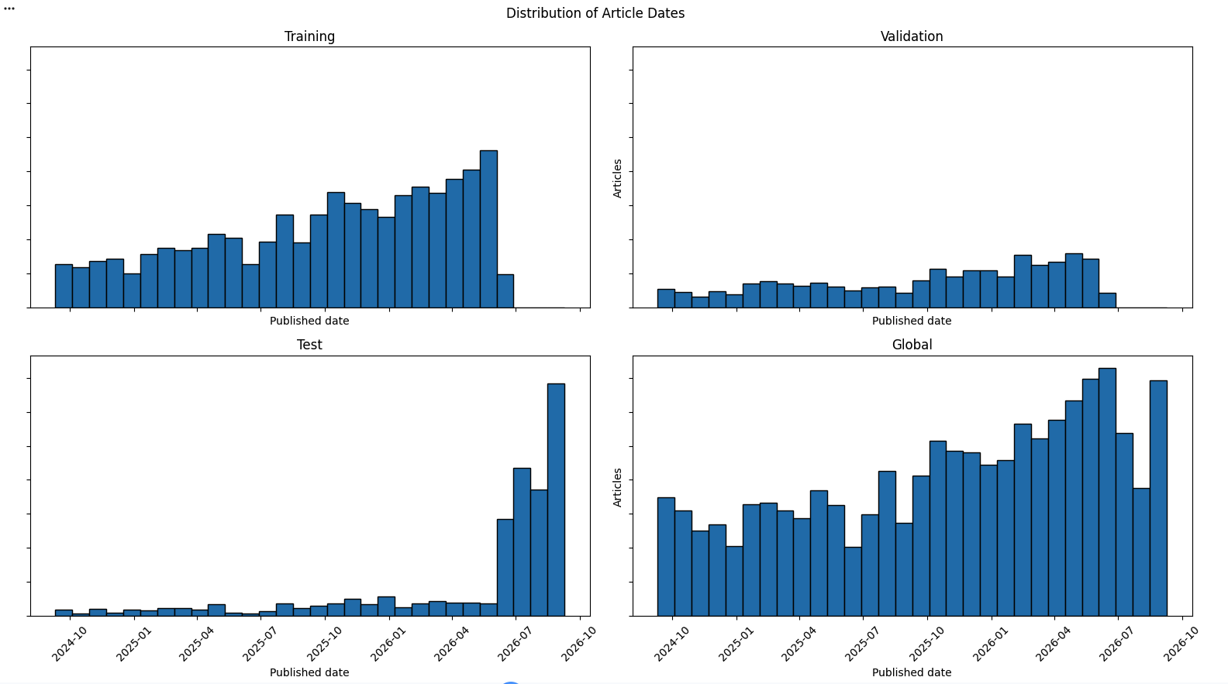
Notes:
Article volume over time, by split.
Two things to notice. The corpus grows over the two years -- more coverage of AI names
recently. And look at the test panel: it is concentrated entirely on the right, in the
newest months. That's the temporal holdout we just described.

Slide 7
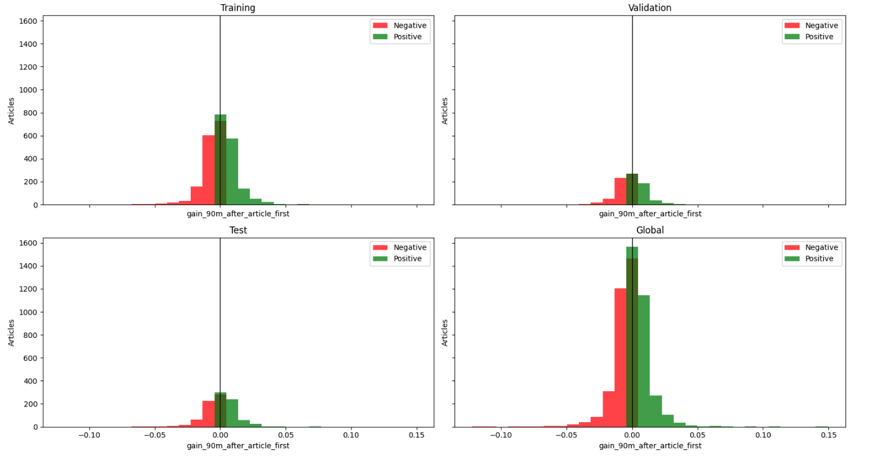
Gain 90m After Article
Notes:
The target: the stock's move in the 90 minutes after the article.
Tight, symmetric, centred on zero. Standard deviation is about 109 basis points -- call
it one percent.
This sets the bar. Any model has to beat a constant predictor that simply guesses the
average every time. That baseline gets a mean absolute error of 74 basis points. It's
the number to keep in your head.

Slide 8
Sentiment vs. what happened next
LLM sentiment | next move DOWN | next move UP
Strongly negative | 50.80% | 49.20%
Negative | 49.82% | 50.18%
Neutral | 51.14% | 48.86%
Positive | 49.76% | 50.24%
Strongly positive | 50.14% | 49.86%
Every sentiment class is a coin flip — a property of the data, not of any model.
Notes:
This is the single most important data slide, and it needs no model at all.
We cross-tabulated the LLM's sentiment reading against which way the stock actually
moved in the next 90 minutes. If sentiment carried directional information, the
strongly-negative row and the strongly-positive row would look different.
They are identical. Every class is a coin flip -- one percentage point separates the
extremes, which on 5,506 articles is inside sampling noise.
Everything in the Results section is a consequence of this table. Pause here.

Slide 9
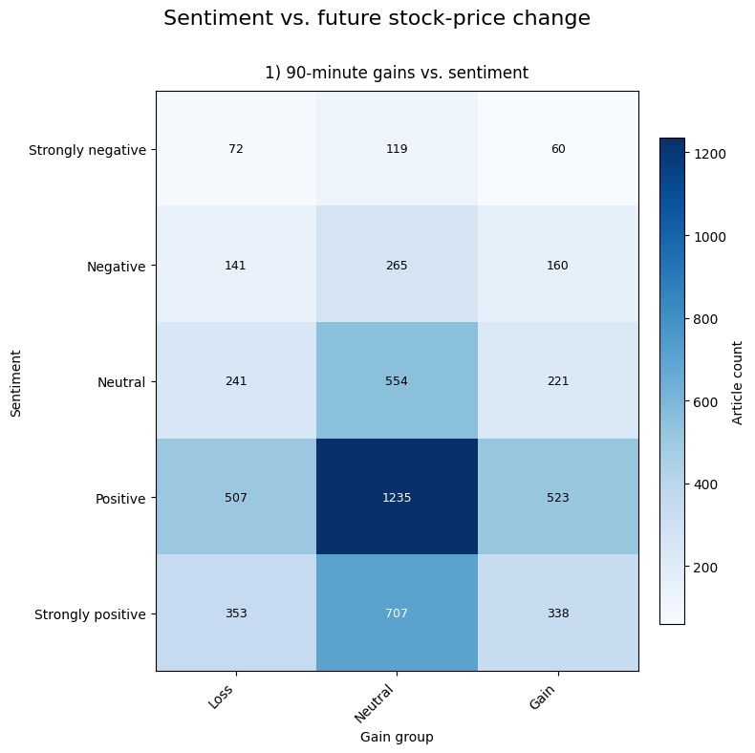
Is 90 minutes even the right horizon?
52% of articles move less than ±0.5%. Of the rest: 50.2% down / 49.8% up.
Notes:
One more data check before any model: is 90 minutes even the right thing to predict?
We bucketed the realised move into Loss, Neutral and Gain at a half-percent threshold. The Neutral column dominates every row -- 52% of articles are followed by a move smaller than half a percent. More than half the corpus is "nothing happened".
And of the ones that did move: 50.2% down, 49.8% up, with no ordering by sentiment.
We have the script to extend this to 24-hour and 7-day windows; those columns are not populated yet.

Slide 10
Architecture
Notes:
Section: architecture. Three approaches, deliberately different in kind.

Slide 11
Architectures
Encoder + NN - we train each separately, on the same dataset
Encode ++ NN - we train both encoder and NN together
Naive LLM - we pack all input as JSON and train LLM using LoRA to predict market movements.
Notes:
Three architectures, deliberately different in kind.
First: encoder and neural net trained separately -- the encoder reads the article and
produces sentiment, a small network takes that plus the market features.
Second: the same shape trained end-to-end, so the encoder can tune its representation to
the prediction rather than to sentiment.
Third: pack everything into JSON and fine-tune an LLM with LoRA.
Three different inductive biases. If any found signal, we'd expect them to diverge.

Slide 12
Numerical Market Features
Encoder
vix
stock
…
index
(1…5)
NN
% change within 90m
Notes:
The encoder architecture.
The article insights go through the encoder to a sentiment representation. That joins
the numerical market features -- index, stock, VIX -- and the concatenated vector feeds
a small network that outputs the percentage change within 90 minutes.
The sentiment bottleneck in the middle is a design decision worth noting: it makes the
model interpretable, but it also means everything the text contributes has to squeeze
through a 1-to-5 scale.

Slide 13
“Recent news indicates that <article insights>.
Market status is:
{
Vix:
Stock:
AI index:
}
What is the expected gain/loss?
LLM
LoRA (...)
% change within 90m
Notes:
The LLM approach.
We build a prompt: "Recent news indicates that -- article insights -- market status is
VIX, stock, AI index. What is the expected gain or loss?" The model outputs the
percentage change within 90 minutes.
LoRA rather than full fine-tuning: about 6 million trainable parameters against a
1-billion-parameter base, which is what makes this affordable on our hardware.

Slide 14
Results
Notes:
Section: results. Two worked examples first, then the consolidated picture across
every model we built.

Slide 15
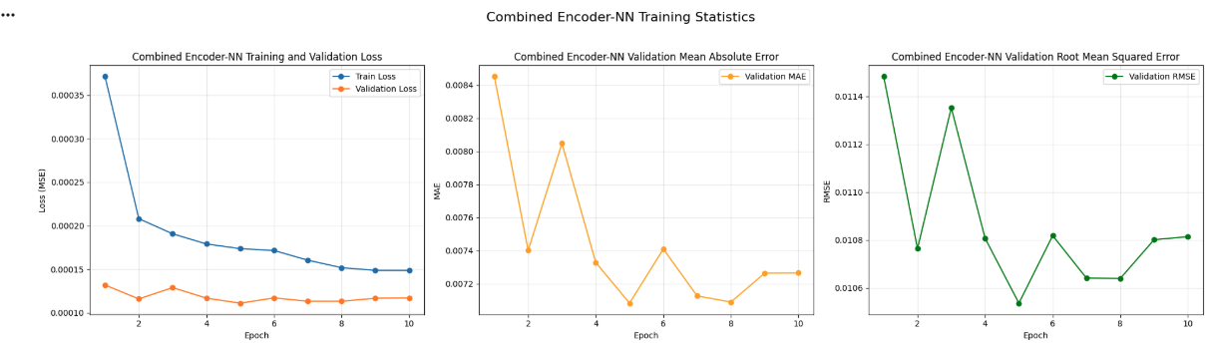
Encoder + NN Combined
Notes:
The combined encoder-NN, trained end-to-end. This was our best performer.
Training loss falls steadily, validation loss flattens almost immediately and stays
flat -- the gap between the two lines is the model learning the training set rather
than the relationship.
Validation MAE bounces between 0.0071 and 0.0084 with no real trend after epoch 4.
Final test MAE is 0.0075, which is 75 basis points. Hold that against the 74-basis-point
baseline from the data section.

Slide 16
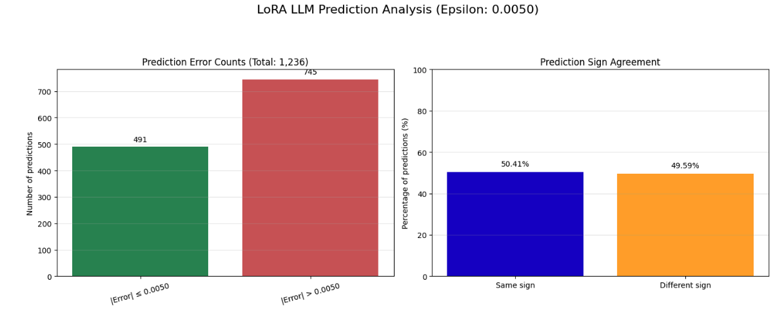
LoRA
Notes:
The fine-tuned LLM on the same 1,236 test articles.
Left: 491 predictions within 50 basis points, 745 outside.
Right is what matters -- sign agreement. 50.41% correct direction. A coin flip, from a
billion-parameter model with full market context in its prompt.
The consolidated table shortly quotes a different, worse-converged LoRA run. Both land
at chance.

Slide 17
Findings
Notes:
Five model families in total -- the three in this deck plus two built as standalone packages. This section puts all of them on one axis.

Slide 18
R² ≈ 0 — no model beat predicting the average
Not on forecast. Not even on 30 minutes of hindsight.
Notes:
Leading with the conclusion.
R-squared of zero means your error is the same size as just guessing the mean every
time. Every model we built landed there or below.
The second line is the part that surprised us: we also asked the models to describe a
move that had ALREADY happened when the article was published. Still nothing.

Slide 19
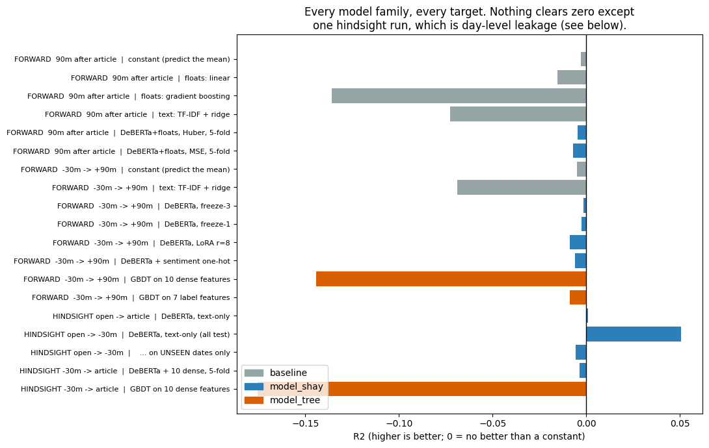
Every family, every target
Notes:
Everything on one axis. Zero means 'no better than a constant'.
Grey is baselines, blue the text model, orange the tree. Almost nothing clears zero,
and the FLEXIBLE models -- gradient boosting, TF-IDF -- are the worst. That is the
signature of fitting noise.
The one bar to the right is a hindsight run. It turns out to be leakage; two slides on.

Slide 20
Nothing beats the constant
 | model | test MAE | R²
— | constant (predict the mean) | 74.1 bps | 0.0000
2a | Encoder + NN (separate) | 78.5 bps | -0.0529
2b | Encoder + NN (combined) | 75.1 bps | -0.0049
2c | Fine-tuned LLM (LoRA) | 274.1 bps | -14.44 ※
2d | DeBERTa + market floats | 89.6 bps | -0.0015
2e | Tree on 10 features (no text) | ~98 bps | -0.1559
Best model = the constant. 50× the capacity → the same flat line (prediction spread 2.6–2.8%).
Notes:
The same picture as numbers, on one held-out split of 1,236 articles.
The constant predictor ignores every input and gets 74.1 basis points. Nothing beats it.
The best model matches it to three decimals -- that is what converging to "just predict
the average" looks like.
We also varied trainable parameters fifty-fold, 0.4 million to 21 million, and the
spread of the predictions barely moved: 2.6 to 2.8 percent of the spread of reality.
Not a capacity problem.
The LoRA row is the notebook run, which under-converged -- flagged, not ranked.

Slide 21
Does it call the direction?
model | correct direction | within ±50 bps
Encoder + NN (separate) | 48.38% | 578 / 1,236
Encoder + NN (combined) | 49.43% | 610 / 1,236
Fine-tuned LLM (LoRA) | 52.19% | 84 / 1,236
Two are below a coin flip. 52.19% is 1.5 SE from chance (SE = 1.42 pp).
Notes:
R-squared is about magnitude. For trading the question is simpler: does it call the
direction?
Two of three are below a coin flip. The third looks like an edge at 52% -- it isn't:
1.5 standard errors from chance, and it comes from the model with the worst magnitude
error, 84 predictions within 50 basis points against roughly 600 for the others.
That row is the notebook LoRA run; the earlier slide's better-converged run gives 50.41%.
Both at chance.

Slide 22
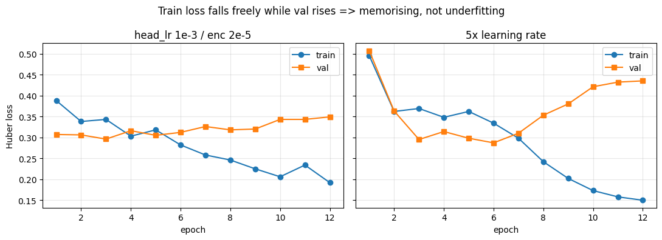
"You just didn't train it right"
Train loss halves while validation rises — it memorises, it does not underfit.
Notes:
The obvious objection: you didn't train it right.
Left, our settings: training loss falls by half while validation RISES. That is
memorisation, not underfitting. Right, five times the learning rate: it memorises harder
and generalises worse.
Everything else we eliminated: capacity, loss function, ticker attribution, measurement
window, and filtering to only "actionable" articles -- which made it worse. Each would
have shown a gradient. None did.
The important one: can the pipeline read text at all? Yes -- ask it to predict sentiment
from the same text and it gets 55% against a 43% baseline. The plumbing is fine. It is
the mapping from text to future return that does not exist.

Slide 23
The one positive result
hindsight run, split by date | n | R² | corr
all test rows | 1,127 | +0.0508 | +0.2315
dates SEEN in training | 312 | +0.1541 | +0.4107
dates NOT seen | 815 | -0.0056 | +0.1271
It learned the day, not the article. Narrow to 30 min and even this vanishes: -0.0035 ± 0.0042
Notes:
The one run that looked alive, and why it does not count.
We asked a model to describe a move that had ALREADY happened. It worked: R-squared 0.05, correlation 0.23, and for the first time the model committed to varied predictions.
Then we split by date. On dates seen in training: 0.15. On unseen dates: below zero. It learned 'that morning was strong' from other articles on the same day and applied it to a different stock -- day-level market state, not article-level information.

Slide 24
The articles describe what the market already did
Collapsing to the mean is correct behaviour when there is no signal.
Notes:
The conclusion, and I want to be precise about what it does and does not say.
It does not say news is useless for trading. It says THIS corpus -- articles published
after the fact, distilled into insights -- does not predict the move that follows, at
this sample size and this horizon.
The models collapsed to the mean because that is the mathematically correct answer
when there is nothing to condition on. They behaved properly.

Slide 25
If we continue — change the data, not the model
Information that precedes the move
Market-adjusted target — strip the day factor
Sign classification with AUC, not regression
Substantially more data
Notes:
These are changes to the data or the question. Tuning is exhausted.
Information that precedes the move. A market-adjusted target that strips the day factor. Direction as classification with AUC, so a weak correlation reads as 53% instead of being erased by squared error. And more data.
Questions.

