Slide 1
Can news insights predict stock moves?
Five model families. Six targets. One answer.
AI/compute news corpus · 6,333 articles · 2024-09 → 2026-09
Notes:
10 minutes. The answer is negative, so I'll lead with it and spend the time on evidence.
The ask was: can LLM-distilled insights from stock news predict the move that follows?
We built five model families across two codebases and ran them on the same corpus.
None of them beat guessing the average.
I want to convince you this is a property of the data, not a failure of effort.

Slide 2
The answer
R² ≈ 0
every model, every target — no better than predicting the average
Not on forecast. Not even on 30 minutes of hindsight.
Notes:
Leading with the conclusion so nothing that follows is a surprise.
R-squared of zero means: your model's error is the same size as just predicting
the average every single time. Every model we built landed there or below.
"Not even 30 minutes of hindsight" is the part that surprised us. We asked the model
to describe a move that had ALREADY happened when the article was published --
and it still couldn't.

Slide 3
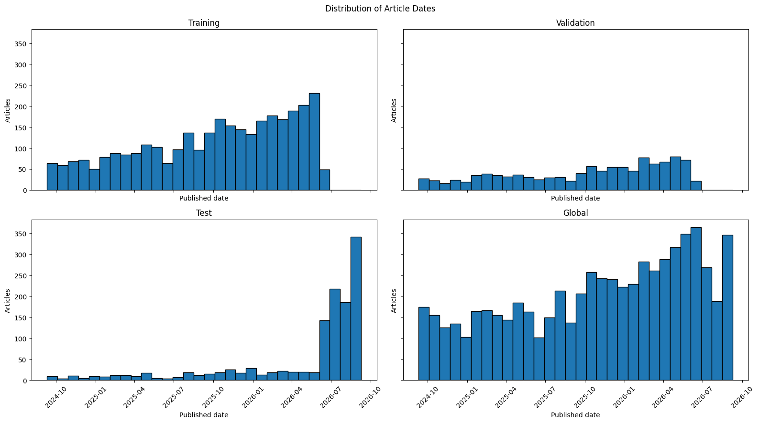
The data
• 6,333 articles · 118 tickers · 2 years
• 5,506 with LLM-distilled insight text — the model input
• Split 60/20/20, most recent days held out as test
Notes:
The corpus: 6,333 articles on 118 AI and compute tickers, two years, NYSE trading
days only, restricted to between the open and 90 minutes before the close so the
target window always closes inside the session.
5,506 have LLM-distilled insight text -- that text is the model input.
The split is 60/20/20 but not random: the most recent trading days are reserved
wholesale as the test set. Point at the chart -- test is concentrated on the right.
That means a model cannot learn a specific day and replay it.

Slide 4
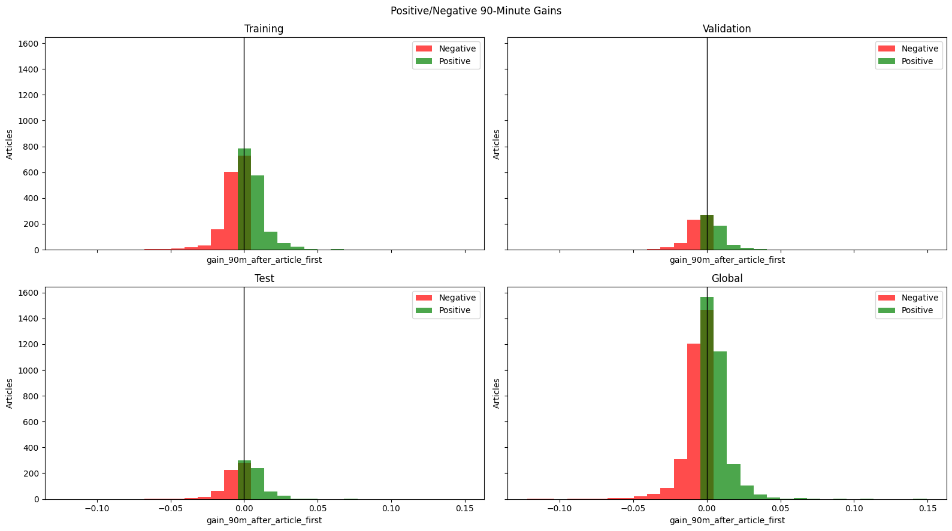
The target: a ~1% move, centred on zero
sd = 109 bps · the bar to clear: a constant predictor, MAE 74 bps
Notes:
The target: the stock's move in the 90 minutes after the article.
Standard deviation is 109 basis points -- about 1%. Tight, symmetric, centred on zero.
This matters for what counts as success. Any model has to beat the constant
predictor, which just guesses the mean every time. That baseline gets a mean
absolute error of 74 basis points. That's the number to beat.

Slide 5
Before any model: sentiment vs. what happened next
LLM sentiment | next move DOWN | next move UP
Strongly negative | 50.80% | 49.20%
Negative | 49.82% | 50.18%
Neutral | 51.14% | 48.86%
Positive | 49.76% | 50.24%
Strongly positive | 50.14% | 49.86%
Every class is a coin flip.
This is a property of the data, not of any model.
Notes:
This is the most important slide in the deck, and it comes BEFORE any model.
We cross-tabulated the LLM's sentiment reading against which way the stock
actually moved next. If sentiment carried directional information, the strongly
negative row and the strongly positive row would look different.
They don't. Every row is a coin flip. One percentage point separates the extremes,
which on 5,500 rows is inside sampling noise.
Everything after this slide is a consequence of this table. Pause here.

Slide 6
Five model families
 | family | input
2a | Encoder-NN, separate | text → sentiment → + market floats
2b | Encoder-NN, combined | same, end-to-end
2c | JSON-LLM, LoRA | everything as raw JSON · 1.04B params
2d | DeBERTa + floats | text + 10 numeric/one-hot features
2e | Gradient-boosted tree | the 10 features only — no text
2e has no text — the gap between 2d and 2e is what the text adds.
Notes:
Five families, deliberately different in kind, so a null result can't be blamed on
one architecture.
Two from the original notebook -- an encoder feeding a fusion network, trained
separately and end-to-end. One LoRA fine-tune of a 1-billion-parameter LLM.
Then two we added: a DeBERTa text encoder with market features, and a
gradient-boosted tree on the numeric features only.
That last one is the control: it has no text at all. The gap between it and the
DeBERTa model is exactly what the text contributes.

Slide 7
Why trust a negative result
• GroupKFold on (ticker, trading-day) — 46% of rows share one
• Scalers and transforms fitted on the training fold only
• Test split never trained on; unseen-date subset reported separately
• Leakage guards enforced in code — refuse, don't report
Notes:
Why you should trust a negative result. Three things we did to avoid fooling ourselves.
First and most important: 46% of articles share a ticker AND a trading day with
another article. Two pieces about Nvidia twenty minutes apart have nearly identical
targets. With ordinary cross-validation those near-duplicates land on both sides of
the split and every score is inflated. We group them.
Second, scalers fitted on the training fold only.
Third, leakage guards in code -- if a target is identical to an input feature,
the config refuses to run rather than reporting a great number.

Slide 8
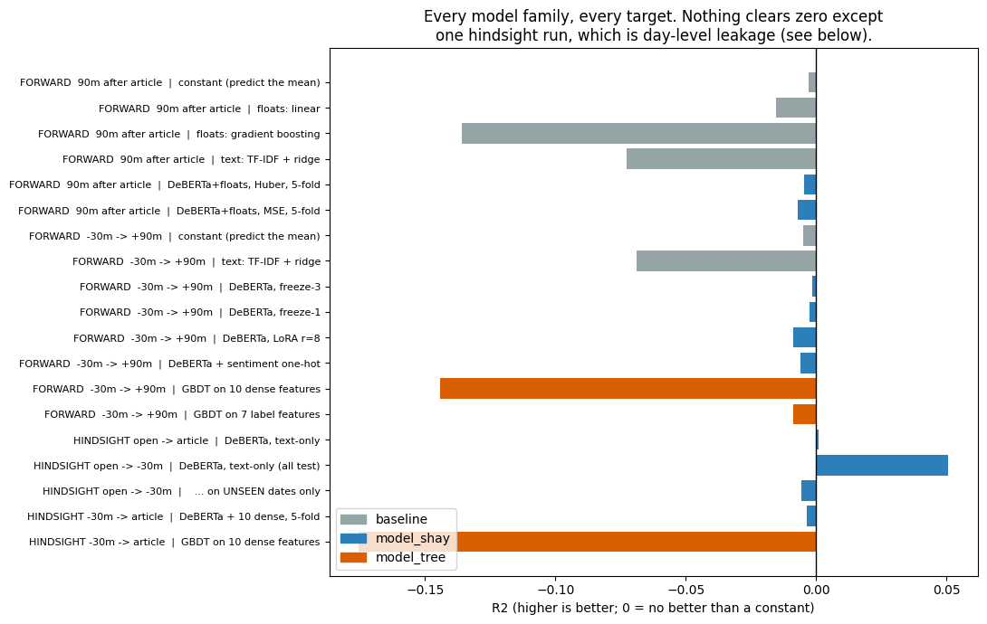
Every family, every target
Notes:
Everything on one axis. Zero is 'no better than a constant'. Grey is baselines,
blue is the text model, orange is the tree.
Almost nothing clears zero. The flexible models -- gradient boosting, TF-IDF --
are the WORST. That's the signature of fitting noise: give a flexible model
noise and it will fit it, then fail out of sample.
The one bar sticking out to the right is a hindsight run. I'll come back to it,
because it turns out to be leakage.

Slide 9
Nothing beats the constant
 | model | test MAE | R²
— | constant (predict the mean) | 74.1 bps | 0.0000
2a | Fusion Network | 78.5 bps | -0.0529
2b | Combined Encoder-NN | 75.1 bps | -0.0049
2c | JSON-LLM, LoRA | 274.1 bps | -14.44 ※
2d | DeBERTa + floats | 89.6 bps | -0.0015
2e | Tree on 10 features | ~98 bps | -0.1559
Best model = the constant, to three decimals.
※ 2c did not converge usefully — error 3.7× the baseline
Notes:
The same thing as numbers, on one held-out split of 1,236 articles.
The constant predictor -- which ignores every input -- gets 74.1 basis points.
Nothing beats it. The best model, 2b, matches it to three decimal places.
That is what a model converging to 'just predict the average' looks like.
The LoRA number is so bad it's not a ranking -- its error is nearly four times the
baseline, which means it didn't converge properly. I flag it rather than quoting it.

Slide 10
Does it at least call the direction?
model | correct direction | within ±50 bps
Fusion Network | 48.38% | 578 / 1,236
Combined Encoder-NN | 49.43% | 610 / 1,236
JSON-LLM, LoRA | 52.19% | 84 / 1,236
Two are below a coin flip.
52.19% is 1.5 SE from chance (SE = 1.42 pp) — and that model has the worst magnitude error of all.
Notes:
R-squared is about magnitude. For trading the real question is simpler:
does it call the direction?
Two of the three are below a coin flip. The third, at 52.19%, looks like an edge --
it isn't. That's 1.5 standard errors from chance, the kind of number that appears
and disappears between runs. And it comes from the model with by far the worst
magnitude error: only 84 of its 1,236 predictions land within 50 basis points,
versus around 600 for the other two.
No family has directional skill worth acting on.

Slide 11
What the models actually do
model | trainable params | R² | prediction spread
LoRA r=8 | 0.4M | -0.0086 | 2.8%
freeze-1 | 7.3M | -0.0025 | 2.7%
freeze-3 | 21.4M | -0.0015 | 2.6%
50× the capacity. The same flat line.
Predictions vary 2.6% as much as reality does — the model emits a constant.
Notes:
Here's what the models actually do. We measured the spread of their predictions
against the spread of reality.
The model outputs a nearly flat line. Its predictions vary about 2.6% as much as
the real moves do. It has learned the average and nothing else.
And look at the left column -- we varied trainable parameters by fifty times,
from 400 thousand to 21 million. The spread barely moves. This is not a
capacity problem.

Slide 12
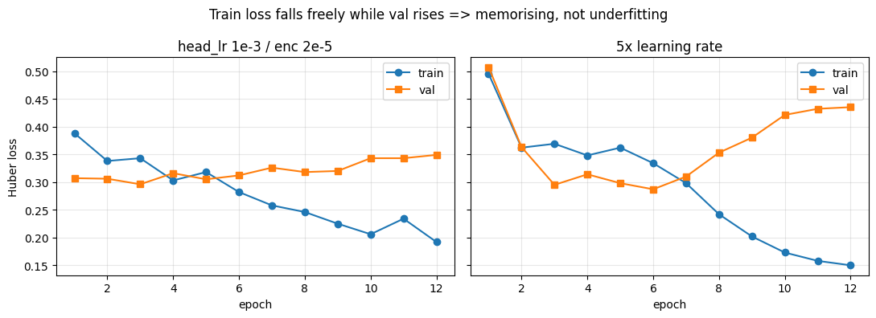
"You just didn't train it right"
Train loss halves while validation rises. It memorises — it does not underfit.
Notes:
The obvious objection: you just didn't train it right.
Left panel, our settings: training loss falls by half while validation loss RISES.
That is memorisation, not underfitting. The model is perfectly capable of learning --
it's learning the training set by heart.
Right panel, five times the learning rate: it memorises harder and generalises worse.
More learning rate, more capacity, more epochs -- all move you further along the
wrong curve.

Slide 13
Ruled out
• Broken training
• Learning rate too low
• Too much capacity
• Wrong loss · wrong ticker · wrong window
• Corpus too noisy
• Pipeline can't read text
Each would have shown a gradient. None did.
Notes:
Everything we ruled out. Run through this quickly -- the point is the breadth,
not each row.
Each of these would have shown a gradient if it were the cause. None did.
The last row is the one that matters most: can the pipeline read text at all?
Yes. Ask it to predict sentiment from the same text and it works fine --
55% accuracy against a 43% baseline. The plumbing is good. It's the mapping
from text to future return that doesn't exist.

Slide 14
The one positive result
hindsight run, split by date | n | R² | corr
all test rows | 1,127 | +0.0508 | +0.2315
dates SEEN in training | 312 | +0.1541 | +0.4107
dates NOT seen | 815 | -0.0056 | +0.1271
It learned the day, not the article.
Narrow the window to 30 minutes and even this disappears: -0.0035 ± 0.0042
Notes:
The one result that looked alive, and why it doesn't count.
We asked the model to describe a move that had already happened. It worked --
R-squared of 0.05, correlation 0.23, and for the first time the model actually
committed to varied predictions.
Then we split by date. On dates the model had seen during training: 0.15.
On genuinely unseen dates: below zero.
It wasn't reading the article. It was learning 'that morning was strong' from
other articles on the same day, and applying it to a different stock.
Day-level market state, not article-level information.
Narrow the window to 30 minutes and even that vanishes.

Slide 15
What this says
• The articles describe what the market already did.
• Collapsing to the mean is the correct answer when there is no signal
• Not a model problem — five architectures, one result
• This corpus, this horizon — not "news is useless"
Notes:
The conclusion, and I want to be precise about what it does and doesn't say.
It does not say news is useless for trading. It says THIS corpus -- articles
published after the fact, distilled into insights -- does not predict the move
that follows, at this sample size.
The models collapsed to the mean because that is the mathematically correct answer
when there's nothing to condition on. They behaved properly.
The articles describe what the market already did.

Slide 16
If we continue — change the data, not the model
• Information that precedes the move
• Market-adjusted target — strip the day factor
• Sign classification with AUC, not regression
• Substantially more data
Detail: FINDINGS.md · tries.md · train_news_model.ipynb
Notes:
If we want to keep going, these are changes to the data or the question --
not to the model. Tuning is exhausted.
One: information that precedes the move. This corpus is retrospective by construction.
Two: a market-adjusted target. The strongest thing our features explain is the day's
overall direction -- strip that out and see if anything stock-specific is left.
Three: predict direction as a classification problem with AUC, so a weak correlation
shows up as 53% instead of being erased by squared error.
Four: more data. We showed 1,000 rows is below the floor; 3,000 probably is too.
Happy to take questions.

