Slide 1
HACK FOR HUMANITY ADELAIDE 2026
Safe Lift
17,358
Plan first. Then lift.
South Australians live in residential aged care.
A Gemma-coached manual handling trainer for aged care workers.
Every transfer they need is a manual handling task for a care worker.
[Team names] · github.com/Shezza5071/safe-lift · Based on: AIHW GEN Aged Care Data 2024-25 (CC BY 4.0), via H4H
Notes:
0:00 to 0:20. Hook. "17,358 South Australians live in residential aged care. Every time one of them moves from bed to chair, a care worker is doing a manual handling task, and body stressing is nearly half of all serious injury claims in that workforce. We built Safe Lift so the plan gets followed before anyone lifts." Then: "Here's Safe Lift in about a minute." Next slide.

Slide 2
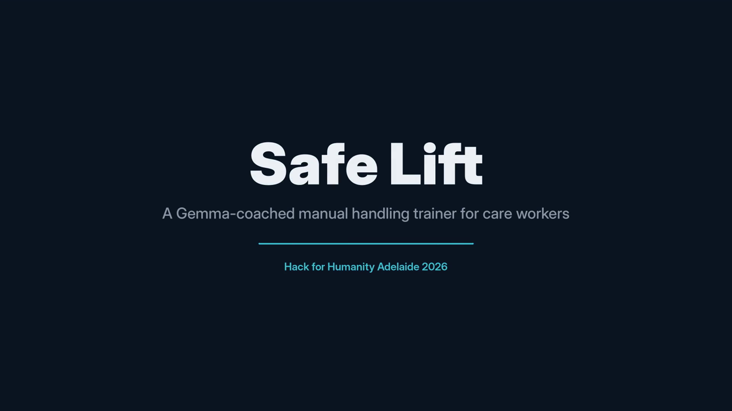
Safe Lift in 68 seconds
Notes:
0:20 to 1:30. Click the video to play (no sound: talk over it or let it run). Cues: the numbers (first 20 s); training alone isn't the control (~0:25); MediaPipe is the eyes, Gemma the coach, Snowflake the memory (~0:30); the gate blocks the lift until the plan is met (~0:40); red only after two seconds, then Gemma asks why (~0:50). When it ends: "Now let's do it live."

Slide 3
One transfer, four moments
LIVE DEMO
1
2
3
4
Gemma reads the plan
The gate blocks
A bad lift goes red
Debrief and dashboard
Photo of a synthetic plan becomes rules: hoist, 2 staff, no manual lift.
“Plan says 2 staff, 1 seen.” The function call shows on screen. A second trainee walks in: unlocked.
Red only after 2 seconds held. Gemma looks at the skeleton and asks a specific question.
A cited debrief in the trainee’s language, then the trainer’s view in Snowflake.
If the camera fails: play the recorded backup run and keep narrating.
Notes:
1:30 to 3:00 (90 s). Leave this slide up while you switch to the laptop. (1) ~15 s: plan photo, Gemma's rules JSON. (2) ~25 s: one trainee in frame, BLOCKED with the block_task call visible; second trainee joins, READY. (3) ~30 s: stoop lift, amber then red after 2 s, beep; Gemma's question; tap the answer (keys 1 to 4). (4) ~20 s: debrief in Nepali or Vietnamese citing the Model Code; flip to the dashboard: ML risk badge, model comparison, SA context tile (17,358). Fallback: the recorded run, same narration.

Slide 4
The camera measures. Gemma reasons. Snowflake learns.
UNDER THE HOOD
Gemma 4: five jobs
Snowflake: the memory
Reads the plan photo into rules
Runs the setup gate with function calls
Asks why after a red alarm
Writes a cited debrief in the trainee’s language
Second-rates every lift to clean ML labels
Readings stream in every 2 seconds
Cortex Search over official guidance
ML classifier learns what trainers call unsafe
Trainer dashboard, plus live research evidence from the Marketplace
H4H open data for SA context
MediaPipe pose runs on the laptop. Only angles and skeleton drawings leave it, never video.
Notes:
3:00 to 3:40. "The camera only measures angles. Every decision is Gemma's: it reads the plan, runs the gate with function calls, asks why, and writes the debrief grounded in the Model Code through Cortex Search. Snowflake is the memory: readings stream in, a classifier learns what our trainers label unsafe, and Gemma acts as a second rater so we drop labels where human and Gemma disagree before training."

Slide 5
Tested, with the limits stated
DOES IT WORK?
0 / 33
74%
Closed
alarm errors on a labelled test set
accuracy when Gemma cleans the labels
the setup gate fails safe
Synthetic staged lifts. Precision 1.00, recall 0.83: the 2 misses are a body hidden from the camera.
23 held-out readings: Snowflake ML v2 74%, Gemma alone 64%, ML v1 52%, REBA rule 43%.
Any error, timeout or empty reply keeps the lift blocked.
Staged lifts, small labelled sets, one 2D camera (about 5 to 10° error): evidence the pipeline works, not proof it prevents injury.
Notes:
3:40 to 4:15. "We tested it honestly. On a labelled set of 33 staged sessions the alarm made no errors; it missed the two where a second worker blocked the camera, which is a real limit. Then the Gemma and Snowflake result: on 23 held-out readings, the REBA rule alone matched our trainers 43% of the time, Gemma alone 64%, our first Snowflake model 52%. When Gemma rated every lift as a second rater and we dropped the labels where it and the human disagreed, the retrained Snowflake model reached 74%. Small numbers, but that is Gemma teaching Snowflake. And the gate fails closed: if anything goes wrong, nobody lifts." Don't claim injury prevention.

Slide 6
Coaching, not surveillance
BUILT FOR A TRAINING ROOM
Skeleton only
Consent first
Fix the task
No video is saved. Gemma sees a stick figure, never a person.
Training-room mode by default. Synthetic plans, consenting adults, no residents.
Patterns by task and plan, never worker rankings or discipline.
Real care settings would need recorded consent: the Surveillance Devices Act 2016 (SA) covers observing, not just recording.
Notes:
4:15 to 4:35. "A camera in a care setting raises real questions, so we designed for the training room. Nothing is recorded, Gemma only ever sees a skeleton, and the data points at tasks and plans that need fixing, never at individual workers. Taking it into a real facility would need recorded consent; South Australia's Surveillance Devices Act covers observing a private activity, not just recording it."

Slide 7
From the hackathon to a pilot
WHAT’S NEXT
Pilot with SA educators
Score the whole transfer
Keep data at home
Real trainer labels across many workers, then retrain the model.
A validated 16-item observation checklist (DINO), pre-filled by Gemma, confirmed by the trainer.
Gemma inside the provider’s Snowflake, or on the device, so care plans never leave.
Notes:
4:35 to 4:50. "Next, we'd pilot with South Australian aged care educators to get real labels. We'd score the whole transfer, not just the back angle, using a validated observation checklist where Gemma pre-fills and the trainer confirms. And we'd run Gemma inside the provider's own Snowflake account or on the device, so care plans never leave the building."

Slide 8
Safe Lift
Plan first. Then lift.
MediaPipe · Gemma 4 · Snowflake · open source, MIT
github.com/Shezza5071/safe-lift
Training aid only, not a safety device or medical advice. Always follow the resident’s plan and your employer’s procedures.
Notes:
4:50 to 5:00. "Safe Lift: plan first, then lift. It's open source, so any trainer can run it. Thank you." Stop. Take questions with the sources slide ready.

Slide 9
Sources and credits
FOR QUESTIONS
17,358 in SA residential aged care at 30 June 2025: based on AIHW, GEN Aged Care Data, People using aged care by region 2024-25, CC BY 4.0 (H4H set A2, summarised to SA totals)
47.6% body stressing: Safe Work Australia, WHS profile: nursing, care and support workforce (May 2025; average since 2012-13)
21% of SA body-stressing claims from health care and social assistance: SafeWork SA, 21 October 2024
Model comparison: Safe Lift MODEL_COMPARE, 23 held-out staged readings, 30 October 2026
Training alone: Cochrane review CD005958.pub3. Hierarchy of controls: Model Code of Practice: Hazardous manual tasks
Alarm bands: REBA, Hignett and McAtamney (2000), Applied Ergonomics 31(2):201-205
Observation checklist: DINO, Johnsson et al. (2004), Applied Ergonomics 35(6):591-601
Gemma 4 (Gemma terms) · MediaPipe (Apache 2.0) · Snowflake · Safe Lift code MIT. Test data in the repo is synthetic.
Notes:
Backup slide for Q&A. Don't present it in the 5 minutes.

