Slide 1
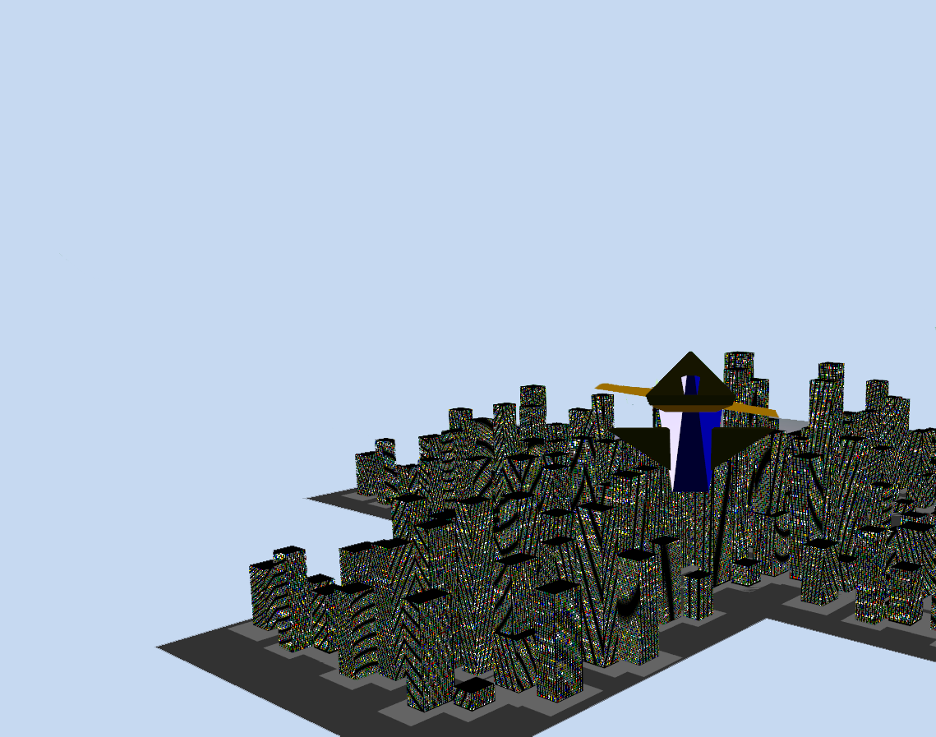
Iridescent Skies
Alpha Demonstration

Slide 2
Iridescent Skies – Alpha Demonstration
Jack Partridge – Responsibilities
Written overarching code structure/engine
Collisions
- Bounding Box based collisions.
- Using an octree for optimisation based up model positions in tree.
Menu system / Gamestates
- Simple menu system that allows game start and a finite state machine.
Procedural Terrain
- Based upon Perlin noise.
- Can take input parameters to customise how it looks.
Splitscreen
- Up to 4 players
Cameras
- First person & third person

Slide 3
Iridescent Skies – Alpha Demonstration
Josh Palmer – Responsibilities

Slide 4
Iridescent Skies – Alpha Demonstration
Luke Kenvyn – Responsibilities

Slide 5
Iridescent Skies – Alpha Demonstration
Pavel Lalik – Responsibilities

Slide 6
Iridescent Skies – Alpha Demonstration
Luke Pullen – Responsibilities

