Slide 1


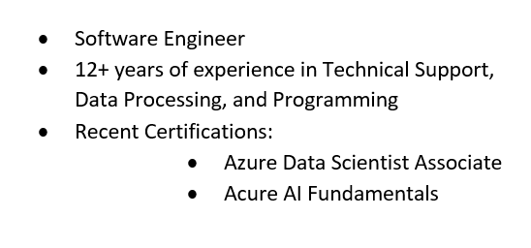

Slide 2
Introduction to PySpark in Fabric Notebook
Overview about PySpark and Fabric
Demo Scenario: Processing and Visualizing Sales Data
A Few Points To Know
Questions & Comments

Slide 3
Overview
PySpark is a Python API for Apache Spark, an open-source, distributed computing system that provides fast and efficient large-scale data processing.
Microsoft Fabric: A comprehensive data platform that integrates various data services and tools to streamline data management and analytics.
Workspaces: Collaborative environments for organizing and managing data assets.
Lakehouse: Combines the features of data lakes and data warehouses for storing and analyzing large volumes of data.
Notebooks: Interactive documents for writing and executing code, visualizing data, and documenting analysis
PySpark in Lakehouse
Notebooks: For interactive data analysis and prototyping.
Spark Jobs: For complex or scheduled data processing tasks.

Slide 4
Demo Scenario: Processing and Visualizing Sales Data
Step 1: Upload Raw CSV Files
Step 2: Transform the Data
Step 3: Aggregate the Data
Step 4: Visualize the Data
Saving and Querying Data

Slide 5
Key Differences Between Files and Tables folders in Lakehouse:
Data Structure: Files folder contains raw, unstructured data, while Tables folder contains structured data with a defined schema.
Management: Files are managed manually, whereas tables are managed by Spark, which handles data and metadata.
Use Cases: Files are used for raw data storage and initial data ingestion, while tables are used for processed data that is ready for analysis.

Slide 6
Saving as Delta File: You gain benefits like data versioning, ACID (Atomicity, Consistency, Isolation, and Durability) transactions, and optimized reads. This can be advantageous if:
You plan to run multiple visualizations or queries on this data, as the data is already persisted in an optimized format.
You need to share the data with other users or processes.
You want to ensure data consistency and reliability.

Slide 7
Dataframes
DataFrames in PySpark are immutable. This means that once a DataFrame is created, it cannot be changed. Instead, any transformation you apply to a DataFrame will result in a new DataFrame being created with the modified data. This immutability is a key feature of Spark, as it allows for safer and more reliable data processing by ensuring that data is not accidentally modified during processing.
This immutability is a crucial feature of Spark for several reasons:
Fault Tolerance: It allows Spark to maintain a lineage of transformations, which helps in recomputing lost data in case of failures.
Consistency: Since the original DataFrame cannot be changed, it ensures that data is not inadvertently modified during processing, leading to safer and more reliable data handling.
Optimizations: Spark can optimize the execution plan based on the immutability of DataFrames, improving performance.

Slide 8
In PySpark, creating many intermediate DataFrames could cause resource overuse. However, Spark manages resources efficiently through:
Garbage Collection: Spark relies on the underlying JVM's garbage collection to clean up unused objects, including old DataFrames. The garbage collector will free up memory by reclaiming objects that are no longer referenced.
Caching and Persistence: Reduces recomputation by storing DataFrames in memory or on disk.
Resource Management: Dynamically adjusts resource usage.
Optimized Execution Plans: Minimizes resource usage by reusing intermediate results.
Tungsten Execution Engine: Enhances performance by managing memory and CPU usage.

Slide 9
RDDs (Resilient Distributed Datasets) in Spark are fault-tolerant collections of elements that can be operated on in parallel across a cluster.
DataFrames in PySpark are built on top of RDDs, providing a higher-level, structured API for working with data.
Spark's lazy evaluation means that transformations on RDDs are not executed immediately but are recorded as a lineage (the sequence of transformations and actions applied to an RDD) of operations. Actions trigger the execution of these transformations, allowing Spark to optimize the execution plan for better performance.

Slide 10
Questions & Comments

