Slide 1

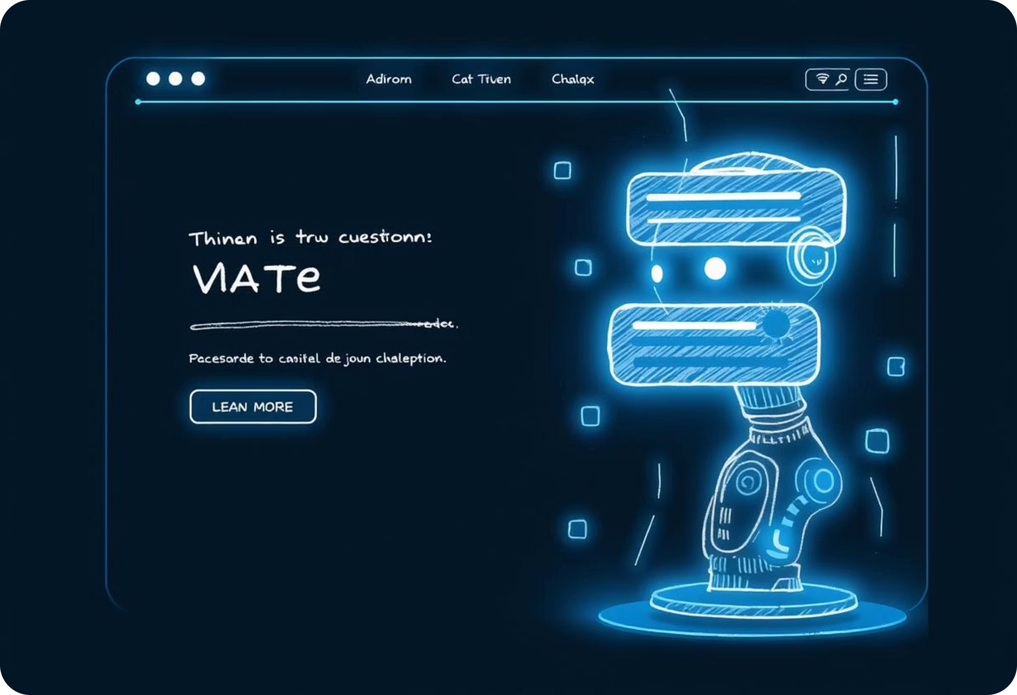
ChatWithWebsite.AI – Gemini-Powered Web Content Chatbot
An AI-powered chatbot to interact with websites using Gemini 2.5 Flash
Presented by Shivam | Roll No.: 2337055 | B. Tech. CSE (Generative AI Summer Training)

Slide 2

Introduction
ChatWithWebsite.AI is an innovative project that leverages Gemini 2.5 Flash to build an AI chatbot enabling users to interact naturally with any website.
It bridges AI with live web content, empowering dynamic question answering and information synthesis directly from websites.

Slide 3

Project Objectives
Implement Retrieval-Augmented Generation (RAG) for accurate info retrieval
Summarize multiple web pages effectively
Enable AI-powered Q&A over live website content
Support multi-URL inputs for comprehensive data access
Create a user-friendly chat interface with history and theme toggle

Slide 4

Key Features
Multi-URL Support
Content Summarization
Query across multiple websites simultaneously.
Automatic extraction of key insights from web content.
Chat History
Theme Toggle
Save and review previous conversations easily.
Switch between light and dark modes for user comfort.

Slide 5







Technologies Used
Python for backend processing and AI integration
Streamlit for building a responsive web app UI
LangChain for chaining and managing LLM workflows
Gemini 2.5 Flash for advanced natural language understanding
ChromaDB for embedding storage and fast retrieval
dotenv to manage environment variables securely

Slide 6

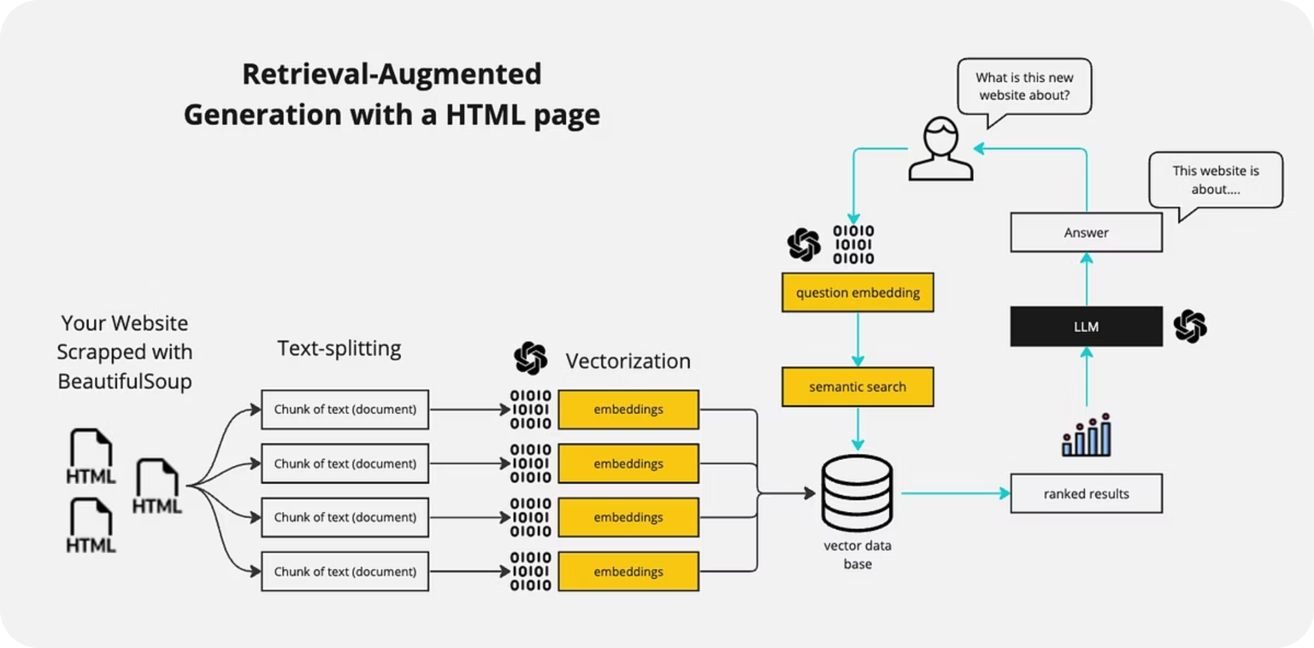

Architecture & Workflow
The app follows a clear data flow: Input URL(s) → Load & scrape website content → Split into chunks → Embed chunks → Query embeddings → Get LLM response & generate chat answers.

Slide 7

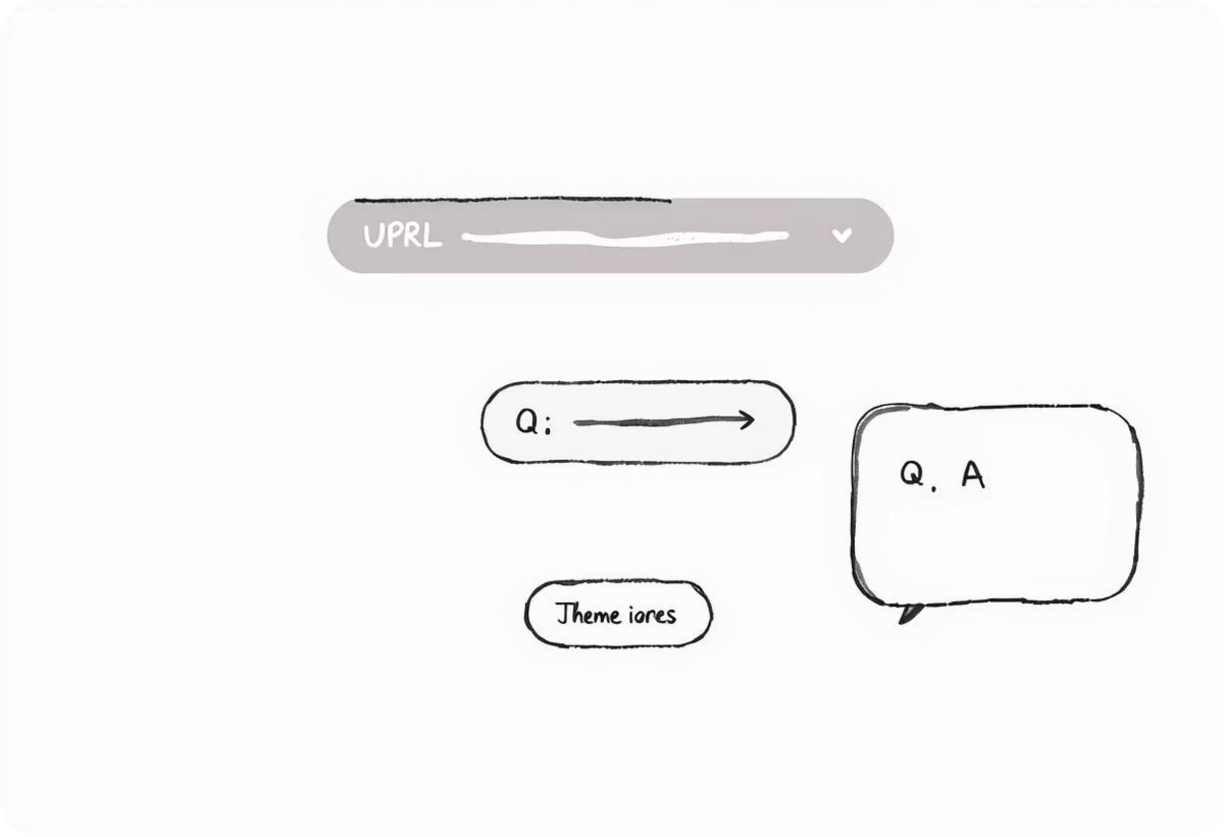
UI Preview & Interaction
Users enter URLs or web content, ask questions via chatbot interface, and view summarized responses with an easy-to-read chat display and navigation features.

Slide 8

Customization & Future Features
File Upload
Mobile Version
Allow users to upload documents for chatbot analysis.
Responsive app design optimized for smartphones and tablets.
Voice Input
Multi-LLM Support
Integrate speech-to-text for hands-free question asking.
Support switching between multiple large language models for flexibility.

Slide 9


Learnings & Outcomes
Developed expertise in AI chatbot integration with web data using Gemini. Gained hands-on experience with embeddings, LangChain workflows, and Streamlit UI development.
Personally, enhanced problem-solving skills and deepened understanding of AI-driven human-computer interaction.
ChatWithWebsite.AI demonstrates strong potential for practical web interaction improvements, paving way for future AI-powered browsing tools.

