Slide 1
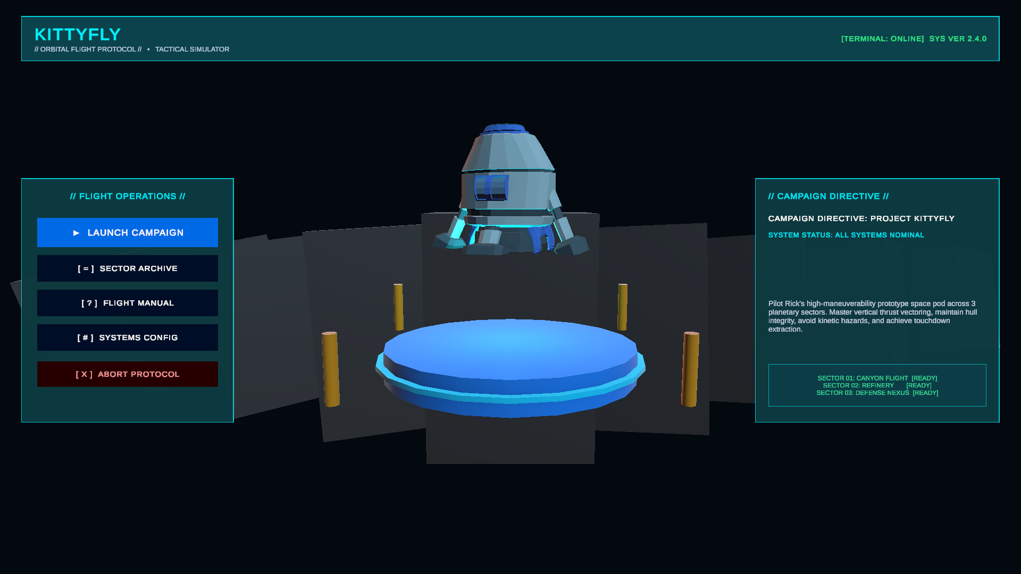
PROJECT SHOWCASE
KITTYFLY
Odyssey Beyond Orbit
A 2.5D Precision Physics Spacecraft Simulator featuring Newtonian flight mechanics, cybernetic UI, multi-stage hazard navigation, and cinematic visual effects.
• Engine: Unity 6 (6000.6.2f1) URP
• Pipeline: Universal Render Pipeline (URP 17.6.0)
• Architecture: Rigidbody 2.5D Physics + State Machine UI

Slide 2
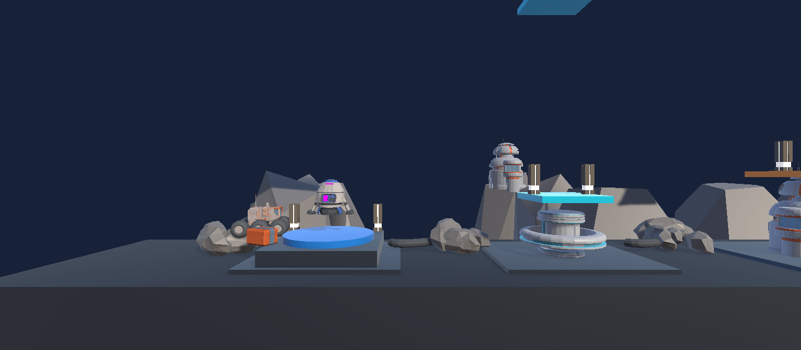
GAME VISION & PILLARS
02/10
Core Game Concept & Mission Loop
01. HIGH CONCEPT
02. THE MISSION LOOP
03. IN-GAME DEMONSTRATION
Inspired by classic Lunar Lander & precision arcade simulators, KittyFly tests pilot dexterity across hostile alien sectors.
Newtonian Flight Physics
Zero-drag atmospheric inertia demands continuous micro-burst adjustments to avoid terminal velocity crashes.
Damage-Tolerant Hull
100 HP health system allows skilled players to absorb glancing impacts and repair through nano-pickup caches.
STAGE 1: LAUNCH & INGRESS
Undock from launchpad, fire primary thrusters to conquer local gravity pull.
STAGE 2: PRECISION VECTORING
Balance roll torque and burst throttle through tight sci-fi corridors.
STAGE 3: DYNAMIC HAZARDS
Time maneuvers past moving cranes, hydraulic crushers, and rotating plasma blades.
STAGE 4: EXTRACTION DOCKING
Touch down softly on the glowing target landing pad under safe velocity.
Real-time 2.5D gameplay showing synchronized HUD telemetry, lighting, and gate navigation.

Slide 3
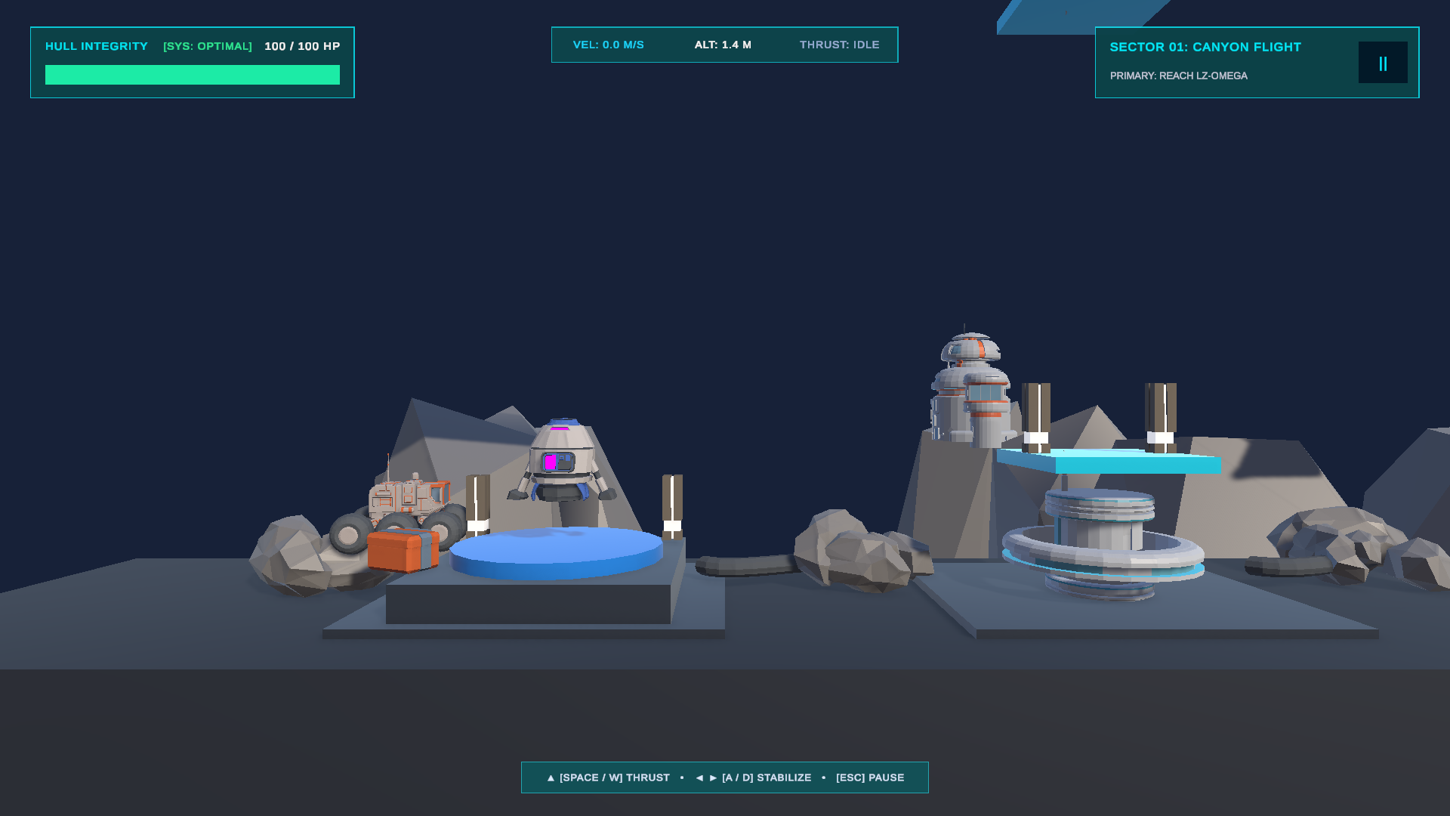
VEHICLE ENGINEERING
03/10
Spacecraft Flight Mechanics & Rigidbody Physics
FLIGHT DYNAMICS ARCHITECTURE
TELEMETRY & VECTOR DISPLAY
• Kinematic 2.5D Constraints
Rigidbody with Z-position lock and X/Y rotation freeze. Prevents drifting off 2D gameplay plane while preserving full 3D lighting.
• Newtonian Thrust Vectoring
Main Thrust: 1000 N force applied along transform.up vector via Rigidbody.AddRelativeForce().
• Dual-Directional Torque
Rotation Speed: 100 deg/s with physics torque overrides for responsive steering without gimbal lock.
• Fail-Safe Dual Input Architecture
Supports Unity Modern Input System actions with seamless fallback to legacy GetKey inputs for 100% hardware compatibility.
• Kinematic Collision Protection
Detects safe pad landings vs. terrain impacts, checking contact normal and vertical touch speed.

Slide 4
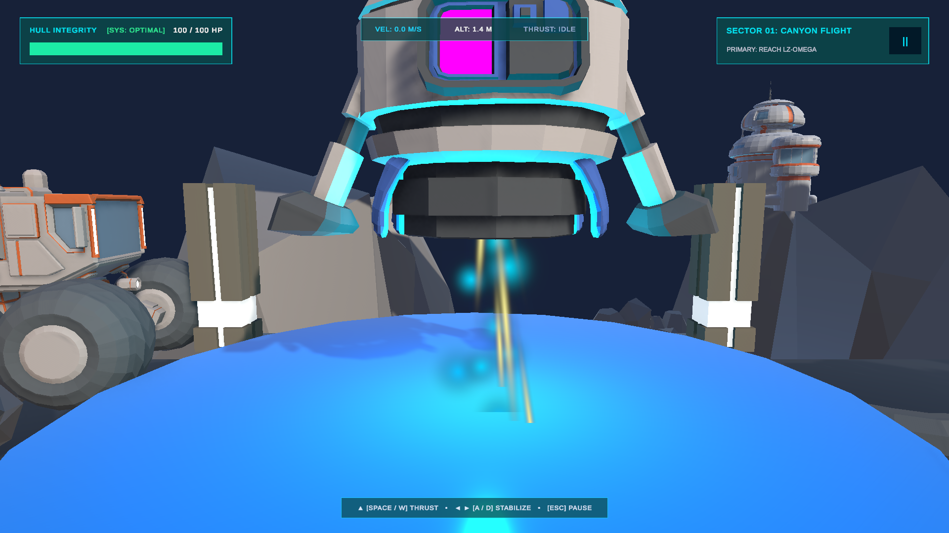
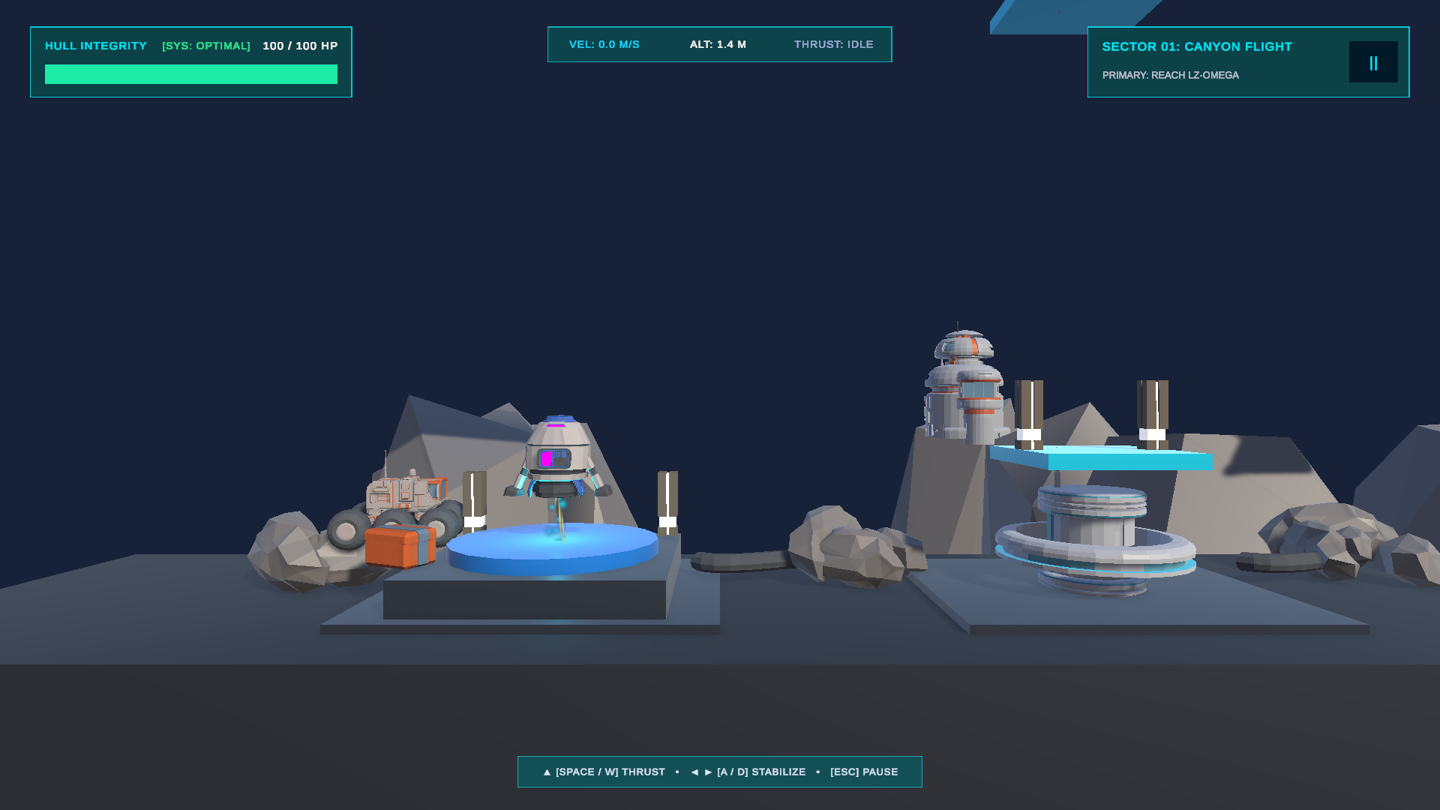
VISUAL EFFECTS & SHADERS
04/10
Multi-Layered Sci-Fi Thruster VFX & Dynamic Lighting
MACRO PLASMA NOZZLE IGNITION
IN-FLIGHT ATMOSPHERIC EXHAUST TRAIL
MULTI-EMITTER PARTICLE ARCHITECTURE
1. Core Mach Plume: High-velocity compressed white/cyan ion stream with size-over-lifetime tapering.
2. Plasma Outer Envelope: Vibrant cyan (#00F0FF) glow cone delivering distinct sci-fi silhouette and volumetric presence.
3. Radiant Sparks & Embers: Amber/gold micro-particles scattering downward with realistic gravity-assisted drift.
4. Dynamic Point Light: Synchronized real-time point light that dynamically illuminates ground terrain and canyon walls on burn.

Slide 5
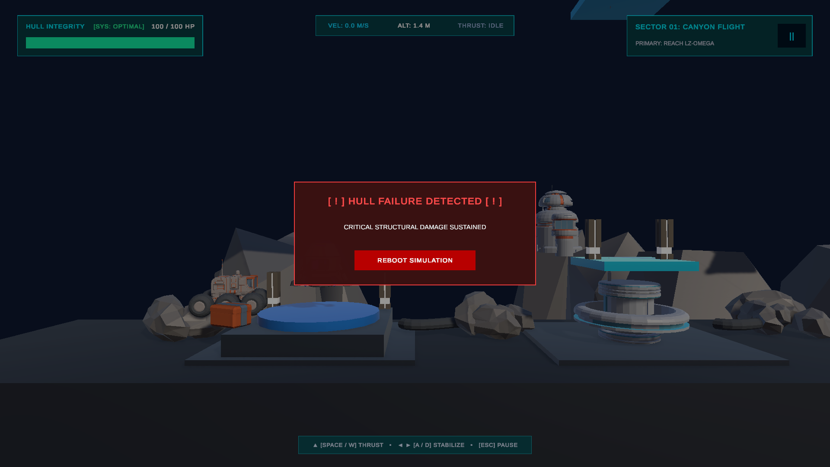
USER INTERFACE & SYSTEMS
05/10
Cyberpunk Diegetic Cockpit HUD & Telemetry
HUD ELEMENTS & PILOT FEEDBACK
IN-FLIGHT HUD TELEMETRY
• Tactical Frame & Brackets
Cyber-cyan hex border overlay (#00F0FF) framing the camera viewport for an immersive cockpit feel.
• Live Velocity & Altitude Readouts
Real-time telemetry measuring speed (m/s) and vertical elevation, warning pilots of high-speed descent rates.
• Dynamic Thruster Throttle Bar
Responsive fuel/burn gauge tracking active propellant burn rate in real time.
• Segmented Health Bar (100 HP)
Color-shifting life bar transitions from Cyber-Cyan (100-60 HP) to Warning Amber (59-30 HP) to Critical Red (<30 HP).
• Holographic Damage Vignette
Procedural crimson screen vignette flashes dynamically upon terrain impact, scaling with damage severity.
MISSION FAILURE DEBRIEF TERMINAL

Slide 6
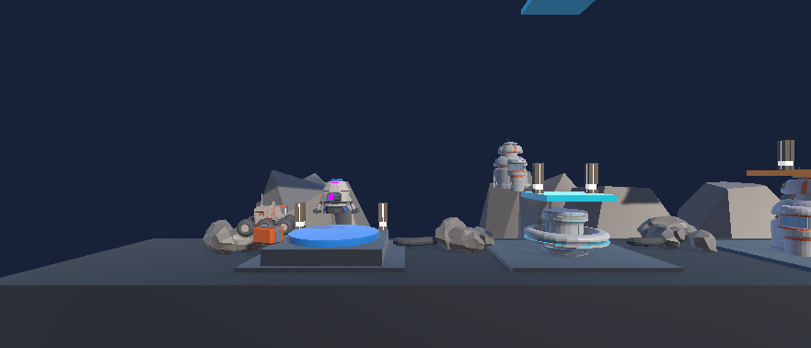
LEVEL DESIGN & CAMPAIGN
06/10
Sector 01: Canyon Flight — Atmospheric Ingress
SECTOR 01: CANYON FLIGHT VIEW
MISSION SPECIFICATIONS
► Environment Theme
High-altitude atmospheric canyon at twilight with deep cyan ambient fill and moody silhouettes.
► Gameplay Objective
Master pitch stabilization, low-gravity hover balance, and gentle deceleration curves.
► Key Architecture
Twin Cyber-Arch Transit Gates glowing with cyan warning markers directing flight traffic.
► Landing Zone
Elevated neon extraction pad with safe-touchdown velocity threshold sensors.
► Hazard Rating
Level 1: Low-moderate hazard density designed to establish foundational pilot muscle memory.

Slide 7
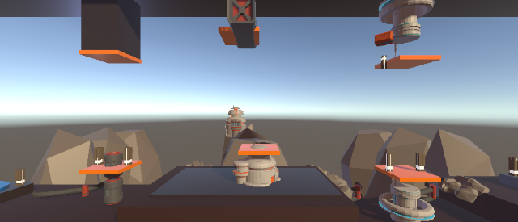
LEVEL DESIGN & CAMPAIGN
07/10
Sector 02: Industrial Refinery — Moving Hazards
KINEMATIC CARGO CRANE OBSTACLE
SECTOR MECHANICS & OBSTACLES
► Terrain Complexity
Asymmetric terrain wave geometry with narrow subterranean ceiling and restricted overhead clearance.
► Dynamic Cargo Crane
Kinematic industrial arm oscillating across flight lane via Mathf.PingPong() / Sinusoidal wave. Crushes careless ships.
► Nano-Repair Cache (+25 HP)
Glowing emerald repair pickup floating in the cavern; pilots can take calculated risks to recover hull integrity.
► Narrow Choke Points
Forces pilots to pause, hover mid-air, and time their forward burn between crane sweeps.
► Hazard Rating
Level 2: High spatial awareness required; combines moving obstacles with precision hovering.

Slide 8
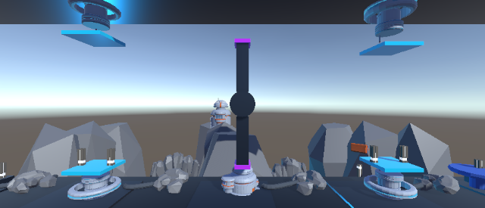
LEVEL DESIGN & CAMPAIGN
08/10
Sector 03: Orbital Defense Nexus — Gauntlet
360° ROTATING TURBINE & PISTON GAUNTLET
GAUNTLET ARCHITECTURE
► Extreme Gauntlet Architecture
High-security orbital defense fortress featuring compound synchronized death-traps.
► Synchronized Piston Crushers
Twin hydraulic vertical pistons moving in counter-cycle; failing to time passage results in instant crushing.
► 360° Rotating Plasma Turbine
Continuous high-speed rotating quad-blade turbine centered in the main extraction shaft. Requires surgical trajectory alignment.
► Multi-Stage Nano Supplies
Strategic repair pickups distributed before the final orbital ascent shaft.
► Campaign Victory Extraction
Touching down triggers the Sector Victory screen, unlocking the complete campaign debrief.

Slide 9
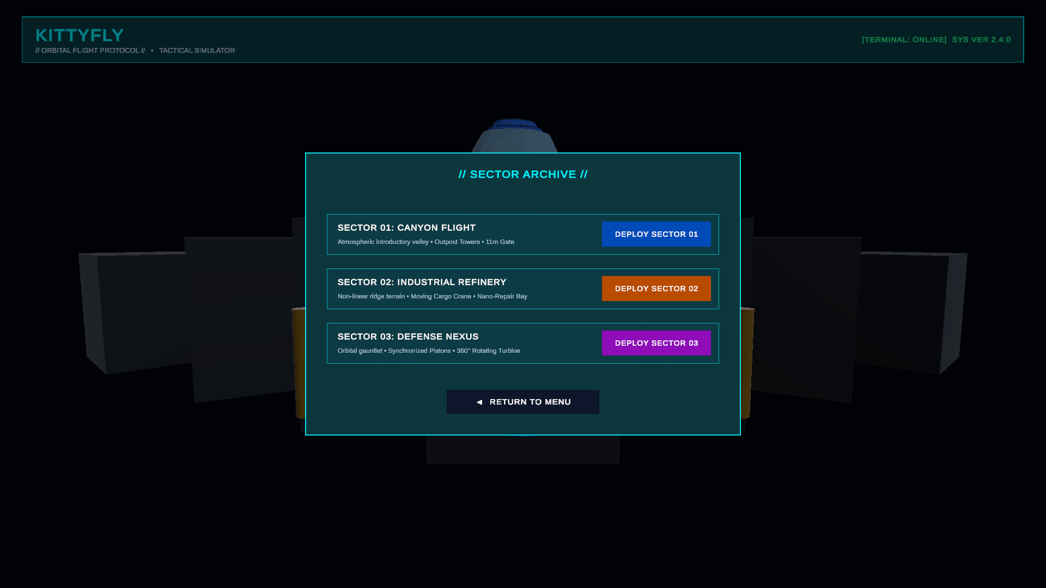
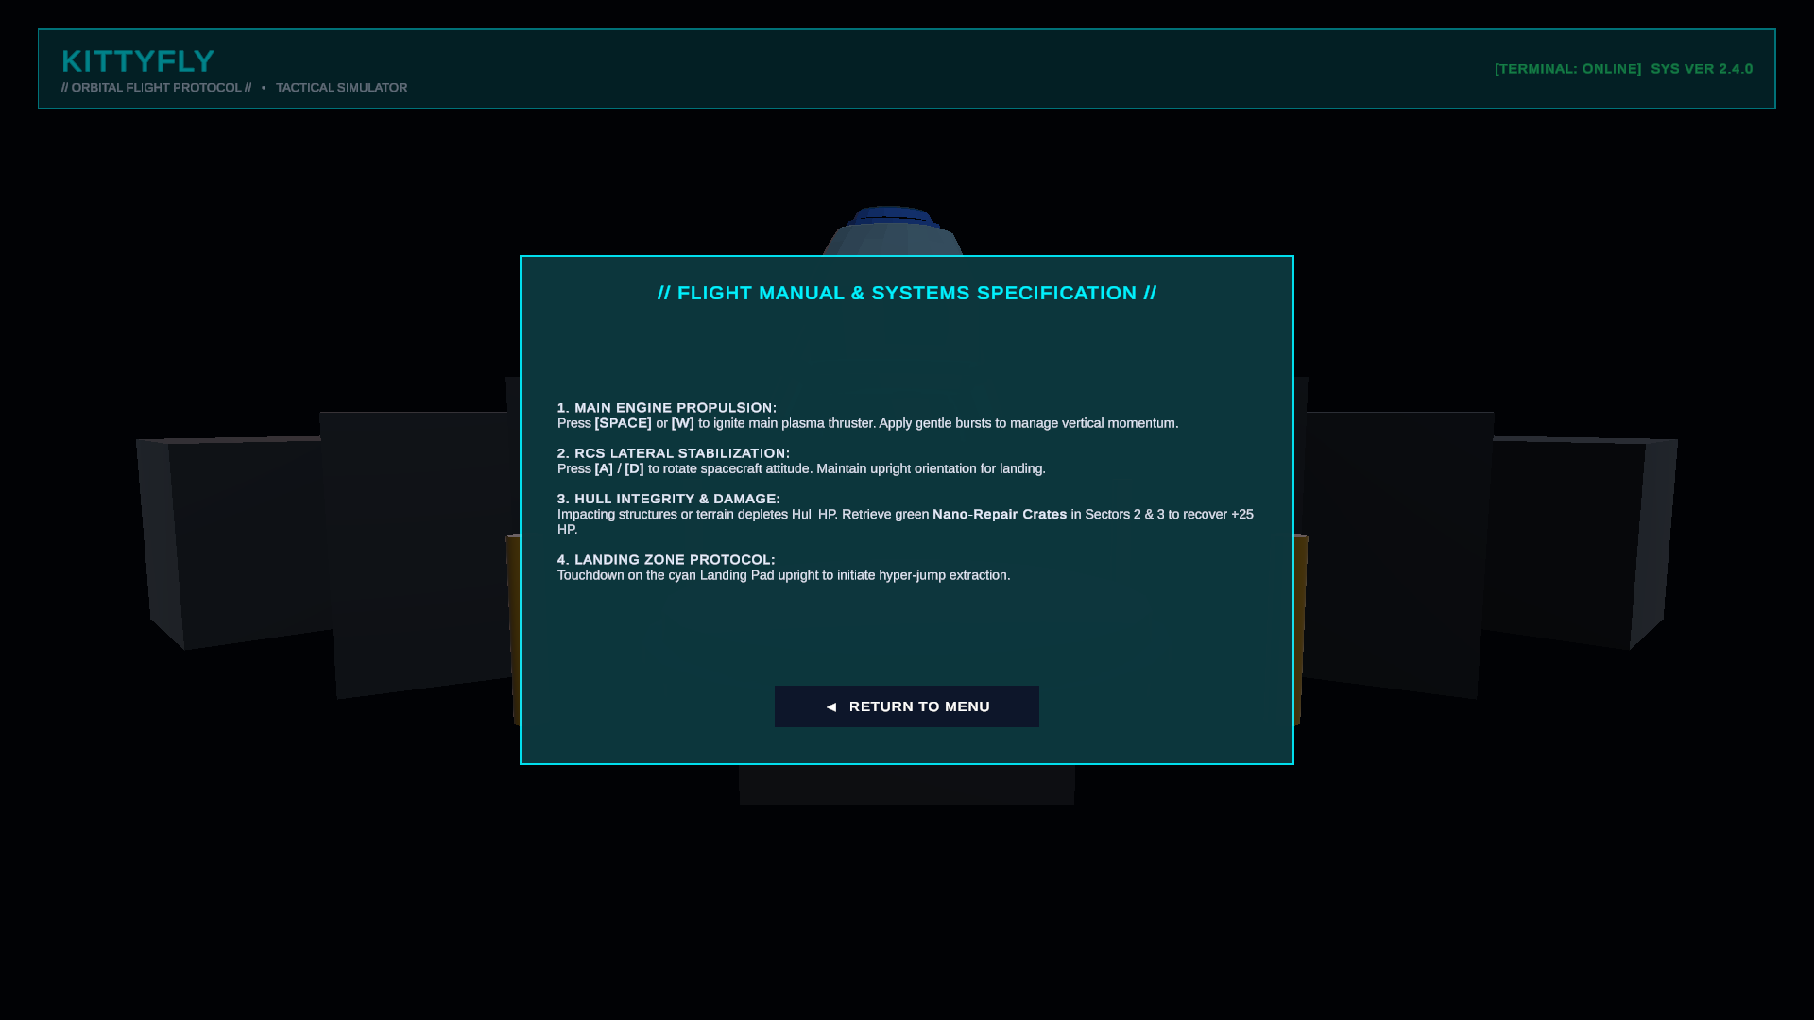
USER EXPERIENCE ARCHITECTURE
09/10
Sci-Fi Menu Suite & 3D Interactive Diorama
3D MAIN MENU DIORAMA
SECTOR ARCHIVE TERMINAL
FLIGHT MANUAL & CALIBRATION
Interactive 3D Stage
Features real-time floating spaceship with gentle idle levitation physics, glowing platform lights, and cyberdeck command button layout.
Direct Mission Selection
Instant jump access to unlocked sectors with real-time sector clearance badges, environmental previews, and hazard level ratings.
In-Game Pilot Handbook
Diegetic pilot handbook detailing key bindings, thruster heat management, and customizable audio/sensitivity calibration options.

Slide 10
SUMMARY & NEXT STEPS
10/10
Technical Architecture & Future Roadmap
TECHNOLOGY STACK & PERFORMANCE
STRATEGIC PRODUCT ROADMAP
• Unity 6 Engine & URP Pipeline
Leverages Universal Render Pipeline with Forward+ rendering and optimized post-processing bloom stacks.
• Zero Garbage Collection Overhead
Cached component references in Awake() and pre-allocated physics calls ensure silky smooth 120+ FPS flight.
• Cinemachine Dynamic Camera
Smooth follow camera tracking ship vector with slight look-ahead damping for cinematic velocity perception.
• Modular Component Architecture
Separated Movement, Health, Oscillator, SciFiHUDController, and SciFiMenuController scripts.
• Multi-Platform Ready
Decoupled input bindings and responsive Canvas scalers enable immediate porting to Mobile (iOS/Android) and Steam Deck.
► Phase 1: Immersive Spatial Audio
Dynamic engine sound pitch modulation matching throttle intensity, atmospheric wind shear, and metallic landing thuds.
► Phase 2: Mobile Port & Virtual Gyro
Dual on-screen thumbsticks with haptic vibration feedback for iOS/Android and Nintendo Switch touchscreens.
► Phase 3: Sector 04 & 05 Expansion
Gravitational anomalies (Black Holes / Pulsar storms), laser tripwires, and anti-aircraft missile defense turrets.
► Phase 4: Global Leaderboards & Ghost Racing
Asynchronous ghost recording system letting pilots compete worldwide for fastest clean-flight extraction times.

