Slide 1
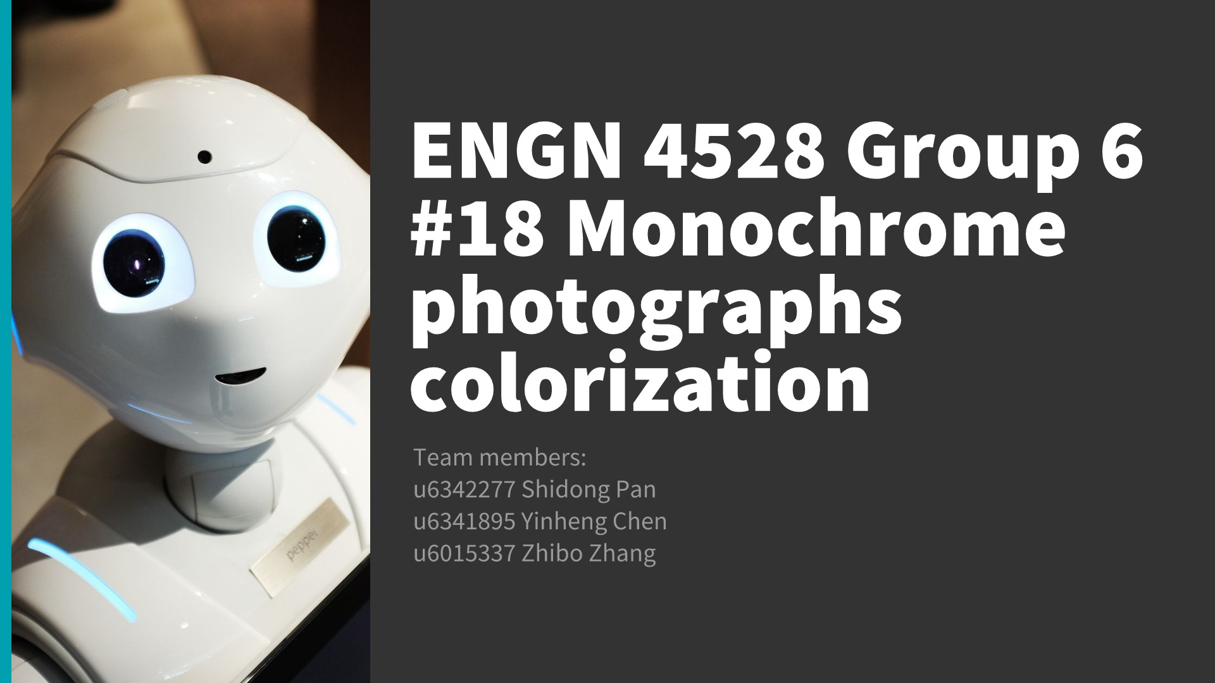
Notes:
its my honour to do this presentation today to introduce our group work--- colorisation. Before I start,

Slide 2
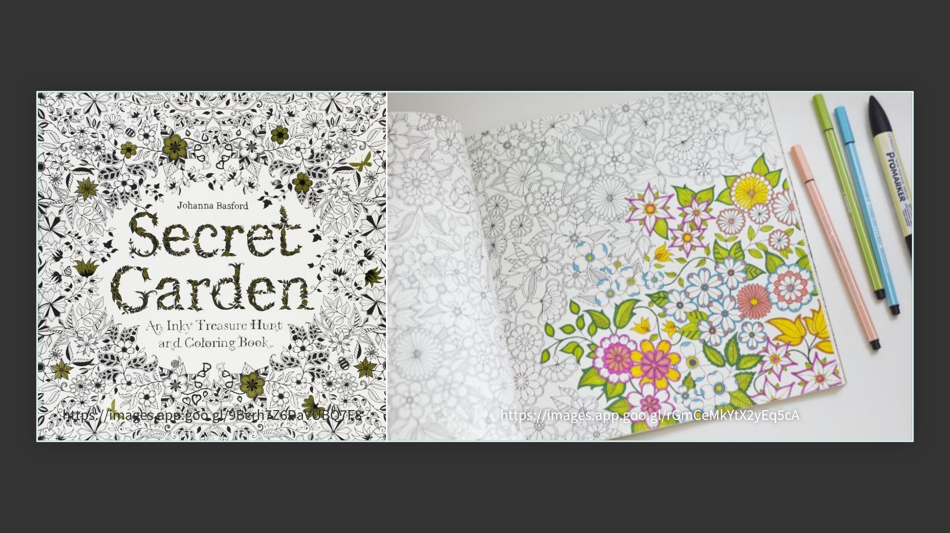
Notes:
Good morning class, I'm Shidong, I believe most of you have heard this "magic" book --- Secret Garden. It's a book about colouring. You can use your colourful crayons to fill the blank part of those images, completing your own work of art. its my honour to do this presentation today to introduce our group work--- colorisation. Before I start,

Slide 3
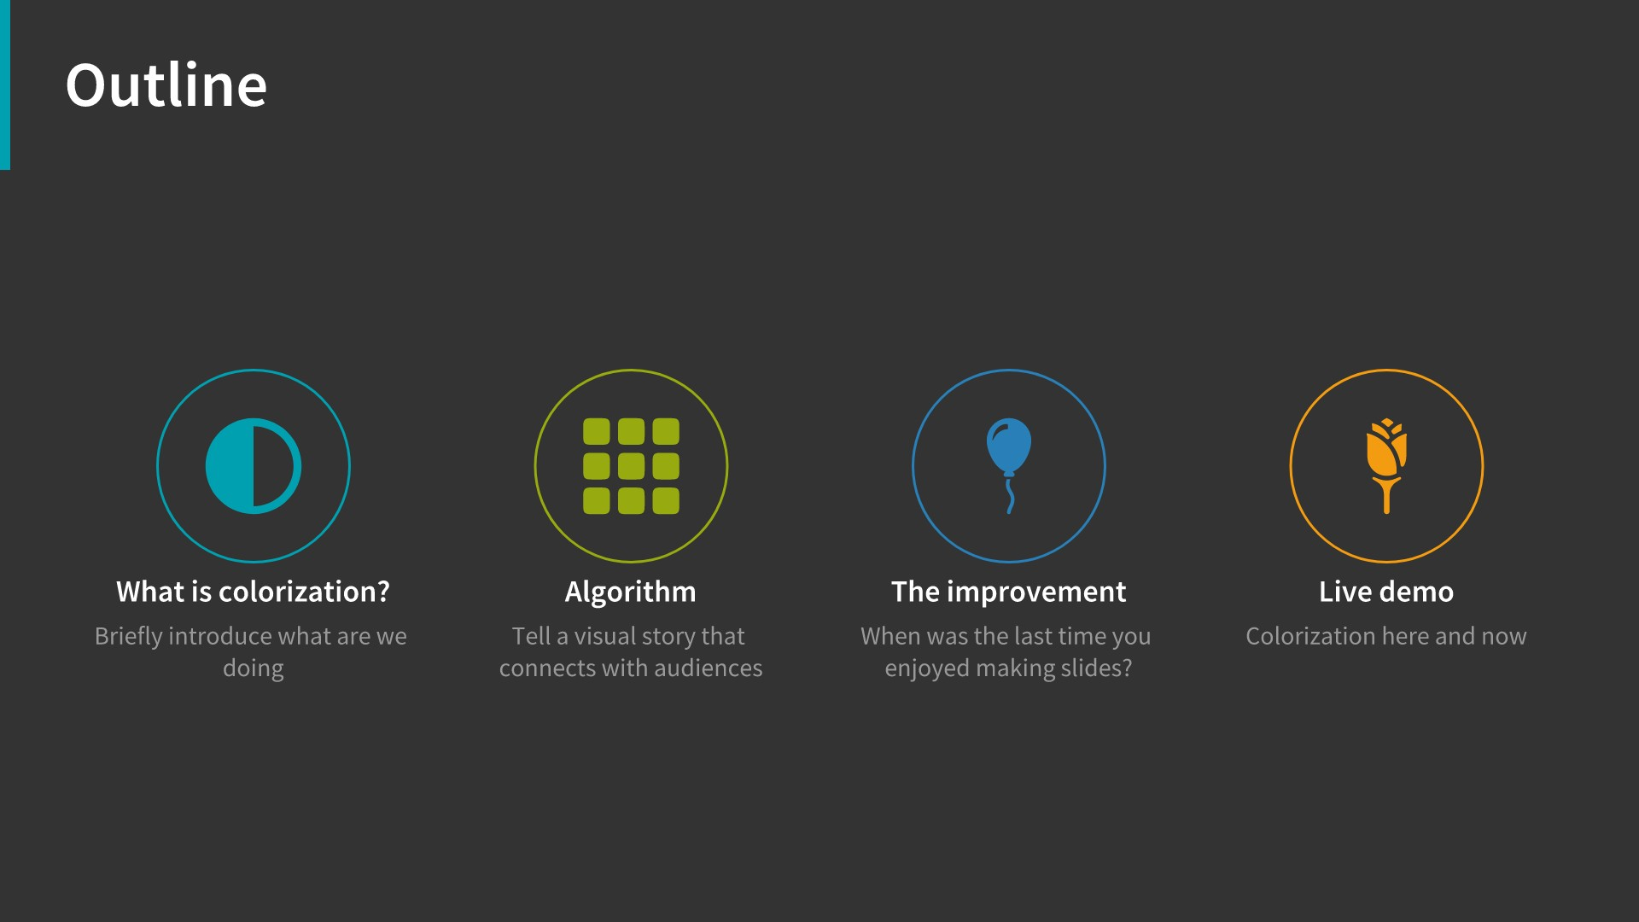

Slide 4
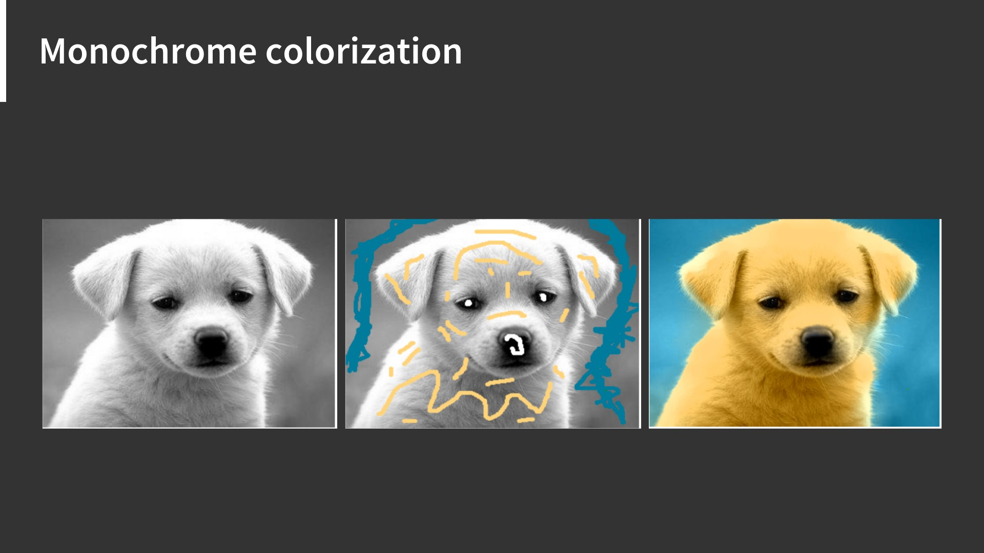

Slide 5
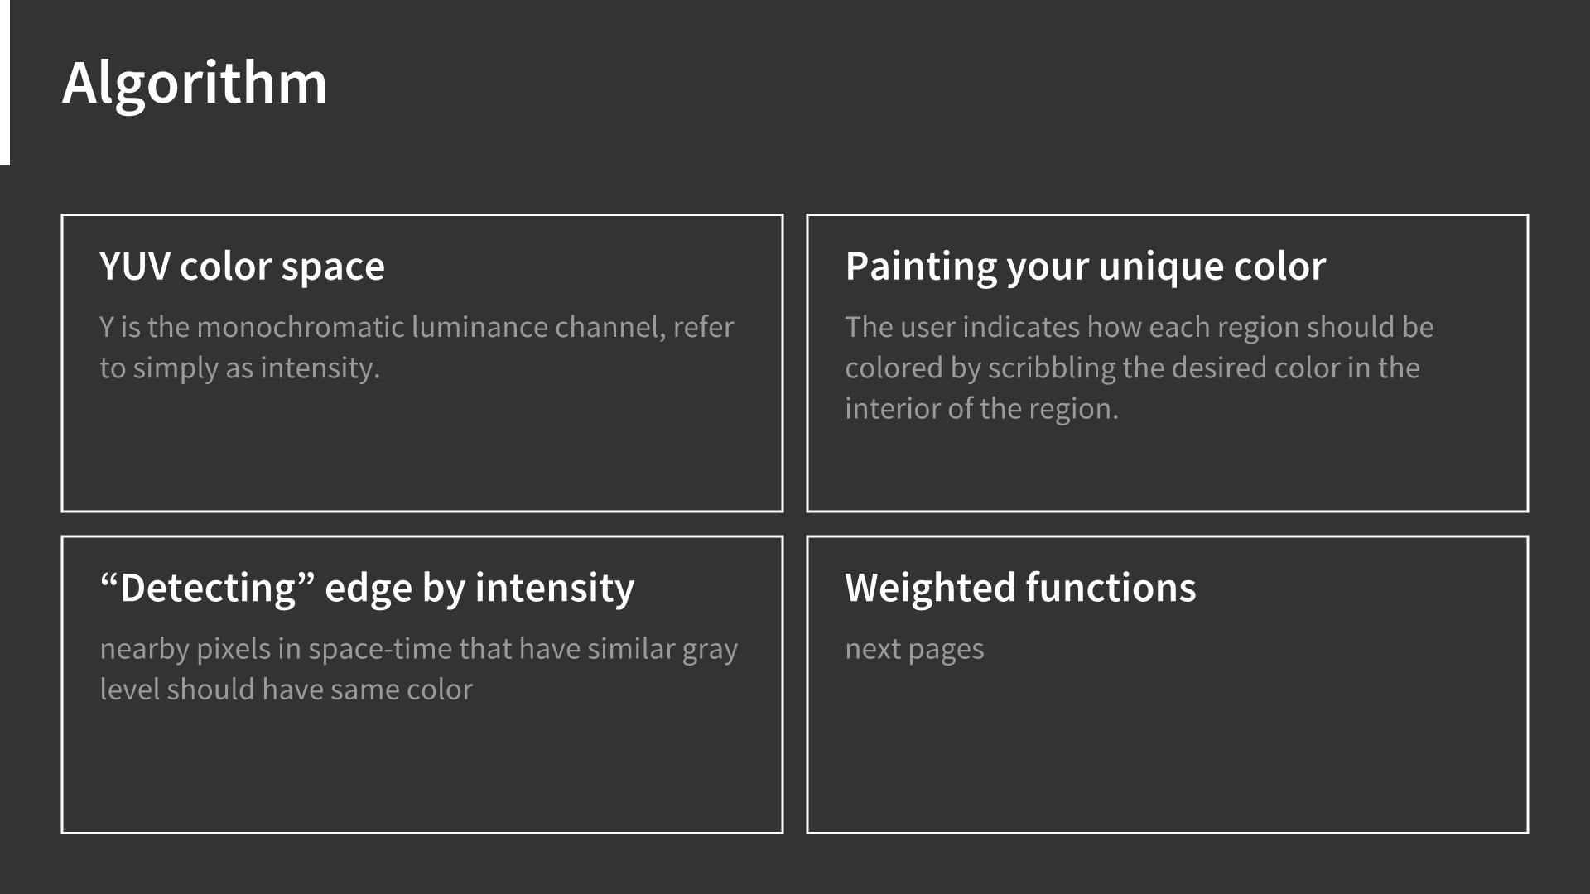

Slide 6
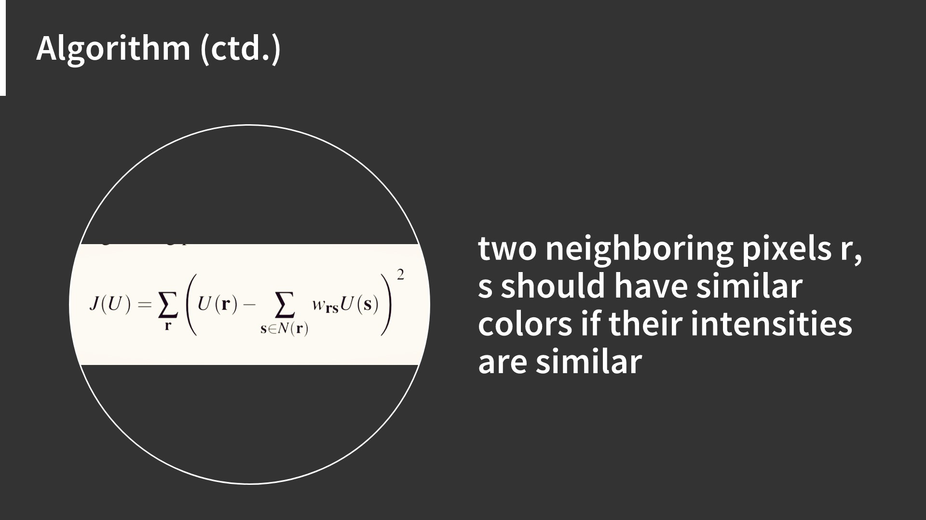

Slide 7
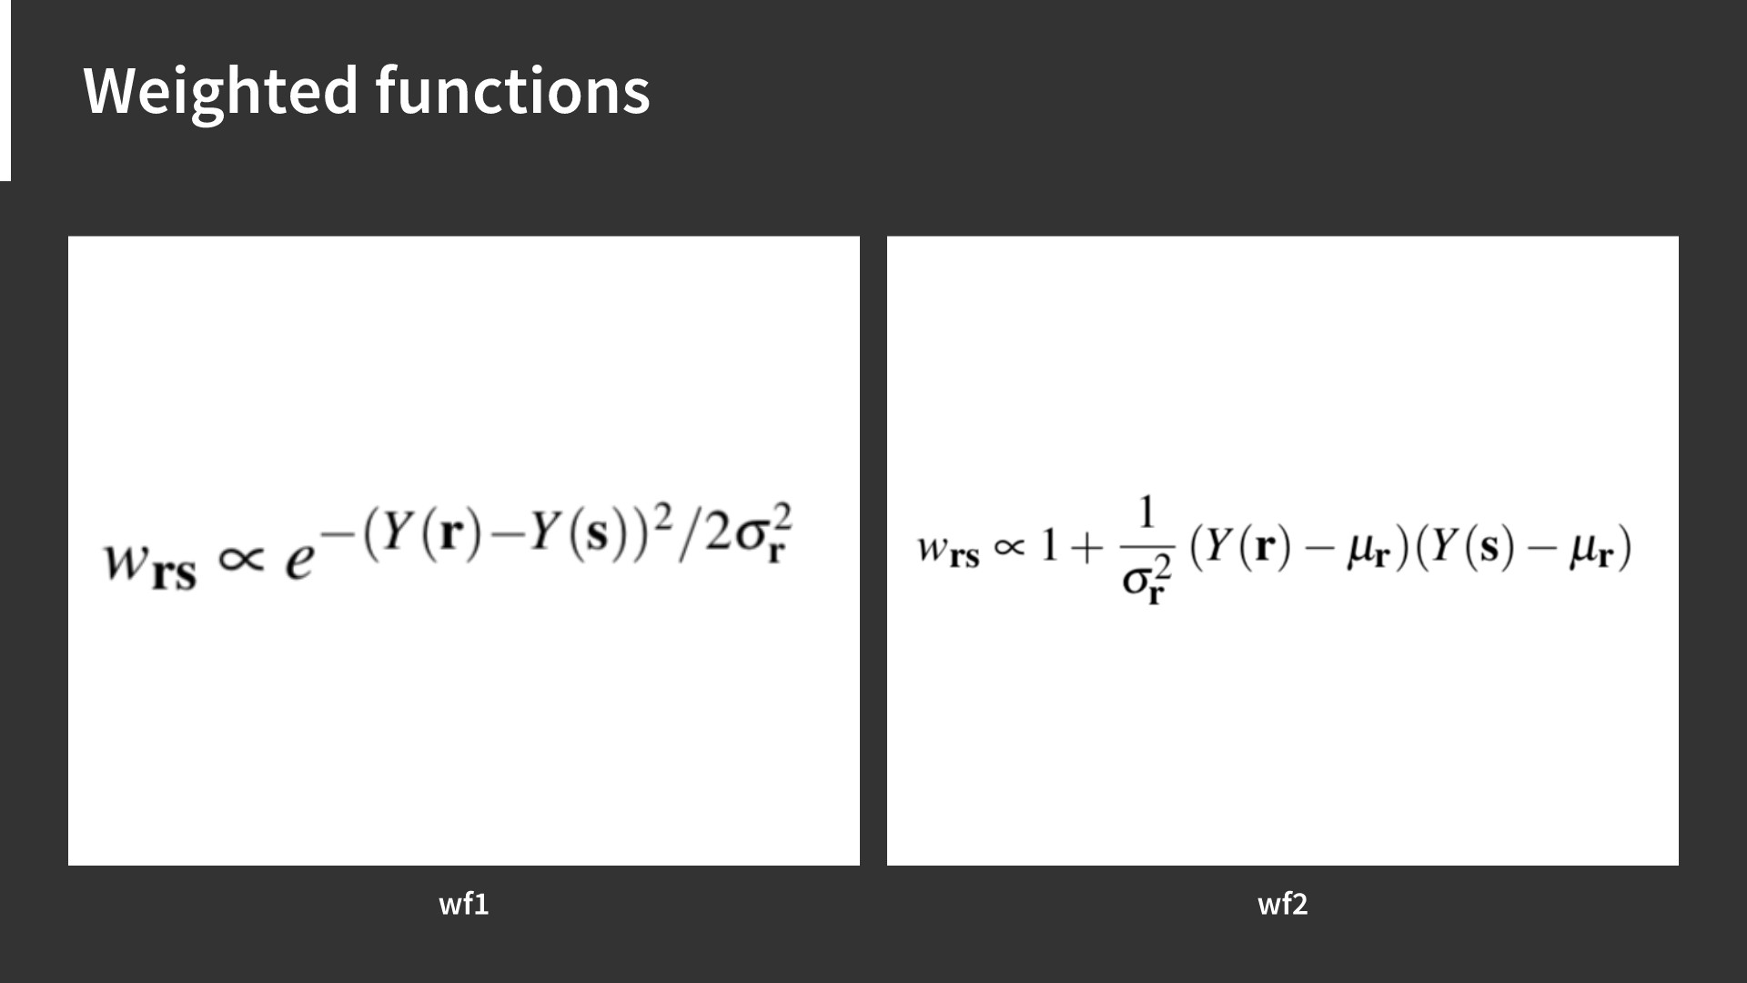

Slide 8
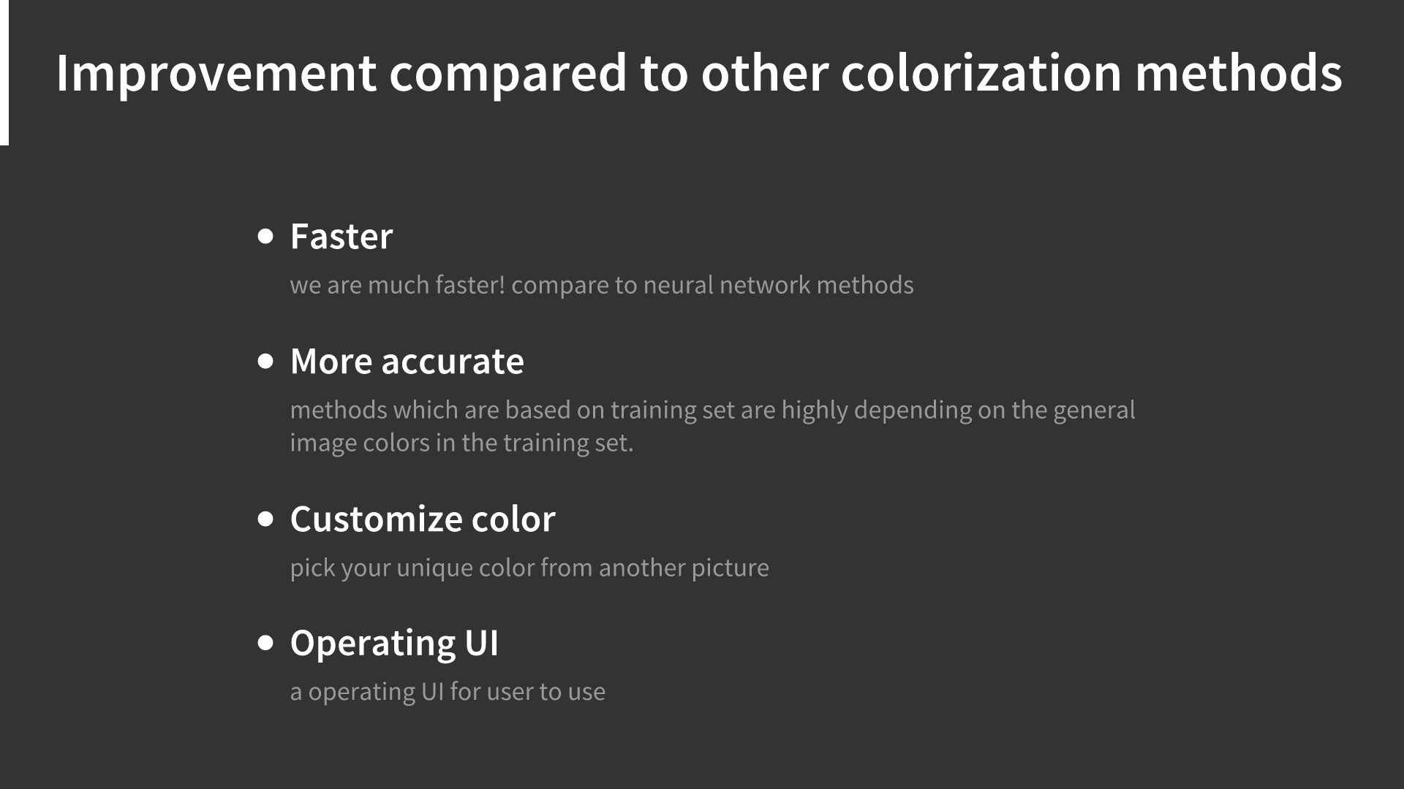

Slide 9
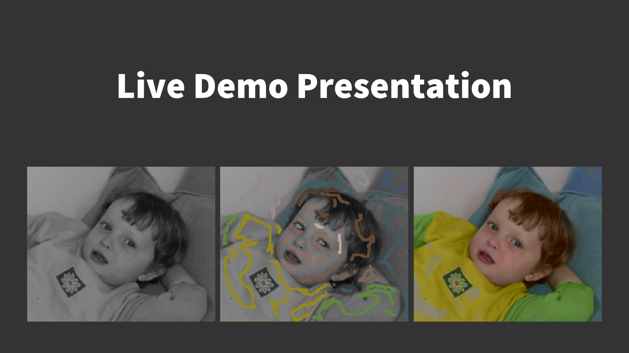

Slide 10
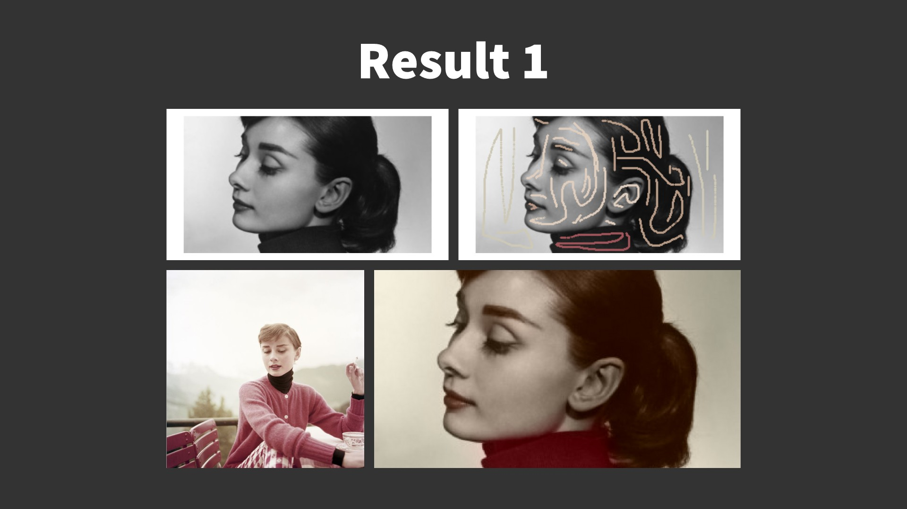

Slide 11
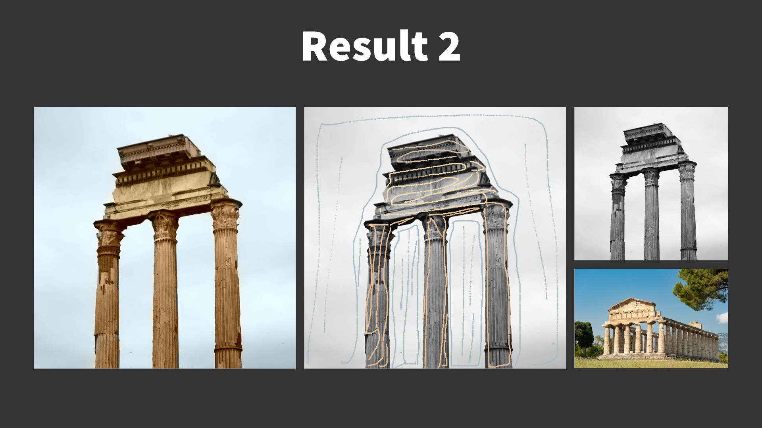

Slide 12
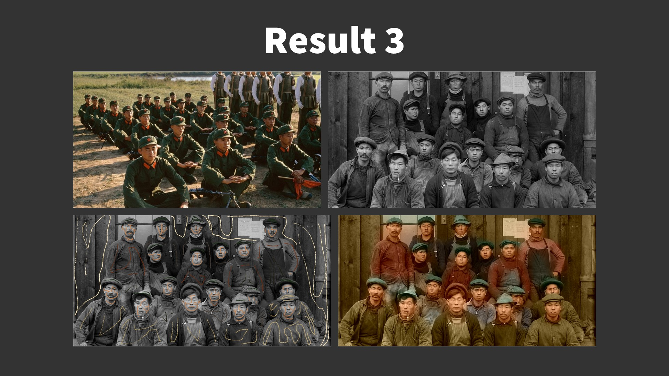

Slide 13
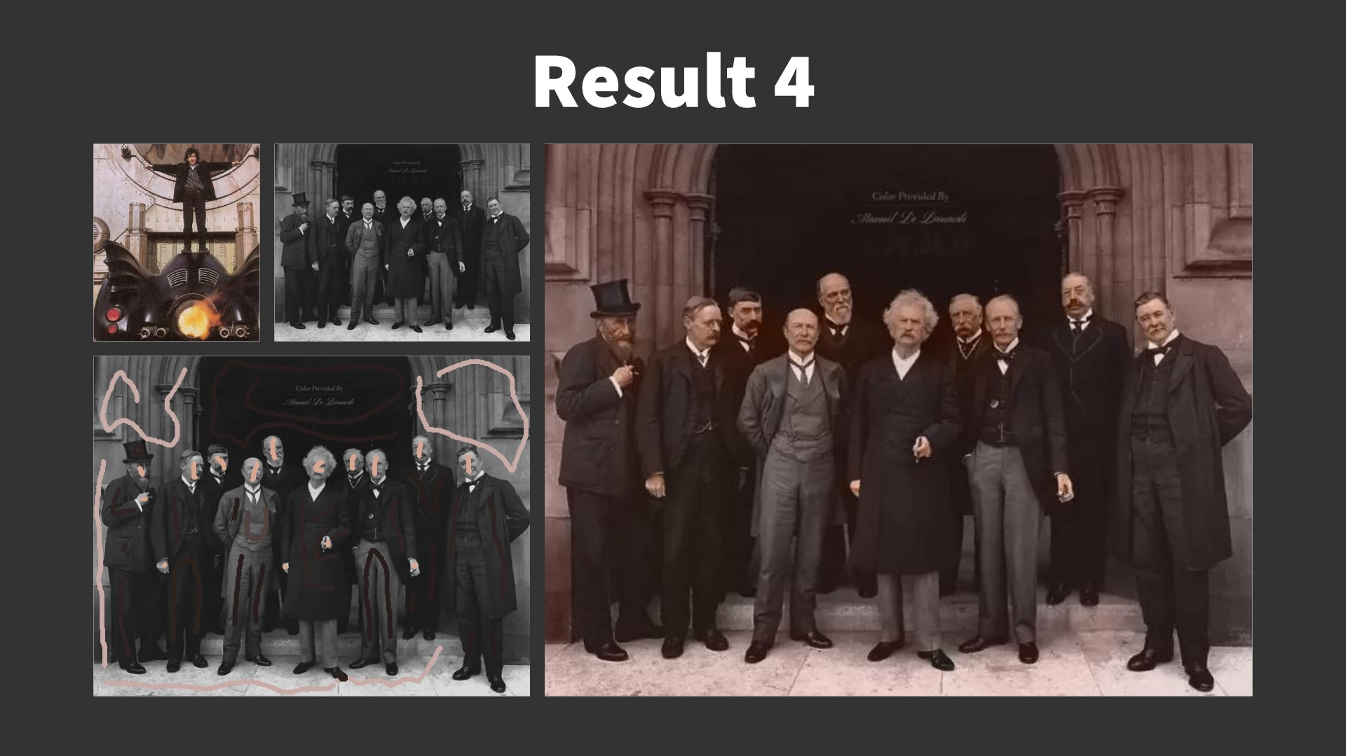

Slide 14
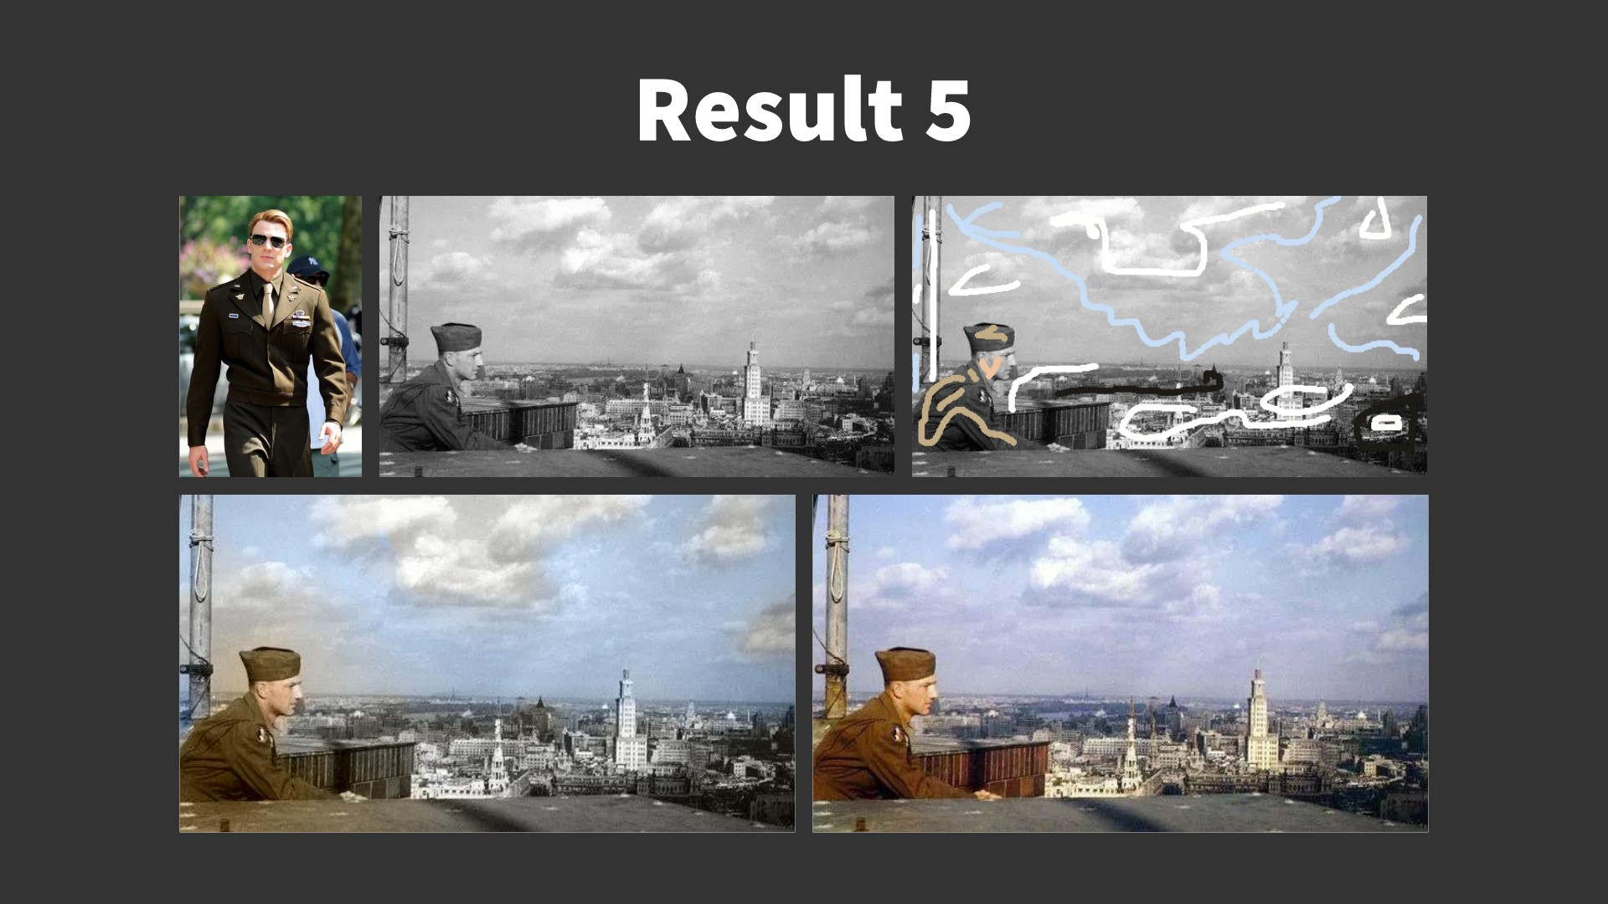

Slide 15
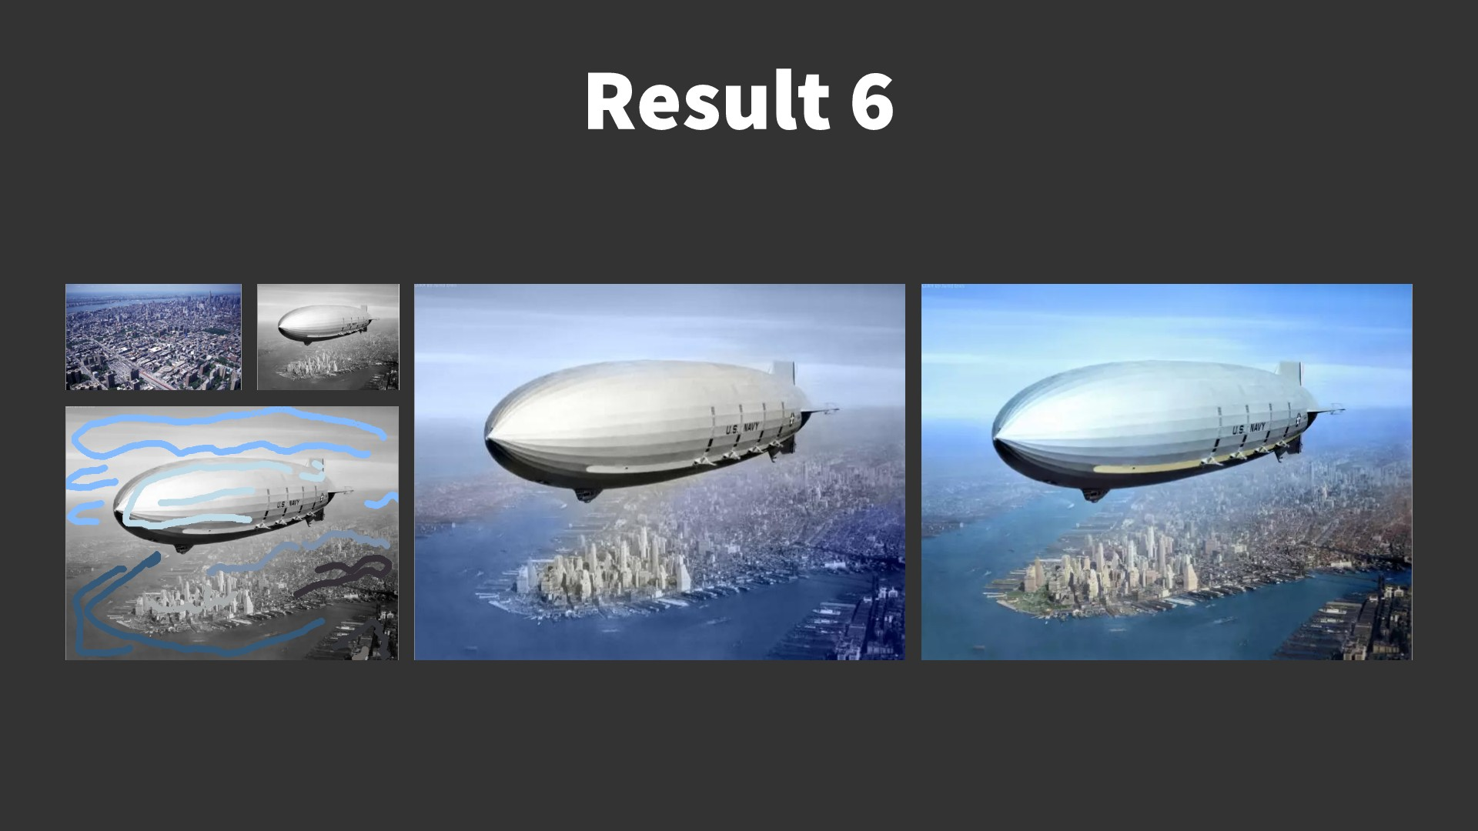

Slide 16
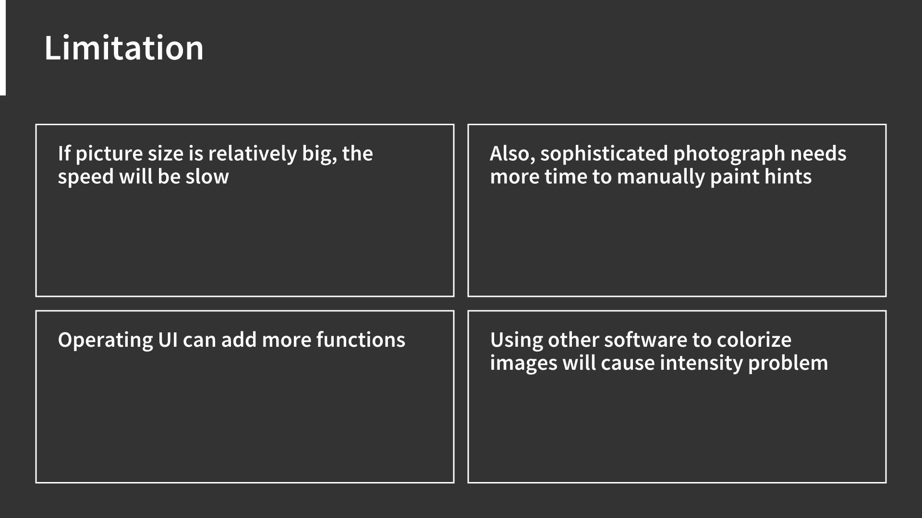

Slide 17
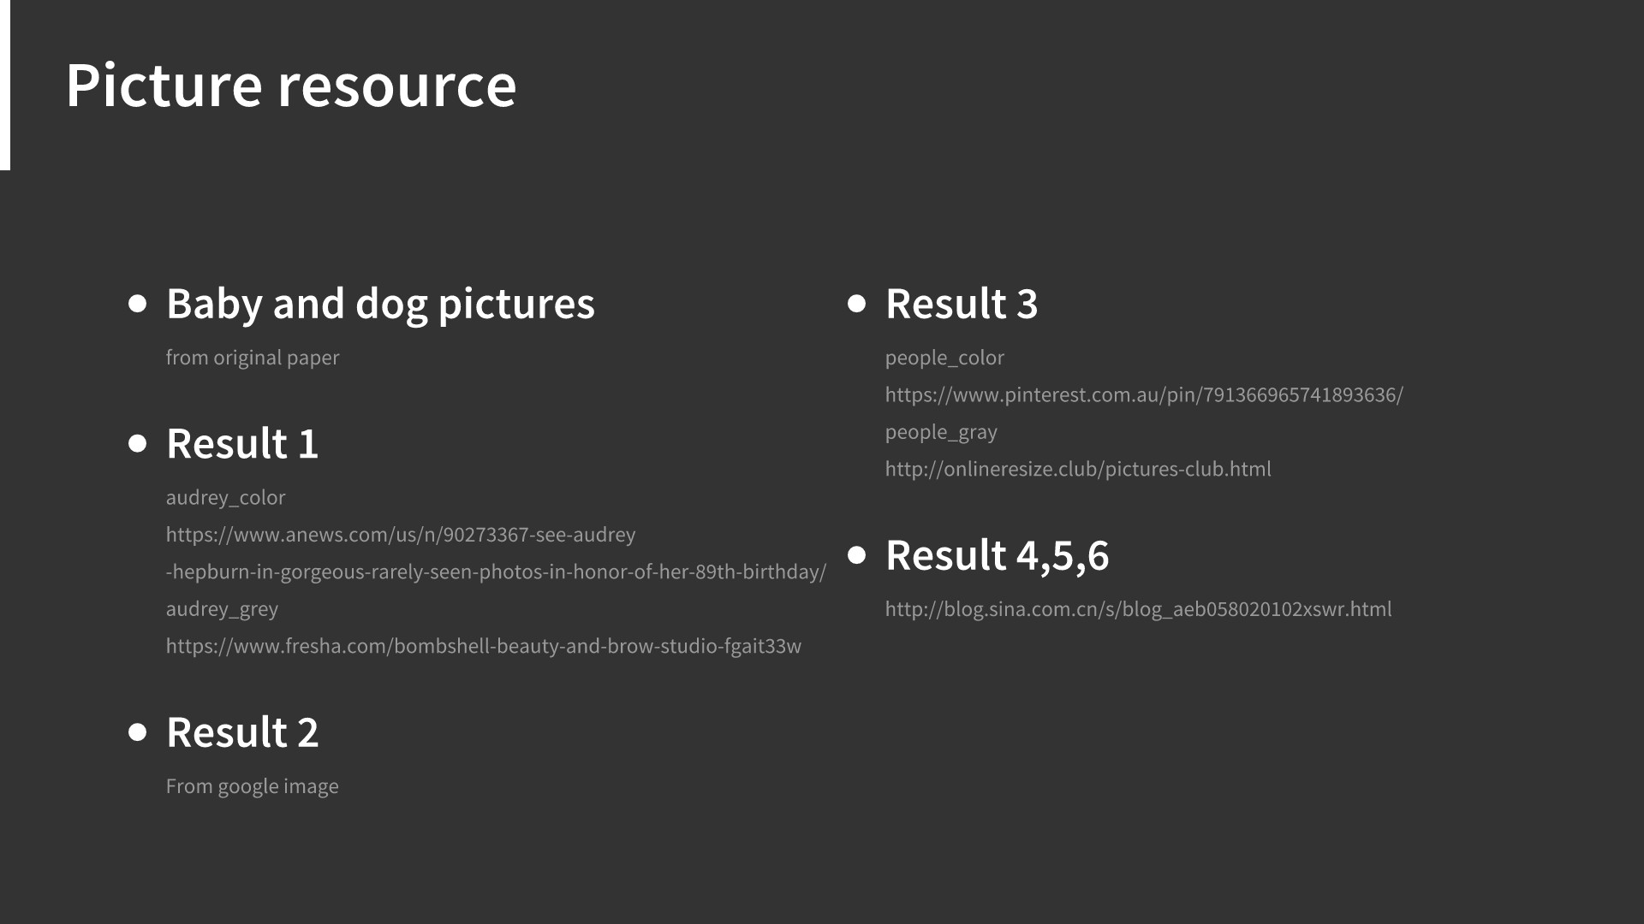

Slide 18


