Slide 1
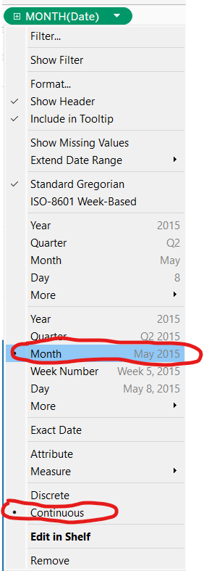
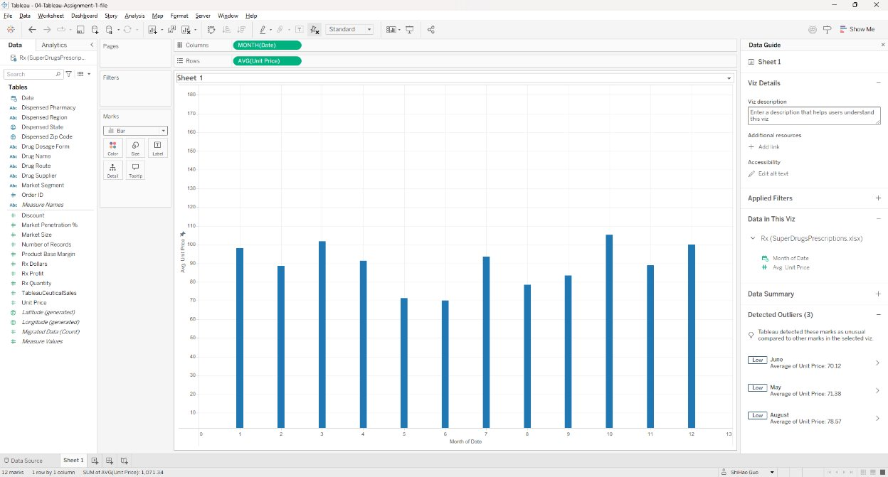
04-Tableau Assignment 1 – Chart 1
The “04-Tableau-Assignment-1-file” tableau file is prepackaged with sales information of fictitious Pharma company. Open that file in Tableau and do the assignments in these two slides.
Create a Bar chart with average prescription price over time by Month . Use Unit Price field for rows and Date field for Columns. Select Month and Continuous as highlighted in the sample picture. Insert a screenshot of the Chart below:

Slide 2
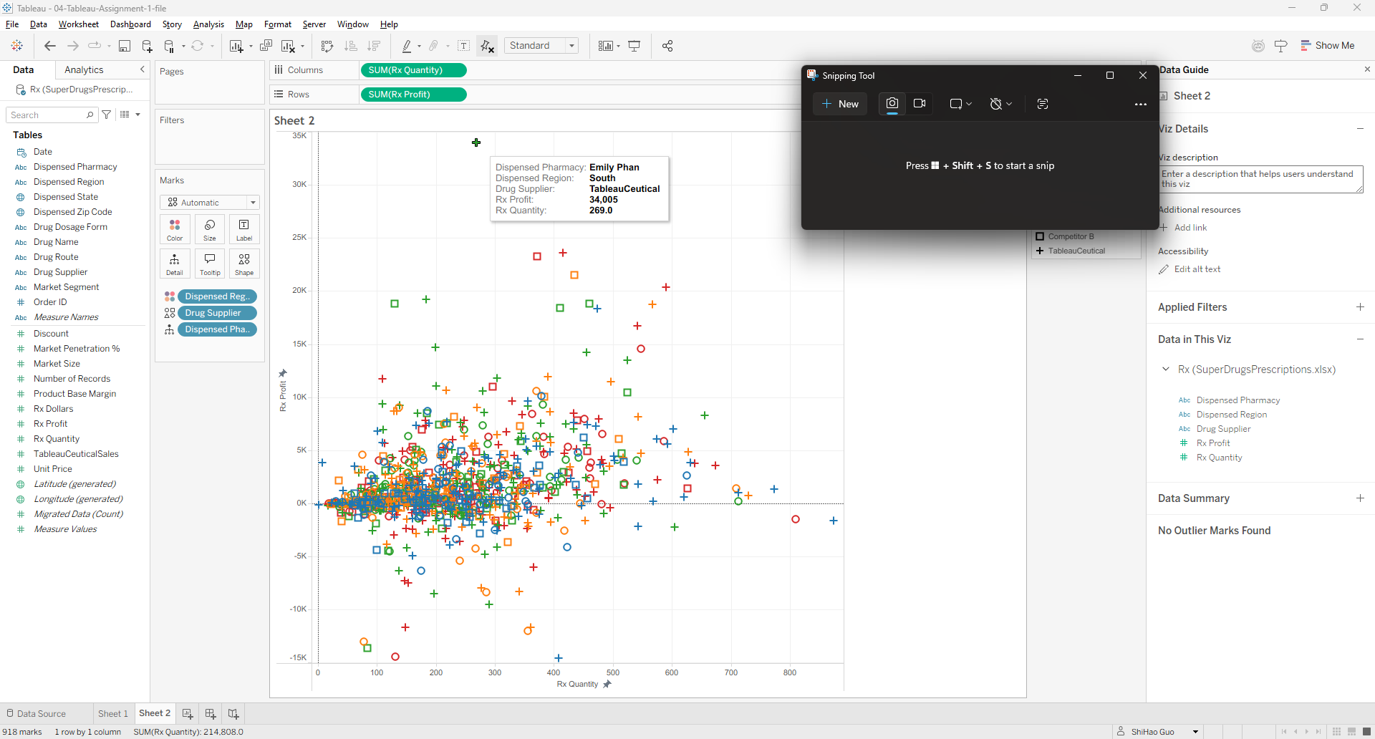
04-Tableau Assignment 1 – Chart 2
Use the same Tableau workbook and create a new sheet do this task. Add your Answers next to questions and Save file with your first and last name and upload into Canvas - 04 Tableau Assignment 1.
Create a visualization with prescription quantity in columns and profit on rows. Use Dispensed Region for Color, Drug Supplier for Shape and Dispensed Pharmacy for Detail mark. Insert a screenshot of the Chart below:
Answers to the questions are on the next slide...

Slide 3
Question and Answers
Use the above viz and answer the following:
What pharmacy and drug supplier represented the highest profit mark on this viz, across all regions? Emily Phan + TableauCuetical
What pharmacy and drug supplier represented the highest profit mark on this viz in the East region? Grant Carroll + Competitor B
What pharmacy and drug supplier represented the least profit across all regions? Dave Kipp + TableauCuetical

