Slide 1
04-Tableau Assignment 2
The “04-Tableau-data-file-assignment-2-Coffee Chain Sales.xslx” Excel file contains Sales data of a Coffee Chain. The file has three Sheets each for Product, Location and FactTable (like 3 tables in a SQL database). Get the data from this Excel file into Tableau by joining the FactTable to Product and Location. Then create necessary visualizations to answer these questions. Add additional Slides as needed.
Questions and answer next slide...

Slide 2
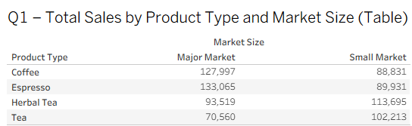
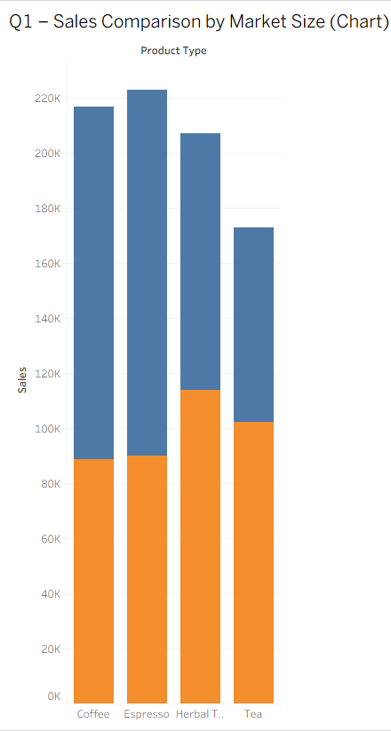

Q1.) Your manager is interested in finding out if total sales by product type is affected by market size? Please create a report showing that. Show it both as a table and as a chart. What type of chart did you use? Why?
This table shows total sales for each product type across different market sizes. Sales vary by market size, showing that market size has an impact on product performance.
I used a clustered bar chart because it clearly compares sales across categories.
The chart shows that sales differ significantly between small and major markets.
Major markets generate higher sales due to larger customer bases.

Slide 3
Q2.) Which product types are doing better in small markets vs. large markets? Why do you think this is the case?
The bar chart shows the total sales for each product type for small and major markets. Coffee sales (127,997) and Espresso (133,065) are much higher for major markets than for small markets. On the other hand, Herbal Tea (113,695) and Tea (102,213) are higher for small markets than for major markets.
This shows that customers in major markets prefer stronger coffee-based beverages. This may be due to the lifestyle of the people living in urban areas and their requirement for specialty coffee. On the other hand, customers in small markets prefer tea-based beverages.

Slide 4
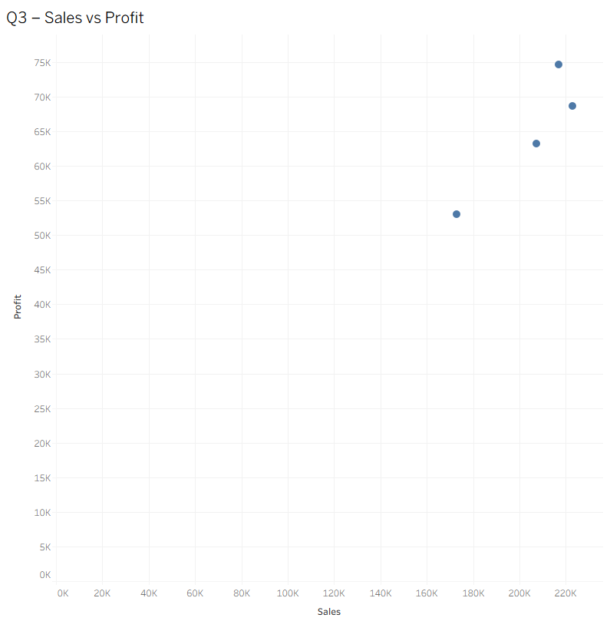
Q3.) How are the total sales related to total profit by product type? Which product type has the highest profit vs. highest sales?
The above figure is a scatter plot that shows a comparison of total sales and total profit in relation to product types. The product type that has the highest sales is Espresso, with a sales figure of 222,996. The product type that has the highest profit is Coffee, with a profit figure of 74,683.
This shows that although a product type may have the highest sales, its profit may not necessarily be the highest. For example, although Espresso has the highest sales, Coffee has a higher profit margin.

Slide 5
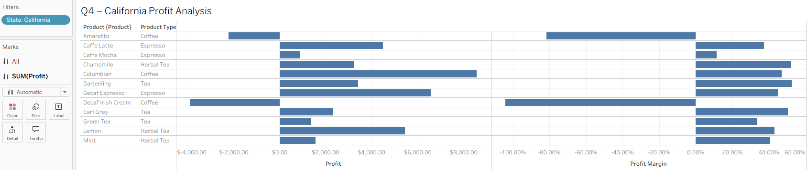
Q4.) You are interested in finding out more about business in California. Show the profit margin and profit by Product and Product type. In which product/type the company is losing money in
California?
This analysis focuses on profit and profit margin for products and types of products in California. Most products make positive profit and have healthy margins in California.
However, Decaf Irish Cream (Coffee) is making negative profit in California, with a significantly negative profit margin. This shows that the product could be priced too low, with high production costs or low demand in this market.
The company should conduct further analysis on cost structure, pricing, or demand for this product in California.

Slide 6
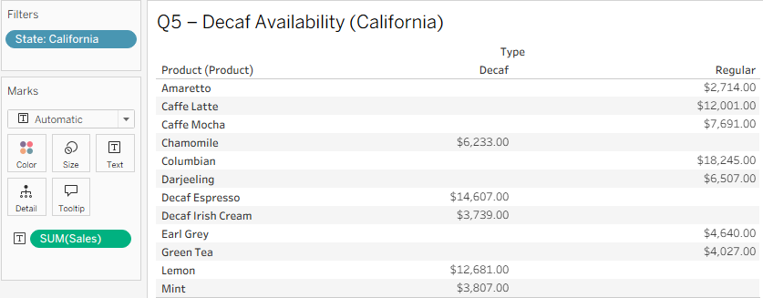
Q5.) Which Products are not available in decaf in California? Which products are only available in decaf (“Type” is the dimension for decaf and regular)
The above table shows the availability of products based on type, i.e., Regular vs. Decaf.
The products that are not available in decaf are Amaretto, Caffe Latte, Caffe Mocha, Columbian, Darjeeling, Earl Grey, and Green Tea.
The products available in decaf are Chamomile, Decaf Espresso, Decaf Irish Cream, Lemon, and Mint.
From the above information, it can be concluded that coffee-based products are available in regular flavor, while herbal-based products are available in decaf flavor.

Slide 7
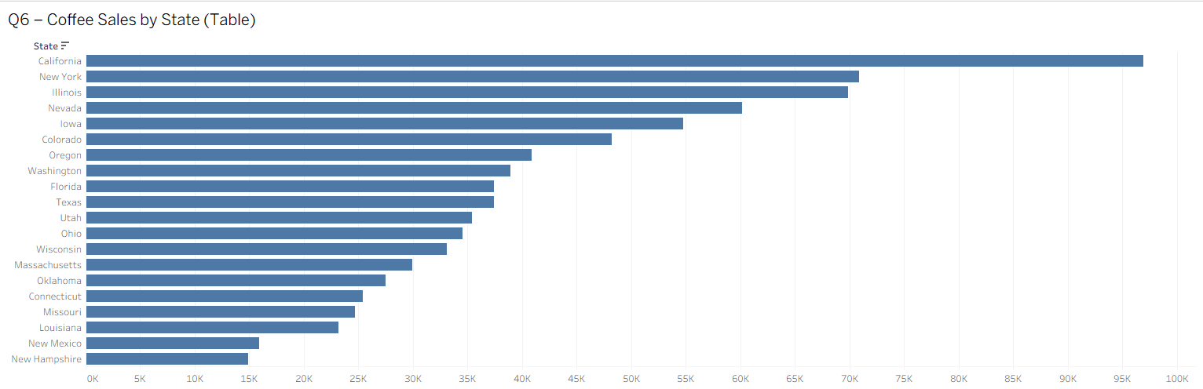
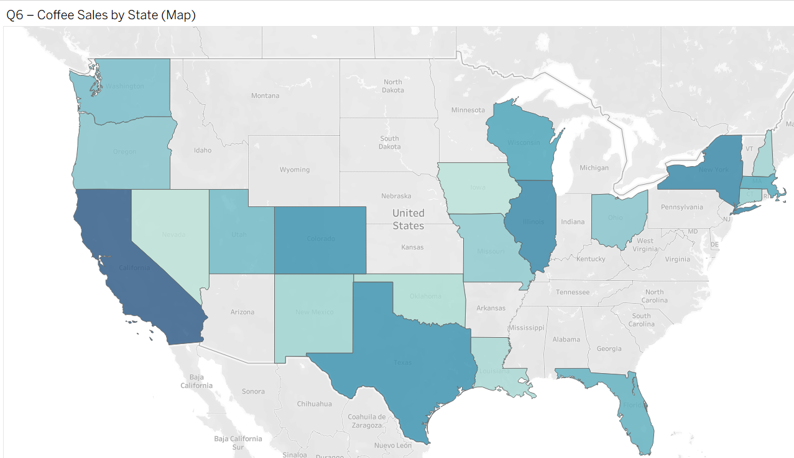
Q6.) Product manager responsible for coffee is interested in sales of coffee across all the states. Which state has the highest coffee sales? Show it on a geo graph and a table. From the geo
graph, can you identify the top 5 states for the highest coffee sales?
The state with the highest coffee sales is California.
The top five states for coffee sales are:
California
New York
Illinois
Nevada
Iowa
These states are likely to generate more coffee sales because of their large population, density, and demand for coffee products.

Slide 8
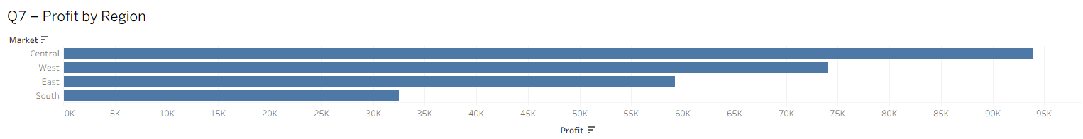
Q7.) Look at Profit by Regions (Market) by product group and Type. Can you identify a region with negative Profit? Can you drill down and find out what is causing it? Find out which product
and which state is causing negative sales?

Slide 9
Q8.) Can you find anything that is interesting that you can share with your group that may be important to the business?
No

