Slide 1
Fix Director for Automated Program Repair
Juhyoung Kim and Eunseok Lee
SungKyunkwan University, Republic of korea

Slide 2
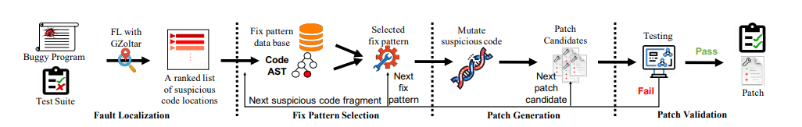
Basic Process of template based apr
The most effective APR tools TBar process
Kui Liu, Anil Koyuncu, Dongsun Kim, and Tegawendé F. Bissyandé. Tbar: Revisiting template-based automated program repair. In Proceedings of the 28th ACM SIGSOFT International Symposium on Software Testing and Analysis, ISSTA 2019

Slide 3
Fix pattern match of TBar
Traverse each node of the suspicious statement AST from its first child node to its last leaf
Match each node against the context AST of the fix pattern
Ex) conditional expression -> Mutate conditional Expression fix pattern
Suspicious statement node
TBar fix the bug using structure of suspicious statement
Child node

Slide 4
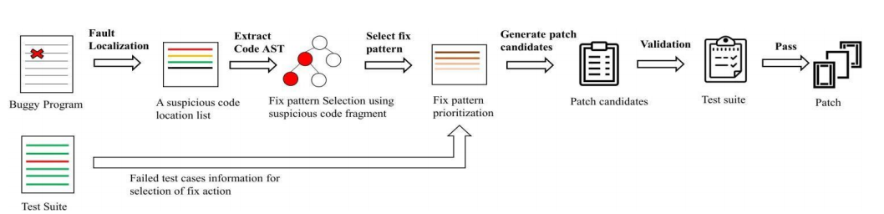
Fix director approach
To follow developer`s process, we use failed test cases information as a basis for choosing fix pattern

Slide 5
Error type
We match each Error type with fix pattern
Prioritize according to applicable fix patterns.
NullPointerException
AssertionFailedError : expected <number> but was <number>
AssertionFailedError : expected <type> but was <type>
IllegalArgumentException
ComparisonFailure
ArrayIndexOutOfBoundsException
ClassCastException
IllegalFieldValueException

Slide 6
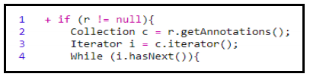
Example
Faulty code from Chart-4
Without fix pattern prioritization
Fix pattern order
Variable replacer(69 candidate patch generated) -> Nullpointerchecker Insertion(70th candidate patch is correct)
With fix pattern prioritization using NullPointerException
Fix pattern order
Nullpointerchecker Insertion first
As a result, without fix pattern prioritization apr tool generate correct patch in the 70th .
Otherwise with fix pattern prioritization APR tool generate correct patch in the 1st

Slide 7
Evaluation
we select the Defects4J dataset as the evaluation benchmark
We implement experiments in two ways
1) reimplementation of TBar
2) implementation of TBar with prioritization process
We record the rank that first correct patch is found.
René Just, Darioush Jalali, and Michael D Ernst. 2014. Defects4J: A database of existing faults to enable controlled testing studies for Java programs. In Proceedings of the 23rd ACM SIGSOFT International Symposium on Software Testing and Analysis. ACM,

Slide 8
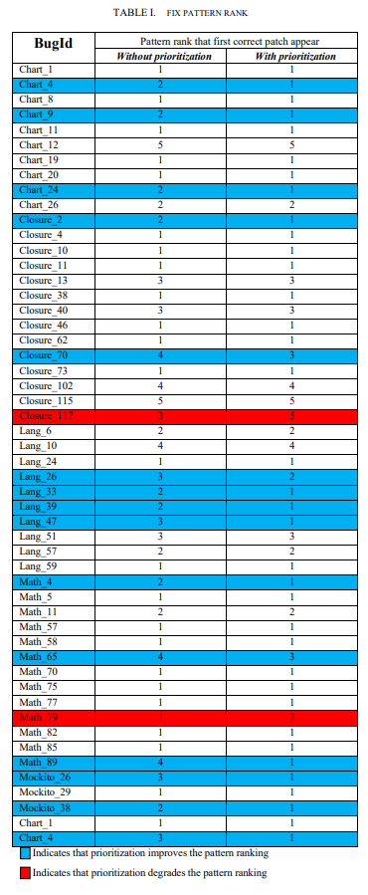
Evaluation
Indicates that prioritization improves the pattern ranking
Indicates that prioritization degrades the pattern ranking
Rank 1 Means : There is a correct patch first fix pattern APR tool take
Rank 6 Means : APR tool fails for the 5 fix patterns applied and succeed with the 6th fix pattern.
15 bug improvements, 2 bug degradations

Slide 9
Limitation and Future work
There are more error messages that need to be classified , because there are various error types that we don`t deal with.
Failed error messages don`t explain all of cause of bugs
We need more sophisticated technology to properly identify the cause of bugs.

