Slide 1


APR - About our position and section
11/22/2019 2014311373 성균관대학교 전자전기공학부 허진석
11/22/2019 2019712383 성균관대학교 소프트웨어학과 김주형
Notes:
전체적인 양식은 금요일날 한번더 수정하겠습니다~
글꼴은 나눔명조 사용했어요
1

Slide 2
0 | Contents
Introduction of APR
APR’s process
Our process
Limitations.
2/28
Notes:
한계점을 영어로 뭐라 할까요?..
2

Slide 3
1 | Introduction
Why Automated Program Repair(APR)?
Debugging software failures is still a painful, time consuming, and expensive process.
There are many factors contributing the the cost of debugging, bug the most impacting one is the extensive
For reducing these effort and cost, automation of debugging is actively studied.
Goal of APR
Generating correct(valid) patch
3/28
Notes:
아무래도 당연히 연구해야할 분야이니 특장점을 생략하고 간단히 목표를 넣음
활발히 연구되고 있다. 를 영어로 자연스럽게 부탁드립니다.
3

Slide 4
2 | APR Process
Overall process of APR
Fault localization(FL)
Find a location where bug might be.
Patch generation
It generates candidate patch for bug
Patch validation
It Checks the patch valid or not
Fault
Localization
Patch
Generation
Patch
Validation
4/28
Notes:
4

Slide 5
2 | APR Process
FL
Goal
Find buggy location
Common input
Buggy program
Common output
suspicious statement
5/28
Notes:
5

Slide 6
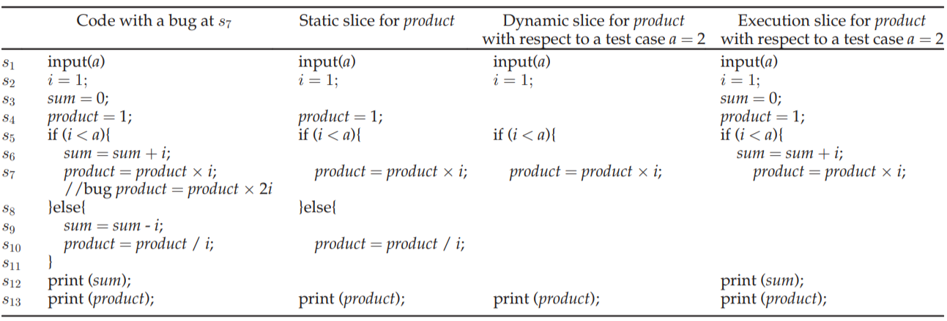
2 | APR Process
FL Technique : Too many techniques...
Slice-based technique
Using program slicing.
Program slicing : a technique to abstract a program into a reduced form by deleting irrelevant parts such that the resulting slice will still behave the same as the original program with certain specifications.
6/28
Notes:
Program slicing 정의를 다 설명하기 보다는 그림 예제를 토대로 설명할 예정
6

Slide 7
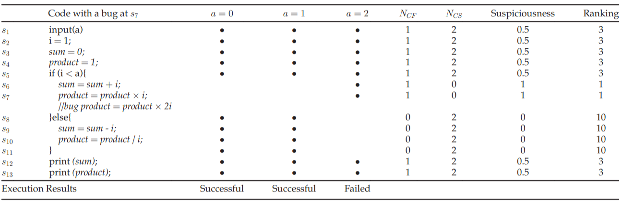
2 | APR Process
FL Technique
Program spectrum-based technique
Program spectrum details the execution information of a program from certain perspectives.
7/28
Notes:
스펙트럼은 if문 분기점에 대한 실행정보와 같은 특정 관점에서 프로그램의 실행 ㅈ어보를 자세히 설명한다.
7

Slide 8
2 | APR Process
Generating patch
Goal
Generating patch apply to buggy location.
Common Input
Buggy program
Suspicious statement
Common Output
Candidate patch
8/28
Notes:
8

Slide 9
2 | APR Process
Generating patch
Technique – G&V / Semantic based
Generate and Validate technique
A technique to generate and test patches by applying a specific operator to the buggy location that is the result of Fl and proceed until the desired number or desired patches are generated
The technique is broken down by operator type. → Atomic and template-based
Atomic change operator modifies a program in a single place of its abstract syntax tree.
Template based repair technique modify programs according to a set of change operators that can affect one or more statements
G & V Technique | Atomic change operator | Search-based
 |  | Brute-force
 | Tempalte based operator | Pre-defined | Search based
 |  |  | Brute-force
 |  | Example based | Search based
 |  |  | Brute-force
9/28
Notes:
9

Slide 10
2 | APR Process
Semantic based
Fault isolation
- Examines one buggy statement at a time from a ranked suspicion statements
Statement level specification inference
- Automatically discover the correct specification of the buggy statement
converting an expression to a non deterministic expression
Program synthesis
Use component based synthesis to synthesize an expression
Ex) SEMFIX, Angelix
10/28
Notes:
10

Slide 11
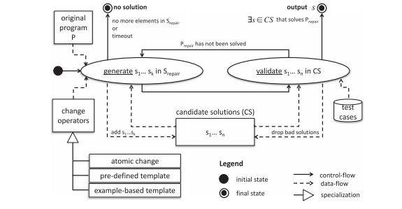
2 | APR Process
Validation
Generate-and-validate techniques
By running the available test cases,
- If a program s in the set of the candidate solutions passes all the available test cases,
the program s is returned to the developer as a possible fix for P
11/28
Notes:
11

Slide 12
2 | APR Process
Automated Test cases Generation.
Random Test Data Generation
- choose inputs arbitrarily until useful inputs are found.
- may fail because info about the test requirements isn`t incorporated.
Advantage
- Easy to implement, useful for small program , easily combine with other technique
Disadvantage
- It`s appropriate just for simple and small programs, similar observable behavior
Symbolic Test Case Generation
- Create algebraic expression for several constraints in program by assigning symbolic values to the variable for bug detection, verification
Dynamic Generation
Static test Generation
12/28
Notes:
12

Slide 13
2 | APR Process
Search Based
Problem of test case generation is considered as optimization problem and looking to find out best test set for class under test
Advantage
- Efficiency of approach reflected form its result
Disadvantage
- produce large search space
13/28
Notes:
13

Slide 14
2 | APR Process
Symbolic Test Case Generation
- Create algebraic expression for several constraints in program by assigning symbolic values to the variable for bug detection, verification
Advantages
- Also use for bug findings
Disadvantage
Scalability issues due to the large number of paths that need to be analyzed
Complexity of the constraints generated
14/28
Notes:
14

Slide 15
3 | Our Process
Position of us
Common part
Using patch history for ingredient of patch generation
Differect part
The way of generating patch
Template
Based
Patch
History
Candidate
Patches
Machine
Learning
15/28
Notes:
박스안을 키워드로 표현함
15

Slide 16
3 | Our Process
Example based Template – JinSeok Heo
Rather than predefine template, I prefer using template which extracted from patch history to immediately identify the type of the bug.
History-driven repair
It exploits information extracted from the history of several software projects.
PAR – manual analysis of more than 60,000 real world fixes
Relifix – focused on regression faults(similar approach to PAR)
I’m focused on create template immediately and add some idea
16/28
Notes:
16

Slide 17
3 | Our process
Machine Learning – JuHyoung Kim
Data driven
Learning based Repair
Learning from a corpus of code a model of correct code,
Infers code transformation templates from successful patches in commit histories
Not only part of the repair process, but trains models for end-to-end repair.
Predicts for a given buggy code the repaired code, without relying on any explicitly provided information.
Deepfix trains a neural network that fixes compilation errors, using a compiler as an oracle
Tufano(NMT) propose a model that predicts arbitrary fixes and train model extracted from version histories.
17/28
Notes:
17

Slide 18
3 | Our process
Machine Learning – JuHyoung Kim
Using learned information to recognize and prioritize potentially correct patches among all candidate patches.
Patches can be directly mined from existing sources
Ex) Sequence to sequence learning approach mostly used in machine learning approach.
Produce patches with tokens(mostly vocabulary).
But Limitation of maintaining context
Effective data control needed.
18/28
Notes:
18

Slide 19
4 | Limitation.
Automatic bug-fixing techniques that rely on a test suite don`t provide patch correctness guarantees, because the test suite is incomplete and does not cover all cases.
In test-suite based program, patches that pass the test suite, yet are actually incorrect(overfitting)
A weak test suite may cause generate-and-validate techniques to produce validated
But incorrect patches that have negative effects such as eliminating desirable functionalities(memory leaks)
Search space explosion, Large number of statements to change
- statements are large number of possible modifications.
19/28
Notes:
19

