Slide 1
SEQUENCER: Sequence-to-Sequence Learning for End-to-End Program Repair
Zimin Chen, Steve Kommrusch, Michele Tufano, Louis-Noël Pouchet, Denys Poshyvanyk and Martin Monperrus
IEEE TRANSACTIONS ON SOFTWARE ENGINEERING, VOL. TBD, 2019
2019 /12/04
Ju Hyoung Kim

Slide 2
〮 Introduction
〮 Background on Neural machine translation
〮 Approach To Using Seq-to-Seq Learning for repair
〮 Evaluation
〮 Ablation Study
〮 Related work
〮 Conclusion

Slide 3
〮 INTRODUCTION
- Focus on one line patches,
- Relying on machine learning to capture syntax and grammar rules
- Seq-to-Seq learning
- Copy mechanism
- Evaluation in two ways
1 Compute accuracy over 4,711 real on-line commits, curated from three open-source projects.
2 Apply SEQUENCER to the mainstream evaluation benchmar for program repair, Defects4J

Slide 4
〮 INTRODUCTION
- Major challenges to overcome when it comes to using seq-to-seq learning
1 The raw data is rather noisy
2 contrary to natural language, misuse of rare words fatal in programming languages.
3 The dependencies have a longer range
- Novelty
1 Create and share a unique dataset for evaluation learning techniques on one-line program repair.
2 Report on using the copy mechanism on seq-to-seq learning on source code.
3 SEQUENCER is able to produce the correct patch for 119% more sample
that the closest related work.

Slide 5
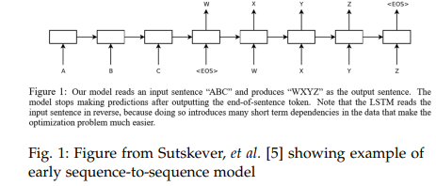
〮 Background on Neural machine translation
- Neural machine translation (Seq-to-Seq)
Problem with the sequence generation described above
Do not appear in the training vocabulary, but necessary for output.
-> Copy mechanism

Slide 6
〮 Background on Neural machine translation
- Copy mechanism
- Rare words not available in the vocabulary (<UNK>)
- may be directly copied from the input sentence
Ex ) “The car is in Chicago” to French.
-> “La voiture est a <UNK>”
-> “La voiture est a <Chicago>”
Model would be able to automatically replace the unknown token with one of the tokens from the input sentence.

Slide 7
〮 Approach To Using Seq-to-Seq Learning for repair
- SEQUENCER : seq-to-seq deep learning model to automatically fix bugs
by generating one line patches.
- Exclusion
-Line deletion
1 Not require a method for token generation
2 Could be combined with the other tool
- Line addition
1 Spectrum based fault localization, used in most of the related work, is not effective for line addition patches

Slide 8

〮 Approach To Using Seq-to-Seq Learning for repair
Buggy context Abstraction
-During bug-fixing activities, developers usually identify the buggy lines,
- Analyze how they interact with the rest of the method`s execution, and observe the context
SEQUENCER needs to balance two contrasting goals
1 reduce the buggy context into a reasonably concise sequence of tokens
2 Retaining as much information as possible to have enough context

Slide 9
〮 Approach To Using Seq-to-Seq Learning for repair
Buggy Line
<START_BUG> is inserted before the first token in the buggy line
<END_BUG> is inserted after the last token
Buggy Method
Remainder of the buggy method is kept in the representation.
Buggy Class
Keep all the instance variables and initializers
Model could use variables and method signatures as potential sources when building the fixed line

Slide 10
〮 Approach To Using Seq-to-Seq Learning for repair
Tokenization and Truncation
Truncation
Limit the abstract buggy context to a predetermined size
-> Allows SEQUENCER to process input files of arbitrary size without
running out of memory.
Process
1 Truncation size can most input files
2 If the buggy line itself is over the truncation limit,
as many tokens as possible line are included
3 Twice as many tokens are included before the line as after the line.
Ex) Truncation limit = 1000tokens, File = 5000tokens
100 tokens buggy line
Abstract buggy context will consist of 600 tokens before
300tokens after the buggy line.

Slide 11
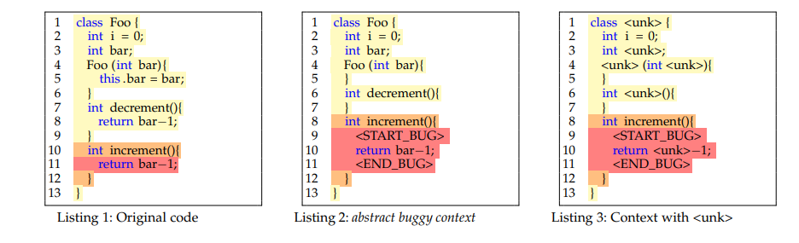
〮 Approach To Using Seq-to-Seq Learning for repair
When tokens that are out of vocabulary are replaced with the unknown token <UNK>.

Slide 12
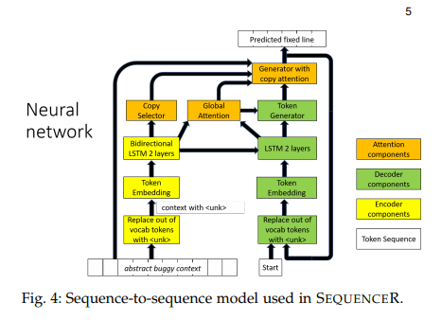
〮 Approach To Using Seq-to-Seq Learning for repair
Seq-to-Seq network with Encoder-Decoder model with attention and copy mechanism

Slide 13
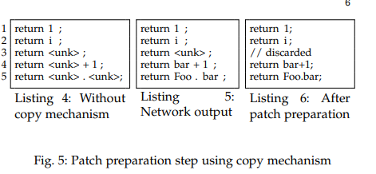
〮 Approach To Using Seq-to-Seq Learning for repair
Beam size : 5
First, Predictions might still contain <UNK> tokens not handled by the copy mechanism.
Second, Predictions contain a space between every token, which is not well-formed source code in many case
Final, Discard all line predictions that contain <UNK> and reformulate the remaining predictions into well-formed source code by removing or adding the required spaces.

Slide 14
〮 Evaluation
• RQ1: To what extent can the fixed line be perfectly predicted?
• RQ2: How often does the copy mechanism generate out-of-vocabulary tokens for a patch, and which parts of abstract buggy context are referenced for the copy?
• RQ3: How effective is SEQUENCER’s sequence-to-sequence learning in fixing bugs in the well-established Defects4J benchmark?
• RQ4: What repair operators are captured with sequence-to-sequence learning?

Slide 15
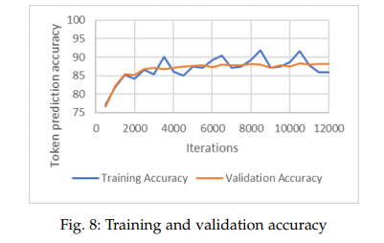
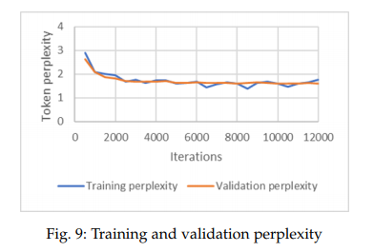
〮 Evaluation
• RQ1: To what extent can the fixed line be perfectly predicted?
Perplexity (ppl) is a measurement of how well a model predicts a sample
Chose 10,000 iterations as the standard training time for model

Slide 16
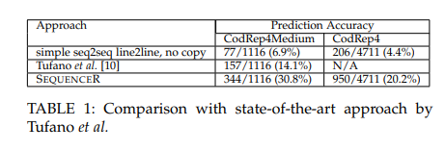
〮 Evaluation
CodRep4
on the 4711 prediction tasks, SEQUENCER is able to generate the perfect fix in 950 cases
Comparison to state-of-the-art

Slide 17
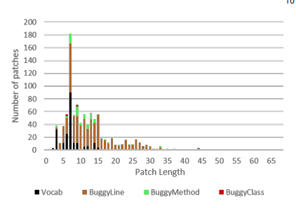
〮 Evaluation
• RQ2: How often does the copy mechanism generate out-of-vocabulary tokens for a patch, and which parts of abstract buggy context are referenced for the copy?
- Non-black bars mean that that the copy mechanism has been used.
- the longest successful patch generated by SEQUENCER was 68 tokens long, but the longest successful patch without the copy mechanism was only 27 tokens long.

Slide 18
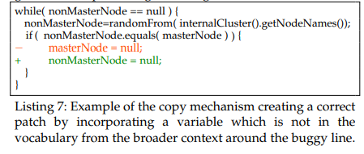
〮 Evaluation
nonMasterNode is not in 1000 token vocabulary
It copied token nonMasterNode from within the buggy method.

Slide 19
〮 Evaluation
RQ3: How effective is SEQUENCER’s sequence-to-sequence learning in fixing bugs in the well-established Defects4J benchmark?
In total SEQUENCER finds 2321 patches for 58 of the 75 bugs.
17 bugs is due to fact that some bugs are not localized inside a method
Which is requirement for the fault localization step that SEQUENCER assumes as input.

Slide 20
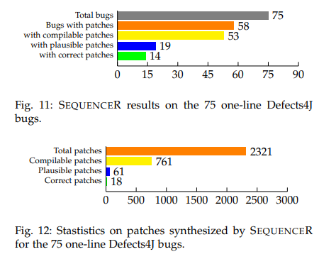

〮 Evaluation

Slide 21
〮 Evaluation

Slide 22
〮 Evaluation

Slide 23
〮 Evaluation

