Slide 1
Automated Program Repair by Using Similar Code Containing Fix Ingredients
2020-01-09
JuHyoung Kim
kjhkjh75@naver.com

Slide 2
-INTRODUCTION
Automated repair work consists of three major steps
1) fault localization
2) generation of candidate patches
3) validation of candidate patches.
In the area of search-based repair, much attention has been paid on reusing
existing code and reusing fix operations.
Due to habit of copy-and-paste in programming, similar code fragments may contain the same bug which may be neglected to fix during software maintenance.
Reusing existing code can fix the bug with no need of fix operation from historical versions of software.

Slide 3
-INTRODUCTION
Contribution.
1) This paper is the first to propose reusability metrics of similar code
fragments for program repair.
2) Implement a repair tool called SCRepair(Similar-Code-based Repair)
which can leverage different techniques of fix localization.

Slide 4
- Background and Related work.
Program Repair
- Semantic-based repair can fix simple bugs by synthesizing correct code that meets the specifications.
- These semantic-based repair tools fail to scale well to large-scale
programs due to the limitations of static analysis methods.
- Search-based repair transforms the problem of program repair into
the problem of searching the correct repair.
B. Similar Code Detection

Slide 5
- Background and Related work.
C. Similar Code Detection used in Program Repair
- SecureSync measure the similarity between the reported vulnerable
code and the given code.
- CodePhage uses two instrumented executions of the donor to identify the correct code to transfer into the recipient
(one positive testcase and one negative testcase enable CodePhage to
isolate a single check that is presented in the donor but absented in the
recipient)

Slide 6
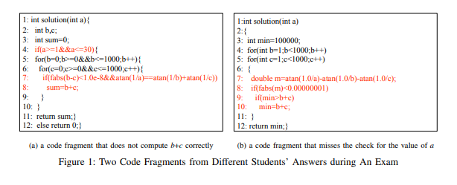
- Reusability Metrics
Motivating Example
-

Slide 7
- Reusability Metrics
Motivating Example
-

Slide 8
- Reusability Metrics
B. Metric Formula
-

Slide 9
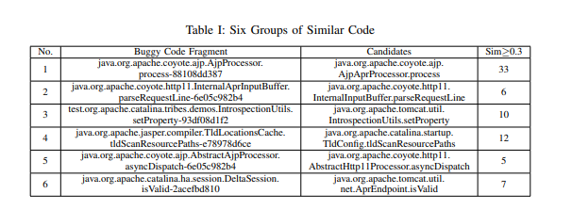
- Reusability Metrics
C. NICAD to compute Sim and the change action model CTET to compute Dif.
- “Buggy Code Fragment” shows the buggy method of a particular version.
- “Candidates” shows the method that may contain fix ingredients,
- “Sim>=0.3” shows the number of candidates whose similarity values are
greater than 0.3.

Slide 10
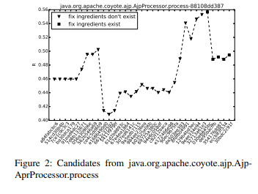
- Reusability Metrics
D. Results and Analysis
Fig. shows R values of candidates by using reusability metrics.
Use the NCC(Number of Checked Candidates) to evaluate the effectiveness of reusability metrics.

Slide 11
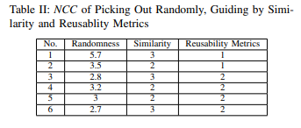
- Reusability Metrics
D. Results and Analysis
- “Randomness” represents the mean value of NCC by randomly picking out from all similar fragments
- “Similarity” represents the NCC by using rankings of similarity values
- “Reusability Metrics” represents the NCC by using rankings of reusability
metrics values

Slide 12
- Reusability Metrics
D. Results and Analysis
- “Randomness” represents the mean value of NCC by randomly picking out from all similar fragments
- “Similarity” represents the NCC by using rankings of similarity values
- “Reusability Metrics” represents the NCC by using rankings of reusability
metrics values

Slide 13
- Reusability Metrics
D. Results and Analysis

Slide 14
- SCRepair
Implementation
- After setting each statement the probability value of containing errors,
SCRepair uses the same mutation operators of RSRepair to modify the
faulty program.
- In the process of generating candidate repairs of SCRepair, each
statements of the faulty program and all candidates owns the probability
value is, the more likely the statement will be chosen to insert into the
fault location.
-SCRepair uses test cases to ensure that the bug has been eliminated.
-At present, SCRepair does not support the normalization of variables and
other syntactic elements.

Slide 15


- SCRepair
B. Strategies of Fix localization
- Present two fix localization strategies based on the rankings of code
fragments by similarity values and reusability metrics results.
- SCRepair-sim, is a fix localization strategy, which is based on the insight
that similar code fragments may contain fix ingredients.
Prob0 = probability of reusing
n = number of all statements
Probsim = similar code fragments the
reusing probability
m = number of similar code framents
li = number of statements from the i-th
similar code fragments

Slide 16

- SCRepair
B. Strategies of Fix localization
- SCRepair-metric is a fix localization strategy, which uses reusability metrics to guide SCRepair to repair faulty programs automatically.
- ScRepair-metric sets different probability values for the statements from
those similar code.
- The similar code fragment can be divided into two parts
one similar part and one different part.
dk = number of statements from the different part of the similar code fragment whose NCC score is k.

Slide 17
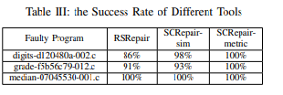
- SCRepair
C. Experimental Design
- Use Introclass benchmark.
D. Results and Analysis
-

Slide 18
Threats to validity.
Leverage NICAD to compute the similarity and adapt the probability model “ALL” of CTET to compute the diff
Although two parameters are crucial for metrics result.
Moreover, the size of these benchmark programs is small and the errors are simple.

Slide 19
Conclusion
Similar code detection techniques become playing an important role in the
field of program repair activities.
Presents the reusability metrics to rank the similar code fragments so that
developers or automated repair tools can efficiently find out the fragments
that contain fix ingredients.
SCRepair Based on the rankings by similarity values and reusability metrics
Values and reusability metrics values, this paper present two fix localization
strategies and carries out experiments to compare the repair effectiveness.

