Slide 1
Trends in prioritization and Similarity based techniques.
2020-07-02
JuHyoung Kim
kjhkjh75@naver.com

Slide 2
Introduction
Paper
1) Trends in prioritization of test cases
2) FAST Approaches to Scalable Similarity-based Test Case Prioritization

Slide 3
Introduction
Trend prioritization
Coverage-based
Requirement-based
Risk-based
Search-based
Fault-based
History-based
Other-based

Slide 4
Introduction
State of the art in Trend prioritization
Location-based
Machine Learning-based
Neural network-based
Empirical
Notes:
알고리즘은 오류 위치에서 삽입 또는 교체를 위한 제안서를 생성하기 위해 순위에 따라 예측 시퀀스의 반복을 열거한다.

Slide 5
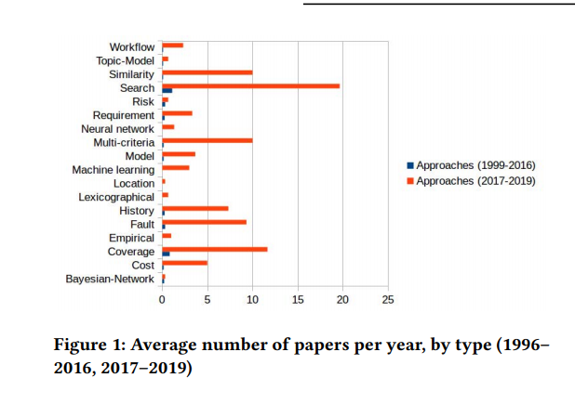
Process
- Number of papers by type
Notes:
a 같은 경우는 괄호나 부분으로 표시된걸 삽입해서 완성시키는 문법오류
(b)같은 경우는 잘못된부분 대체 하는부분
c같은경우는 잘못 입력된 스펠링이나 잘못표현된 부분을 전체 대체한다.
컴파일러는 항상 에러위치를 정확하게 말해주지 못하기 때문에
에러가 나오는 이전 라인을 모델에 넣어서 새라인으로 끝나는 토큰 시퀀스를 예측

Slide 6
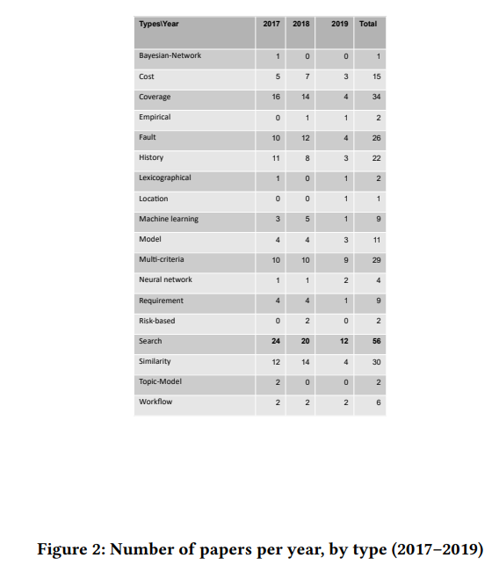
Process
Most used type : Search-based, coverage-based, Similarity-based
Notes:
이 모델 같은경우는 컴파일러로 에러위치가 파악이 되지 않아 rnn모델 사용해서 전체라인 예측한 것인데 SKETCH solver 를 통해

Slide 7
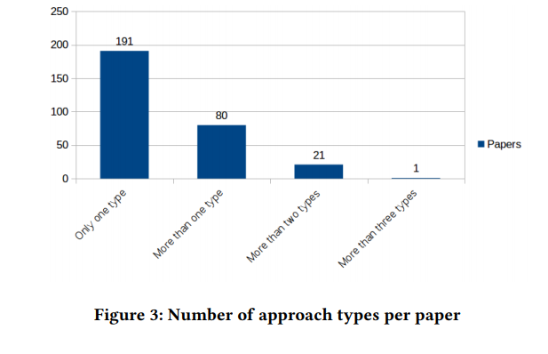
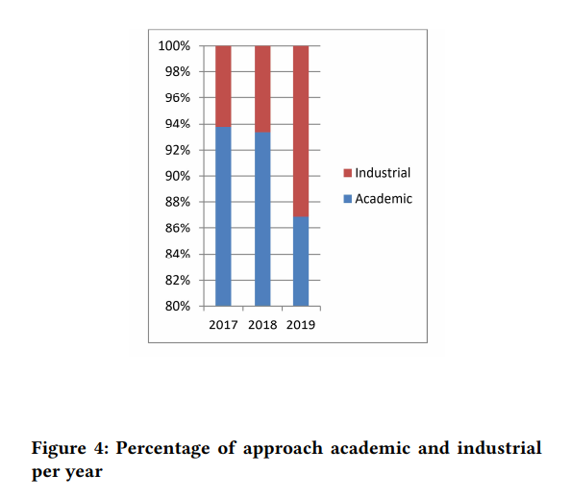
Process

Slide 8

Introduction
FAST Approaches to Scalable Similarity-based Test Case Prioritization
Test case prioritization(TCP) is a very active topic in software testing
The goal of TCP is to speed up fault detection : Re-orders a test suite so that those test cases that are most likely to fail are executed first.
TCP can help to detect faults more quickly and to provide confidence
TCP techniques is evaluated by Average Percentage Faults Detected

Slide 9
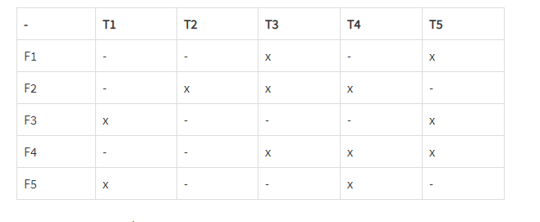
Introduction
APFD = 1 – ( ( 3 + 2 + 1 + 3 + 1 )/ ( 5 * 5 ) + 12∗5

Slide 10
- Introduction
- Contribution
First proposal of exploiting data mining algorithms for similarity-based testing of big testsets.
The definition and implementation of the FAST family of similarity-based TCP techniques.
A large scale experimentation of 20 FAST techniques, compared for effectiveness

Slide 11
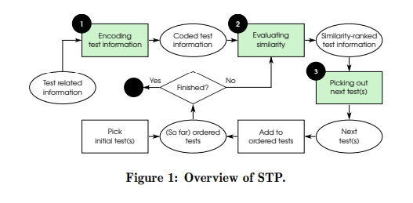
Background
Similarity-based TCP
Given a test suite S, the set P of permutations of S , and award function f: p ->R , then TCP consists in finding a T ∈ P such that f(T)≥ f(T`) for all T`∈ P with T` =/ T.
Notes:
예측 시퀀스인 Tk를 얻고나서 알고리즘은 토큰 시퀀스를 증가하면서 검색한다. 삽입하던 대체하든 문법 오류가 안나타날때까지 알고리즘이 문법오류가 안나는 시퀀스를 못찾는다면 다른 Tpref 를 찾는다 이 후보군은 에러 토큰 위치가 있는 라인의 모든 이전 토큰을 무시한다.
최종적으로 알고리즘은 예측된 토큰과함께 에위치를 포함하는 줄을 대체하는지 체크한다.

Slide 12
Algorithms for Similarity Estimation
Jaccard similarity
JS(A, B) = |A ∩B| / |A ∪B|
Jaccard distance JD(A, B) = 1 − JS(A, B).
Combine techniques able to drastically reduce the cost of computing similarity.
Shingles
Mean Hash
Locality-Sensitive Hashing(LSH)

Slide 13
Idea
Set the standard test case and calculate the similarity ( Jaccard )
Arrange the test set through similarity
Ex) group 1 ) under the similarity value 0.1
group 2 ) 0.2
group 3 ) 0.3 etc…
don`t care imbalance of the test case number of each group
( group 1 30, group 2 20 okay)

Slide 14
Future work
More survey for TCP
New other direction.

