Slide 1
Test Case prioritization
2020-07-09
JuHyoung Kim
kjhkjh75@naver.com

Slide 2
- Plan
Read and organize each techniques (7/3rd)
Using above information and make up the point (7/3rd)
Organize the promotion (7/4th)
Progress experiment(7~

Slide 3
- Paper list
Recent work
Trends in prioritization of test cases: 2017-2019
(SAC 2020)
An Empirical Study on the Use of Defect Prediction for Test Case Prioritization
(ICST 2019)
The Application of Machine learning In Test Case prioritization
(EJECE 2020)
Learning to Prioritize Test Programs for Compiler Testing
(ICSE 2017)
FAST Approaches to Scalable Similarity-based Test Case Prioritization
(ICSE 2018)
Future work
Scalable Approaches for Test Suite Reduction
(ICSE 2019)
Optimizing Test Prioritization via Test Distribution Analysis
(FSE 2018)

Slide 4
- Introduction
Aiming to reduce the time taken to detect regressions, researchers have created a variety of regression techniques.
Recent studies reveal that previously evaluated strategies may be less effective at prioritizing test cases to defect real faults when compared to other fault types
(relative complexity of real faults and the use of naïve coverage- based approaches)
G-clef(paper`s test case prioritization technique) uses bug prediction data
to reorder a test suite so that If first focuses on those classes that are most likely to contain faults

Slide 5

- Background
Bug Prediction
1) Schwa
- Extracts information from commit, such as its message, author, timestamp, list of all modified files, and changes performed(i.e., the diff)
- It performs a bug prediction computation based on three metrics
1. revisions ( how often a Java class has been changed)
2. fixes (how often a Java class has been fixed)
3. authors (how often a Java class has been modified by more than
one developer)
- Robust, not language specific
- Uses a ranked-based techniques, Time-Weighted Risk(TWR)
to estimate how reliable a Java class is

Slide 6
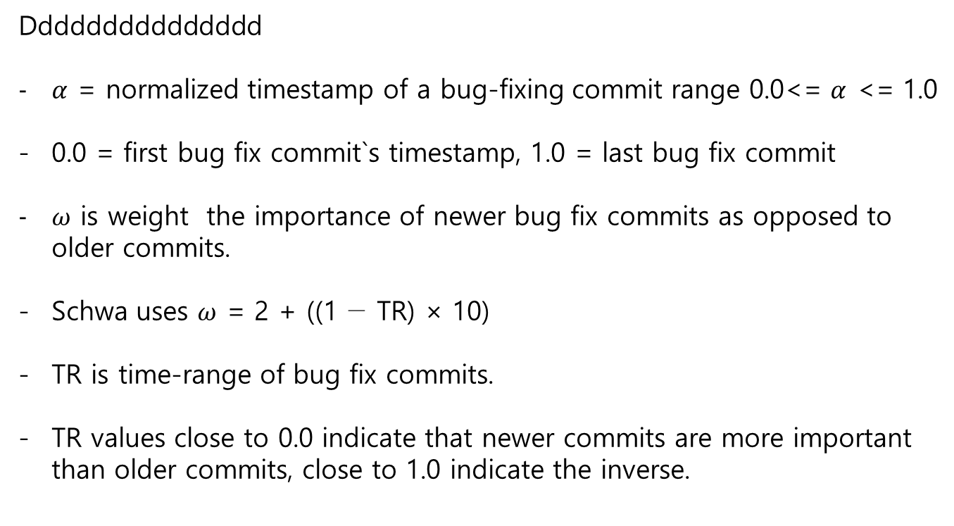
- Background
Ddddddddddddddd
$α$ = normalized timestamp of a bug-fixing commit range 0.0<= $α$ <= 1.0
0.0 = first bug fix commit`s timestamp, 1.0 = last bug fix commit
$ω$ is weight the importance of newer bug fix commits as opposed to older commits.
Schwa uses $ω$ = 2 + ((1 − TR) × 10)
TR is time-range of bug fix commits.
TR values close to 0.0 indicate that newer commits are more important than older commits, close to 1.0 indicate the inverse.

Slide 7
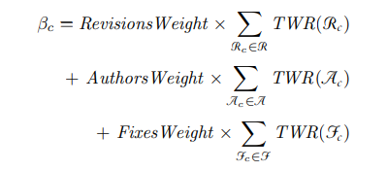
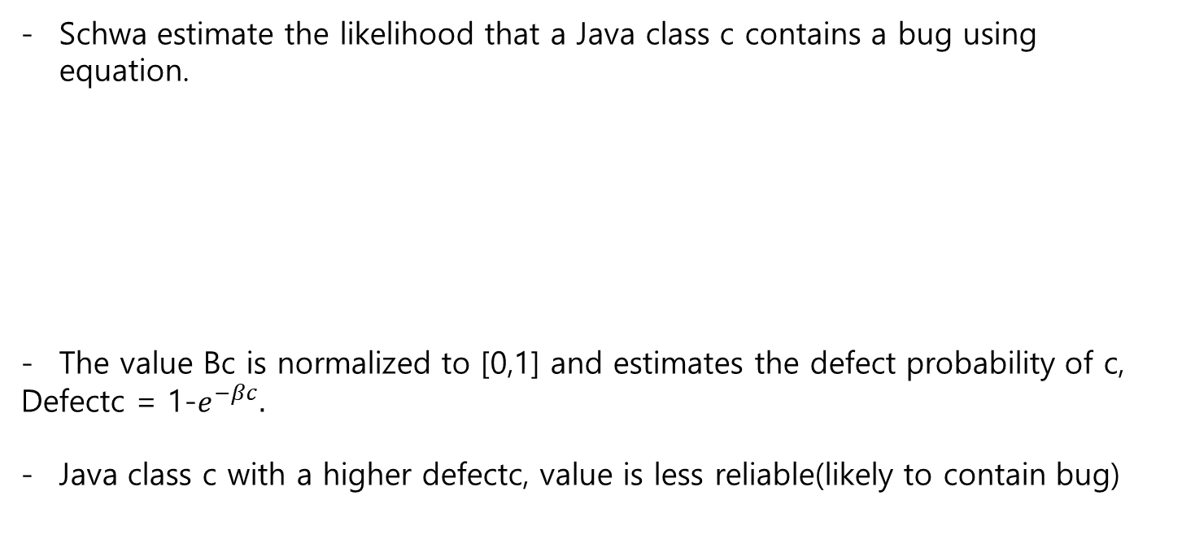
- BackGround
Schwa estimate the likelihood that a Java class c contains a bug using equation.
The value Bc is normalized to [0,1] and estimates the defect probability of c,
Defectc = 1-$e^{−βc}.$
Java class c with a higher defectc, value is less reliable(likely to contain bug)

Slide 8
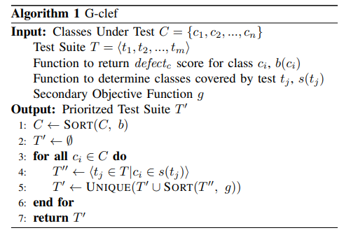
- G-CLEF
Orders the classes in a program by the bug prediction score produced by Schwa
For each of the classes c, G-clef then identifies the tuple of test cases, G-clef applies a secondary objective g.
G-clef places the ordered test cases into the prioritized suite.

Slide 9
- G-clef
Example
- 3 Classes
1) ClassA : 100 test cases and defectc score 0.8
2) ClassB : 30 test cases and defectc score 0.35
3) ClassC : 1000 test cases and defectc score 0.1
G-clef starts by selecting all the test cases for ClassA, this is most likely to contain a bug.
The secondary objective decides how the 100 test for ClassA should be ordered

Slide 10
- G-clef
Secondary objective
- Four secondary objectives to prioritize test case.
1) greedy(or total statement) : orders test cases by the total number of statements
2) additional greedy(or additional statement)
selecting the test that covers the most previously uncovered lines
3) random : random ordering for test case
4) constraint solver : representing the lines of code as constraints that must be covered by one or more test cases

Slide 11
- G-clef
Grouping Classes
- If a bug prediction report incorrectly assigns a high defectc score to a class with many test cases,
- To avoid bias for or against subject programs that contain more classes than others, use a percentage of the classes in the chosen project
- For example bug report that incorrectly assign Class C defectc score 0.9
- To address this problem grouping Class A and C and using percentage of the grouped classes.

Slide 12
- Empirical Evaluation
Experimental setup
1) subject programs : DEFECTS4J project
2) Coverage Analysis : used Gzoltar
3) Test History : number of execution, failure
4) Schwa : set the weights of revisions, authors and fixes. And other TR
5) Test Case Prioritization : used KANONIZO (implementation four coverage-based strategies)
extend the tool with history-based strategies.

Slide 13
- Empirical Evaluation
Experimental setup
6) Evaluation Measurement : In this paper consider 395 program versions, each containing single fault.
-> reduces the APFD
7) Analysis Procedure
8) Threats to validity : This paper`s results may not generalize to other programs with either different characteristics or types of test suites or faults.

Slide 14
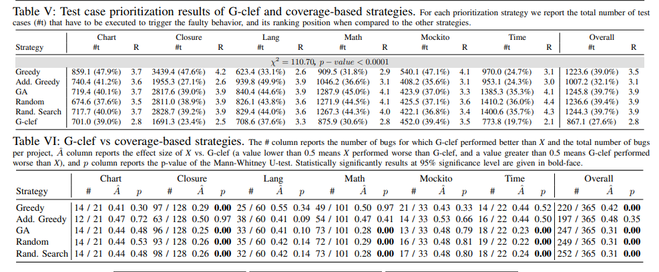
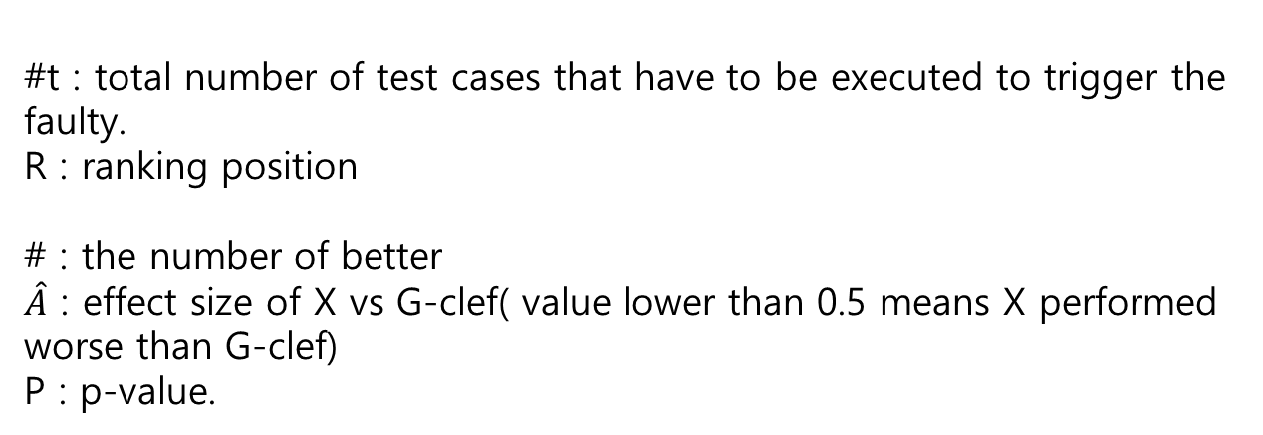
- Comparison
#t : total number of test cases that have to be executed to trigger the faulty.
R : ranking position
# : the number of better
$\hat{A}$ : effect size of X vs G-clef( value lower than 0.5 means X performed worse than G-clef)
P : p-value.

Slide 15
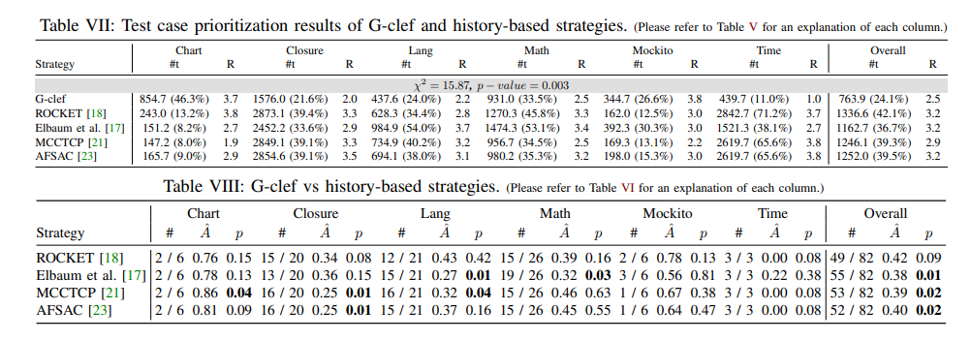
- Comparison

Slide 16
- Conclusion And Future Work
Demonstrate promise of G-clef, intend to improve the presented approach and conduct additional experiments with new subjects.
Investigate how defect prediction is able to capture characteristics of test suites in comparison with other strategies
Investigate whether defect prediction techniques based on software features.
Investigate how the choice of a programming language influences the effectiveness of G-clef

