Slide 1
Test Case prioritization
2020-07-16
JuHyoung Kim
kjhkjh75@naver.com

Slide 2
- Plan
Read and organize each techniques (7/3rd)
Using above information and make up the point (7/3rd)
Organize the promotion (7/4th)
Progress experiment(7~

Slide 3
- Paper list
Recent work
Trends in prioritization of test cases: 2017-2019
(SAC 2020)
An Empirical Study on the Use of Defect Prediction for Test Case Prioritization
(ICST 2019)
Learning to Prioritize Test Programs for Compiler Testing
(ICSE 2017)
FAST Approaches to Scalable Similarity-based Test Case Prioritization
(ICSE 2018)
Future work
Scalable Approaches for Test Suite Reduction
(ICSE 2019)
Optimizing Test Prioritization via Test Distribution Analysis
(FSE 2018)

Slide 4
- Introduction
Reordering the test cases
more likely to fail are executed first
-> Test case prioritization
Select a subset
Should ideally include the failing test case
-> Test case selection, or test suite reduction

Slide 5
- Introduction
FAST Approaches to Scalable Similarity-based Test Case Prioritization
Cause : test suite sizes grow
-> need techniques to address big test sets.
-> similar based techniques is very efficient algorithms
Minhashing, Locality-sensitive hashing algorithms.
Want to select the test cases that are dissimilar from the so-far-prioritized ones

Slide 6
- Introduction
FAST Approaches to Scalable Similarity-based Test Case Prioritization
- Process
Encoding of test-related information
Evaluating similarity
Picking out the next test cases

Slide 7
- Introduction
Scalable Approaches for Test Suite Reduction
-Use test source code or command line input as input
-Should consider the computational effort and of the resources.
Adopt additional approaches
1) K-means++
2) a recent importance sampling to construct coresets.
Enhance the scalability
1) random projection technique

Slide 8
- Introduction
Scalable Approaches for Test Suite Reduction
Preparation phase
1) transform test cases into points in the Euclidean space via the v vector-space model the textual representation of each test case
(test source code or command line input)
2) The components are weighted according to term-frequency
n = total number of terms used in the whole test suite.
3) The computation of the Euclidean distance between any two
n-dimensional points can be expensive when n is large
-> random projection
(high dimensional space is projected into a much lower)

Slide 9
- Introduction
Scalable Approaches for Test Suite Reduction
Preparation phase
clustering problem as a k-means problem
P = {p1,…,pk} of the points that minimizes the sum of the squared Euclidean distances

Slide 10
- Process
Scalable Approaches for Test Suite Reduction
Process
1) mapping each test case into a vector according to the vector- space model
2) lowering its dimensionality via random projection
3) Pick the first point uniformly at random
4) until B points have not been selected
5)

Slide 11


- Introduction
Optimizing Test prioritization via Test Distribution Analysis
APFD assumes that all the tests have the same execution time and treats them equivalently,
-> It`s usually not true in practice
- APFDc
ti is the cost associated with the test case.
Tfi the faults detected by the test case
Ti and fi is the severities of detected faults.

Slide 12
- Introduction
Optimizing Test prioritization via Test Distribution Analysis
Cost-unaware
Cost-aware
Cost-only

Slide 13
- Introduction
Optimizing Test prioritization via Test Distribution Analysis
Cost-unaware
Prioritization without balancing testing time and other factors (test coverage)
Total technique prioritizes
tests based on the descending order of the number of program elements(statements) covered by the tests.
Additional technique prioritizes
tests based on the number of program elements that are uncovered

Slide 14
- Introduction
Optimizing Test prioritization via Test Distribution Analysis
Cost-unaware
Search-based prioritization
first randomly generates a set of permutations, and then forms the next generation through crossover and mutation
Adaptive Random prioritization
use the test set distance that is defined to select a test that has the largest minimum distance with the already selected tests
Tot,Add,Sea,ARP

Slide 15
- Introduction
Optimizing Test prioritization via Test Distribution Analysis
Cost-aware
Balances testing time and other factors in test prioritization.
cost-cognizant additional prioritization.
proposed to leverage testing time and fault severities in test prioritization.
APFDc evaluation metrics.

Slide 16
- Introduction
Optimizing Test prioritization via Test Distribution Analysis
Cost-only Test prioritization.
Schedules the execution order of tests based on testing time alone, ignoring other factors(including test coverage)

Slide 17
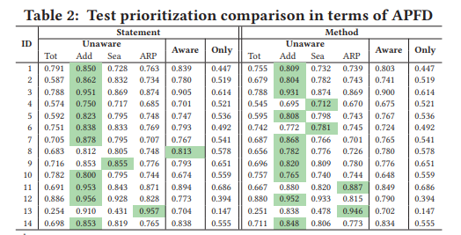
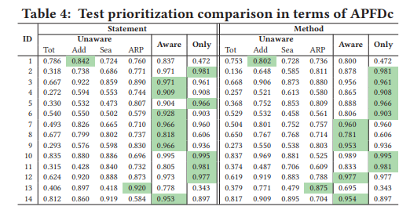
- Introduction
Optimizing Test prioritization via Test Distribution Analysis
Quantitative Analysis
Unaware(add) performs better than cost-aware and cost only in most cases in terms of APFD
Unaware(add) performs better than cost-aware and cost only in most cases in terms of APFD

Slide 18
- Introduction
Optimizing Test prioritization via Test Distribution Analysis
Qualitative Analysis
Three criteria may impact prioritization effectiveness.
Test coverage
Testing time
Coverage per unit time

Slide 19
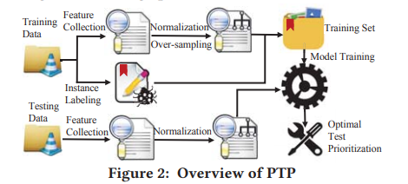
- Introduction
Optimizing Test prioritization via Test Distribution Analysis
Predictive Test Prioritization
Projects with similar distribution of test coverage, testing time, and coverage per unit time
-> tend to have the same optimal prioritization technique.

Slide 20
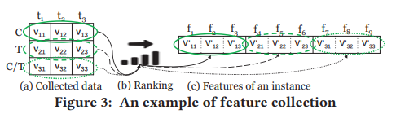
- Approach
Optimizing Test prioritization via Test Distribution Analysis
Predictive Test Prioritization
Feature collection
The number of program elements covered by each test
Testing time of each test
The number of program elements covered by each test per unit time.
Different projects tend to have different number of tests
-> zero padding

Slide 21
- Approach
Optimizing Test prioritization via Test Distribution Analysis
Predictive Test Prioritization
Instance Labeling

Slide 22
- APpproach
Optimizing Test prioritization via Test Distribution Analysis
Predictive Test Prioritization
Predictive Model Training
PTP normalizes the three types of feature values for each training instance into the range [0,1] using min-max normalization.
PTP uses the oversampling strategy(resampling the minority class)
to deal with the imbalanced data problem
Coverage,time,C/T of each test are regarded as features, but such
basic features are hard to predict the optimal prioritization technique
->proposed XGBoost algorithm

Slide 23
- Evaluation
Optimizing Test prioritization via Test Distribution Analysis
Predictive Test Prioritization
PTP Evaluation
Subjects
- Scale up subjects to 50 open-source projects
- 50 is small in machine learning
-> constructed 50 test suites for each subject by randomly selecting a subset of tests from its original test suite.
-

Slide 24
- Evaluation
Optimizing Test prioritization via Test Distribution Analysis
Predictive Test Prioritization
PTP Evaluation
2. Measurements
- Tend to care different metrics based on different requirements.
- Used other three practical time-based measurements(in milliSec)
FT, the time spent on detecting the first regression fault
LT, the time spent on detecting the last regression fault
AT, the average time spent on detecting all regression faults

Slide 25
- Introduction
Optimizing Test prioritization via Test Distribution Analysis
Predictive Test Prioritization
PTP Evaluation
3. Implementation
- XGBoost approach implemented by the XGBoost python package
- softmax
- used statement coverage

Slide 26
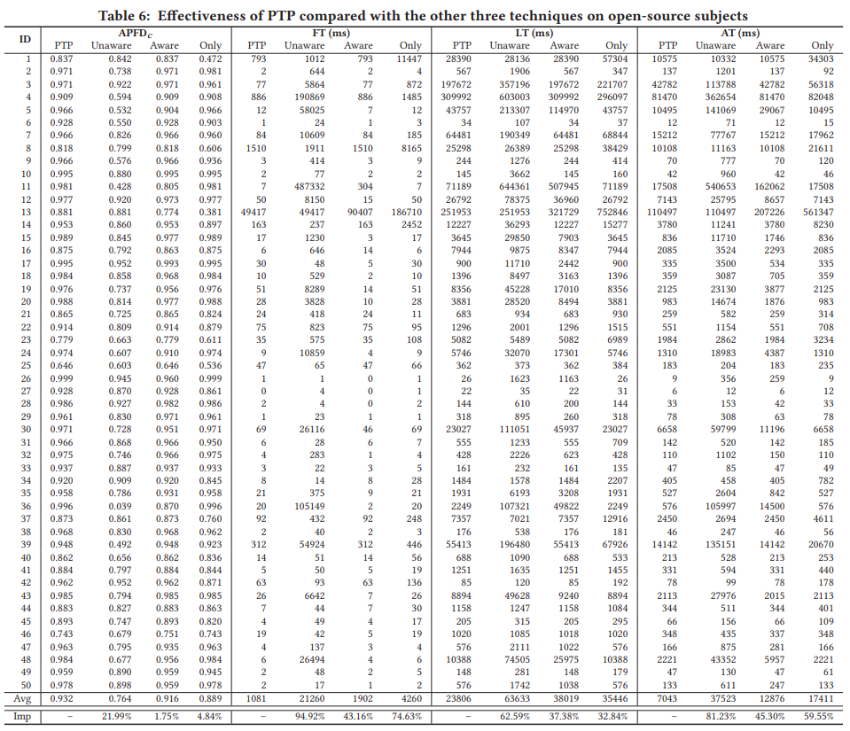
- Introduction
Optimizing Test prioritization via Test Distribution Analysis
Predictive Test Prioritization
Result and Analysis
1. Overall Effectiveness
PTP correctly predicts the optimal technique for 46 of 50 subjects

Slide 27
- Introduction
Optimizing Test prioritization via Test Distribution Analysis
- Threats to validity
External validity in the subjects and faults
- threat from mutations.
- to reduce this threat, report the industrial subjects
Construct validity in the regression scenario, instance collection, and measurement

Slide 28
- Discussion
Optimizing Test prioritization via Test Distribution Analysis
Practical Implications
- Cost-only technique performs surprisingly well on some subjects.
New Perspective from PTP
- Aims at generating the optimal prioritization results for each project
Practical Usage of PTP
Future Extensions of PTP
- can be transformed to a pattern recognition problem
- other factors may also influence prioritization

Slide 29
- Conclusion
Optimizing Test prioritization via Test Distribution Analysis
The optimal test prioritization technique in practice still remains unknown.
Existing technique can always perform the best.
Distribution of test coverage, testing time and coverage per unit time can serve as the guidelines for selecting the optimal prioritization technique for different cases.

Slide 30
Appendix
Shingles

Slide 31
Appendix
2. Minhashing

Slide 32
Appendix
3. Locality-Sensitive Hashing

Slide 33
Appendix
K means vs K means++

Slide 34
Appendix
Random projection
Dimensionality reduction technique

Slide 35
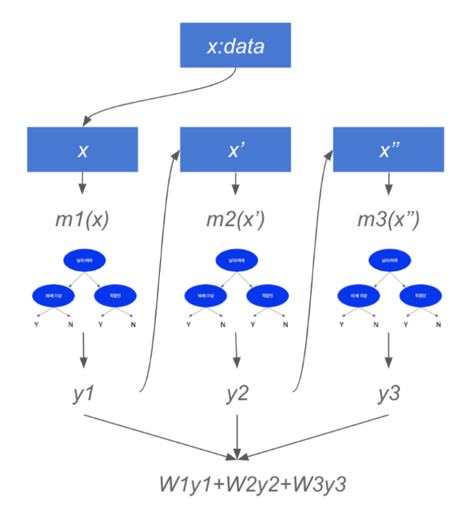
Appendix
XGBoost
Support both regression, classification
Ensemble algorithm with combination of Decision trees.
Boosting
y = W1m1(x)+W2m2(x)+W3m3(x)+error3(x)
Parallel learning this process.

