Slide 1
Test Case prioritization
2020-07-30
JuHyoung Kim
kjhkjh75@naver.com

Slide 2
- Plan
Read and organize each techniques (7/3rd)
Using above information and make up the point (7/3rd)
Organize the promotion (7/4th)
Progress experiment(7~

Slide 3


- Introduction
Optimizing Test prioritization via Test Distribution Analysis
APFD assumes that all the tests have the same execution time and treats them equivalently,
-> It`s usually not true in practice
- APFDc
ti is the cost associated with the test case.
Tfi the faults detected by the test case
Ti and fi is the severities of detected faults.

Slide 4
- Introduction
Optimizing Test prioritization via Test Distribution Analysis
Cost-unaware
Cost-aware
Cost-only

Slide 5
- Introduction
Optimizing Test prioritization via Test Distribution Analysis
Cost-unaware
Prioritization without balancing testing time and other factors (test coverage)
Total technique prioritizes
tests based on the descending order of the number of program elements(statements) covered by the tests.
Additional technique prioritizes
tests based on the number of program elements that are uncovered

Slide 6
- Introduction
Optimizing Test prioritization via Test Distribution Analysis
Cost-unaware
Search-based prioritization
first randomly generates a set of permutations, and then forms the next generation through crossover and mutation
Adaptive Random prioritization
use the test set distance that is defined to select a test that has the largest minimum distance with the already selected tests
Tot,Add,Sea,ARP

Slide 7
- Introduction
Optimizing Test prioritization via Test Distribution Analysis
Cost-aware
Balances testing time and other factors in test prioritization.
cost-cognizant additional prioritization.
proposed to leverage testing time and fault severities in test prioritization.
APFDc evaluation metrics.

Slide 8
- Introduction
Optimizing Test prioritization via Test Distribution Analysis
Cost-only Test prioritization.
Schedules the execution order of tests based on testing time alone, ignoring other factors(including test coverage)

Slide 9
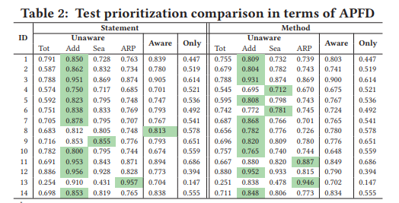
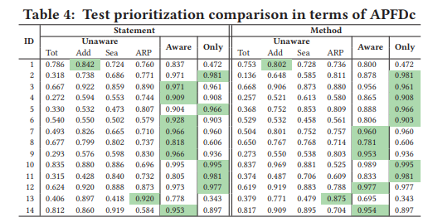
- Analysis
Optimizing Test prioritization via Test Distribution Analysis
Quantitative Analysis
Unaware(add) performs better than cost-aware and cost only in most cases in terms of APFD

Slide 10
- Approach
Optimizing Test prioritization via Test Distribution Analysis
Qualitative Analysis
Three criteria may impact prioritization effectiveness.
Test coverage
Testing time
Coverage per unit time

Slide 11
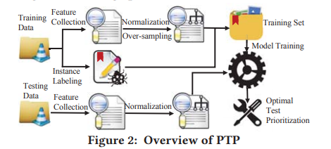
- Approach
Optimizing Test prioritization via Test Distribution Analysis
Predictive Test Prioritization
Projects with similar distribution of test coverage, testing time, and coverage per unit time
-> tend to have the same optimal prioritization technique.

Slide 12
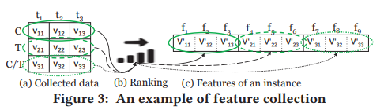
- Approach
Optimizing Test prioritization via Test Distribution Analysis
Predictive Test Prioritization
Feature collection
The number of program elements covered by each test
Testing time of each test
The number of program elements covered by each test per unit time.
Different projects tend to have different number of tests
-> zero padding

Slide 13
- Approach
Optimizing Test prioritization via Test Distribution Analysis
Predictive Test Prioritization
Instance Labeling

Slide 14
- APpproach
Optimizing Test prioritization via Test Distribution Analysis
Predictive Test Prioritization
Predictive Model Training
PTP normalizes the three types of feature values for each training instance into the range [0,1] using min-max normalization.
PTP uses the oversampling strategy(resampling the minority class)
to deal with the imbalanced data problem
Coverage,time,C/T of each test are regarded as features, but such
basic features are hard to predict the optimal prioritization technique
->proposed XGBoost algorithm

Slide 15
- Evaluation
Optimizing Test prioritization via Test Distribution Analysis
Predictive Test Prioritization
PTP Evaluation
Subjects
- Scale up subjects to 50 open-source projects
- 50 is small in machine learning
-> constructed 50 test suites for each subject by randomly selecting a subset of tests from its original test suite.
-

Slide 16
- Evaluation
Optimizing Test prioritization via Test Distribution Analysis
Predictive Test Prioritization
PTP Evaluation
2. Measurements
- Tend to care different metrics based on different requirements.
- Used other three practical time-based measurements(in milliSec)
FT, the time spent on detecting the first regression fault
LT, the time spent on detecting the last regression fault
AT, the average time spent on detecting all regression faults

Slide 17
- Introduction
Optimizing Test prioritization via Test Distribution Analysis
Predictive Test Prioritization
PTP Evaluation
3. Implementation
- XGBoost approach implemented by the XGBoost python package
- softmax
- used statement coverage

Slide 18
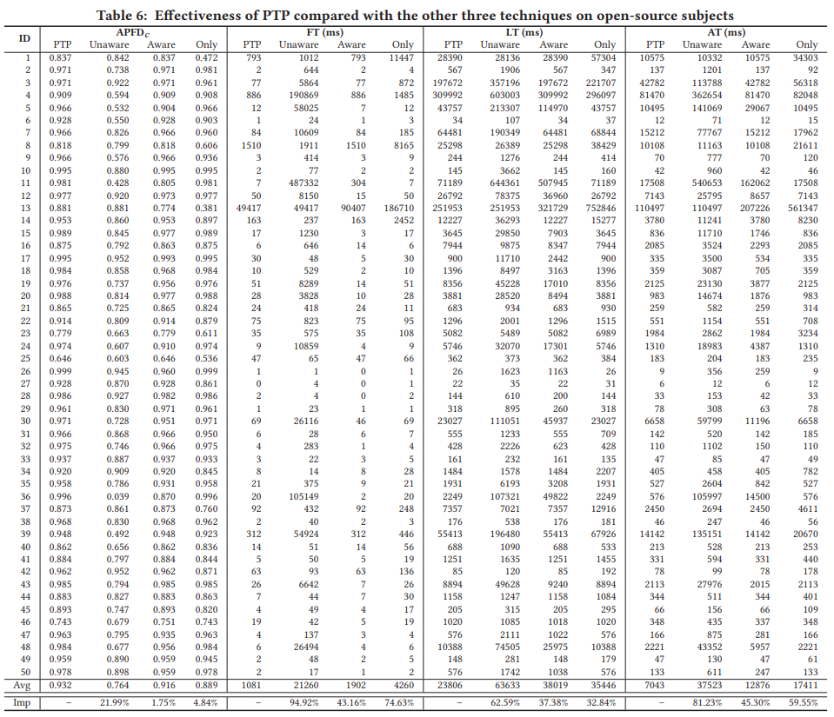
- Introduction
Optimizing Test prioritization via Test Distribution Analysis
Predictive Test Prioritization
Result and Analysis
1. Overall Effectiveness
PTP correctly predicts the optimal technique for 46 of 50 subjects

Slide 19
- Introduction
Optimizing Test prioritization via Test Distribution Analysis
- Threats to validity
External validity in the subjects and faults
- threat from mutations.
- to reduce this threat, report the industrial subjects
Construct validity in the regression scenario, instance collection, and measurement

Slide 20
- Discussion
Optimizing Test prioritization via Test Distribution Analysis
Practical Implications
- Cost-only technique performs surprisingly well on some subjects.
New Perspective from PTP
- Aims at generating the optimal prioritization results for each project
Practical Usage of PTP
Future Extensions of PTP
- can be transformed to a pattern recognition problem
- other factors may also influence prioritization

Slide 21
- Conclusion
Optimizing Test prioritization via Test Distribution Analysis
The optimal test prioritization technique in practice still remains unknown.
Existing technique can always perform the best.
Distribution of test coverage, testing time and coverage per unit time can serve as the guidelines for selecting the optimal prioritization technique for different cases.

Slide 22
- Experiment
Doing experiment test prioritization.
1) increase the data.
2) apply other algorithm.
- Analysis for mutant and real bug problem
Assessing Test Case Prioritization on Real Faults and Mutants

Slide 23
A B C D E
5 10 7 6 1
Prioritization : Fault case/Total Test case (in here fixed Total test case)
B>C>D>A>E

Slide 24
A B C D E
- Clustering with similarity in N groups
- Prioritization : Fault case/Total Test case (in here each groups are different)
B A C D E
- And Ordering test case in group with time cost and fault existence
- Permutate each group`s one test
B1>A1>C1>D1>E1>B2 …

Slide 25
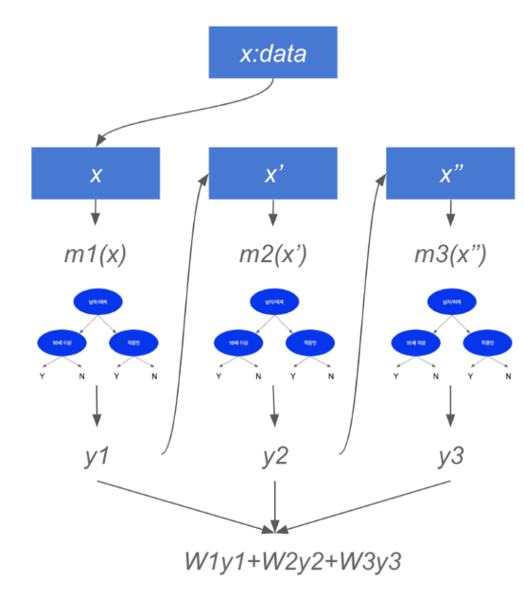
Appendix
XGBoost
Support both regression, classification
Ensemble algorithm with combination of Decision trees.
Boosting
y = W1m1(x)+W2m2(x)+W3m3(x)+error3(x)
Parallel learning this process.

