Slide 1
Speedup Automatic Program Repair Using Dynamic Software Updating: An Empirical Study
2020-09-17
JuHyoung Kim
kjhkjh75@naver.com

Slide 2
- Abstract
APR tool needs to repeatedly run the same test suite
To scale to large programs, APR has to consider small patch space
Found that restarting processes to load patched code consumes the majority of total validation time.
DSU(dynamic software updating) can load and execute new code without restarting.

Slide 3
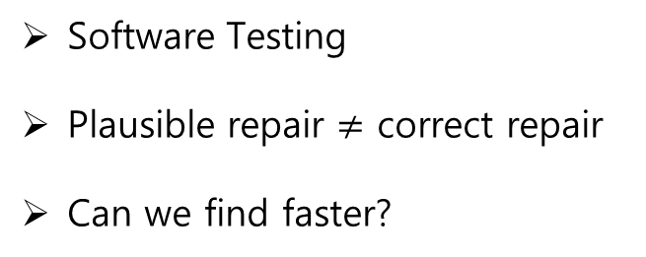
- BackGround
APR
Patch Generation
Patch Validation
Fault localization
Passing and failing test case
identify suspicious location.
Patch ingredients.
Software Testing
Plausible repair $≠$ correct repair
Can we find faster?

Slide 4
- BackGround
Testing Framework for APR
Integration test
Unit Test
(Junit)
System test

Slide 5
- BackGround
Dynamic Software Updating
Reducing the service interruption caused by software updates
Enhancing the software availability
safety
Timeliness
Flexibility
Efficiency
Usability
An efficient DSU system should not introduce long service disruption during update
Flexible DSU system should have sufficient ability to modify runtime states to support sufficient changes to the program code
Most DSU systems cannot update the active methods and have to wait until those changed active methods finish the execution.
Guaranteed various kinds of safety such as type safety
An extremely ease-to-use DSU system should be fully automated.

Slide 6
- Methodology
1. Defects Dataset
2. APR Algorithms
3. Process-Based Validation
4. HotSwap-Based Validation Method
5. Validation Consistency

Slide 7
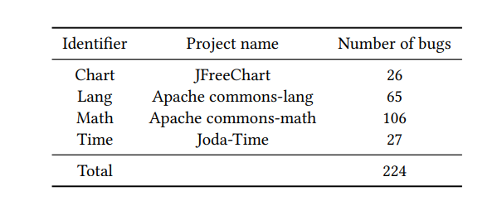
* Defects Dataset

Slide 8
- Methodology
1. Defects Dataset
2. APR Algorithms
3. Process-Based Validation
4. HotSwap-Based Validation Method
5. Validation Consistency

Slide 9
* APR algorithms
jGenProg : the Java implementation of GenProg
jKali : the java implementation of Kali
jMutRepair : a mutation based repair algorithm
1
Validate the given patch using the failing test cases.
2
Further validate test all passing test cases.
Astor
3
Implements using process-based approach
4
patch must be validated in a standalone process

Slide 10
- Methodology
1. Defects Dataset
2. APR Algorithms
3. Process-Based Validation
4. HotSwap-Based Validation Method
5. Validation Consistency

Slide 11
* Process-Based Validation
Each patch applied to the original program P to create a variant P`
Run each test case t in T to test P` to validate
Result of run can be of the three status(error, pass, timeout)
Process-based validation method needs to restart the process with the new variant P` for each patch

Slide 12
- Methodology
1. Defects Dataset
2. APR Algorithms
3. Process-Based Validation
4. HotSwap-Based Validation Method
5. Validation Consistency

Slide 13
*HotSwap-Based Validation Method
Same input as the process-based validation method.
Leverages the redefineClass API defined by HotSpot JVM
redefineClass take existing classes C and new class Bn
redefineClass fails - > process-based validation.
Use timeout as an imprecise indicator of internal error(user can define)
Reversion is only necessary when the next patch has a different set of changed classes with the previous patch.

Slide 14
- Methodology
1. Defects Dataset
2. APR Algorithms
3. Process-Based Validation
4. HotSwap-Based Validation Method
5. Validation Consistency

Slide 15
* Validation Consistency
All test cases have passed
->Patch is accepted
Weak Consistency
Strong Consistency
Testing results same
Testing results same
Output message same

Slide 16
- Results and Discussions
RQ1: (Performance) How much can HotSwap validation speed up the patch validation process?
RQ2: (Feasibility) How many patches can be validated using HotSwap validation?
RQ3: (Consistency) Does HotSwap validation incur inconsistent validation results?

Slide 17
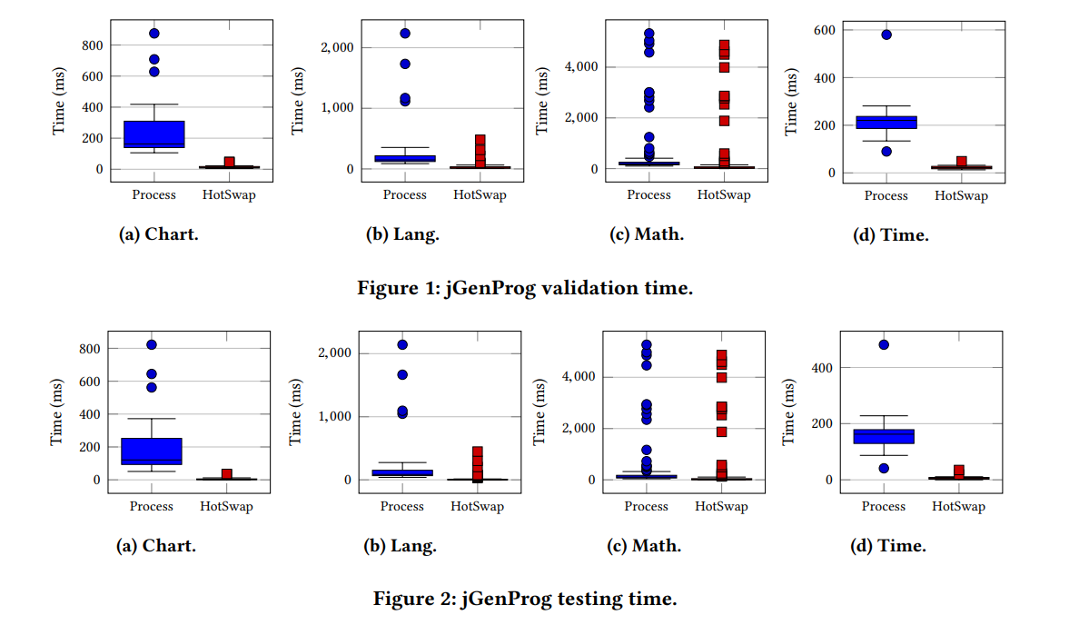
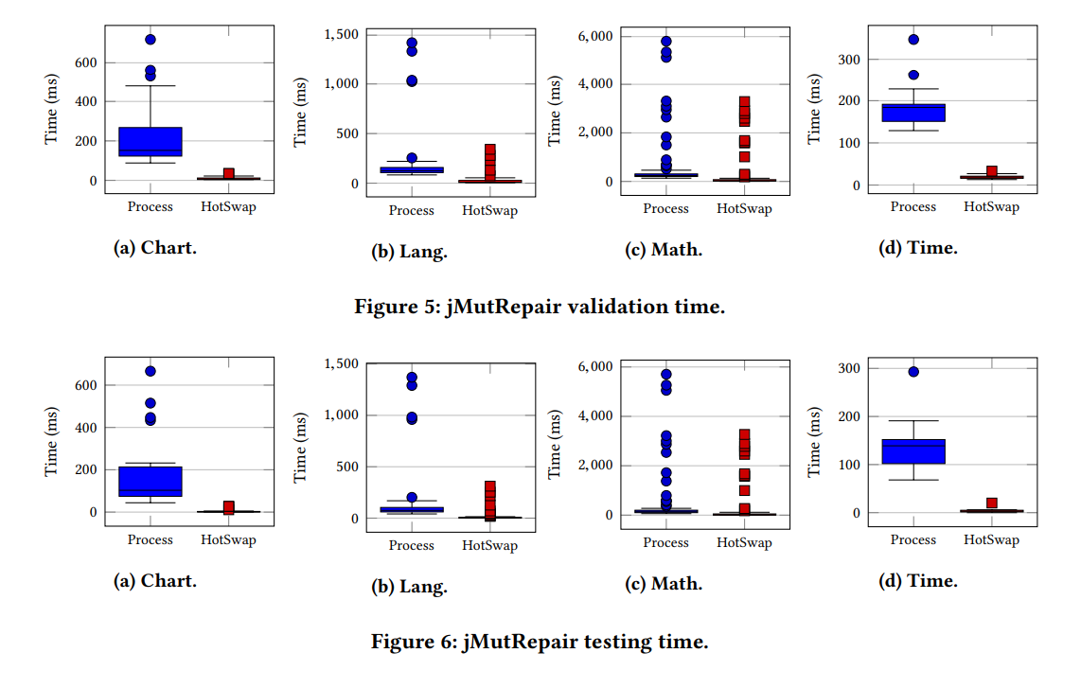
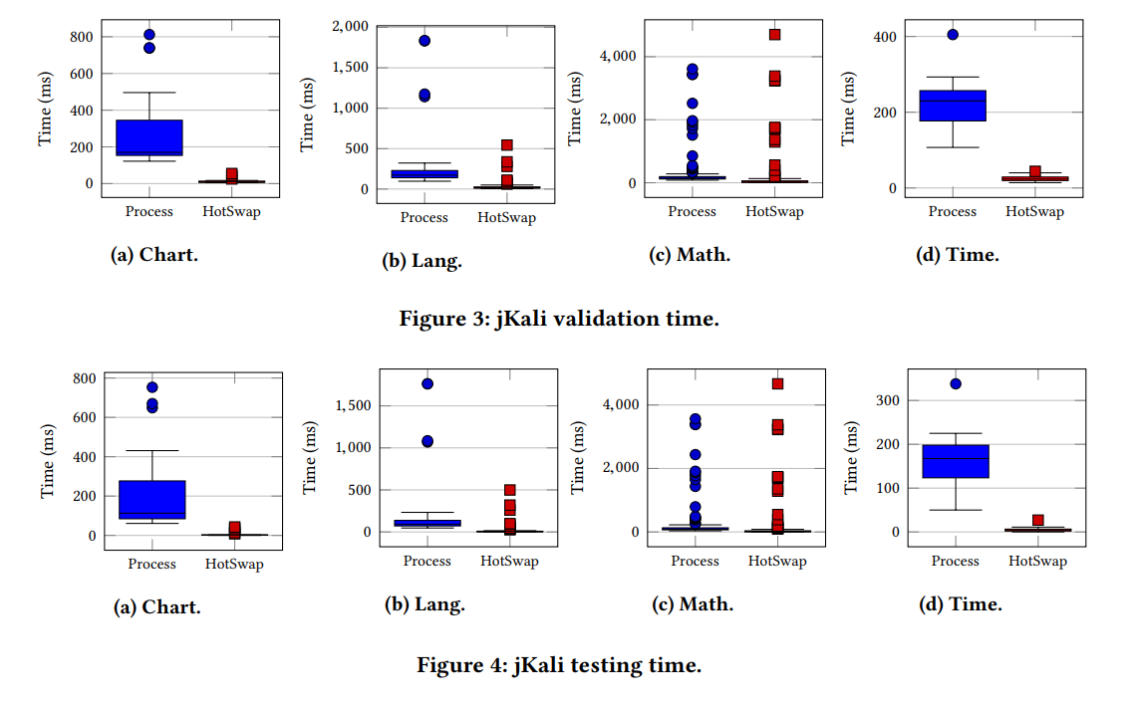
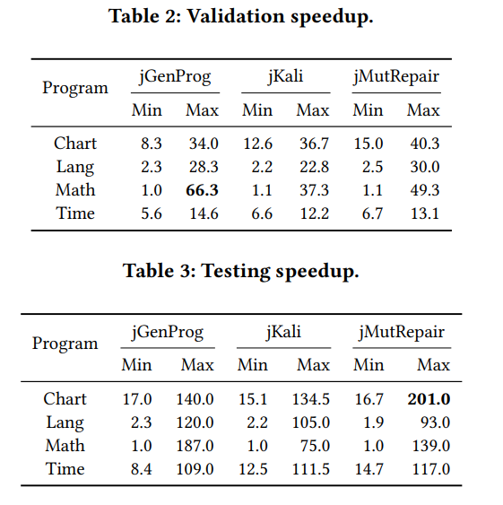
- Results and Discussions
Performance
jGenProg
jKali
jMutRepair
Result Table

Slide 18
- Results and Discussions
Performance
Performance gain mainly comes from the reducing of unnecessary warmup of JVM
JVM needs
Load class
Run the class initializers
Interpret and profile the execution of Java bytecode methods
Compile the Java bytecode of ”hot” methods into native code using the just-in-time(JIT)
Instead interpret the code all case, cashing the code repeated code and compile changed code.

Slide 19
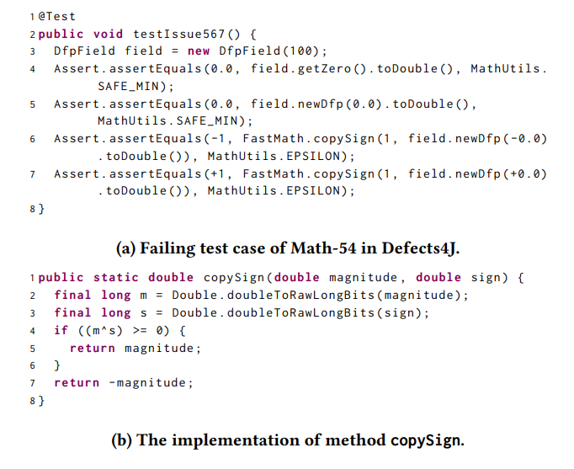
- Results and Discussions
Performance
Not be compiled
Compiled

Slide 20
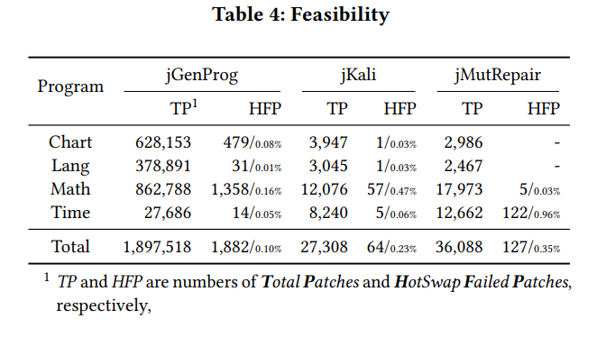
- Results and Discussions
Feasibility
For anonymous classes
(cannot match old and new classes by the class name)

Slide 21
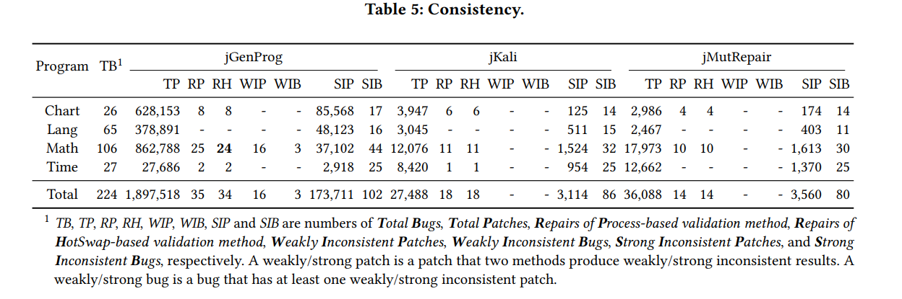
- Results and Discussions
Consistency

Slide 22
- Future work
- Recent research with speed up APR

