Slide 1
Causal Testing: Understanding Defects’ Root Causes
ICSE 20
Brittany Johnson, Yuriy Brun, Alexandra Meliou
2020-10-08
JuHyoung Kim
kjhkjh75@naver.com

Slide 2
- Configuration
Abstract
Introduction
Motivating Example
Casual Testing
Holmes
Casual Testing Effectiveness
Causal Testing Applicability to Real-world Defects
Discussion

Slide 3
- Abstract
Understanding the root cause of a defect is critical to isolating and repairing buggy behavior.
Using Defects4J
Applied 71% of real-world defects, 77% of those can help identify root cause

Slide 4
- Introduction
Most techniques don`t focus on why the code is faulty.
Need technique for identifying root causes of failing execution based on counterfactual causality
Changing the input minimally differently, observe the behavioral changes.
Evaluate Causal Testing in two ways
- Use Holmes in a controlled experiment.
- applicability to real-world defects (defects4J)
Causal testing focuses on explaining why buggy behavior is taking place.
Generate similar tests that exhibit different behavior.

Slide 5
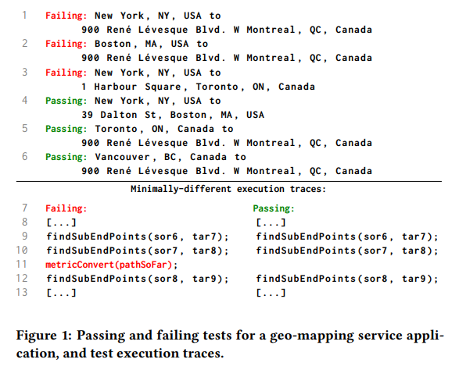
- Introduction
Developer would quickly see
The first address being a city
Length of the route
Construction
The tool found a passing and failing input with minimal execution trace differences.
All passing the test have same country starting and ending addresses in the same country.

Slide 6
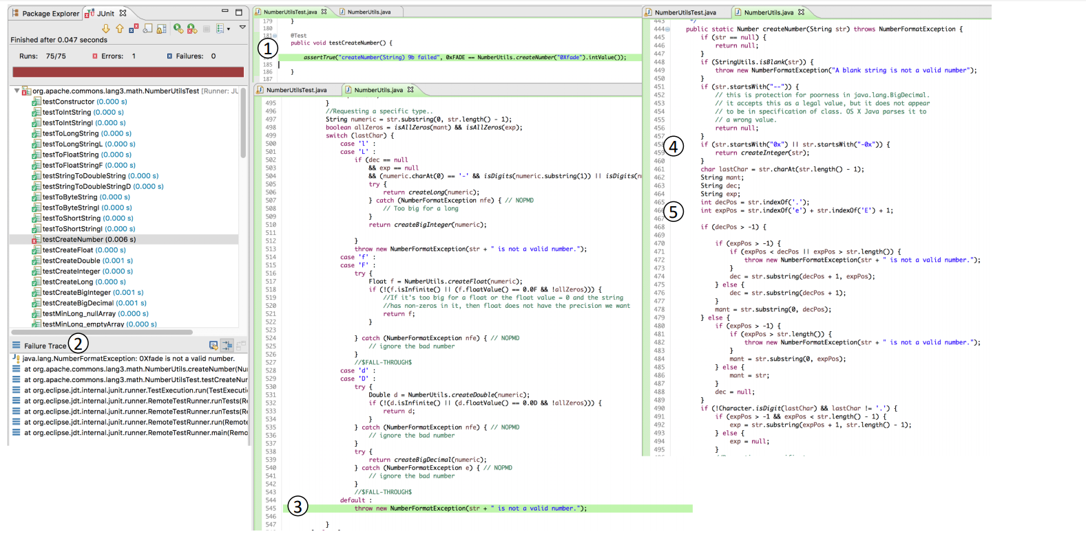
- Motivating Example

Slide 7
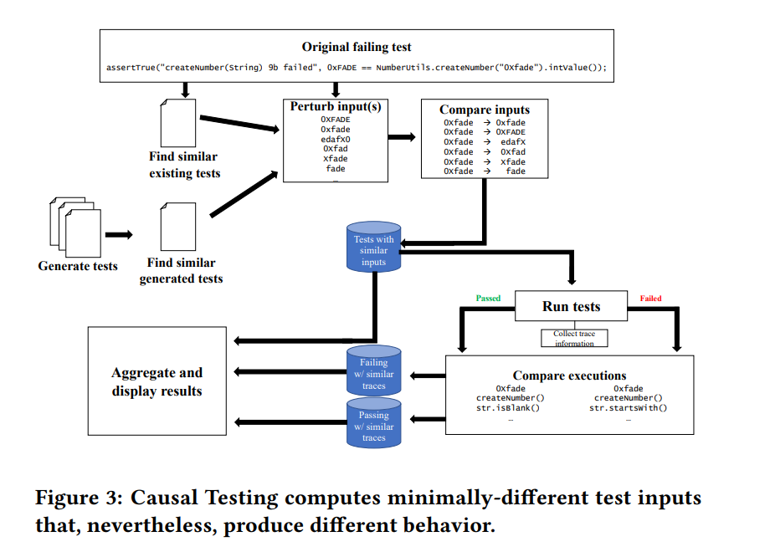
- Causal Testing
Causal Experiments with Test Cases

Slide 8
- Causal Testing
Perturbing Test inputs
First, Causal Testing rely on the existed test suite.
Second, Use automated test generation tools to get a large number of inputs
Third, Use test fuzzing to change the existing test`s inputs to generate new to similar inputs.
In real-world system, contain passing and failing tests.
Challenge of generating similar input is
Start with all existing tests
Use multiple fuzzers to fuzz these test
Generate many tests
Filter those tests to select the ones similar to the original failing test.

Slide 9
- Causal Testing
Input similarity
Static Input Differences.
Inputs can be agree in some and differ in others of their arguments
Each argument whose values for the two tests differ can differ to varying degrees.
Levenshtein distance and Hamming distance (in this case string type)
Execution Path Differences
Considering only static differences is not enough
Comparing the statements and method calls in each execution provides information is helpful to understanding root causes.
Only one statement differ - > important role

Slide 10
- Causal Testing
After generating and executing test inputs, ranks them by similarity and selects a user-specified target number of the most similar passing test cases.
In this experiments, three target and time-out was necessary
Showing difference of trace was simplified.

Slide 11
- HOLMES
Input & Test Case Generation
Searches all test in the current test suite.
Holmes converts the entire test file to a string line by line.
Holmes generate new tests.
Test case generation : Evosuite, Holmes determines the target class
ex) original failing test : NumberUtilsTest, generate test for NumberUtils
2) Input fuzzing : fuzzes existing and generated test inputs. To increase the chances that fuzzed inputs will produce passing test, and prioritizes inputs.

Slide 12
- HOLMES
Test Execution & Edit Distance Calculation
Holmes determines the Hamming distance between the two arguments.
Uses the Levenshtein distance to further refine
Edit distance threshold is 3.

Slide 13
- HOLMES
Communicating Root Causes to Developers
Holmes has computed a set of passing(failing)tests, organizes the information for presentation.
Under each tests, Holmes presents a minimized test execution trace.
Includes the option to toggle showing and hiding trace information.
Limitation
Needed to fully automation.
Project bias(defects4J).

Slide 14
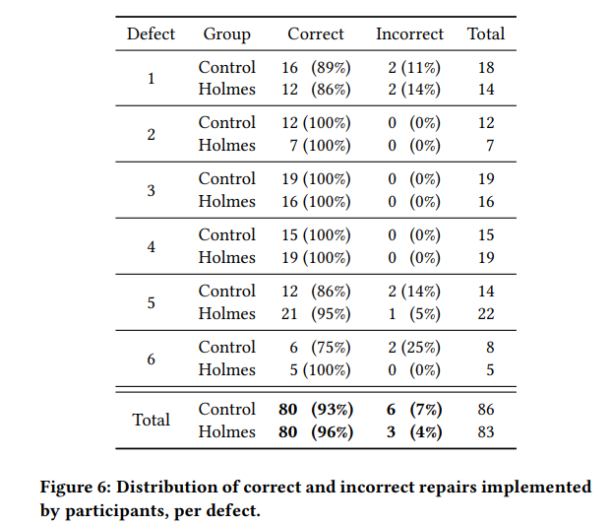
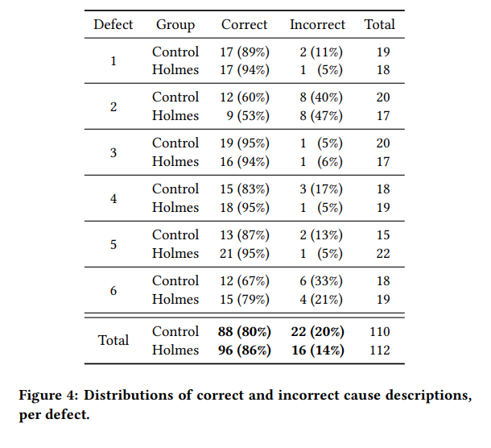
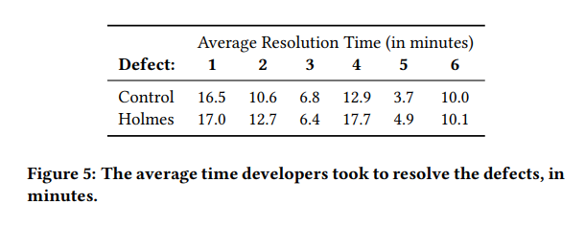
- CAUSAL TESTING EFFECTIVENESS
Causal Testing supports and improves developer ability to understand root causes, for at least some defects.
Causal Testing sometimes helps developers repair defects, but neither consistently nor statistically significantly.
Causal Testing is useful for both cause identification and defect resolution, and is complementary to other debugging tools.

Slide 15
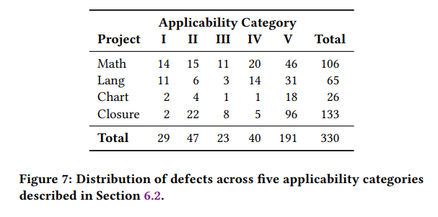
- CAUSAL TESTING APPLICABILITY TO REAL-WORLD DEFECTS
Works, useful, and fast
Works, useful, but slow
Works, but is not useful
Will not work
We could not make a determination
Causal Testing produces results for 71% of realworld defects, and for 77% of those, it can help developers identify and understand the root cause of the defect.

Slide 16
- Discussion
Encapsulating causality in generated tests
Execution information for defect understanding & repair
Causal Testing as a complementary testing technique
Supporting developers with useful tools

Slide 17
- Discussion
Threats to validity
External validity : defects4J
Internal validity : participants self-selection bias
Construct validity : representation from developers for manual

Slide 18
- Plan
Run HOLMES with defects4J
Search better approach (test prioritization, similarity measure and patch application)

