Slide 1
Causal Testing: Understanding Defects’ Root Causes
ICSE 20
Brittany Johnson, Yuriy Brun, Alexandra Meliou
2020-10-15
JuHyoung Kim
kjhkjh75@naver.com

Slide 2
- Research Goal
- Repair fundamental defect finding root cause.

Slide 3
- Progress
Paper review
First evaluation verification
Defects4J verification till this week.
Code analysis and result analysis till next week.

Slide 4
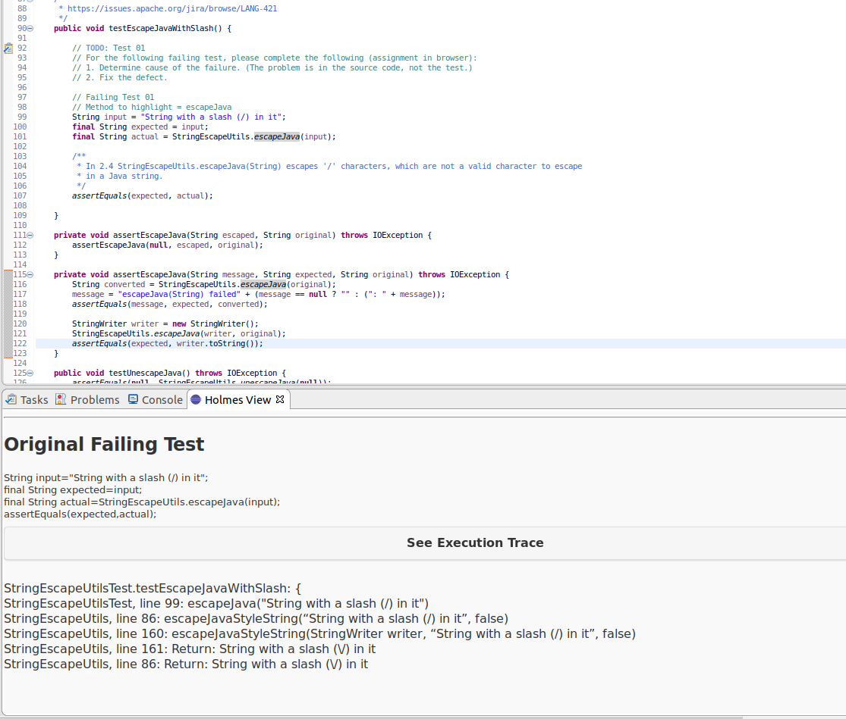
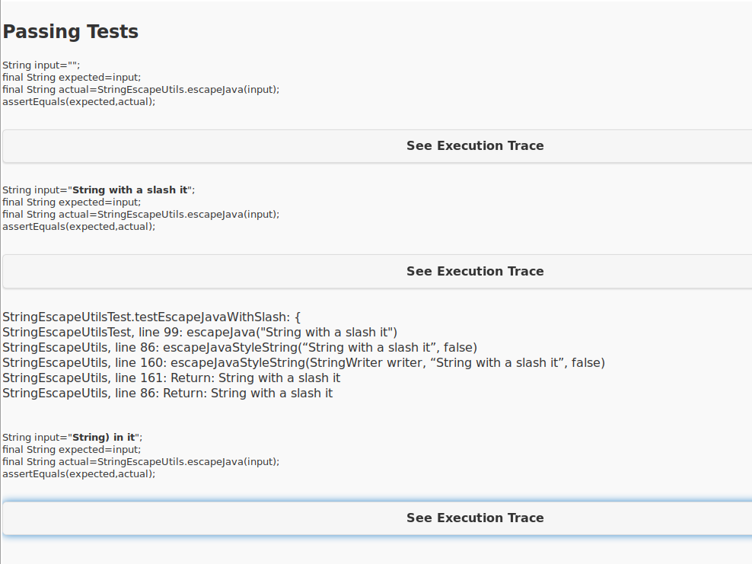
- Example

Slide 5
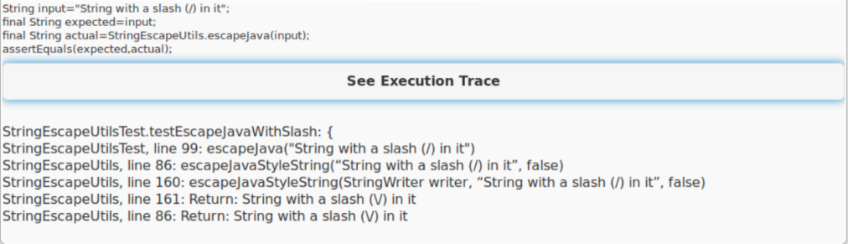
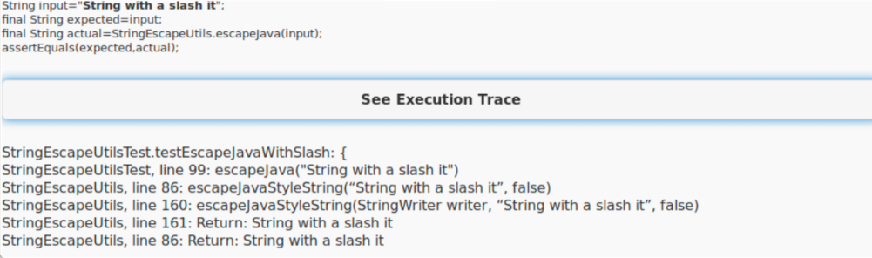
- Example
Original failing test case
Most similar test case

Slide 6
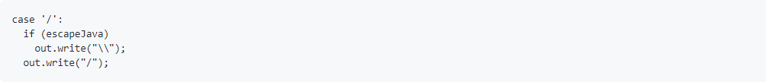
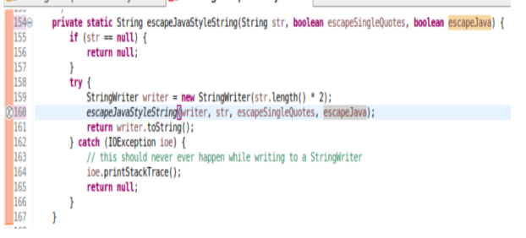
- Example
Repairing the defect
Add a condition for the escape character
Parameter edit needed.

Slide 7
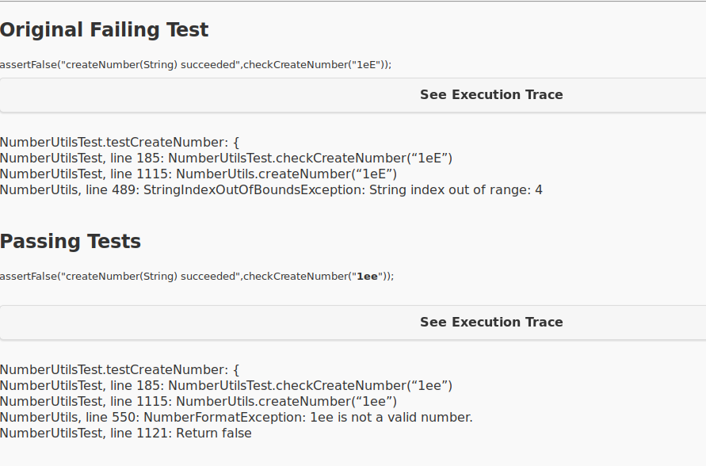
- Example

Slide 8
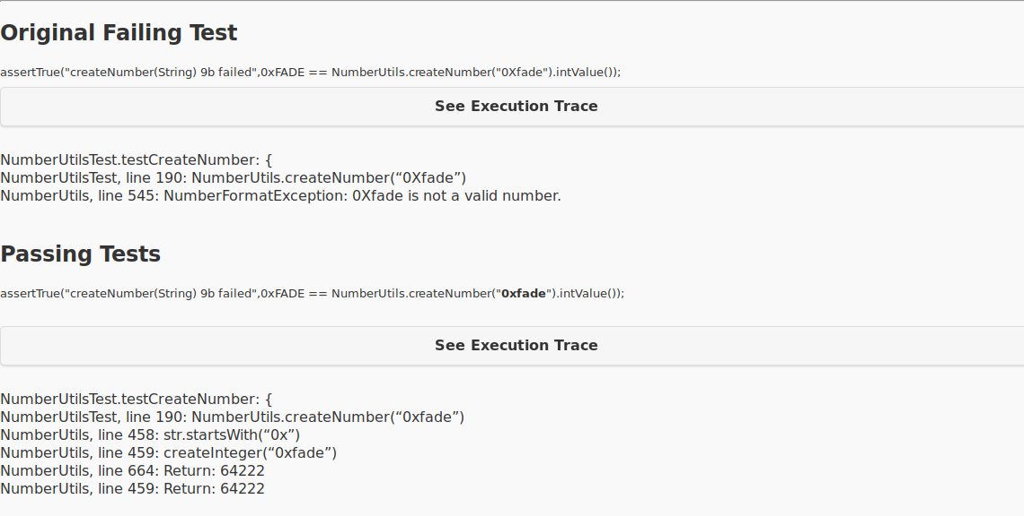
Maybe time out.

Slide 9
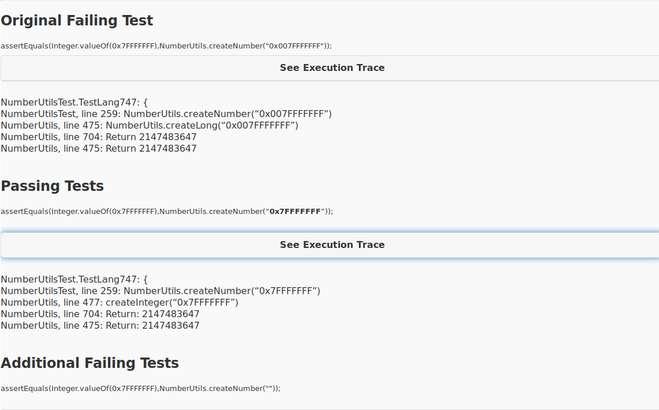
Maybe time out.

Slide 10
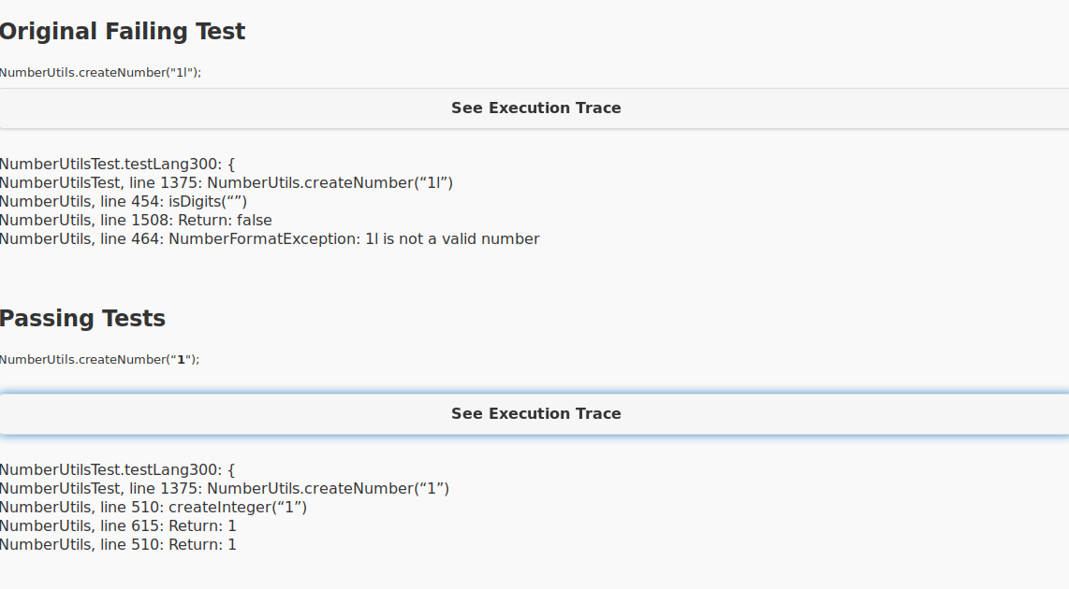
Maybe time out.

Slide 11
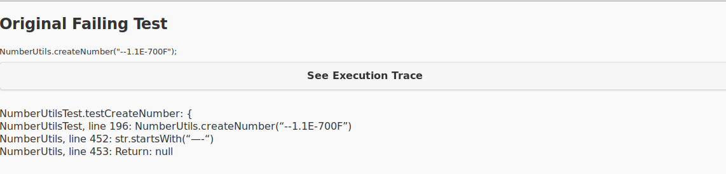
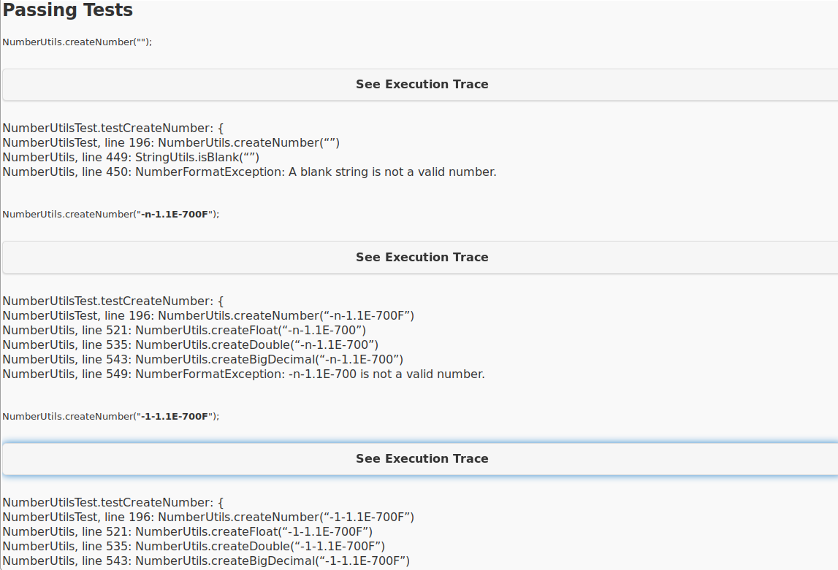

Slide 12
- Plan
Run HOLMES with defects4J
Analyze test case arrangement method
Follow passing test case path

