Slide 1
Automatic program repair
2020-11-12
JuHyoung Kim
kjhkjh75@naver.com

Slide 2
- Result
FL : Too Large range, can`t specify the space for repairing.
Method {
}
Ingredient pool : Not only in execution trace ,but there are outside of execution trace. It is not effective.

Slide 3
- Research Goal
Pattern extraction using VFL
APR with above information.

Slide 4
- Process
Done
VFL paper
Doing
Par paper
Plan
latest pattern paper

Slide 5
VFL : Variable-based fault localization
Information and Software Technology 2019
Jeongho Kim , Jindae Kim , Eunseok Lee

Slide 6
- Contents
Abstract
Introduction
Background
Approach
Evaluation
Result
Discussion
Threats to validity
Related work
Conclusion and future work

Slide 7
- Abstract
SFL leverage converge information and localize faults based on coverage difference between the failed and passed test cases.
SFL cannot localize faults effectively when coverage differences are not clear.
To address this issue and improve the fault localization performances of the SFL techniques, propose a Variable-based Fault Localization (VFL) technique
VFL identifies suspicious variables and uses them to generate a ranked list of suspicious source code lines.
224 real Java faults and 120 faults used to Evaluation.
More effective debugging than SFL

Slide 8
- Introduction
SFL is the most popular FL techniques.
Tarantula, Jaccard, Naish, and GP have been proposed, these similarity coefficients are different, but their purpose is same
SFL techniques is that if an entity covered by more failed test and fewer passed tests is more possibly faulty.
SFL cannot localize if the coverage information is not sufficient to distinguish the execution of failed and passed test cases.
Passed test and failed test execute the same block, same coverage.
Focus on variables that appear at the source code lines and try to find suspicious variables.

Slide 9
- Introduction
VFL requires information about variables appearing in the source code and coverage information.
VFL process detail
1) Extract variables and function invocations information and calculate the suspicious ratio variables and function invocations.
2) Assign the suspicious ratio statements that contain variables and function invocations.
3) perform debugging in the order of a ranked list of statements derived from the above steps

Slide 10
- Background
SFL technique identifies suspicious statements using execution traces and test results.
Failed test cases increase the suspicious ratio of statements, while passed test cases reduce the suspicious ratio of statements that are relatively unrelated to program failure
SFL technique cannot be applied in the absence of at least one failed test case
Definition
Given a program P with n statements and m test cases , vectors = V can be calculated for each Sn using an SFL matrix(n*m) Similarity coefficients can be calculated using V

Slide 11
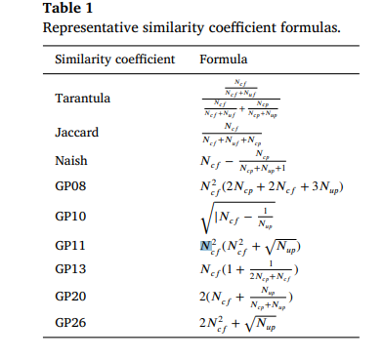
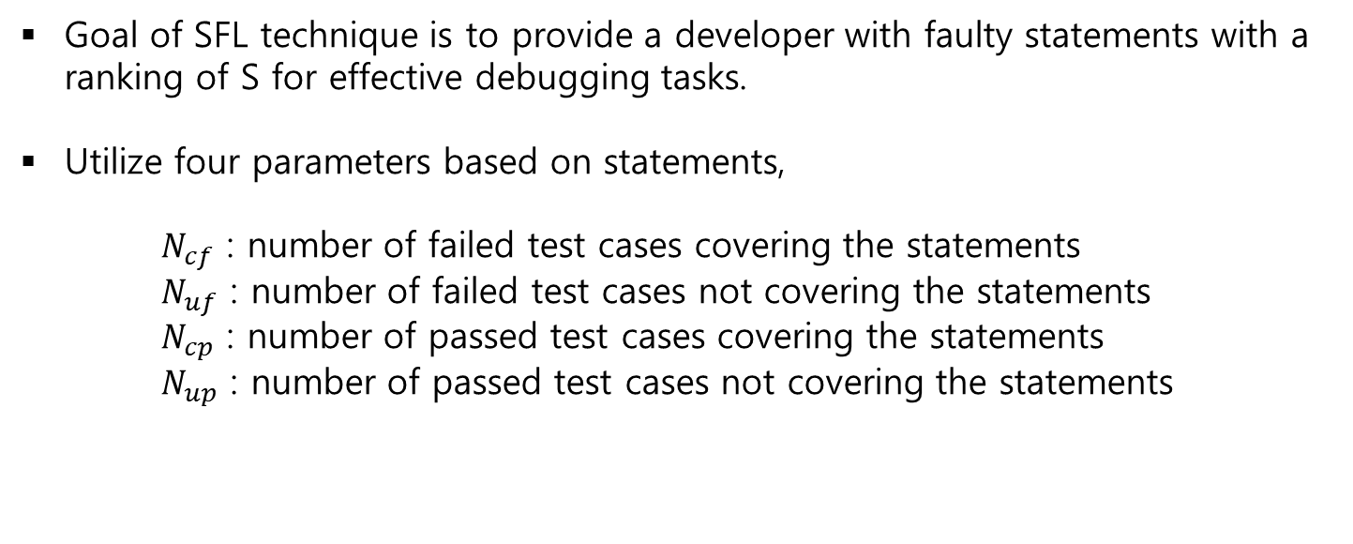
- Background
Goal of SFL technique is to provide a developer with faulty statements with a ranking of S for effective debugging tasks.
Utilize four parameters based on statements,
$N_{cf}$ : number of failed test cases covering the statements
$N_{uf}$ : number of failed test cases not covering the statements
$N_{cp}$ : number of passed test cases covering the statements
$N_{up}$ : number of passed test cases not covering the statements

Slide 12
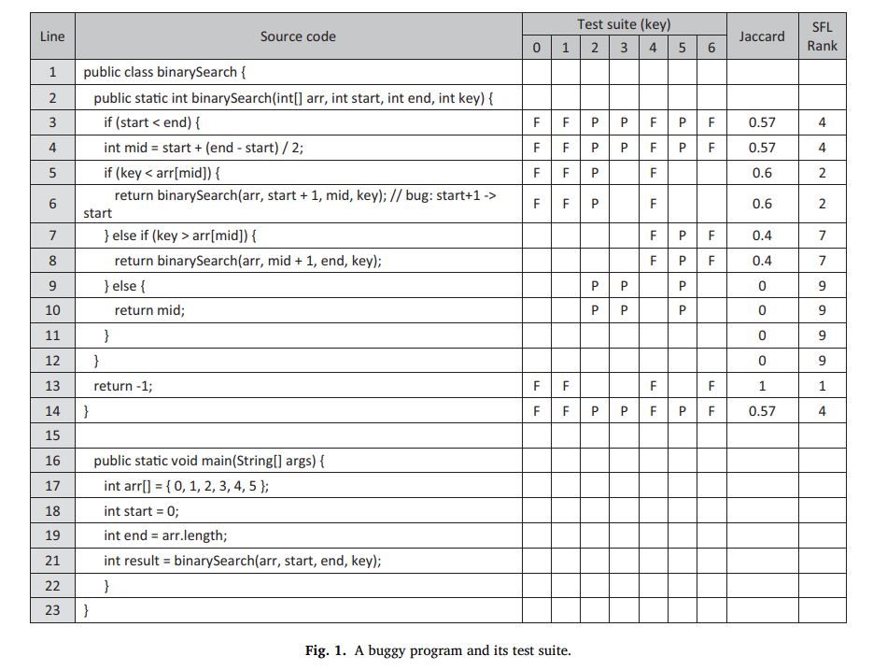
- Approach
Tied-rank problem of the traditional SFL technique
SFL cannot distinguish tied-rank statements.

Slide 13
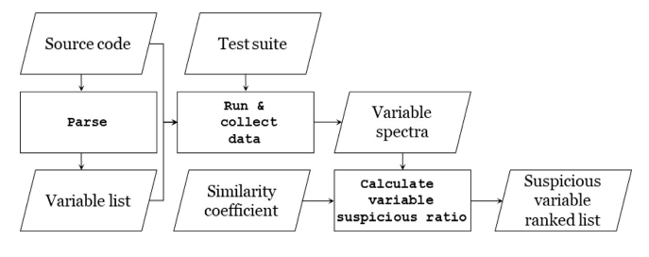
- Approach
Variable spectra are calculated based on the execution traces and the test results of the program.
Calculate the suspicious ratio of the variables by substituting the variable spectra into the similarity coefficient.

Slide 14
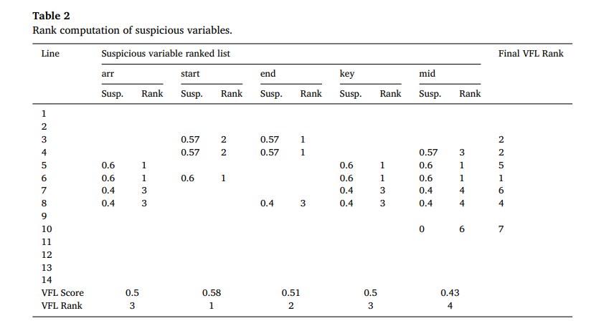
- Approach

Slide 15
- Approach
VFL designed with the assumption that most executable statements contain variables and that the probability that a statement without a variable is defective is very low.
But all faults do not necessarily occur in statements including variables.
VFL(V) version , VFL(VF) version
VFL(VF) can handle not only statements including variables but also excluding.

Slide 16
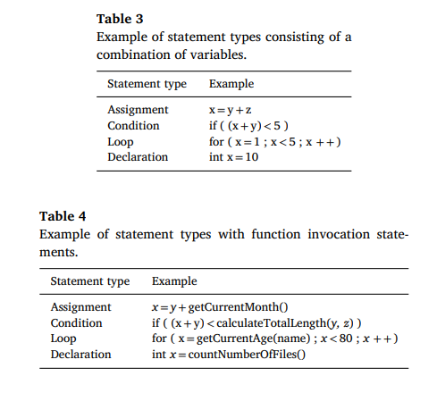
- Approach
VFL(VF)
1) the type of statement is classified as assignment, condition, command(invocation and a return), loop, and other statements
2) If there is a fault in the function invocation statement, VFL(V) accuracy
can be lowered.
3) VFL(V) assigns suspicious ratios based on variables
VFL(VF) assign ratios based on both variables and function invocation statements.

Slide 17

- Evaluation
RQ1 : How well does the VFL(v) technique localize faults?
RQ2 : How well does the VFL(V) technique place faulty statements at low ranks?
RQ3 : Is the VFL(V) technique effective for every fault?
RQ4 : Can we increase the VFL(V) technique performance and applicability by using additional techniques?
Benchmark and Tools : Defects4J and Siemens suite (Java and C)
One popular metric

Slide 18
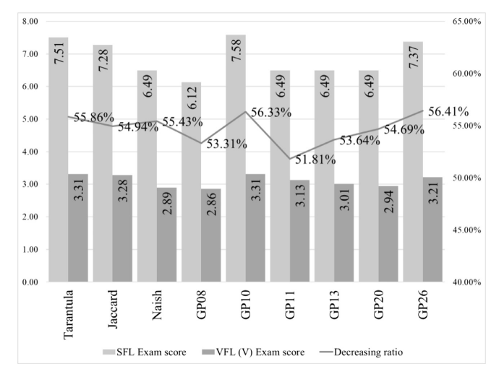
- Result
RQ1: How much effort can be saved with the VFL (V) technique?

Slide 19
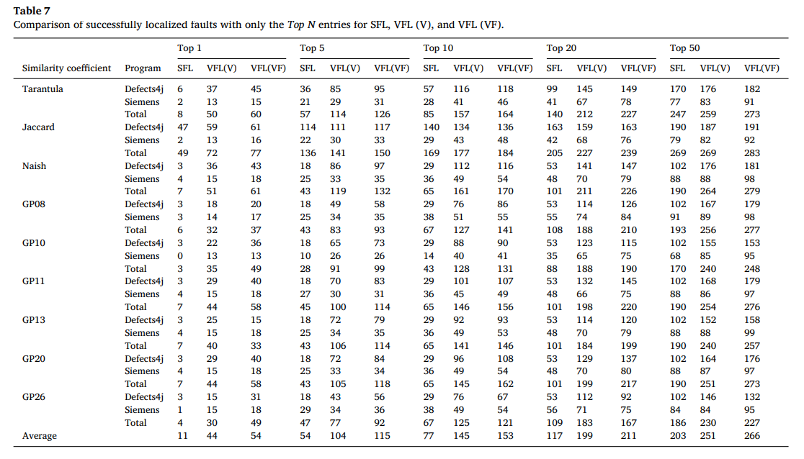
- Result
RQ2: How well does the VFL (V) technique place fault statements at low ranks?

Slide 20
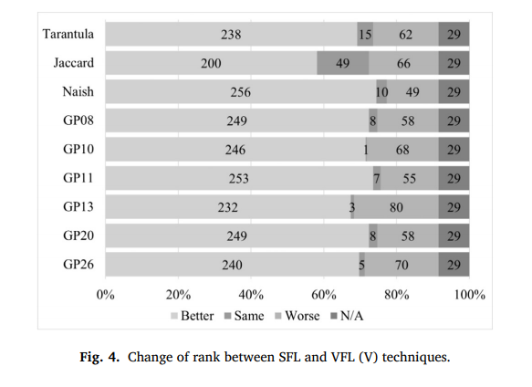
- Result
RQ3: Is the VFL (V) technique effective for every fault?

Slide 21
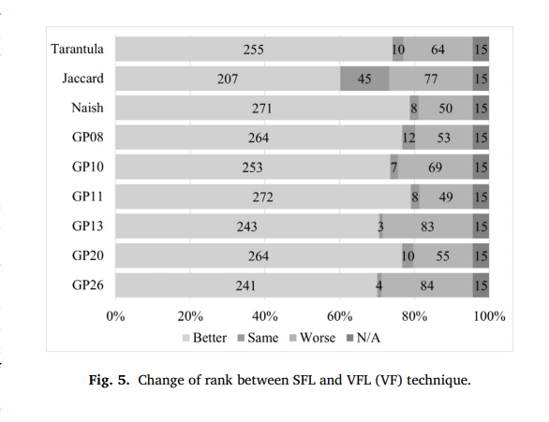
- Result
RQ4: Can we increase the VFL (V) technique performance and applicability by using additional techniques?

Slide 22
- Threats to validity
Result might not be generalizable.
Siemens suite.

Slide 23
- Conclusion
VFL requires execution traces and test results same with SFL
And name and location information of the variables and functions
And easily extracted automatically
It solves the coverage problem of SFL
VFL is very lightweight
In the future, assigning weight instead of accounting type of statements

Slide 24
- Plan
Next task
Read Par and another pattern paper.

Slide 25
- Appendix
APR : High FL rank -> high Performance in terms of time
Can predict time cost approximately using bug pattern?
Pattern prioritization using variable information?

