Slide 1
Automatic program repair
2020-11-26
JuHyoung Kim
kjhkjh75@naver.com

Slide 2
- Research Goal
Pattern extraction using VFL
APR with above information.

Slide 3
The effectiveness of context-based change application on automatic program repair
Jindae Kim ·Jeongho Kim · Eunseok Lee · Sunghun Kim
(2020 ESE)

Slide 4
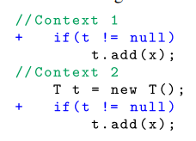
- Introduction.
Apply with different Context
First is meaningful
Second is not
Collecting information context, prevent creating second case.
Contribution.
1) Found that change contexts are effective to find necessary change from patch search space expanded by many collected changes
2) Inspect the usefulness of contexts in fix location selection
3) Evaluate change concretization with name selection.

Slide 5
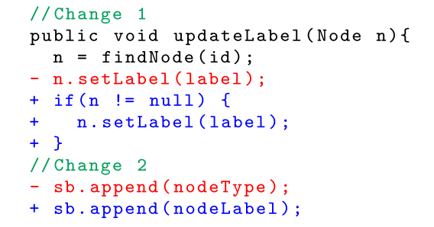
- Introduction
Not suitable for re-use
1) highly dependent to coding style (brackets or white space)
2) include user-defined names

Slide 6
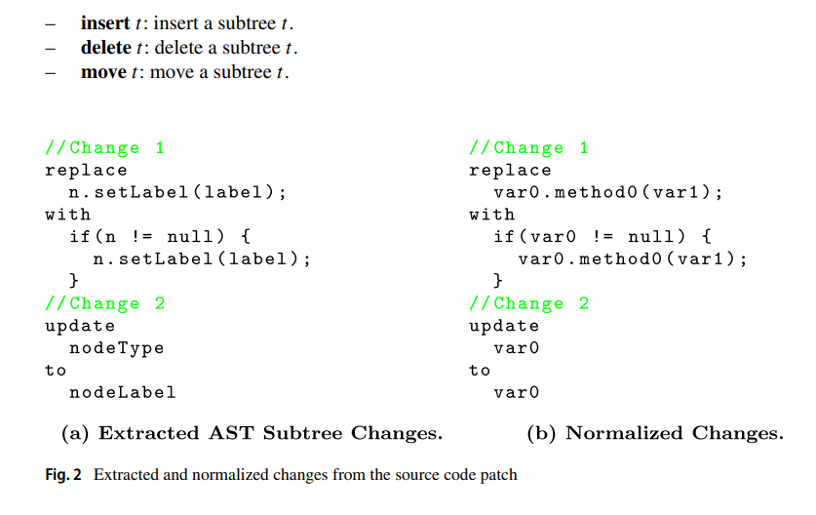
- Context-based Change Application Tech

Slide 7
- Context-based Change Application Tech
Change selection
– Random (RND): A baseline method. Randomly selects one of the given changes.
– Roulette-Wheel Selection (RWS): A stochastic method with change frequency as weight.
– Most Frequent First (MFF): Selects the most frequent change among given changes.

Slide 8
- Context-based Change Application Tech
Change Concretization and Name Selection
– Random (RND): A baseline method. Randomly selects one of the concrete names.
– Type-Compatible (TC): Consider type-compatibility of variables, types and methods for assignments.
– Variable-oriented Fault Localization (VFL): Consider relevance of names to a bug, computed by variable-oriented fault localization technique (Kim et al. 2018).
– Hybrid Method (TC-VFL): Consider both type-compatibility and relevance to select concrete names.
Type-compatibility
Var0.method0(var1) is selected
Var0 type = Type0
Var1 type = String
Method0 = must return an integer

Slide 9


- Context-based Change Application Tech
VFL
- Using more relevant variables for a selected changed is more
desirable than using irrelevant variables to fix the given bug.

Slide 10
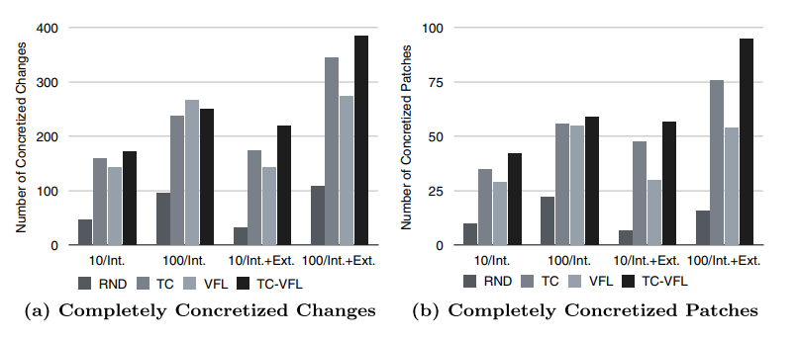
- Context-based Change Application Tech
Result

Slide 11
- SEQEUNCER

Slide 12
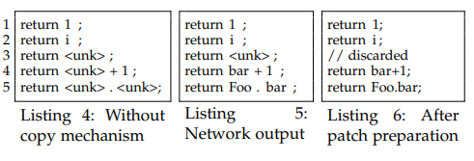
- SEQUENCER
Process OOV with copy mechanism in this paper
Suspicious variable can be answer?
Processing realization.

Slide 13
- Processing and Plan
Checking some fault from defects4j data with confix
SequenceR has same problem with variables.

