Slide 1
Automatic program repair
2020-12-10
JuHyoung Kim
kjhkjh75@naver.com

Slide 2
Priority Measurement of Patches for Program Repair Based on Semantic Distance
Yukun Dong ∗ , Meng Wu , Li Zhang , Wenjing Yin , Mengying Wu and Haojie Li

Slide 3
- Introduction.
Only a few patches meet the developer`s requirements
Quality of a patch is determined by many characteristics, such as retaining the expected function of the program in certain aspects
Propose a method to rank the quality of patches based on semantic distances

Slide 4
- Related Work
Repair Strategy
1) Nopol, which is used to fix single condition errors that occur in conditional and loop statement
2) DynaMoth, synthesize conditions containing method calls(nopol X)
3) SemFix, replaces the expression ->symbolic expression
(generic condition or variable assignment)
4) ACS, Variable selection - > Predicate selection
APR tool based on generation and verification

Slide 5
- Related Work
Most of them mutate programs in other locations to generate patch search space, add patches to suspicious locations, judge correctness through test cases.
GenProg, AE,
Due to the incompleteness of validation standards, patches are still defective.
To solve this problem, Propose a patch quality evaluation method

Slide 6
- Related Work
Patch Prioritization
Many repair use internal sorting to correct probability
Different patches have different thresholds -> a perfect patch prioritization methods does not necessarily produce a perfect patch classification method
Patch prioritization categories.
1. Based on the frequency of patches in historical error repairs.
2. Number of passing test cases to sort patches
3. Syntax and semantic distance between the original program

Slide 7
- Evaluation of patch quality based on semantic distance
Generated patches contain a large number of error patches.
Patches can be three types, namely insertion, deletion, and modification.
The semantic distance, proposed by paper, between the patch and the original program is analyzed through interval distance, output coverage, and path matching.
Convert a patch quality evaluation problem into a prioritization problem by recommendation.

Slide 8

- Evaluation of patch quality based on semantic distance
Interval Distance
Interval distance to measure the degree of “inconsistency” between any two Boolean expressions,
When a defect appears in the Boolean expression, the feasible interval between the patch and the original expression will definitely change
It will cause a new defect because the semantics of the original program may change if the distances is greater than a given value
tj, test case
e, Boolean expression
m, method
p, original program

Slide 9

- Evaluation of patch quality based on semantic distance
Interval Distance
tj, test case
e, Boolean expression
m, method
p, original program
pi, patch given to the defect

Slide 10
CoCoNuT: Combining Context-Aware Neural Translation Models using Ensemble for Program Repair
Thibaud Lutellier, Hung Viet Pham, Lawrence Pang, Yitong Li, Moshi Wei, Lin Tan
ISSTA2020

Slide 11
- Introduction
Main approaches for APR
1) candidate patches are generated using a set of transformation or mutations(deleting a line or adding a clause)
2) Candidates are ranked and validated by compiling and running a given test suite.
Existing techniques require extensive customization to work across programming languages
Need for easy transferable model to different language
NMT popular deep learning generate sequences.

Slide 12
- Introduction
Two advantages
1) Automatically learn complex relations between input and output sequences that are difficult to capture manually.
2) While G&V methods often use hard-coded fix patterns that are programming-language-dependent and require domain knowledge,
NMT tech can be retained for different languages automatically

Slide 13
- Introduction
Two main Challenges
1) Representing Context (e.g statements before and after the buggy lines)
- To represent the context effectively is a challenge
SequenceR, tufano et al : concatenate context and buggy code as one input instances
problem )
1. Concatenating context and buggy code makes the input sequences very long
-> fix short methods
2. Concatenating buggy and context lines makes it more difficult for NMT to extract meaningful relations
-> 1 buggy line and 9 line of context,
9 context lines will add noise to the buggy line

Slide 14
- Introduction
Two main Challenges
1) Representing Context (e.g statements before and after the buggy lines)
- Propose a new context-aware NMT architecture has two separate encoders : one for buggy lines, the other one for the context
Advantages)
1. Buggy line encoder will only have shorter input sequence
->extract strong relations buggy and correct fix
2. Separate context encoder helps the model learn useful relations from the context
3. Two encoders are independent, encoders can have different complexity
-> can improve the performance

Slide 15
- Introduction
Two main Challenges
2) Capturing the diversity of bug fixes
- Due to the diversity bugs and fixes(many different type)
Single NMT model would struggle to generalize.
-> Leverage ensemble learning
- CoCoNut, proposed techniques consists of an ensemble of fully convolutional models and new context-aware NMT models

Slide 16
- Introduction
Contributions
A new context-aware NMT
First application of CNN for APR ( outperforms LSTM, Transformer)
Ensemble approach for better capture the diversity of bug fixes.
First APR technique that is easily portable to different programming languages.
6 benchmarks in four programming languages.
Use of attention maps to explain why certain fixes are generated or not by CoCoNuT

Slide 17
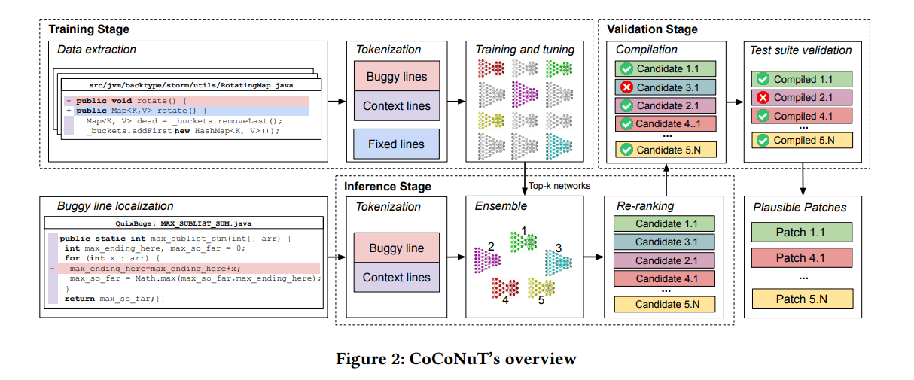
- Approach
Three stages : training, inference, validation

Slide 18
- Approach
1. Challenges
Representing context, capturing the diversity of fix patterns, additional
3) Choice of Layers of Neurons
- Source code is generally not executed in the same sequential way ( e.g., conditional blocks might be skipped)
->relevant information can be located farther away
- Use convolutional layers as main, better capture than RNN
- Layers of larger kernel sizes model long-term relations
<->Layers of smaller kernel sizes model short-term relations

Slide 19
- Approach
1. Challenges
Representing context, capturing the diversity of fix patterns, additional
4) Large vocabulary size
- Developers can practically create arbitrary tokens
- Letter case indicates important meanings
-> Increases the vocabulary size
- 1,136,767 -> 139,423 tokens vocabulary set

Slide 20
- Approach
2. Data Extraction
“Fix”, “bug”, or “patch” collection.
Filter “rename”, “clean up”, “refactor”, “merge”, “misspelling” and “compiler warning”
93 of 100 are bug-related commits. (7% reasonable noise amount)
Representing the context of the bug using the function surrounding in the buggy lines
-> it gives semantic information
(relatively small, contains relevant variables)
SequenceR`s context = <1000 tokens
Tufano`s context = method but one encoder

Slide 21
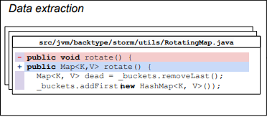
- Approach
3. Input Representation and Tokenization
Two separate inputs : a buggy line and context
Choose a correct abstraction to transform a buggy line and its context
Use a tokenization method analogous to world-level tokenization

Slide 22
- Approach
3. Input Representation and Tokenization
Challenges of tokenization
1) Separate operators from variables as they might not be space-separated.
2) Vocabulary size is extremely large and many words are infrequent or composed of words without separation(getNumber and get_Number)
->considering underscores, camel letters, numbers as separators.
-> <CAMEL> to mark camel case split, abstract string and numbers (except 0,1)
vocabulary size 1,136,767 to 139,423 tokens

Slide 23
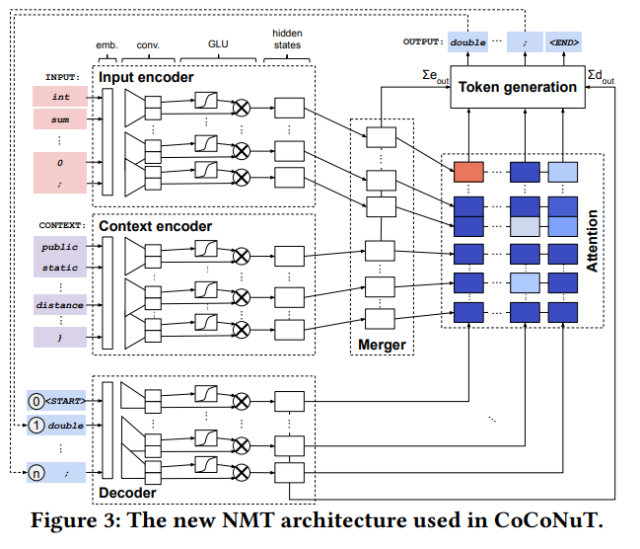
- Approach
4. Context-Aware NMT Architecture
Choose Fconv layers for stacking to extract hierarchical features for large contexts.
-> enables modeling source code at different granularity levels
like developers read code
Architecture consists of several components : an input encoder, a context encoder, a merger, a decoder, an attention module

Slide 24
- Approach
5. Ensemble Learning
There are very diverse bugs with very different fixing patterns
Simple patterns(e.g., changing the operator < to >)
<> complex (e.g., adding a null checker or calling a different function)
Training a model to fix all types of bugs is difficult.
->Instead, combine multiple models into an ensemble model
Propose an ensemble approach
1) models with and without context
2) models with different hyperparameters(different networks)
to perform the best results.

Slide 25
- Approach
5. Ensemble Learning
Different hyperparameters have a large impact on the complexity of a network, the speed of the training process, and the final performance of the trained model.
Apply random search for tuning process
Since training a model until convergence is very expensive, tune with only one epoch.
Train n models with different random sets of parameters do obtain models with different behavior and keep the top k best models

Slide 26
- Approach
6. Patch Validation
Statement Reconstruction
- Model outputs a list of tokens that forms a fix
- For the abstracted tokens(strings and numbers), extract donor code from the original bug file
- After generation fix, validate it.
Compilation and Test Suite Validation
- Model does not have access to entire project
-> Validation step check compilation and Test suite pass
- Two criteria for validation process
1) Test cases that make the buggy version pass still pass
2) At least one test case that failed on the buggy version pass

Slide 27
- Approach
7. Generalization to Other Languages.
CoCoNuT Learns patterns automatically
-> It can be generalized to other programming languages
Need New input data, then top k models can be retrained without
Re-implementation.
CoCoNuT will learn fix patterns automatically for the new languages.

Slide 28
- Experiment Setup
Selecting Training Data
- Two training sets.
1) All instances committed before 2006
2) Committed before 2010
- First data set can be trained for all bugs
<> Second data set can be trained for bugs (2010~)
-> for no future data.
Selecting State-of-the-art Tools for Comparison
- 27 APR techniques

Slide 29
- Experiment Setup
Training, Tuning, and Inference
- For tuning, a random 20,000 instances for validation, rest for training
- Random search to tune hyperparameters.
- Train 100 models for one epoch on the 2006 Java training set with different hyperparameters and rank them based on their perplexity
- Use beam search with a beam width of 1,000.
Infrastructure
- Pytorch for LSTM, Transformer, and FConv

Slide 30
- Evaluation and Result
Realistic Evaluation Setup
- Using training/validation instances that are newer than bus in bench
could helpful but not realistic.
- Pattern-based techniques could suffer this problem
- To address this issue, split into two parts
1) Contains bugs from 2006~2010 trained with before 2006
2) Contains bugs from 2011~2016 trained with before 2011
- Stop CoCoNuT after the first generated patch that validated
- Time limit six hours

Slide 31
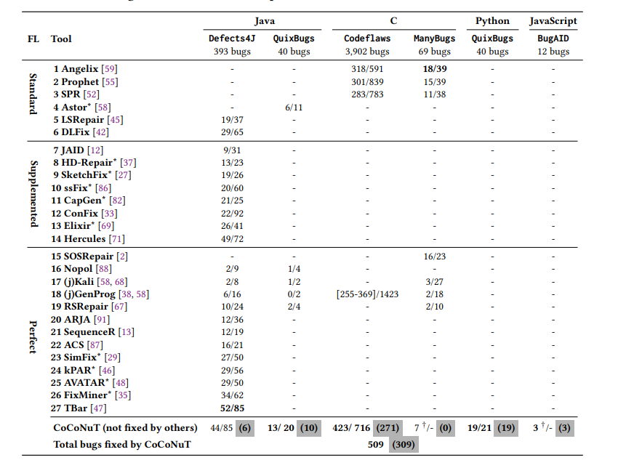
- Evaluation and Result
1. RQ1 : How does CoCoNuT perform against state-of-the-art APR techniques?
x/y : correct/plausible
FL column : based on FL types
1) Standard : SBFL
2) Supplemented : with improvement
3) Perfect : Perfect Loc
: Only CoCoNuT fix

Slide 32
- Evaluation and Result
1. RQ1 : How does CoCoNuT perform against state-of-the-art APR techniques?
CoCoNuT performs better than all techniques but Tbar and Hercules.
6 Bugs CoCoNuT only fix.
2 of the 6 bugs new patterns
Fifteen of the bugs fixed by Hercules are multi-hunk bug fixes
-> Most NMT techniques don`t handle.

Slide 33
- Evaluation and Result
1. RQ1 : How does CoCoNuT perform against state-of-the-art APR techniques?
In Defects4J, 43% (19 out of 44) of the bugs fixed by CoCoNuT are not fixed by Tbar
Several bugs fixed by Tbar that CoCoNuT fails
1) If statement insertion(e.g., null check) - 7
2) Move a statement to a different location – 3
->Targeting modifying a statement, not appear in training set
1,000 patches for each bug per model, correct patches are generally ranked very high.
Ten of the 44 correct patches ranked first
Average rank of a correct patch is 63 and median 4 ,Worst is 728.

Slide 34
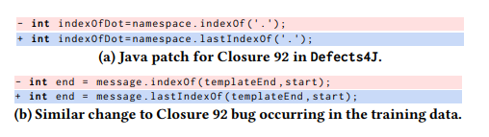
- Evaluation and Result
RQ2 : Which bugs only CoCoNuT can fix?
With Perfect FL, without a time limit, Tbar can`t fix
CoCoNuT fix because existing pattern-based techniques does not cover
CoCoNuT directly learns patterns from historical data without any additional manual work,making it portable to different programming languages.

Slide 35
- Evaluation and Result
RQ3 : What are the contributions of the different components of CoCoNuT and how does it compare to other NMT-based APR techniques?
Three Contributions
1) Performance of new NMT architecture compared to state- of-the-art NMT architectures
2) Impact of context
3) Impact of ensemble Learning
Comparison with State-of-the-art NMT
- CoCoNuT 44 fix, DLFix 29,
- Fconv 21, Transformer 13, SequenceR 12
- LSTM 5 bug fixed.

Slide 36
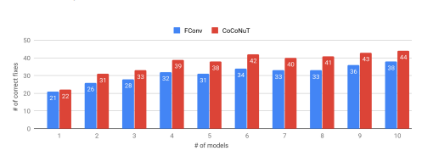
- Evaluation and Result
RQ3 : What are the contributions of the different components of CoCoNuT and how does it compare to other NMT-based APR techniques?
Impact of the Context
- without context : Fconv
- with context : CoCoNuT

Slide 37
- Evaluation and Result
RQ4: Can we explain why CoCoNuT can (or fail to) generate specific fixes?
The Majority of the Fixes are not Clones
- Keep training and validation instances from before the first bugs in benchmarks for a fair evaluation.
- The majority of the bugs fixed by CoCoNuT do not appear in the training sets.

Slide 38
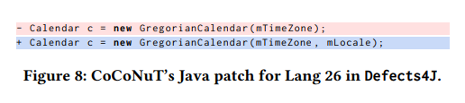
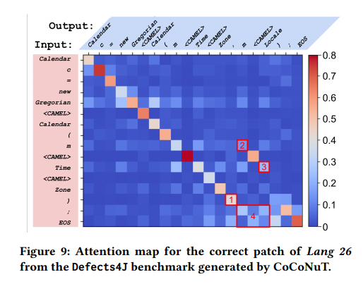
- Evaluation and Result
RQ4: Can we explain why CoCoNuT can (or fail to) generate specific fixes?
Analyzing the Attention Map

Slide 39
- Evaluation and Result
RQ4: Can we explain why CoCoNuT can (or fail to) generate specific fixes?
Patches that pass the test suite but are incorrect are an issue that CoCoNuT and other APR techniques share
CoCoNuT Could generate a correct fix for 8 additional bugs if more time is given
For these 8 bugs, CoCoNuT generates an incorrect patch that passes the test suite or timed out before the correct fix

Slide 40
- Limitation
Dataset used to train is different from the ones used by other work
->but comparison with LSTM, Fconv, and Transformer architecture are better
Benchmark Generalizable (6 bench mark)
Randomness

Slide 41
- Issue
Future data
Noise data(about 7%)
Test case quality for correction or plausible patch quality
Patch in machine and human difference
Context for buggy line
Multi hunk problem

