Slide 1
Automatic program repair
2020-01-13
JuHyoung Kim
kjhkjh75@naver.com

Slide 2
- Contents
Summary
Progress
Research Scenario
Document configuration.
Template based techniques
Issue
Future work

Slide 3
- Summary
Recently APR techniques characteristics and Comparisons for improvement

Slide 4
- Progress
Previous Work
- Change data set to defects4j 2.0.0
- Setting Jgenprog, Tbar
- Running the Tbar
Processing work
- Add template-based techniques.
- Document process
- Paper (all techniques paper for template based)
Future work
- comparison with template based techniques and ideation.

Slide 5
- Research secenario
Search-based techniques have limitations
1. may have not correct patches
2. For randomly search, search space explosion happen.
Template-based techniques cover these limitations.
Learning-based techniques cover templated-based techniques and opposite case can happen.
We can judge which techniques can be more effective these evidence.

Slide 6
- Document configuration
Introduction
- Explanation for APR and techniques
- existing techniques problems
- contribution.
Background
- G & V
- Template-based tech
- Learning-based tech
- Summary each techniques.
Analysis and comparison

Slide 7
- Comparison paper
Confix
Capgen
Simfix
FixMiner
AvaTar
Capgen
TBar

Slide 8
- Template based Paper
Confix
Fix pattern mining
- Abstract AST subtree changes from human-written patches
Number of Fix pattern
- Uncountable
Change abstraction
ex) var0,var1,str0
Pattern matching
- Use the parent of the subtree`s root, root`s left and right nodes

Slide 9
- Template based Paper
Capgen
Fix pattern mining
- Highest frequencies for replacement, insertion, deletion top 10
Number of Fix pattern
- 30
- Cover 69.69% of the datasets.

Slide 10
- Template based Paper
Capgen
Patch ingredient prioritization
1) node`s genealogical structure
- infix expression equals(x,y,1) is frequently used as the returning value in return statements then high probability to be ingredients for mutating returning values.
2) Variable usages
- fixing ingredients uses the same variables as the target expression to be replaced
3) dependency
- variables used or defined in a given node are affecteced by or can affect other nodes.

Slide 11
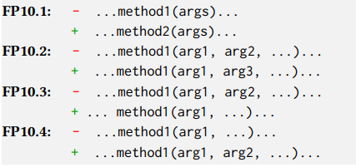
- Template based Paper
TBar
Fix pattern mining
- 15 categories of patterns labeled based on existing techniques.
- 35 code change patterns ( each category have sub-categories)
Pattern matching
- match each node of the suspicious statement AST from its first child node to its last leaf node
ex) child node of a suspicious statement is a method invocation expression will match FP10

Slide 12
- Template based Paper
TBar
Patch pattern prioritization
- Update > Insert > Delete
Patch ingredient prioritization
- distances between donor code and buggy code node in the AST
- smaller distances, priority is given.

Slide 13
- Template based paper
AVATAR
Fix pattern mining
- Collect edit scripts from AST, leverage CNN to learn features of edit scripts and clustering based on X-means algorithm.
Largest common subset of edit actions among all edit scripts in a cluster is considered as the pattern.
Number of fix pattern
- 13
Pattern matching
- AST nodes associated to the faulty code
these nodes are checked against the nodes involved in the edit scripts of fix patterns

Slide 14

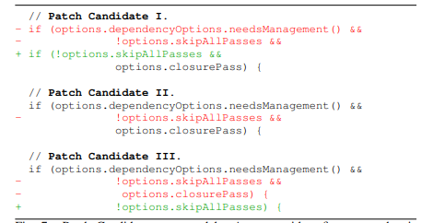
- Template based paper
AVATAR
- Ifstatement
- InfixExpression
- Infixexpression must contain at least two sub-predicate expressions

Slide 15
- Issue
Plausible patch
- Not all passed test patch may be plausible patch?
-> patch that number of test case improved can be another target file?

Slide 16
- Future work
More analysis for template based techniques
Design the experiments

