Slide 1
Automatic program repair
2020-01-20
JuHyoung Kim
kjhkjh75@naver.com

Slide 2
- Contents
Summary
Progress
Research Scenario
Technique`s pattern extraction and match
Issue
Future work

Slide 3
- Summary
Recently APR techniques characteristics and Comparisons for improvement
Not Targeting the concrete techniques, targeting better approach
(ex, focusing ingredient prioritization or pattern prioritization) – not fixed

Slide 4
- Progress
Previous Work
- Add template-based techniques
- Document process
- read more papers
Processing work
- comparing each pattern use
Future work
- Real case verification.

Slide 5
- Target paper
Tbar
SimFix
Capgen
AVATAR
FixMiner
Confix

Slide 6
- Real scenario
Pattern matching , get ingredients
Use AST for these process.
Can categorize each technique`s pattern extraction and matching
Can distinguish each bug type fit with what approaches.

Slide 7
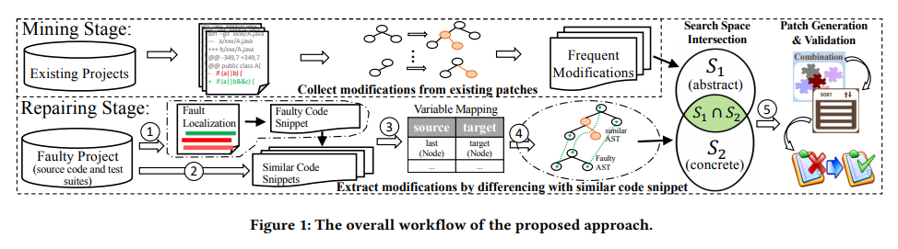
- SimFix
Using donor code in same projects with faulty code, fix faulty code.
Modification operations : Insert, Replace

Slide 8
- Matching Pattern
SimFix (Modification extraction from Donor)
Matching AST to the Source code (Match : same node type, ancestors are matched)
1. match function with the roots of the two ASTs.
-> if the two nodes can be matched
2. recursively check their children or check whether the nodes can be matched by inserting some parent nodes in the referenced AST to the faulty AST.
-> Two nodes are matched
3. Check their children (two types of nodes)
1) tuple nodes, children at the corresponding positions are matched
2) Sequence nodes, children can be freely matched

Slide 9
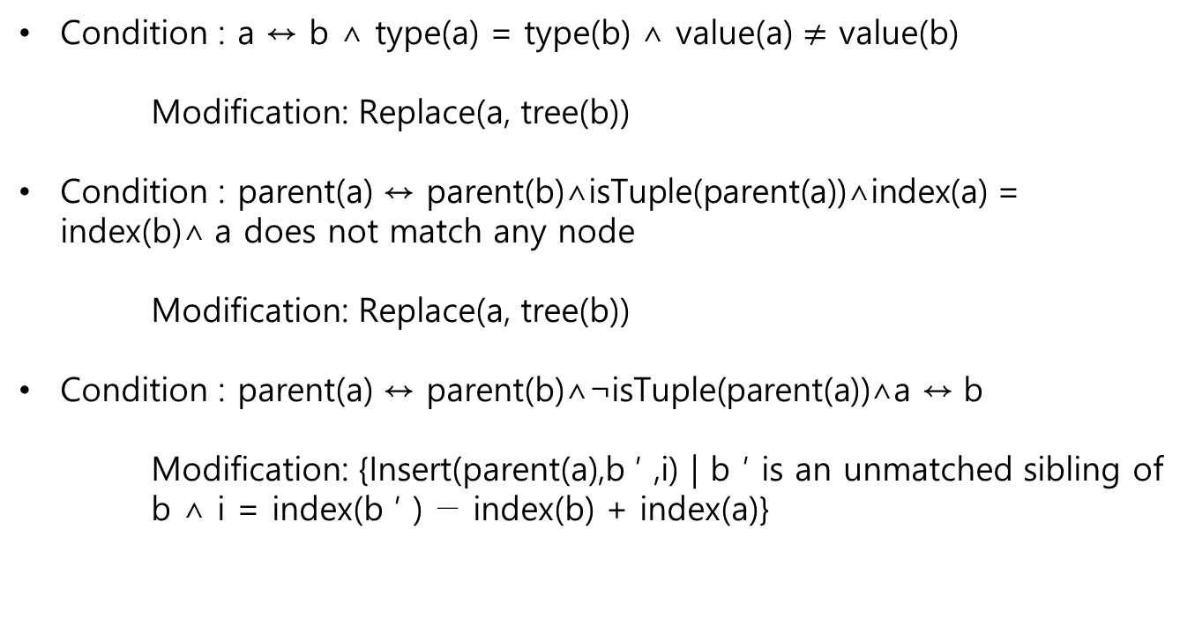
- Matching Pattern
SimFix (Matching AST nodes)
a = from Source AST b = from Target AST
↔ : Matched
Condition : a ↔ b ∧ type(a) = type(b) ∧ value(a) $≠$ value(b)
Modification: Replace(a, tree(b))
Condition : parent(a) ↔ parent(b)∧isTuple(parent(a))∧index(a) = index(b)∧ a does not match any node
Modification: Replace(a, tree(b))
Condition : parent(a) ↔ parent(b)∧¬isTuple(parent(a))∧a ↔ b
Modification: {Insert(parent(a),b ′ ,i) | b ′ is an unmatched sibling of b ∧ i = index(b ′ ) − index(b) + index(a)}

Slide 10
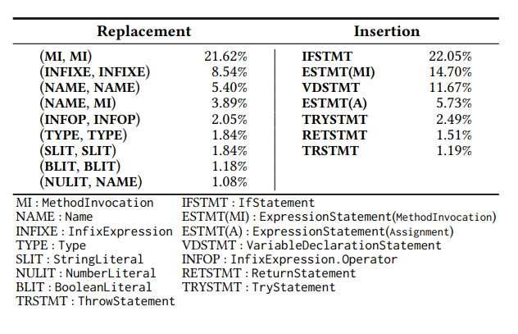
- Matching Pattern
SimFix ( Modification extraction from Donor)
a = Source AST B = Target AST
↔ : Matched
Condition: a ↔ b ∧ parent(a) ↔ b ′ ∧ b ′ , parent(b)
Modification: Replace(parent(a),t), where t is obtained by applying Replace(b, tree(a)) to tree(b ′ ).

Slide 11
- Matching Pattern
SimFix ( Pattern matching)
To identify donor code snippets
1. Structure Similarity
- the number of for statements , the number of arithmetic operators (cosine similarity between two vectors)
2. Variable Name similarity
- splitting a variable name in Camel case, obtain two sets of tokenized variable names (Dice`s coeficient for calculating similarity)
3. Method Name Similarity
- Same with 2

Slide 12
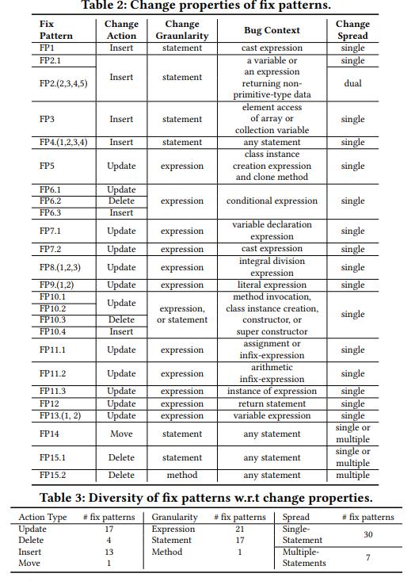
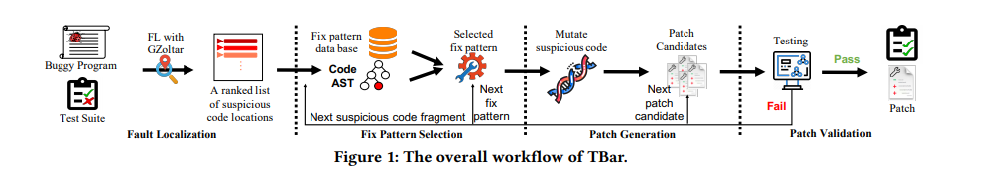
- TBar
Manually assessing all fix patterns from previous papers
Identified 15 categories of patterns labeled based on the code context
Given category may include one or several specialized sub-categories.
about 35 code change patterns

Slide 13
- Matching Pattern
TBar
Fix pattern Selection
1. Tbar sequentially traverse each node of the suspicious statement AST from its first child to its last leaf node
2. Try to match each node against the context AST of the fix patterns

Slide 14
- Matching Pattern
TBar
Tbar update over Insert that is over Delete, which is prioritized over Move.
In case of multiple donor code options for a given fix pattern, the candidate patches are ordered based on the distances between donor code node and buggy code node in the AST of the buggy code file.

Slide 15
- Capgen
Capgen
Consider the tree basic AST mutation operators
1. Replacement
2. Insertion
3. Deletion
Correct fixing ingredients should share high similarity with the target nodes
Replacement, insertion, deletion each 10 patterns.

Slide 16
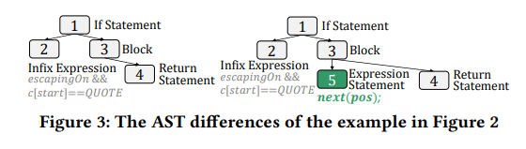
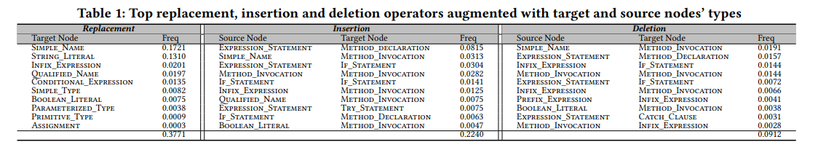
- Matching Pattern
Capgen
Fix Pattern matching
1. augment a mutation operator with the context information of the source node`s type and the target node`s type

Slide 17
- Matching Pattern
Capgen
Hypothesis is that the correct fixing ingredients should share high similarity with the target nodes in terms of their context
Using context information of an AST node from three aspects
1. genealogy
2. variable
3. dependency

Slide 18
- Matching Pattern
Capgen
Genealogical structure
- ex) infix expression equals(x,y,1) used as the returning value in return statements.
Variable usages
- fixing ingredients uses the same variable as the target expression
Dependency
- Variables used or defined in a given node are affected by or can affect other nodes.

Slide 19
- Matching Pattern
Capgen
Integrate the three models to prioritize the extracted ingredients.
For three different mutation operators, different treatments.
Patch prioritization
1. Each mutation operators has the corresponding operation probability freq(mutation) by considering the contexts of Nt
2. prioritizes all compatible source nodes based on context similarity

Slide 20
- Approach
Analyzing the AST of buggy code, can take the better approach

Slide 21
- Issue
FL application
- All techniques use gzoltar based with Ochiai
- Some techniques use FL result to calculate patches score.
Patch prediction problem

Slide 22
- Future work
Extract classifier what approaches better using AST structures or something else.

