Slide 1
Automatic program repair
2020-01-20
JuHyoung Kim
kjhkjh75@naver.com

Slide 2
- Real scenario
Template based techniques have own patterns extraction, pattern matching method, process with ingredient code.
Even though they have same patterns, their techniques have different patch effectiveness because of pattern matching method, processing ingredient code
As result, Used AST granularity could be different according to techniques.

Slide 3
- SimFix
Matching pattern : To identify donor code snippets
1. Structure Similarity ( Use snippet`s vector information of AST)
2. Variable Name similarity
3. Method Name similarity

Slide 4
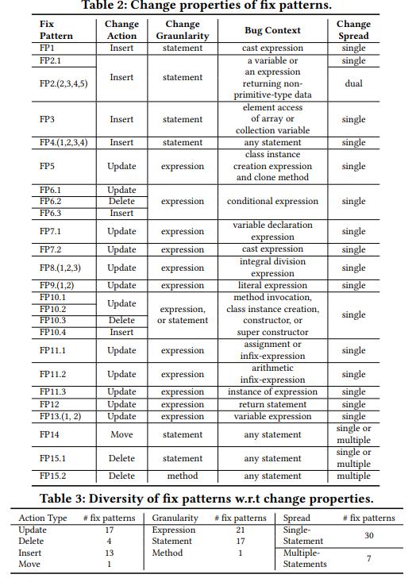
- Matching Pattern
TBar
Fix pattern Selection
1. Tbar sequentially traverse each node of the suspicious statement AST from its first child to its last leaf node
2. Try to match each node against the context AST of the fix patterns

Slide 5
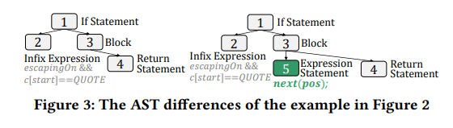
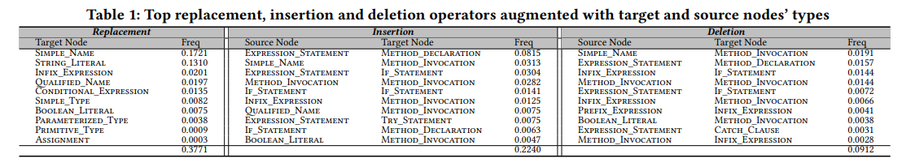
- Matching Pattern
Capgen
Fix Pattern matching
1. augment a mutation operator with the context information of the source node`s type and the target node`s type

Slide 6
- Matching Pattern
Capgen
Hypothesis is that the correct fixing ingredients should share high similarity with the target nodes in terms of their context
Using context information of an AST node from three aspects
1. genealogy
- Checking Ancestor Nodes of N to see N under (what types of code elements)
- Sibling nodes of N with what types of code elements.
ex ) traverse from N to its ancestors until method declaration
Sibling case, extract nodes of category statement and expression within the same block of N
2. variable
3. dependency

Slide 7
- Approach
Analyzing the AST of buggy code, can take the better approach

Slide 8
- Future work
Extract classifier what approaches better using AST structures or something else.

