Slide 1
Automatic program repair
2020-12-24
JuHyoung Kim
kjhkjh75@naver.com

Slide 2
- Contents
Summary
Techniques
Data set
Experimental criteria
Comparison Analysis
RQ

Slide 3
- Summary
Recently APR techniques characteristics and Comparisons.

Slide 4
- Techniques
JgenProg : statement level search-based techniques
Cardumen : expression level search-based techniques
Seqeuncer : Learning-based NMT model with RNN
CoConut : Learning-based NMT model with CNN
Tbar : template-based algorithm
Confix : context-based algorithm
-> can be changed or added.

Slide 5
- Data set
Defects4J
- Each techniques experiment dataset version is different
-> Test with 1.4.0 versions. 395 bugs
(Chart, Math, Closure, Mockito, Time)

Slide 6
- Experimental criteria
Fault Localization : To focusing on APR quality, provide the perfect buggy line to APR techniques (To remove FL bias)
Time cost : Exclude preparation time, because of one time cost, Not valid measurement for long term view
Categorize techniques can fix and not fix and plausible fix.

Slide 7
- Comparison analysis
Introduce techniques
Techniques comparison analysis with similarities, explain techniques with differences.
Best techniques comparison with different bug fix type and same bug differences.

Slide 8
- Comparison analysis
 | JgenProg | Cardumen
Granularity | Statement level | Expression level
Operator | Insertion, removement and replacement | replacement
Ingredient pool | Package ingredient pool | Global ingredient pool
Ingredient transformation | No-transformation for ingredients | Out-of-scope variables from ingredients replaced by in-scope variable based on the frequency

Slide 9
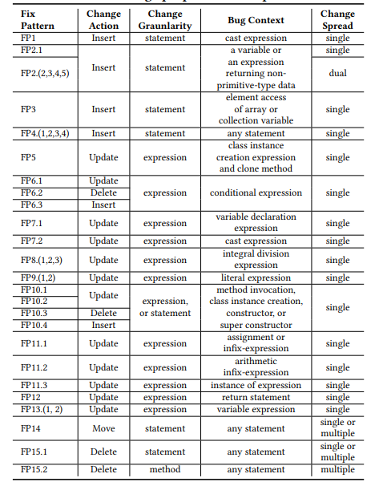
- Comparison analysis
 | TBar | Confix
Pattern | Fixed pattern | Collected pattern
Pattern matching | Traverses each node from its first child node to its last leaf node of buggy line and match each node context AST of the fix pattern | Check coincidence that parent of the subtree`s root
Operation | Update, Insert, Delete, Move | Update, insert, replace
Patch Prioritization | Several pattern for one node Update>Insert>Delete>Move | Maxcount-based for all prioritization
Others |  | Process of abstraction and concretization

Slide 10
- Comparison analysis
 | Sequencer | CoConut
Encoder configuration | One encoder for buggy line and context. | One encoder for buggy line, one encoder for context (surrounding of buggy line)
Learning-model | RNN | CNN
Model configuration. | One single model | Ensemble model
Context | All source code including buggy line within 1000 tokens | Method where buggy line exist

Slide 11
- RQ list
What techniques can better approach and cause.
What techniques are better speed for same bug type
What problems to fix over all APR techniques
What techniques is promising

Slide 12
- Plan
Run test set with APR techniques.
Organize the result and analysis

