Slide 1


Slide 2
Chart_1 TBar

Slide 3
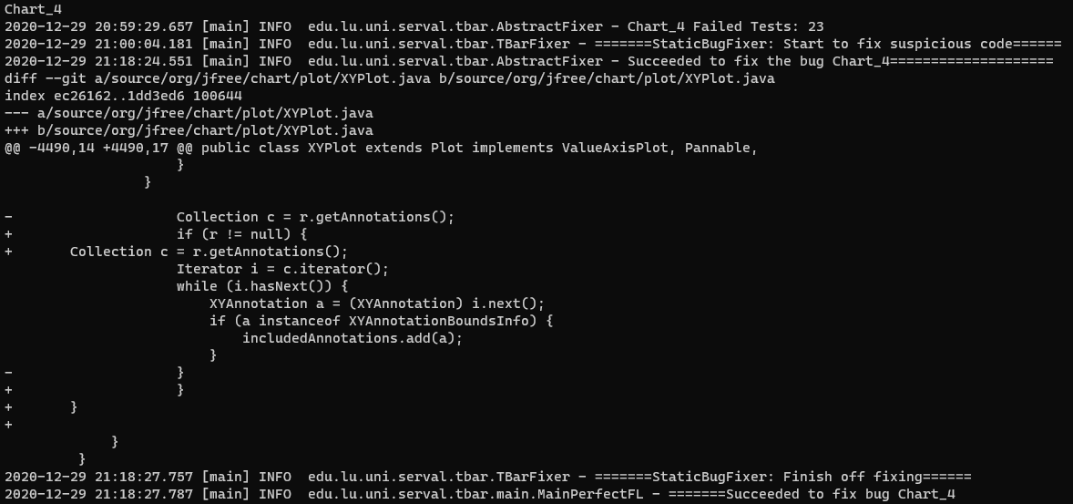
Chart_4 TBar

Slide 4

Chart_7

Slide 5

Chart_8

Slide 6

Chart_9

Slide 7

Chart11

Slide 8

Chart12

Slide 9

Chart_20

Slide 10

Chart_24

Slide 11
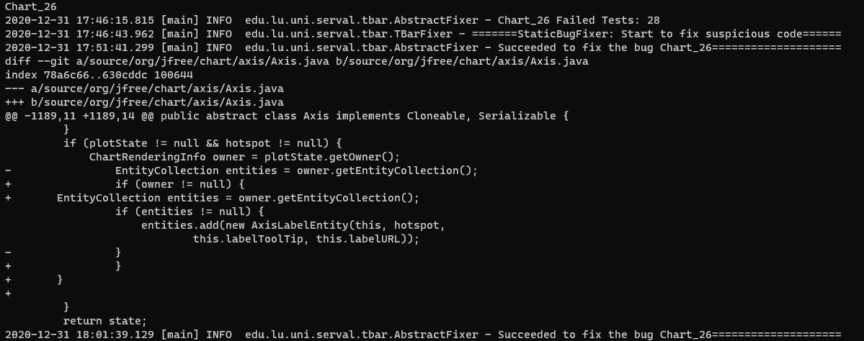
Chart_26_1

Slide 12

Chart_26_2

Slide 13

Chart_26_3

Slide 14

Chart_26_4

