Slide 1
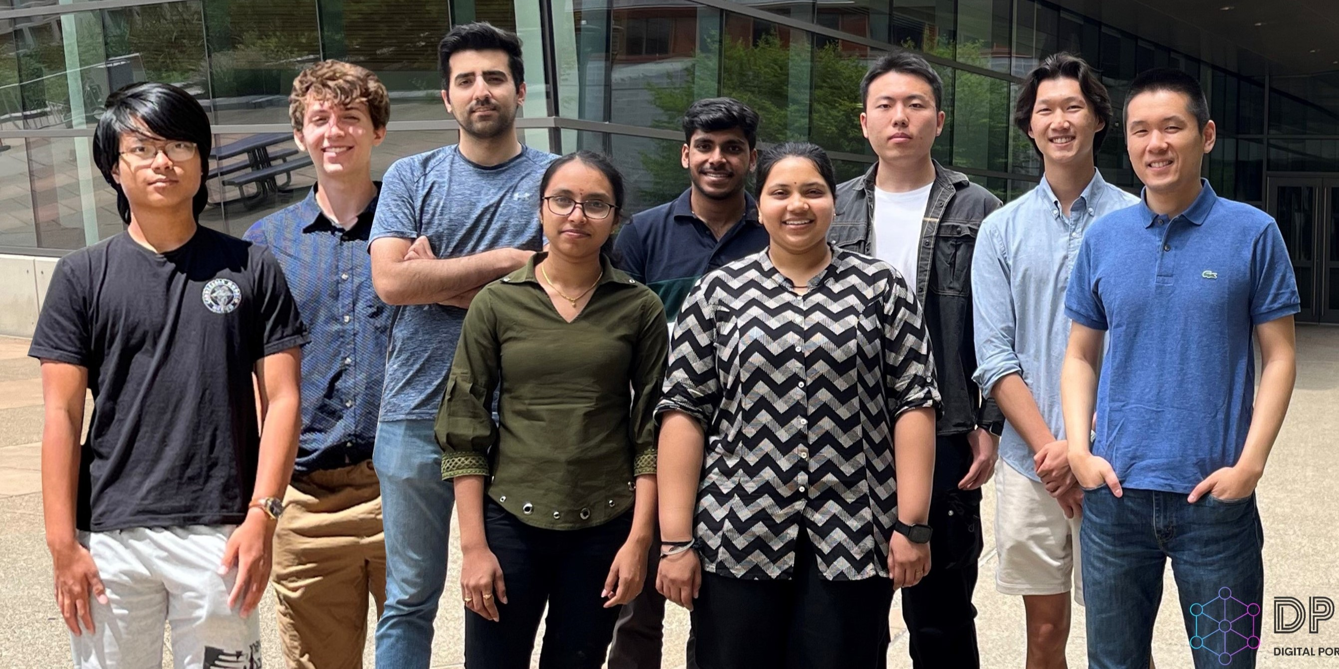
Shi group photo in June 2024

Slide 2
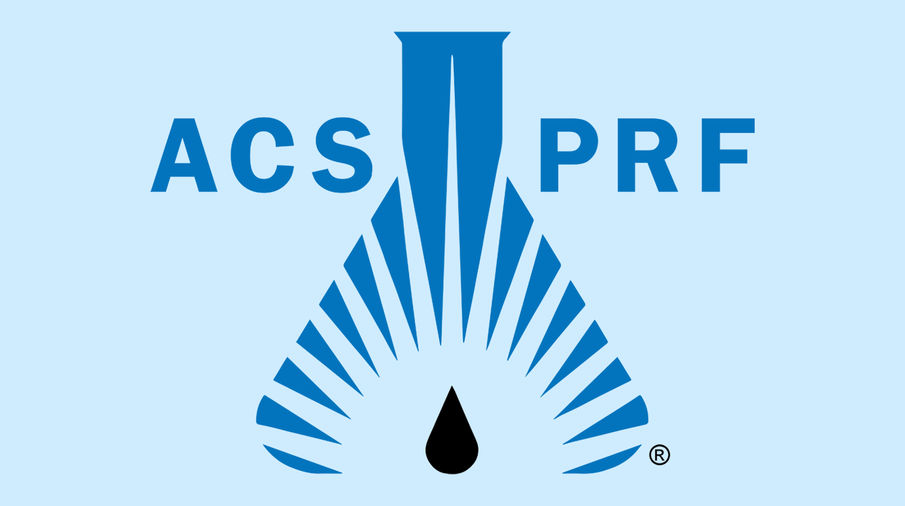
Prof. Shi has won the American Chemical Society Petroleum Research Fund Doctoral New Investigator award!

