Slide 1
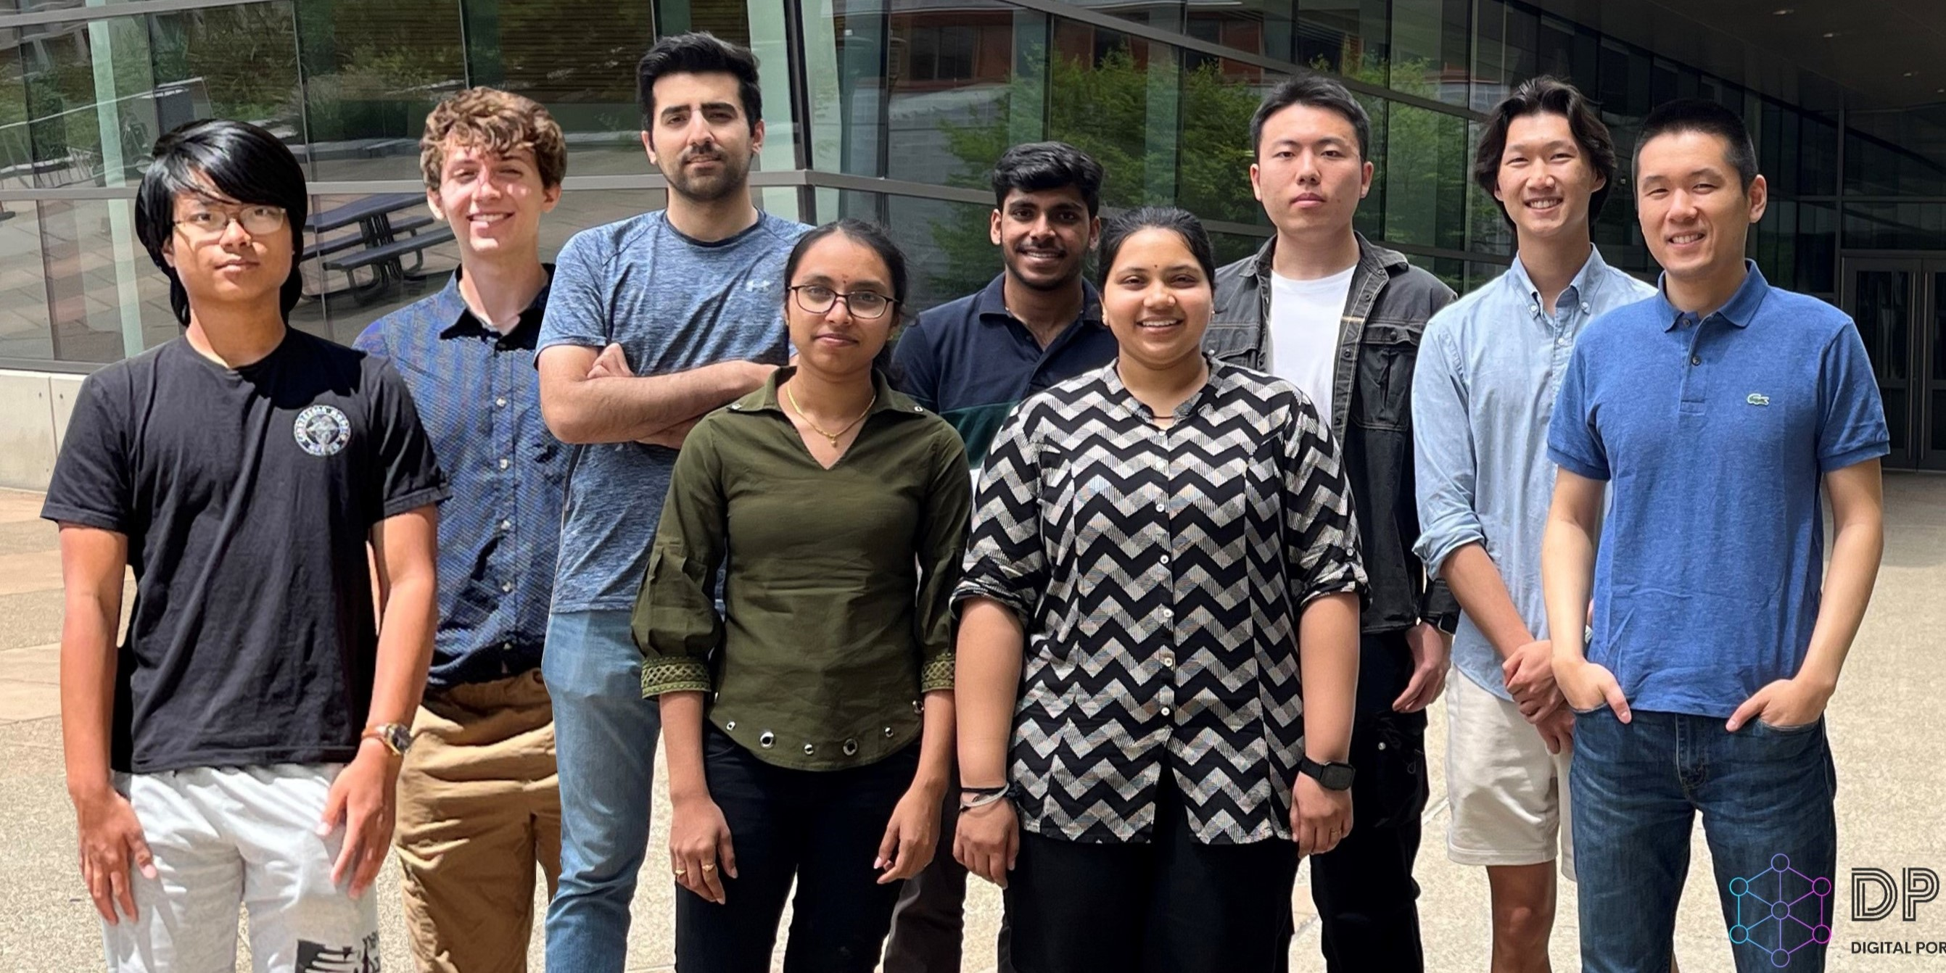
Shi group photo in June 2024

Slide 2

Prof. Shi has won the American Chemical Society Petroleum Research Fund Doctoral New Investigator award!

Slide 3
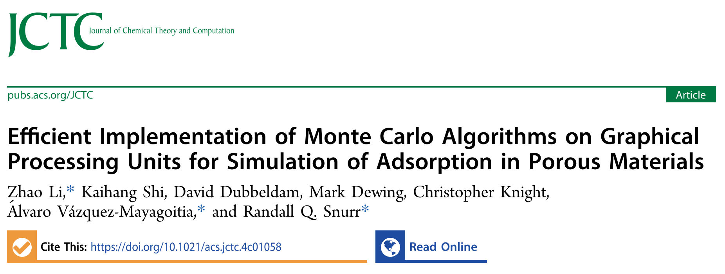
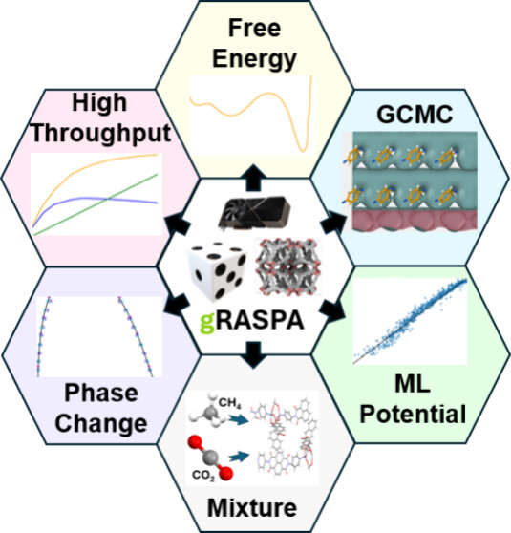
Prof. Shi co-authored work on “gRASPA”, a GPU-accelerated Monte Carlo software, is now published in the Journal of Chemical Theory and Computation. Check it out!

