Slide 1
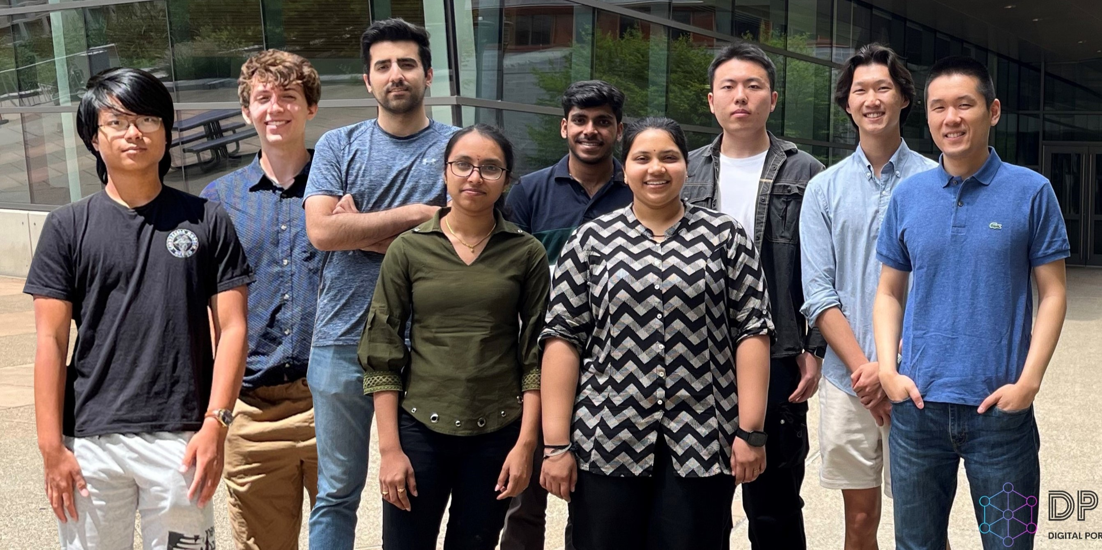
Shi group photo in June 2024

