Slide 1
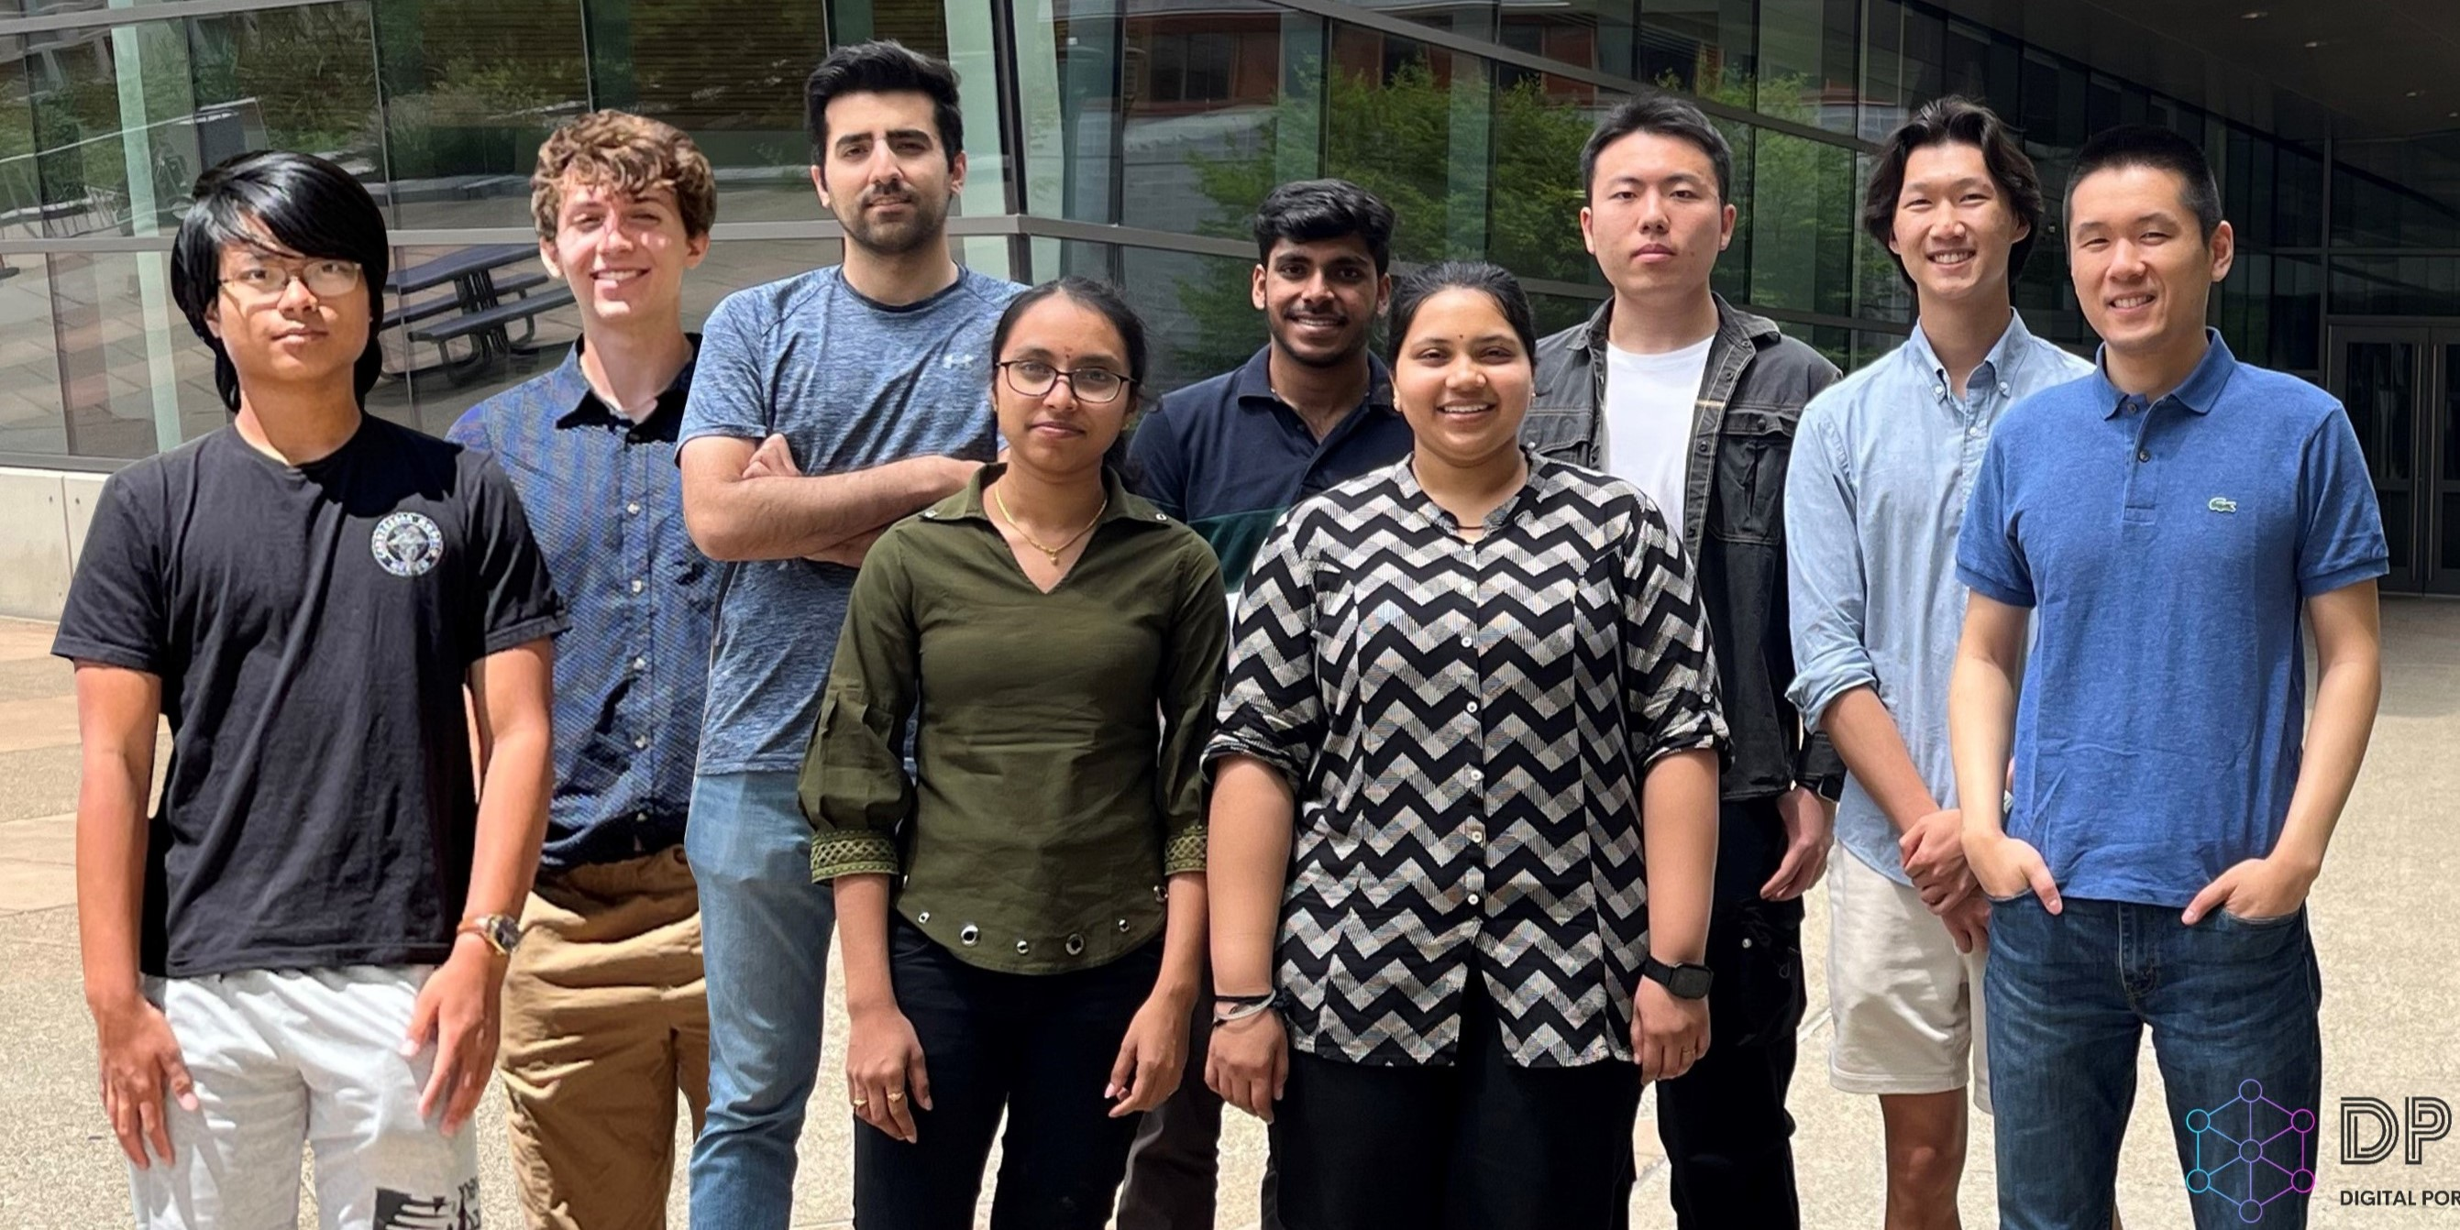
Shi group photo in June 2024

Slide 2
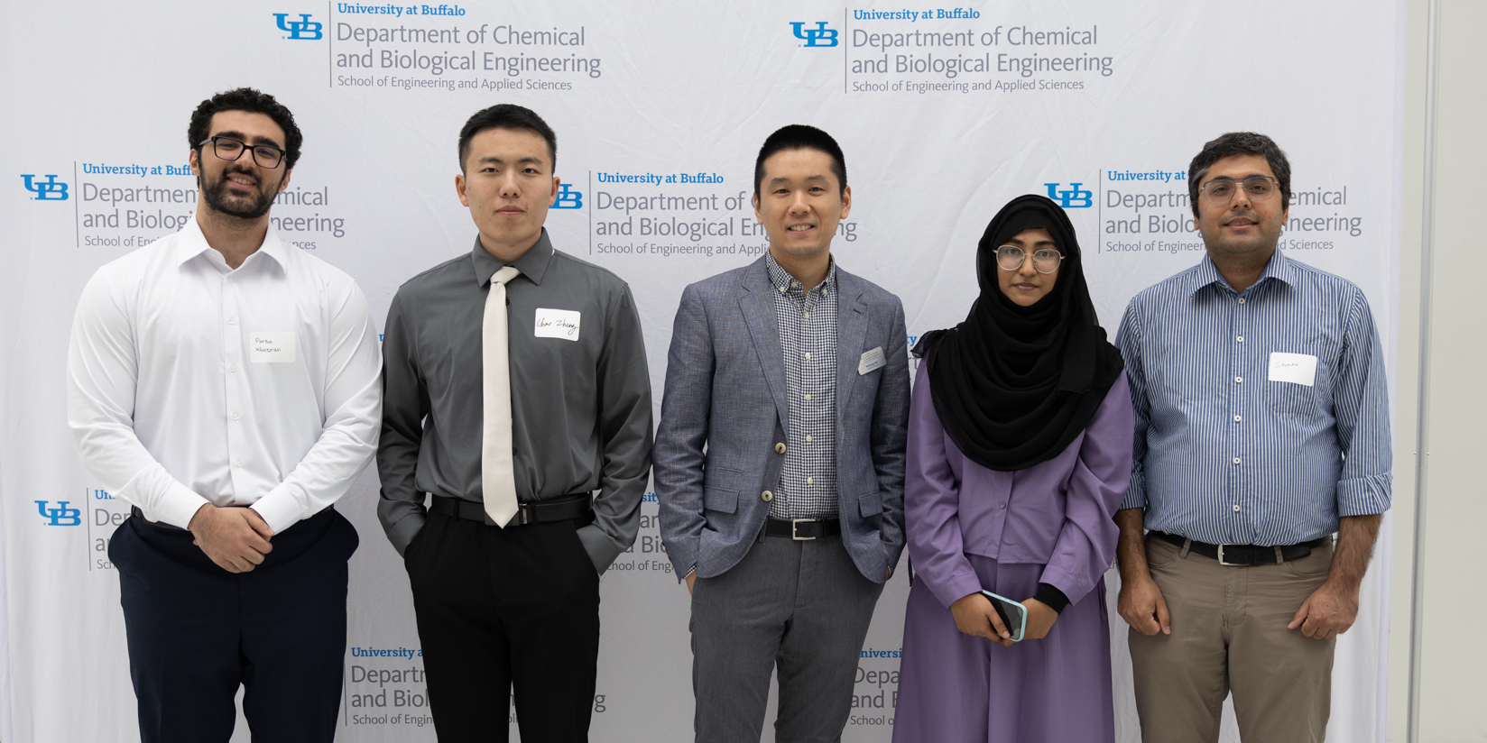
Shi group at the 2025 Annual CBE Graduate Student Research Symposium

Slide 3

Prof. Shi has won the American Chemical Society Petroleum Research Fund Doctoral New Investigator award!

Slide 4
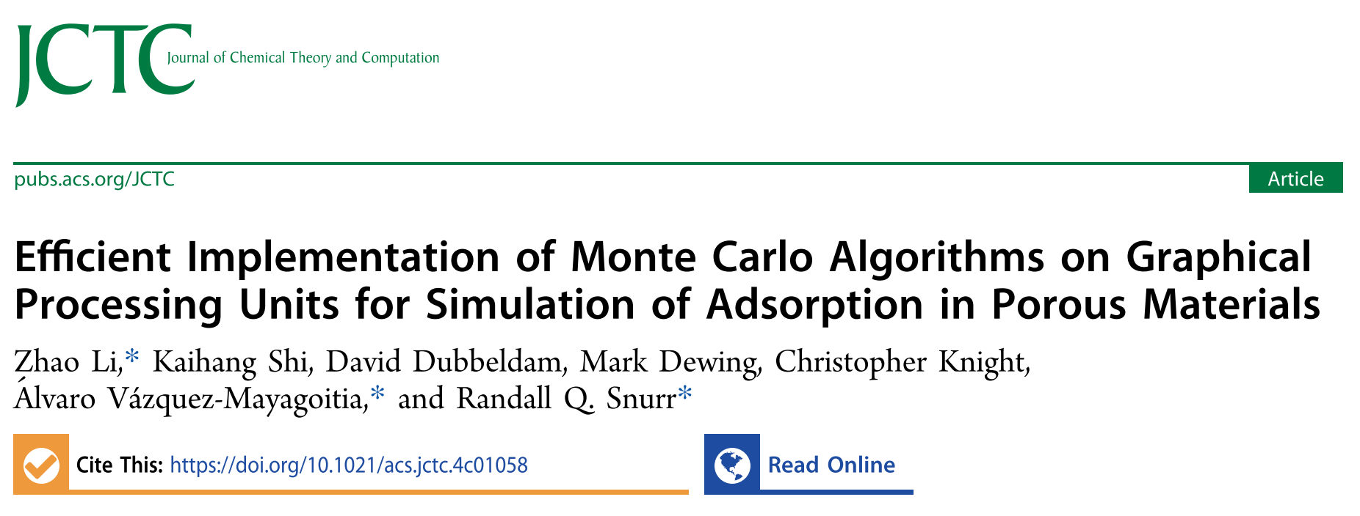
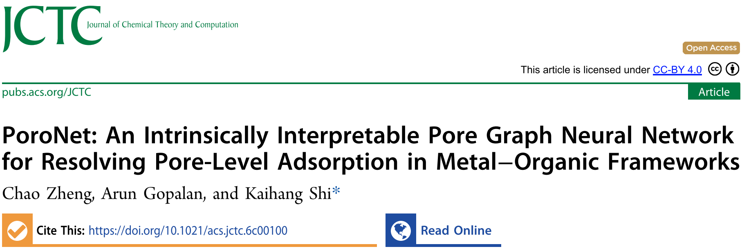
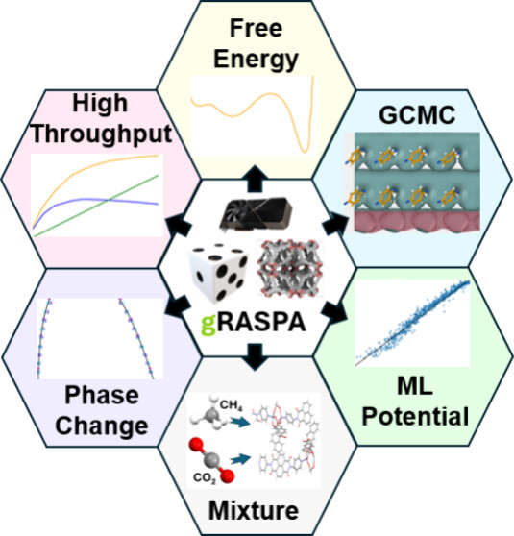
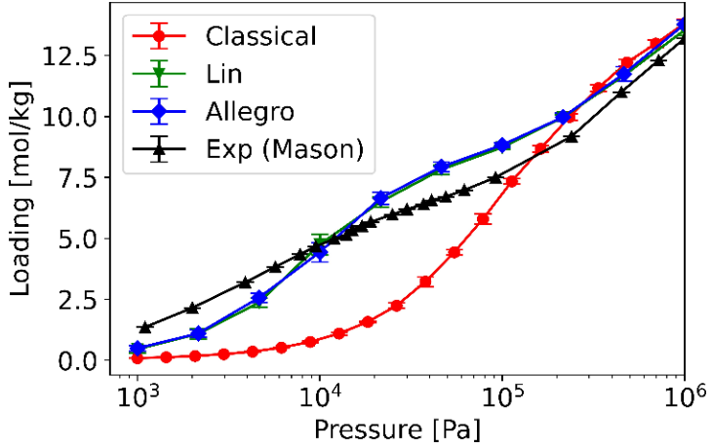
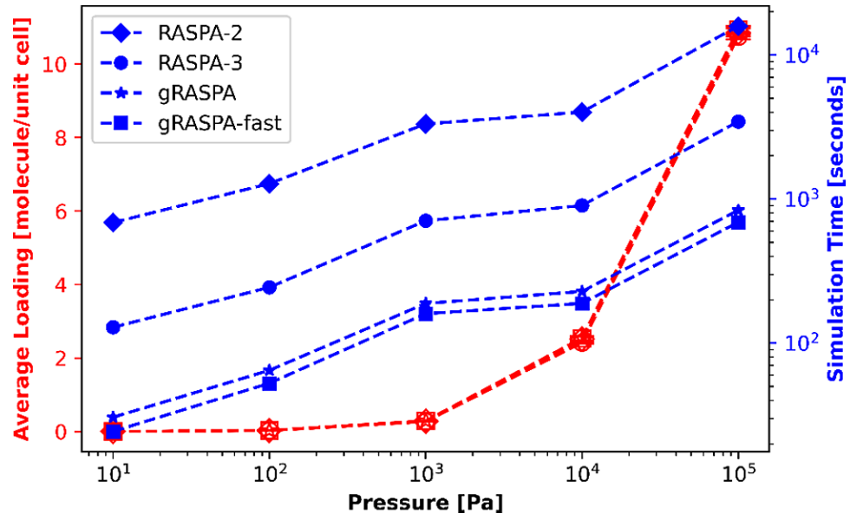
GCMC with ML potential
GPU acceleration
Prof. Shi co-authored work on “gRASPA”, a GPU-accelerated Monte Carlo software, is now published in the Journal of Chemical Theory and Computation. Check it out!

Slide 5
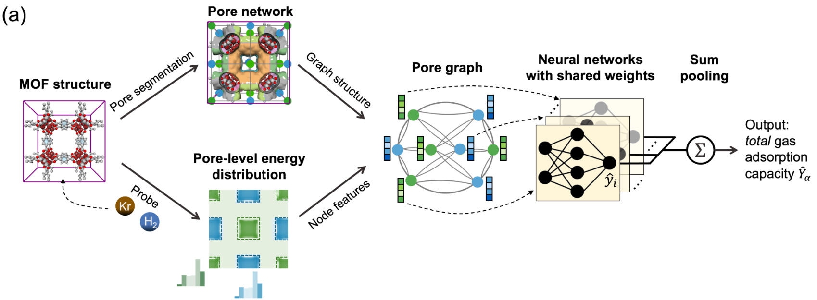
PoroNet is out in the Journal of Chemical Theory and Computation. Check it out!

Slide 6
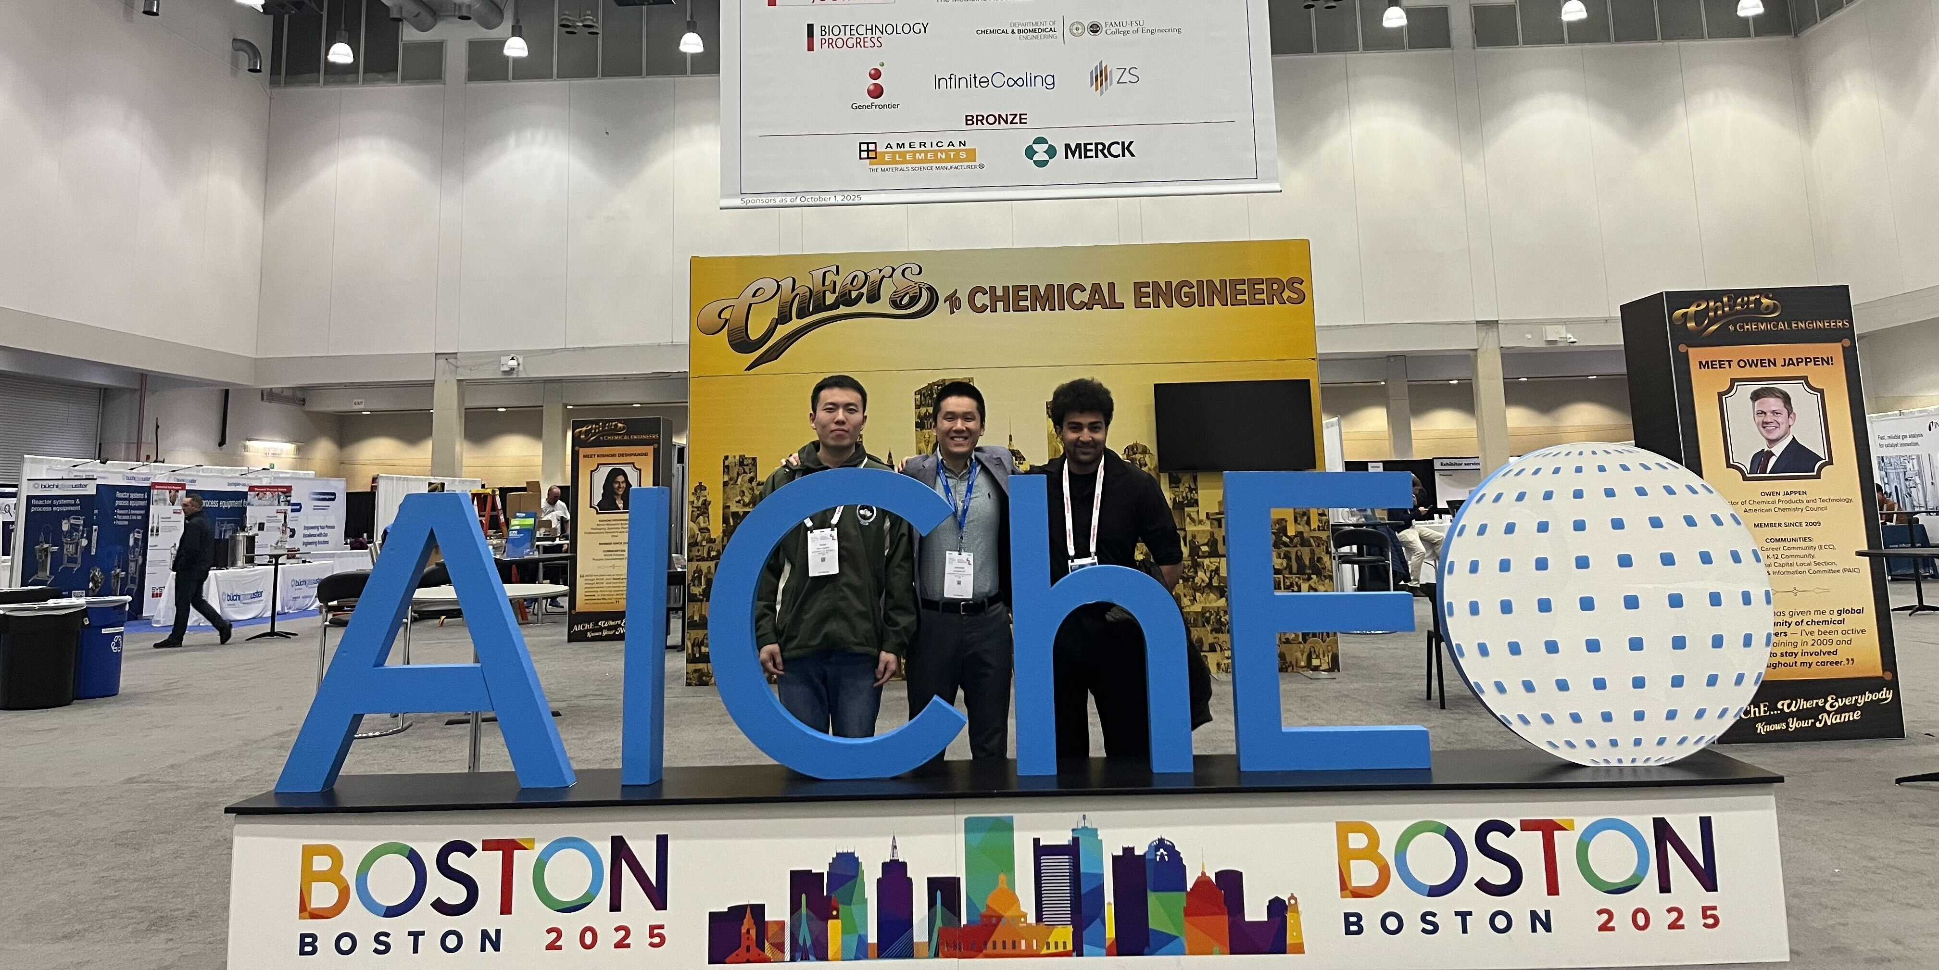
Shi group at the 2025 AIChE Annual Meeting in Boston!

