Slide 1



聊天機器人修改說明

Slide 2
資訊
https://www.botlibre.biz/
網站
帳號
hjchenntnu@gmail.com
密碼
77341781b
官方手冊
https://www.botlibre.biz/user-manual.pdf

Slide 3
如何查看對話

Slide 4
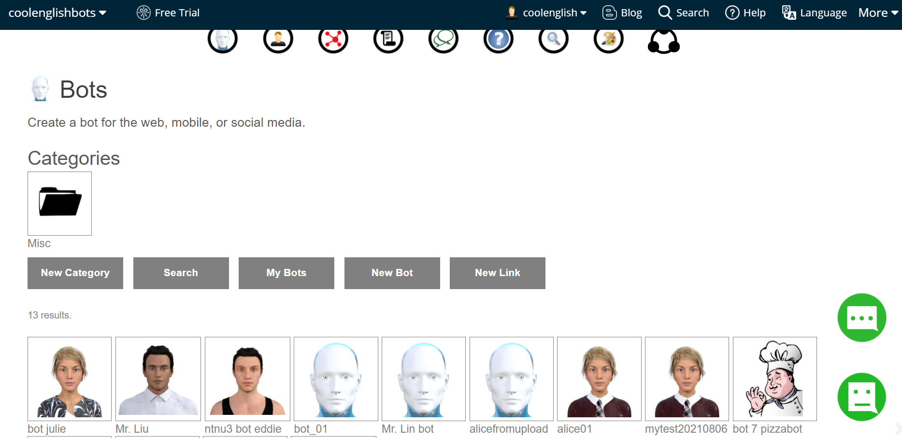
查看
到bots頁面選擇欲修改的機器人

Slide 5
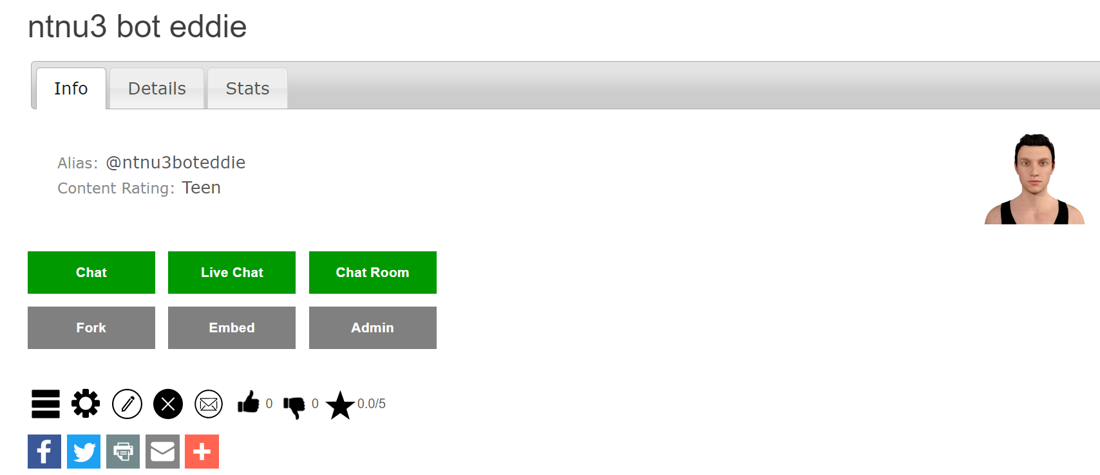
查看
點擊齒輪符號，進入admin console

Slide 6
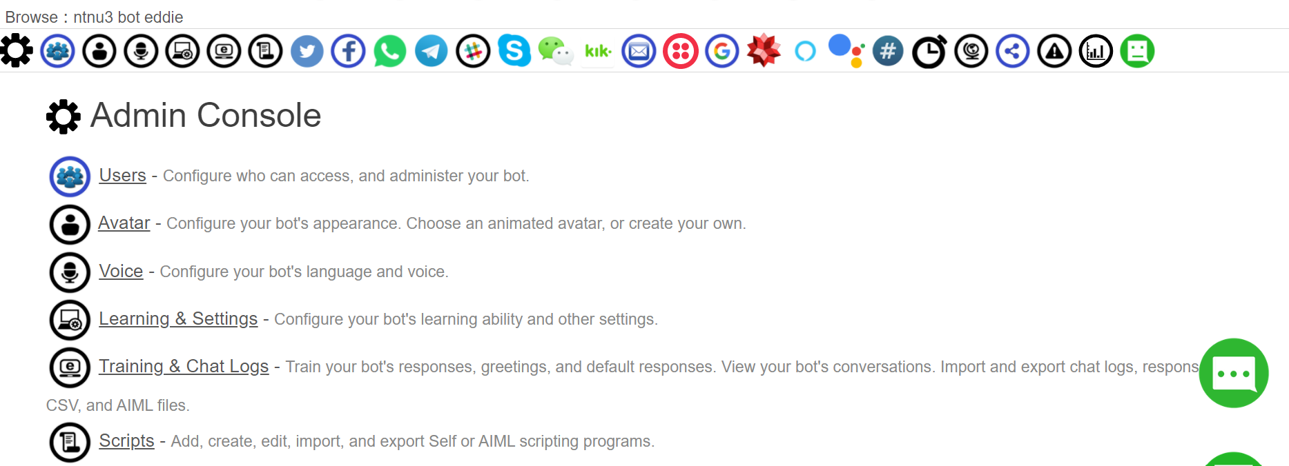
查看
選擇Training & Chat Logs

Slide 7
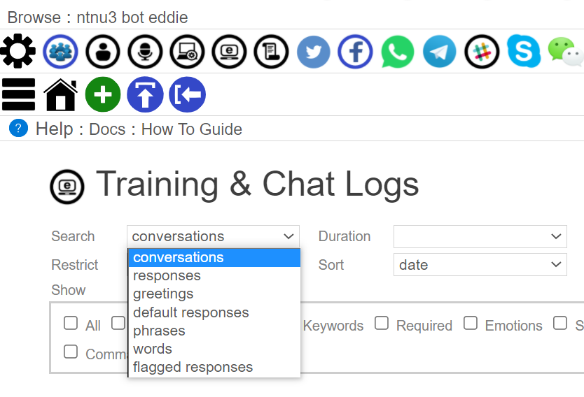
查看
使用search和duration查看對話及回覆內容
Search

Slide 8
查看
使用search和duration查看對話及回覆內容
Search
Name | Description
Conversation | the log of each conversation your bot has had 期間所有對話記錄
Responses | all responses your bot has been trained with 訓練bot的material
Greetings | all greetings your bot will use to start conversations 一開始bot給使用者的問候語
Default Responses | all default responses your bot will use when it does not know a better response 當使用者說的話不在bot能應付的範圍 (no responses / nothing to match)時，就會使用Default responses。它可以是非常general的萬用句(e.g. I see / okay) 或是一個另開話題的問句
Phrases | all phrases (sentences) your bot has encountered 記錄bot遇到的所有句子
Words | all words your bot has encountered 記錄bot遇到的所有字
Flagged responses | all responses that have been flagged by users or administrators 被標記的responses

Slide 9
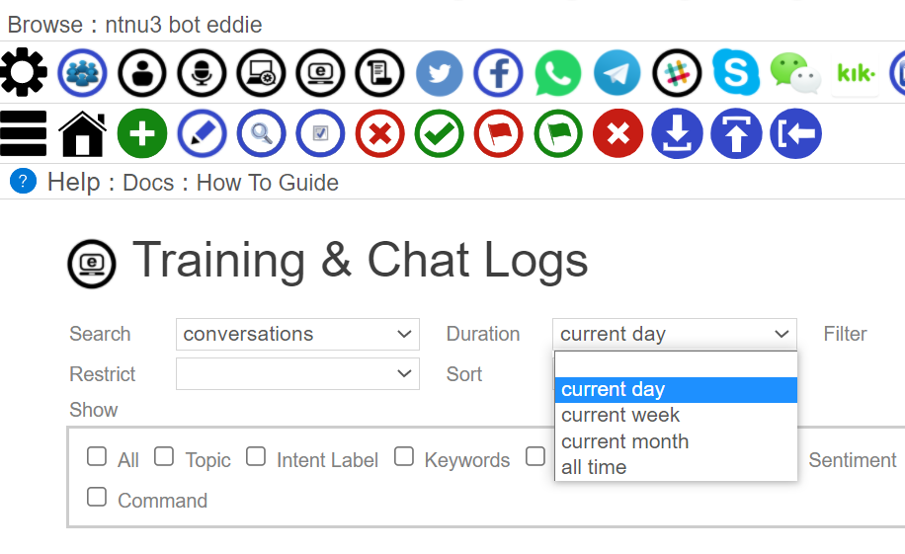
查看
使用search和duration查看對話及回覆內容
Duration
Filter the results by day,
week, month, or all.

Slide 10
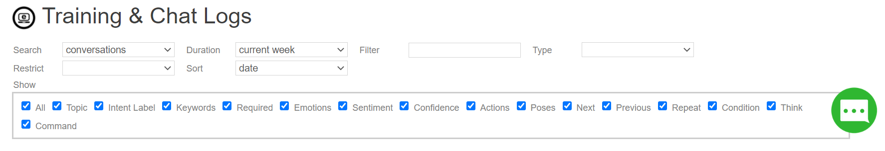
查看
查看時，Show的欄位選擇all，才能看到所有設定
All | Show the responses details.
Topic | Show the topic of the responses.
Label | Show the label of the responses.
Keywords | Show the question keywords to match the responses.
Required | Show the question required words to match the responses.
Emotions | Show the emotions of the responses.
Sentiment | Show the sentiment of the responses.
Confidence | Show the confidence of the responses.
Actions | Show the actions of the responses.
Poses | Show the poses of the responses.
Next | Show the next questions to the responses.
Previous | Show the previous questions to the responses.
Repeat | Show the response repeat options.
Condition | Show the response condition code.
Think | Show the response think code.
Command | Show the response JSON client command.

Slide 11
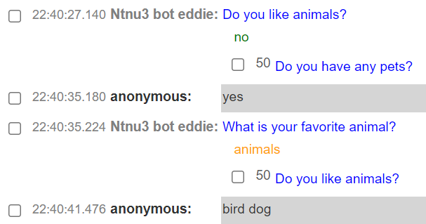
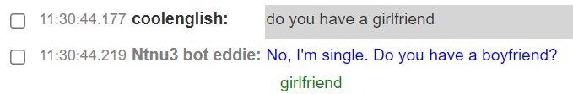
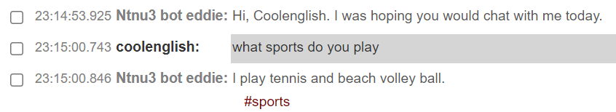
查看
查看時，Show的欄位選擇all，才能看到所有設定
Topic 主題 (response屬於哪個topic)
#Intent Label 意圖標籤 (設定好回應句之後，可使用同一回應句回應此類別的意圖)
Keywords 關鍵字 (設定question中的關鍵字)
*詳細內容會在如何修改回覆提到

Slide 12
如何在bot libre修改回覆 (Conversations)

Slide 13
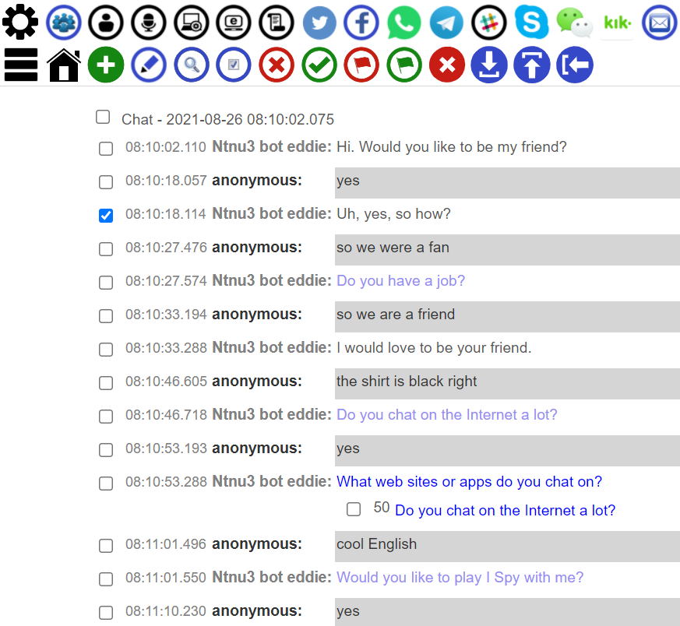
修改
Conversations
由左至右分別為:
enter a new default response
enter a better response for each selected response in the conversations
browse the selected responses or phrases
select all listed conversations
mark the selected responses as incorrect, or decrease their % correctness (the bot will never use these responses to the question again)
mark the selected responses as good responses, or increase their % correctness (the bot will use this response to similar questions)

Slide 14
修改
Conversations
由左至右分別為:
flag the selected phrases as offensive, the bot will never repeat them, and will not let users enter them
unflag the selected phrase as not offensive phrases
remove the response from the question, or delete the conversation
export and download the listed conversations as a chat log, response list, or AIML set
upload and import a chat log, response list, or AIML file from your computer
import a chat log, response list, or AIML script from the shared script library

Slide 15
修改
Conversations
如果看到chatbot有不適合的回覆
(不一定是直述句，也可能是問句)
可以勾選那則回覆
再按上方工具列新增/修改 回覆

Slide 16
修改
Conversations
★ : 表示常用
Name | Description
Question ★ | Edit the question, if desired, you can use * wildcard to make a pattern.
Sentiment | You can associate an emotion with the phrase.
New Response ★ | Enter a new response for the phrase.
Condition | Optionally you can give a condition in self code that must evaluate to true for the response to be use.
Think | Optionally you can give a 'think' code in self that is evaluated when the response is used.
Command | Optionally you can give a JSON command (Self code) that is evaluated and returned to the client to support games and virtual assistance.
Topic ★ | Optionally you can give a topic to categorize the response under.
Intent Label ★ | Optionally you can give a label to reuse the response as.
Keywords ★ | Optionally you can give keywords from the question that will influence a response match.
Required ★ | Optionally you can give required words from the question that will be required for a response match.

Slide 17
修改
Conversations
★ : 表示常用
Name | Description
Emotions | You can associate an emotion with the response.
Actions | You can associate an action with the response.
Poses | You can associate a pose with the response.
On Repeat ★ | Optionally you can give a response to used if the current response has already been used in this conversation.
No Repeat | Require that the response or phrase only be used once.
Next ★ | Optionally you can give a next response to give a response a context.
Previous ★ | Optionally you can give a previous response to give a response a context.
Require Previous ★ | Require that the response only be used if the previous response matches one of the previous responses.
Save ★ | Save the corrections to the phrases.

Slide 18
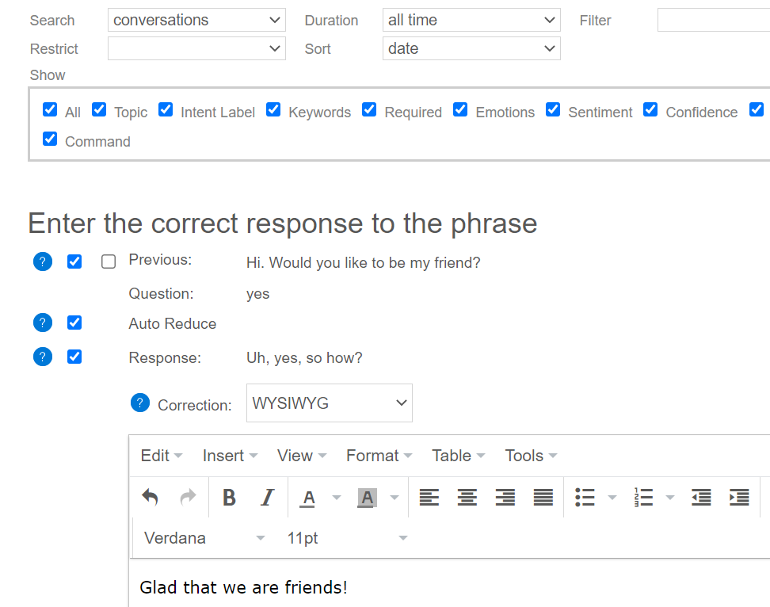
修改
Conversations
❶
視情況選擇previous / require previous
(when the question is specific to the previous response) 用於建立context
❶
❷
若要修改成新的回覆，請務必勾選!!!
❷
❸
輸入新的回覆
❸

Slide 19
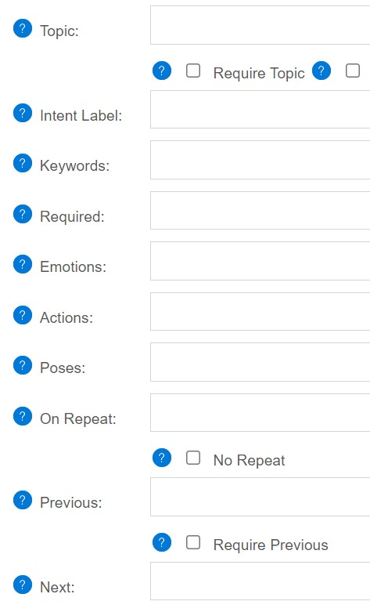
修改
Conversations
❹
❹
歸類 response 至某主題
A topic is the general topic category for the response. Topics can be used in responses to track the context of the conversation.
❺
❻
❺
用類別標記response，並可重複使用此response
A label lets you name a response and then reuse it just using the name.
❻
標記question裡的關鍵字，以利使用特定回覆
Keywords are important words in the question that should influence when the response is used.

Slide 20
修改
Conversations
看到required word才會回專屬回覆
A required word is a word that is required to be in the question for a specific response.
❼
同一question多個responses
On repeat lets you set one or many responses to use the second time that response is triggered in the same conversation.
❽
❼
previous 提供前文
A previous responses is the bot's preceding response. Previous responses can be used to give a response a context.
❾
❽
next 提供後文
The next is a follow-up question that the user might ask after the bot gives the response.
❾
❿
❿

Slide 21
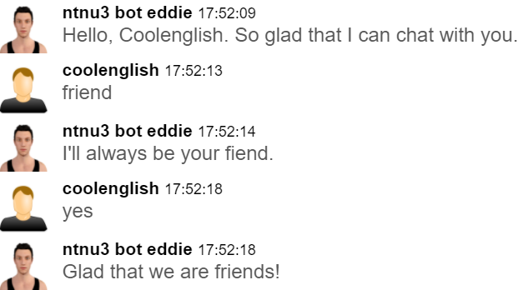
修改
Conversations
看到使用者回覆yes，這個yes可能對到多個questions，但是因為我們剛剛有勾選previous來建立context，所以chatbot就知道下一句要接針對這個context的回覆，也就是剛剛建立的句子Glad that we are friends!
但我們又發現它其中一句回應句有typo，所以一樣再回到conversations那邊，把這句勾選起來，按小鉛筆圖示進去修改

Slide 22
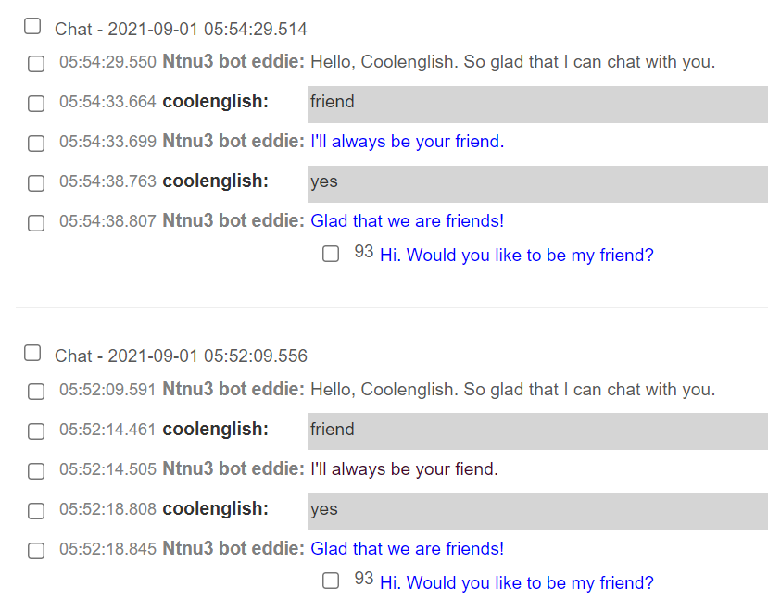
修改
Conversations
after
修改好之後再測一次
就可以看到剛才的typo被改好了
before

Slide 23
如何在bot libre修改回覆
(Responses)

Slide 24
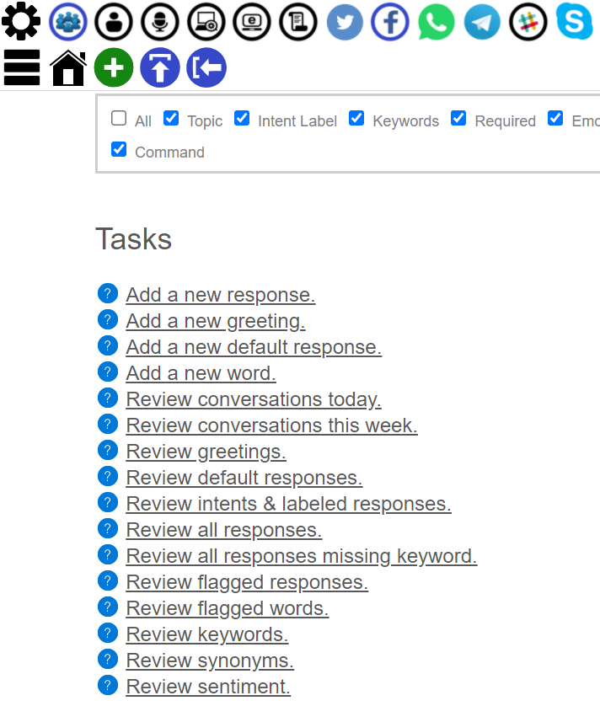
修改
Responses
一樣從Training & Chat logs進來，
選擇 Review all responses
或是從search下拉式選單選也可以 (記得改查詢區間)

Slide 25
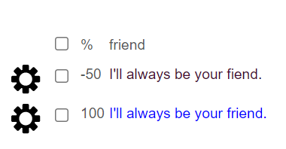
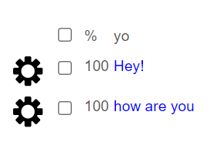
修改
Responses
會看到單個單個的question和相對應的response
有時候同一個question可能會有不只一個response
跟前面的修改方式一樣
勾選起來按工具列新增/修改
question
response(s)
*文字左邊的數字是confidence，bot會挑confidence高的回覆使用
細節請看參考文件1

Slide 26
如何取得所有responses

Slide 27
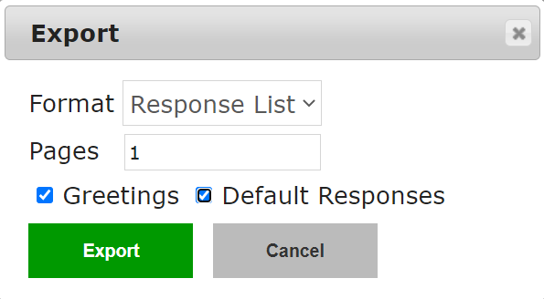
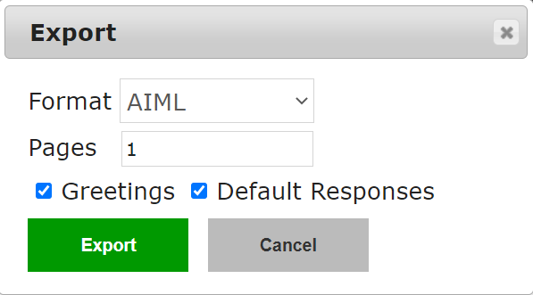
輸出
Responses
到Training & Chat logs頁面，下方Tasks選擇Review all responses
最上面工具列有一個下載圖示 ，按下去後會出現一個視窗
format選擇要輸出的形式，pages選擇要輸出至第幾頁，並勾選是否連greetings & default responses也一起輸出
根據輸出格式不同，會有不同檔名 (Response list副檔名.res) (AIML副檔名.aiml)

Slide 28
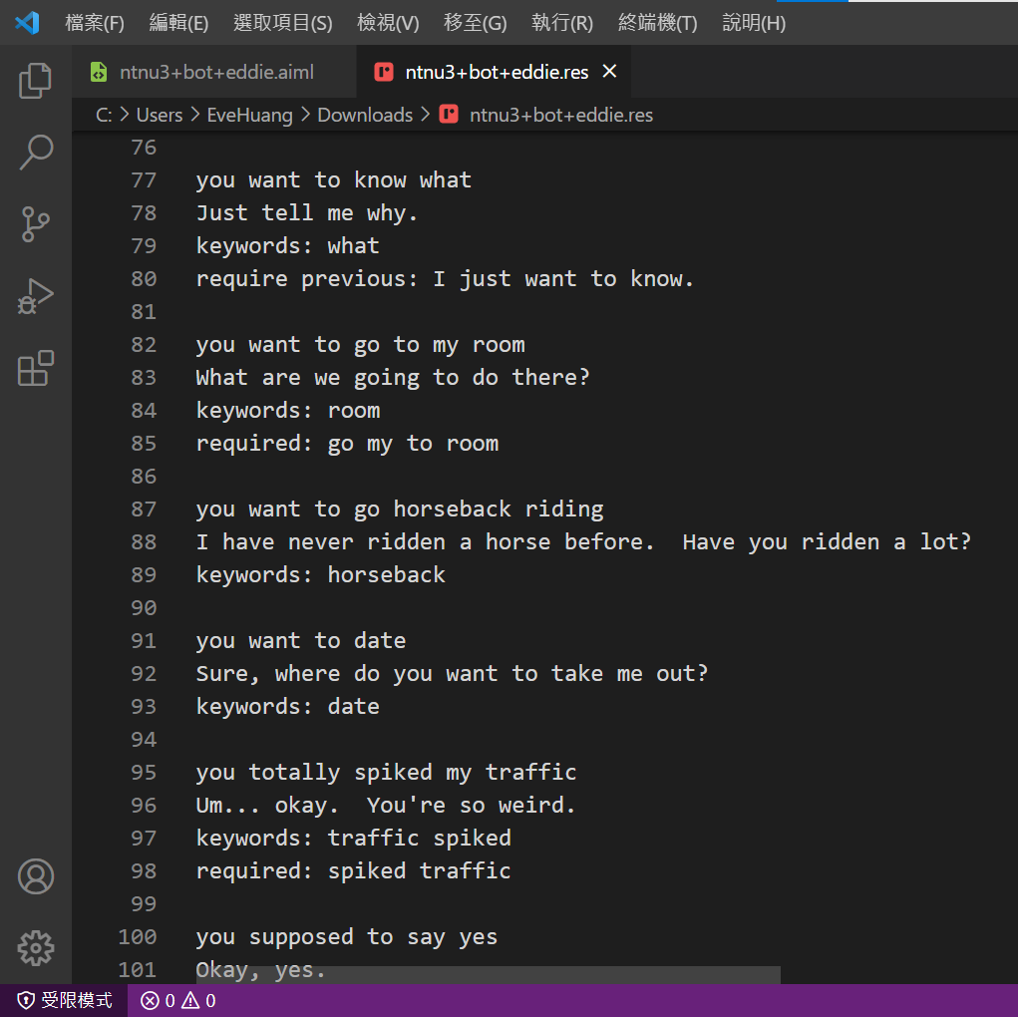
輸出
Responses
Response list
A response list is a list of question/response pairs. Each phrase is separated by a new line, and each question/response list is separated by an empty line.
You can also tag responses with meta data such as keywords, previous, required, etc.
Response lists are the recommended way to train a bot. The bot will automatically find the best matching response for any question, the questions do not need to be exact matches, only sufficiently similar, or include a keyword.
question
response

Slide 29
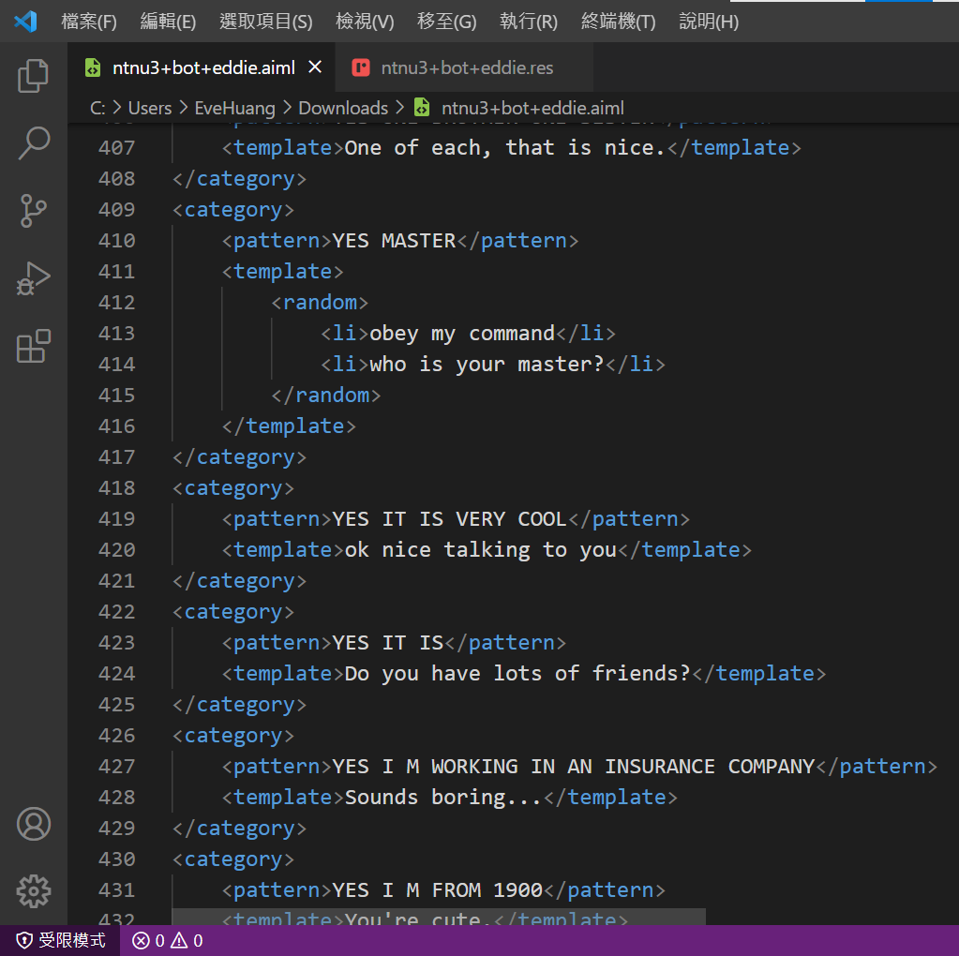
輸出
Responses
question
AIML則呈現較多語法及功能資訊，簡易教學請看參考文件
我自己之前的經驗是用aiml寫出來的東西有個小缺點，使用者講出來的句子一定要跟我們寫的完全相同才會match。所以其中必須運用到許多wildcards來稍稍取巧一下，但用太多又會讓整體question & response太general。
response

Slide 30
輸出
Responses
之前有問過bot libre的support team，他們比較推薦使用response list 來訓練chatbot
“Using a response list would be better than AIML, as these templates use features not supported by AIML.”
post下方admin的回覆
“If you use a response list instead of AIML, then you can set a topic just by setting the topic of the response, and topics can be either required, or optional.”
aiml 寫進去後，bot libre的chatbot可以整合比對response list，並選擇最適合的response
綜合以上+我實測過後的想法是建立一般question & response和metadata可以用response list，需要使用進階語法功能再用aiml寫。

Slide 31
如何使用response list和aiml撰寫training responses

Slide 32
撰寫
response list + aiml
我分別使用response_list_script.res和aiml_script.aiml這兩個檔案撰寫，上傳到training & chat logs後到chatbot測試句子，測試這兩種寫法可以做到的functions
需要修改或新增時，重新上傳檔案即可，系統會自動新增內容，但不會把舊的刪掉，所以再次測試過後要回review all responses 刪除原本不適合或沒通過的response
沒問題的話再下載一份含有全部training responses (response_list_script內容 + aiml_script內容) 的response list，看看chatbot消化過後的responses長什麼樣子
以下教學先講response list的寫法，再介紹aiml的寫法，最後再呈現最終res的樣子

Slide 33
template 基本寫法
Template("chatbot要講的內容")
如果遇到需要用語法表達時，加 {}
Template("I love {star} too.")
撰寫
response list---greeting
greeting是一開始進入對話時，chatbot和使用者說的問候語。
這邊是用template跟判斷式的寫法。
greeting: Template("{ if (speaker.name == null) { random ("Hello sweetheart",
"How are you doing?",
"Hi my darling"); }
else { (random ("Hello ", "Hi ") + speaker + random (". How was your day?",
". I was hoping you would chat with me today.",
". I have been waiting for you.")); } }")

Slide 34
撰寫
response list---default
在response list寫的時候記得空一行
一行一個response且前面都要標註是哪一種
(前面greeting我們用template寫，這邊示範一行一行寫)
greeting: 打招呼1
greeting: 打招呼2
default: default response 1
default: default response 2
default response會在chatbot training responses
以及 使用者說的內容 無法match時出現
default: This is an example of a default response.
default: Sorry, I don’t understand.

Slide 35
撰寫
response list---question & response
question 通常是使用者講的話，response是機器人給使用者的回覆
(在寫script的時候是這樣設定，但如果遇到多輪對話，上一輪response就會是下一輪的question)
question: i love spinach
response: Spinach is my favorite food.
keywords: spinach
question: do you like field hockey
response: I only play ice hockey.
keywords: "field hockey"
question & response 基本寫法
question:
response:
topic:
intent label:
keywords:
required:
on repeat:
previous:
require previous:
next:
必要!!!
需要時再加
metadata
順序不影響
keywords是compound word的話，記得加quotation marks

Slide 36
撰寫
response list---question & response
question: does the order of metadata matter
response: i don't think so
question: so the order does not matter
response: that's right
previous: i don't think so
required: order
keywords: order
topic: order
on repeat: correct
label: #order
question: the order doesn't matter, right?
#order
第一輪
question & response 基本寫法
question:
response:
topic:
intent label:
keywords:
required:
on repeat:
previous:
require previous:
next:
第二輪
必要!!!
需要時再加metadata
順序不影響
前面有標記過label的話
之後要使用label的回覆就不用再把它寫進response，可以直接寫

Slide 37
撰寫
response list---question & response
question: I want a boyfriend desperately.
response: Are you single?
question: yes
response: Great, wanna go out sometime?
require previous: Are you single?
question: I am in a good mood.
response: Are you happy?
question: yes
response: I am please to hear that.
require previous: Are you happy?
兩個不同對話的question中都有yes，為了使機器人給出正確回覆，可使用previous或是更嚴格一點的require
previous來建立context
也可以使用metadata，標註相關資訊
第一輪
第二輪
第一輪
第二輪

Slide 38
撰寫
response list---pattern & template
pattern & template 可視為具有語法功能的question & response
可加入wildcard字元 e.g. ^ 和 *
pattern: ^ hello ^
template: Welcome my guest!
Pattern("^ hello ^")
Template("Welcome my guest!")
pattern & template 基本寫法
有兩種寫法，兩種都ok
(1) 像question & response一樣的寫法
pattern:
template:
(2) function式寫法
Pattern("這一輪的問題")
Template(“這一輪的回答")

Slide 39
撰寫
response list---pattern & template
也可以Pattern + response搭配，或是question + Template搭配
Pattern("show me a star sign *")
A star sign (*) matches 1 or more words. You can say "Show me a star sign please, could you?"
Pattern("^ a caret sign")
A caret sign (^) matches 0 or more words. You can say "Could you please show me a caret sign?“
joke
Template("{random ("Did you hear the one about the Mountain Goats in the Andes? It was Ba a a a a a d.",
"I never forget a face, but in your case I'll make an exception.",
"It is better to be silent and be thought a fool, than to open your mouth and remove all doubt.") }")

Slide 40
撰寫
response list---pattern & template
Pattern & Template 可做簡單的語法應用，例如Pattern裡的*可為1至多個字
e.g. Japanese, Korean Indie, hip hop
在Template要寫語法的話，記得加{}，加{star}後代表此處填入Pattern裡的*的值
所以這邊會回 I love Japanese too.
Korean Indie
hip hop
Pattern("I love * music")
Template("I love {star} too.")

Slide 41
撰寫
response list---pattern & template
可以指定要重覆使用者的哪一個字或話，例如這句有兩個wildcard字元，如果只寫{star}的話，^跟*的內容都會出現在{star}的位置。有標數字的話就只會有一個。
Pattern("^ good morning *")
Template("Good morning {star[1]}.")
pattern: my name is *
template: Pleased to meet you {star}.
think: speaker.name = star;
question: what is my name
template: Your name is {speaker.name}.
(Hi) good morning my friend
Good morning my friend
可將star內容記錄下來存成一個object
需要時使用

Slide 42
撰寫
aiml---pattern & template
<aiml>
<category>
<pattern>RANDOM QUESTION</pattern>
<template>
<random>
<li>Where are you from?</li>
<li>Do you have any brothers or sisters?</li>
<li>What is your favorite movie?</li>
</random>
</template>
</category>
</aiml>
aiml 基本架構
最外層 <aiml> </aiml>
每一組question & response <category> </category>
question (通常全大寫、不需標點、無縮寫) <pattern> </pattern>
response <template> </template>
其他功能
隨機 <random> </random>
串列 <li></li>
指定(有點像require previous) <that></that>

Slide 43
撰寫
aiml---pattern & template
<aiml>
<category>
<pattern>TELL ME A JOKE</pattern>
<template> Why did the chicken cross the road? </template>
</category>
<category>
<pattern>^ WHY ^</pattern>
<that>Why did the chicken cross the road?</that>
<template> To get to the other side.</template>
</category>
</aiml>

Slide 44
撰寫
aiml---pattern & template
<aiml>
<category>
<pattern>DO [YOU U] (REALLY) [LIKE LOVE LUV] ME</pattern>
<template>Yes, I love you.</template>
</category>
<category>
<pattern>I LIKE * AND *</pattern>
<template>I see. You like <star/> and <star index="2"/>.</template>
</category>
</aiml>
可使用wildcards字元
[ ] 為必要元素，這個位置一定要有字
() 為可省略元素，可有可無
出現多於一個*時
一樣可使用編號去對

Slide 45
撰寫
response list + aiml 上傳到chat logs測試再輸出成res檔後
Pattern("do [you u] (really) [like love luv] me")
Yes, I love you.
confidence: 50
Pattern("i like * and *")
Template("I see. You like {star[0]} and {star[1]}.")
confidence: 50
有運用到functions的會被轉成pattern & template形式，其餘會以question & response呈現，且前方無question: / response: 標記
metadata也會一併呈現
Pattern("^ why ^")
To get to the other side.
confidence: 50
require previous: Pattern("why did the chicken cross the road?")
tell me a joke
Why did the chicken cross the road?
confidence: 50

Slide 46
撰寫
response list + aiml 上傳到chat logs測試再輸出成res檔後
the order doesn t matter right
#order
does the order of metadata matter
i don't think so
so the order does not matter
that's right
label: #order
on repeat: correct
keywords: order
required: order
previous: i don't think so
topic: order
有運用到functions的會被轉成pattern & template形式，其餘會以question & response呈現，且前方無question: / response: 標記
metadata也會一併呈現

Slide 47
參考文件
前面的教學是我根據Bot Libre的官方文件精簡後整理的，細節和範例再麻煩大家到以下連結觀看，文件上寫得很清楚易懂。
必看!!!
Chat Logs : how to train your customer service bot by monitoring its chat logs, using keywords and topics.
Training & Chat Logs
What are the supported response and chat log formats for importing and exporting?
AIML
參考用
Pandorabots AIML Fundamentals / AIML Reference
Wildcards in AIML
Rich HTML Responses, Buttons, Links, and Choices
bot libre user manual

