Slide 1
6G Midband Technology and Spectrum
RIT
Shima Mashhadi
Jan 2025

Slide 2
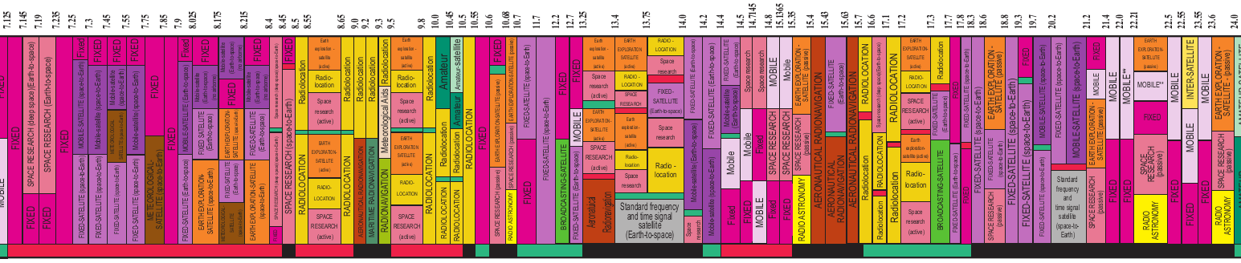
RIT
Current allocations and uses in 7.125 - 24 GHz in the U.S.
7.125 - 24 GHz band is split into four sub-categories for ease of presentation and analysis
7.125 - 8.5 GHz
8.5-13.75 GHz
13.75-17.1 GHz
17.1 - 24 GHz

Slide 3
RIT
7.125 - 8.5 GHz
 | 7125 | 7145 | 7190 | 7235 | 7250 | 7300 | 7375 | 7450 | 7550 | 7750 | 7900 | 8025 | 8175 | 8215 | 8400 | 8450
F | Fixed (FS)
F |  |  | Earth Exploration Satellite(EESS) |  |  |  | Mobile(MS) |  |  |  |  | Earth Exploration Satellite(EESS)
N |  |  |  |  |  |  |  |  |  |  |  | EESS
F |  |  |  |  | Fixed satellite (FSS) |  |  |  |  |  | Fixed satellite (FSS)
F |  |  | MetSat |  |  |  |  | MetSat |  | MetSat |  | MetSat
F |  |  |  |  | Mobile-Satellite (MSS) |  |  |  |  |  | Mobile-Satellite (MSS)
F |  | Space Research (SRS) |  |  |  |  | Maritime Mobile Satellite (MMSS) |  |  |  |  |  |  |  | Space Research (SRS)
N |  | SRS |  |  |  |  |  |  |  |  |  |  |  |  | SRS
FS, FSS and MSS are the largest current allocations
Approximately 20% of FS use is by the Department of Defense (DoD),
The 8400 – 8500 MHz band is allocated for SRS (DL).
Other uses may not be ubiquitous and hence perhaps more amenable to sharing.

Slide 4
RIT
7.125 - 8.5 GHz
 | 7125 | 7145 | 7190 | 7235 | 7250 | 7300 | 7375 | 7450 | 7550 | 7750 | 7900 | 8025 | 8175 | 8215 | 8400 | 8450
F | Fixed (FS)
F |  |  | Earth Exploration Satellite(EESS) |  |  |  | Mobile(MS) |  |  |  |  | Earth Exploration Satellite(EESS)
N |  |  |  |  |  |  |  |  |  |  |  | EESS
F |  |  |  |  | Fixed satellite (FSS) |  |  |  |  |  | Fixed satellite (FSS)
F |  |  | MetSat |  |  |  |  | MetSat |  | MetSat |  | MetSat
F |  |  |  |  | Mobile-Satellite (MSS) |  |  |  |  |  | Mobile-Satellite (MSS)
F |  | Space Research (SRS) |  |  |  |  | Maritime Mobile Satellite (MMSS) |  |  |  |  |  |  |  | Space Research (SRS)
N |  | SRS |  |  |  |  |  |  |  |  |  |  |  |  | SRS
6G

Slide 5
RIT
8.5-13.75 GHz
 | 8.5 |  | 8.65 |  | 8.85 |  | 9.2 |  | 9.5 |  | 9.9 |  | 10 |  | 10.4 |  | 10.5 |  | 10.6 |  | 10.7 |  | 11.2 |  | 11.7 |  | 12.1 |  | 12.5 |  | 12.75 |  | 13.4
N |  |  |  |  |  |  |  |  |  |  |  |  |  |  |  |  |  | FS |  |  | Fixed (FS) |  |  |  |  |  |  | Fixed (FS)
N |  |  |  |  |  |  |  | EESS |  |  |  |  |  |  |  |  |  |  | EESS |  |  |  |  |  |  |  |  | BSS |  | Mobile(MS) |  | EESS
 | Radiolocation (RLS)
 |  |  |  |  |  |  |  |  |  |  |  |  |  |  |  |  |  |  |  |  | FSS |  |  |  |  |  |  |  |  | FSS
 |  |  |  |  |  |  |  | SRS |  |  | MetSat |  |  |  |  |  |  |  | SRS |  |  |  |  |  |  |  |  |  |  |  |  | SRS
 |  |  |  | AR |  | AR |  |  |  |  |  |  |  |  |  |  |  |  |  |  |  |  |  |  |  |  |  |  |  |  |  | AR
(RAS)
RLS
RLS is the single largest allocation.
~2500 MHz in 10.7 – 13.25 GHz is allocated for non-federal use, of which 12.2 - 13.25 GHz is already under consideration by the FCC for sharing with other services.
13.25 - 13.75 may also be available for sharing with limited restrictions.

Slide 6
RIT
8.5-1375 GHz
 | 8.5 |  | 8.65 |  | 8.85 |  | 9.2 |  | 9.5 |  | 9.9 |  | 10 |  | 10.4 |  | 10.5 |  | 10.6 |  | 10.7 |  | 11.2 |  | 11.7 |  | 12.1 |  | 12.5 |  | 12.75 |  | 13.4
N |  |  |  |  |  |  |  |  |  |  |  |  |  |  |  |  |  | FS |  |  | Fixed (FS) |  |  |  |  |  |  | Fixed (FS)
N |  |  |  |  |  |  |  | EESS |  |  |  |  |  |  |  |  |  |  | EESS |  |  |  |  |  |  |  |  | BSS |  | Mobile(MS) |  | EESS
 | Radiolocation (RLS)
 |  |  |  |  |  |  |  |  |  |  |  |  |  |  |  |  |  |  |  |  | FSS |  |  |  |  |  |  |  |  | FSS
 |  |  |  |  |  |  |  | SRS |  |  | MetSat |  |  |  |  |  |  |  | SRS |  |  |  |  |  |  |  |  |  |  |  |  | SRS
 |  |  |  | AR |  | AR |  |  |  |  |  |  |  |  |  |  |  |  |  |  |  |  |  |  |  |  |  |  |  |  |  | AR
(RAS)
Passive EESS in the nearby 10.6−10.7 GHz band

Slide 7
RIT
13.75-17.1 GHz
 | 13.75 | 14 | 14.2 | 14.3 | 14.4 | 14.47 | 14.5 | 14.71 | 14.75 | 14.8 | 15.13 | 15.35 | 15.4 | 15.43 | 15.63 | 15.7 | 16.6
 |  |  |  |  | Fixed (FS)
 |  |  |  |  | Mobile(MS)
F |  |  |  |  |  |  |  |  |  |  | EESS | EESS
 |  |  |  |  |  |  |  |  |  |  |  | RAS
 | RLS |  |  |  |  |  |  |  |  |  |  |  | Radiolocation (RLS)
 |  |  |  |  |  |  | Space Researc (SRS) |  |  |  |  |  | Aeronautical Radionavigation (AR) |  |  |  | SRS
 |  | Mobile-Satelite (MSS)
 | Fixed Satellite (FSS)
RLS, SRS, FS and MS are the largest allocations in this part of the spectrum.
200 MHz between 14.2 – 14.4 GHz is not allocated for federal use.

Slide 8
RIT
13.75-17.1 GHz
 | 13.75 | 14 | 14.2 | 14.3 | 14.4 | 14.47 | 14.5 | 14.71 | 14.75 | 14.8 | 15.13 | 15.35 | 15.4 | 15.43 | 15.63 | 15.7 | 16.6
 |  |  |  |  | Fixed (FS)
 |  |  |  |  | Mobile(MS)
F |  |  |  |  |  |  |  |  |  |  | EESS | EESS
 |  |  |  |  |  |  |  |  |  |  |  | RAS
 | RLS |  |  |  |  |  |  |  |  |  |  |  | Radiolocation (RLS)
 |  |  |  |  |  |  | Space Researc (SRS) |  |  |  |  |  | Aeronatical Radionavigation (AR) |  |  |  | SRS
 |  | Mobile-Satelite (MSS)
 | Fixed Satellite (FSS)
6G

Slide 9
RIT
17.1-24 GHz
 | 17.1 |  | 17.3 |  | 17.8 |  | 18.1 |  | 18.4 |  | 18.8 |  | 19.7 |  | 20.2 |  | 21.4 |  | 22.21 |  | 22.55 |  | 23.55
 |  |  |  |  |  |  |  | Fixed (FS) |  |  |  |  |  |  | MSS | Fixed (FS)
 |  |  |  | Fixed (FS) |  |  |  |  |  |  |  |  | MSS |  |  | Fixed (FS)
 |  |  |  |  |  |  |  |  |  |  |  |  |  |  |  | Mobile(MS)
 |  |  |  |  |  |  |  |  |  |  |  |  |  |  |  |  |  | RAS | RAS |  | RAS |  |  | RAS
 | RLS |  |  |  | MetSat |  |  |  |  |  |  |  |  |  |  |  |  |  |  |  | ISS
 |  | SRS |  |  |  |  |  |  |  | SRS |  |  |  |  |  | SRS |  |  | SRS |  | SRS |  |  | SRS
 |  | EESS |  |  |  |  |  |  |  | EESS |  |  |  |  |  | EESS |  |  | EESS |  |  |  |  | EESS
 |  |  | FSS |  | Fixed Satellite (FSS)
 |  |  | Fixed Satellite (FSS)
100 MHz spectrum in 17.7 – 17.8 GHz is not allocated for federal use.
2,200 MHz of spectrum in 17.8 – 18.6 GHz and 18.8 – 20.2 GHz may be practical for coexistence if used for earth stations rather than user devices.
Notes:
Sharing Spectrum and Services in the 7-24 GHz Upper Midband
18.8 − 20.2 GHz: While the propagation characteristics of this band are less favorable than the lower ones, hotspots and Wireless Local Area Network (WLAN) can benefit of the higher bandwidth, comparable to the ones available at the higher mmWave frequencies, while maintaining good coverage (above 80%),
NON Federal :
18.4-18.6 SRS and EESS are passive
NSF 17.8-19.7 Radio asstoronomy research
FEderal FSS the DL of som satellite network
18.6-18.8NASA passive sensing of the Earth from the space rain rates Sea State, sea ice, ocean wind speed and humidity.

Slide 10
RIT
Potential Shared Spectrum Bands
7.125-8.5 GHz
Federal Fixed
Federal Fixed satellite
10.7-13.25 GHz
Non-Federal Satellite Services
14.0-14.2 GHz
17.8-18.6 GHz and 18.8-20.2 GHz
Federal Satellite
Additional analysis need to be done with regard to commercial satellite
Federal Mobile Satellite
Space Research

Slide 11
RIT
Fundamental sharing framework
New entrant capabilities
Incumbent capabilities and limitations
Frequency and time coordination capabilities
Interference reporting mechanisms
Success of spectrum sharing depends upon a few basic components:
They have to work in harmony with each other for the overall benefit

Slide 12
RIT
6G Spectrum
6G demand : Peak data rate 200 Gbit/s
More Bandwidth?
5G
6G
Upper Mid
Current 5G candidates:
3.3-3.8 GHz (400 MHz)
6.4-7.1 GHz (700 MHz)
WRC-23 candidates:
4.4-4.8 GHz (400 MHz)
7.1-8.4 GHz (600-1275 MHz)
14.8-15.35 GHz (550 MHz)
6G will only have slightly more bandwidth than 5G
Björnson E, Kara F, Kolomvakis N, Kosasih A, Ramezani P, Salman MB. Enabling 6G performance in the upper mid-band through gigantic MIMO. arXiv preprint arXiv:2407.05630. 2024 Jul.
Notes:
https://www.youtube.com/watch?v=TJK1PvfAgQU
https://www.youtube.com/watch?v=70BOKA0PmdE

Slide 13
RIT
6G Spectrum
More Bandwidth?
6G will only have slightly more bandwidth than 5G
Bigger MIMO
5G
100 MHz
2x-4x
6G
200-400 MHz
64 Antenna
128 – 256 Antenna
Björnson E, Kara F, Kolomvakis N, Kosasih A, Ramezani P, Salman MB. Enabling 6G performance in the upper mid-band through gigantic MIMO. arXiv preprint arXiv:2407.05630. 2024 Jul. https://www.academia.edu/download/118233219/2407.05630.pdf
Notes:
https://www.youtube.com/watch?v=TJK1PvfAgQU
https://www.youtube.com/watch?v=70BOKA0PmdE

Slide 14
RIT
The need for 6G
6G demand : Peak data rate 200 Gbit/s
6G will only have slightly more bandwidth than 5G
Increase the Frequency and number of the antenna
More Bandwidth?
Bigger MIMO
Notes:
https://www.youtube.com/watch?v=TJK1PvfAgQU
https://www.youtube.com/watch?v=70BOKA0PmdE

Slide 15
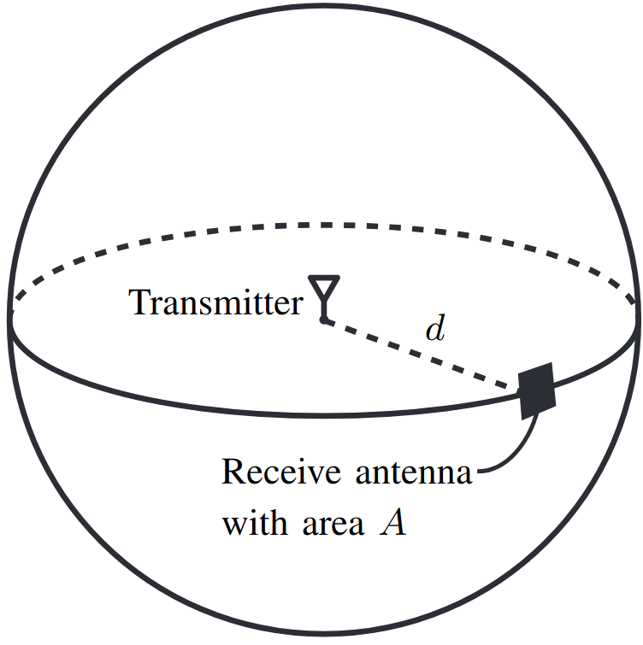
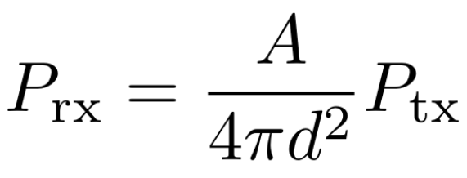

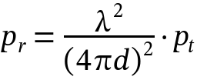
RIT
What Happens to Path Loss at High Frequencies?
Friis' formula: the received power from an isotropic transmitter antenna
Higher frequency Less power
Björnson E, Sanguinetti L. Power scaling laws and near-field behaviors of massive MIMO and intelligent reflecting surfaces. IEEE Open Journal of the Communications Society. 2020 Sep 1;1:1306-24.

Slide 16



RIT
What Happens to Path Loss at High Frequencies?
A reasonable design goal is to keep the free-space path-loss constant when frequency increased
d
Received power with array areas At and Ar
Higher frequency More power!!
We need more antenna to fill the area
Björnson E, Kara F, Kolomvakis N, Kosasih A, Ramezani P, Salman MB. Enabling 6G performance in the upper mid-band through gigantic MIMO. arXiv preprint arXiv:2407.05630. 2024 Jul.
6G in the Upper Mid-Band: The Rise of Gigantic MIMO - YouTube

Slide 17
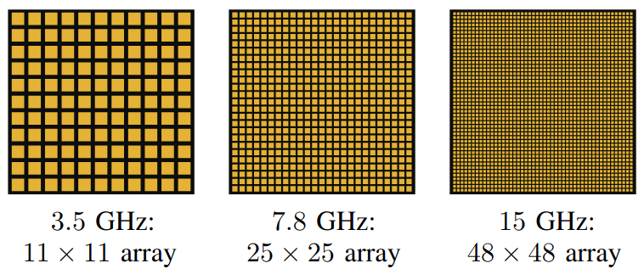
RIT
What happen to pathloss in high frequency?
Higher frequency More power!!
d
Improve the free space pathloss by increasing the number of the antenna but the same aperture area
So what is the problem with mmWave?
6G in the Upper Mid-Band: The Rise of Gigantic MIMO - YouTube

Slide 18
RIT
What happen if we increase the number of the antennas?
Just more links between the transmitter and receiver?
Just a bigger channel matrix?
Just more complexity?

Slide 19
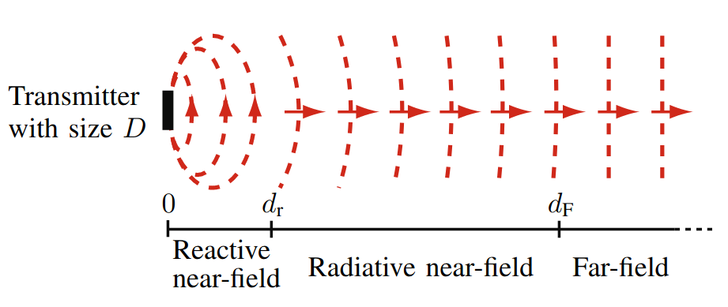
RIT
What happen if we increase the number of the antennas?
Just more links between the transmitter and receiver?
Just a bigger channel matrix?
Just more complexity?
Nearfield Communication

Slide 20


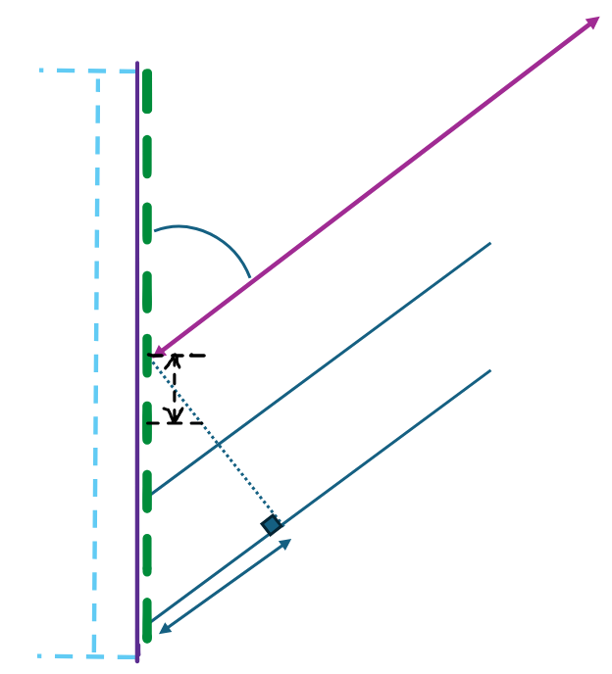

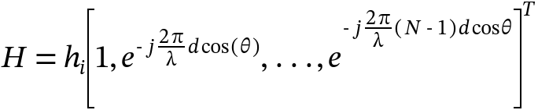

RIT
SIMO Channel Model
Considering a simple SIMO channel with LOS
r
Aperture Antenna D
d

Slide 21

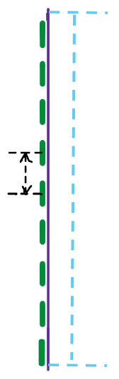





RIT
SIMO Channel Model in Near-field
Considering a simple SIMO channel with LOS
r
Aperture Antenna D
Taylor approximation
Wang Z, Mu X, Liu Y. Near-field integrated sensing and communications. IEEE Communications Letters. 2023 May 25;27(8):2048-52.

Slide 22


RIT
SIMO Channel Model in Near-field
r
Aperture Antenna D
For the enough large r (far-field) equal to 0

Slide 23
RIT
SIMO Channel Model in Nearfield
r
Aperture Antenna D
For the enough large r (far-field) equal to 0
But how much large?

Slide 24
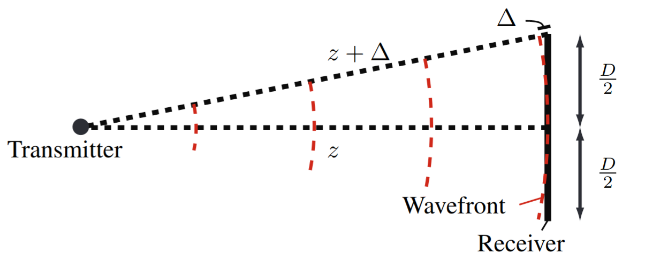
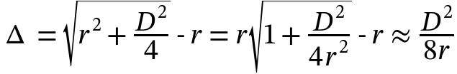



RIT
Phase Variation in the Nearfield of the Antenna Array
r
r
What is the largest phase shift for a given r?
Taylor approximation
Fraunhofer array distance
Björnson E, Demir ÖT, Sanguinetti L. A primer on near-field beamforming for arrays and reconfigurable intelligent surfaces. In2021 55th Asilomar Conference on Signals, Systems, and Computers 2021 Oct 31 (pp. 105-112). IEEE.

Slide 25
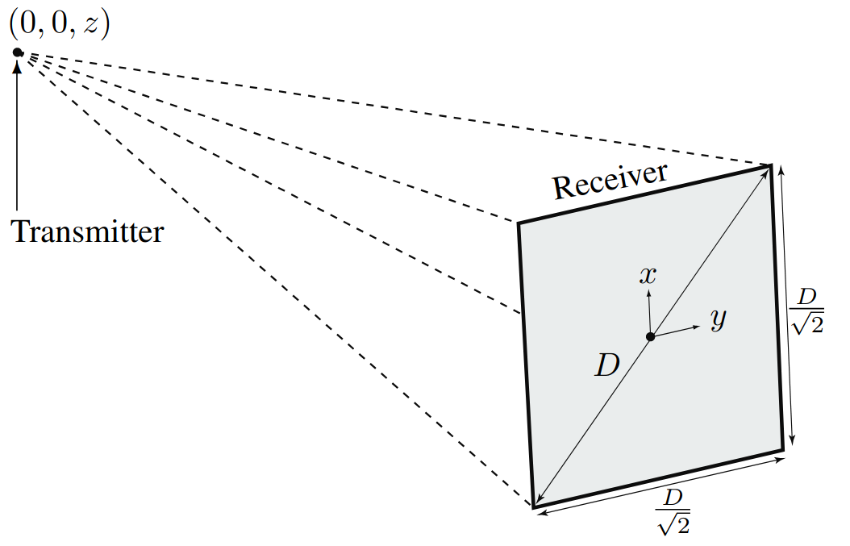
RIT
Phase Variation in the Nearfield of the Antenna Array
Fraunhofer array distance
Planar wavefront
Far-field
phase variation depends on the incident angle.
Curved wavefront
Nearfield
phase variation depends on the incident angle and distance.

Slide 26
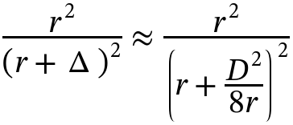


RIT
Power Variation in Nearfield of the Antenna Array
The spherical curvature also gives rise to power variations over the receive antenna.
The power differences
Bjönson distance
Phase variations are more prevalent
Björnson E, Demir ÖT, Sanguinetti L. A primer on near-field beamforming for arrays and reconfigurable intelligent surfaces. In2021 55th Asilomar Conference on Signals, Systems, and Computers 2021 Oct 31 (pp. 105-112). IEEE.

Slide 27

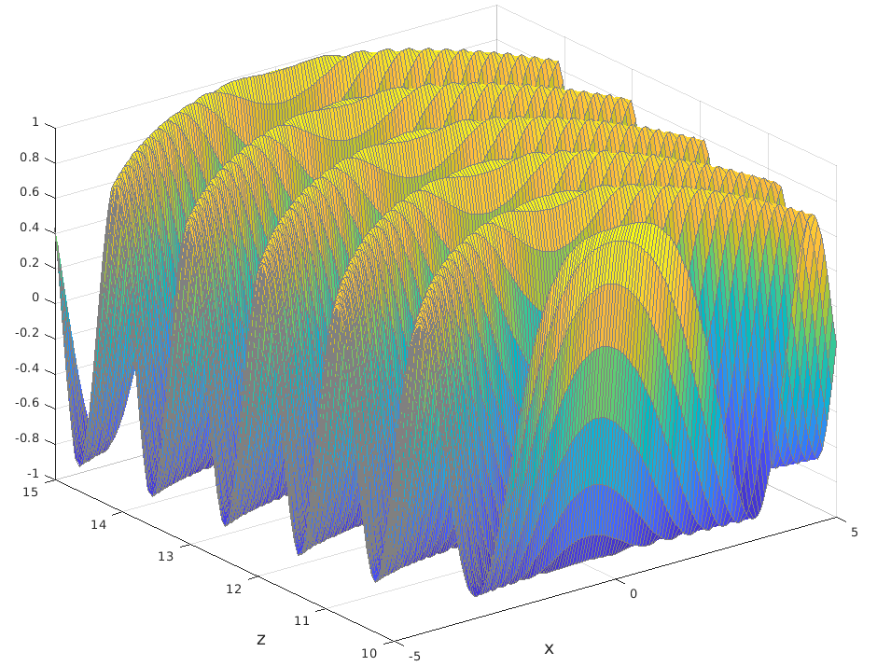
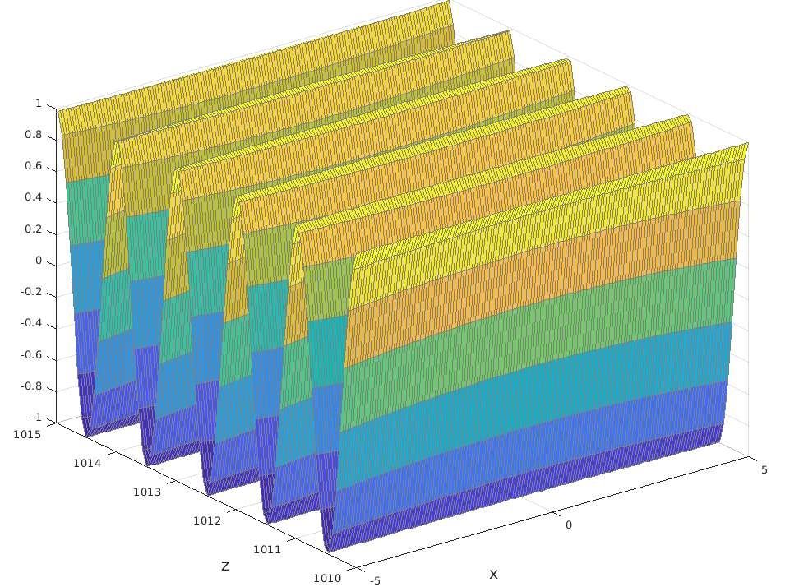
RIT
Nearfield of the Antenna Array
Fresnel region and is characterized by the fact that the amplitude variations can be neglected, but not the phase variations.
Example : Fraunhofer distance
0.5×0.5, 3 GHz = 10 m
1×1 m, 15 GHz = 200m
1×1 m, 30 GHz = 400 m
6G in the Upper Mid-Band: The Rise of Gigantic MIMO - YouTube

Slide 28
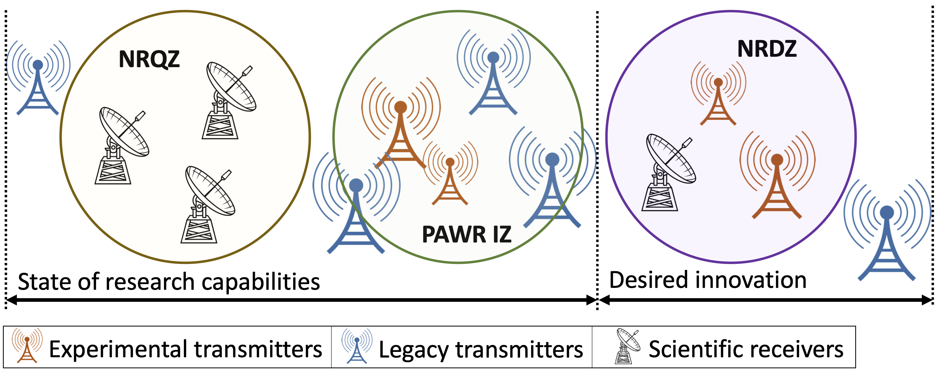
RIT
National Radio Dynamic Zones (SII-NRDZ)
Allows radio waves to transmit freely.
  Advanced technologies for spectrum sharing and coexistence.
What is the Dynamic Zone?​
  Spectrum is a limited resource.​
  Traditional methods are insufficient.​
Why It Matters
https://www.cs.albany.edu/nrdz-ra/
https://new.nsf.gov/funding/opportunities/sii-nrdz-spectrum-innovation-initiative-national-radio-dynamic-zones/505990/nsf22-579

Slide 29
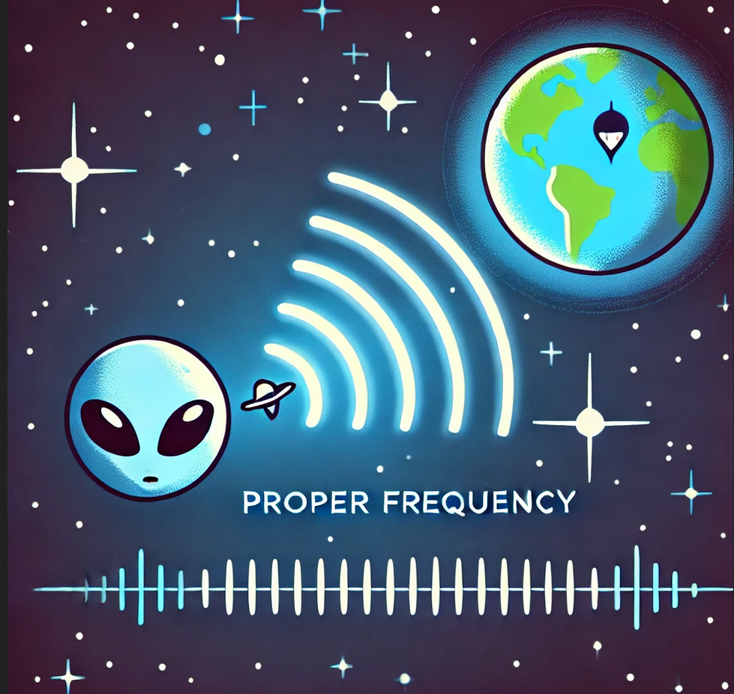
RIT
How to detect aliens' signals?
NASA's Project Cyclops in 1971
Detect signals traveling up to 1000 light-years
Absorbtion
Noise
Distinguishable from natural sources
Microwaves
1 mm – 1 m
https://en.wikipedia.org/wiki/Water_hole_(radio)
https://en.wikipedia.org/wiki/Project_Cyclops
Notes:
He went on to list the following reasons:
Galactic noise (synchrotron radiation) at a minimum
Thermal noise (receiver and isotropic background noise) at a minimum
Quantum noise (spontaneous emissions or shot noise) at low level
Star noise at a low level
https://www.seti.net/NewToSETINet/aboutSETINet/about.php
https://www.seti.net/indepth/waterhole/waterhole.php

Slide 30
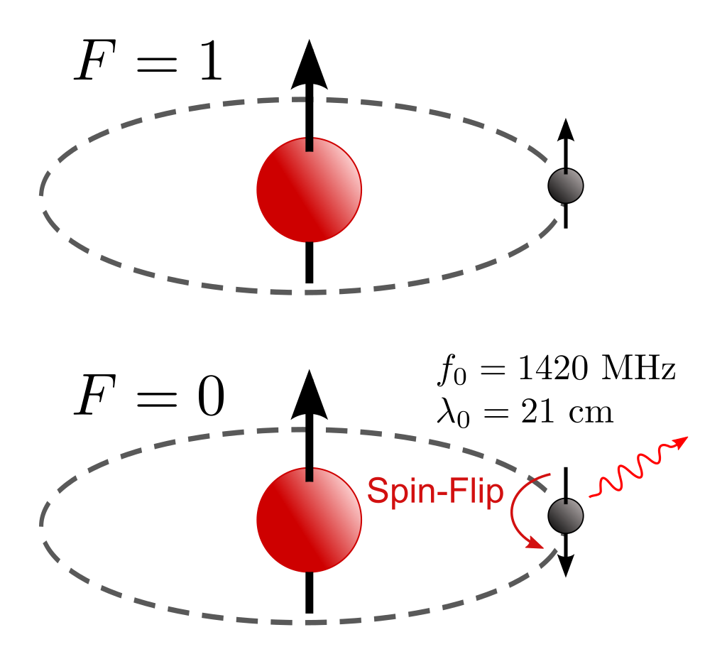





RIT
Waterhole
There is a magical narrow gate in Microwaves
Water hole
18cm-21cm
https://en.wikipedia.org/wiki/Hydrogen_line
https://en.wikipedia.org/wiki/Hydroxyl_radical
The 242 MHz area, between the hydrogen line (1420 MHz) and the hydroxyl lines (1662MHz), are the quietest part of the spectrum
https://en.wikipedia.org/wiki/Water_hole_(radio)
https://en.wikipedia.org/wiki/Project_Cyclops

Slide 31
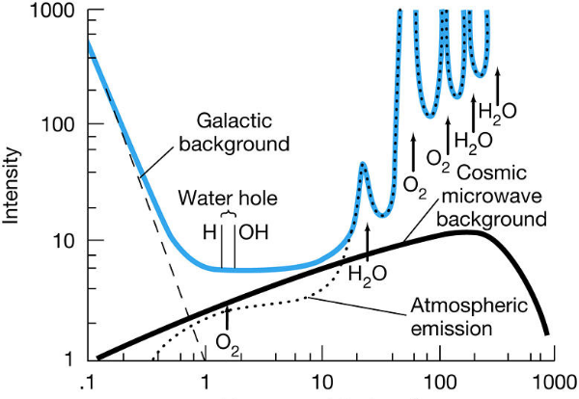
RIT
Waterhole
Waterhole
18cm-21cm
1420-1662 MHz
Oliver:
“What more poetic place could there be for water-based life to seek its kind than the age-old meeting place for all species: the water hole”
https://www.seti.net/indepth/waterhole/waterhole.php

