Slide 1

K.RAMAKRISHNAN COLLEGE OF TECHNOLOGY (AUTONOMOUS), TRICHY.
STOCK MANAGEMENT SYSTEM
PRESENTED BY
SHIBANI S
2303811710422147
SUPERVISOR
Mr. A. Malarmannan, M.E., AP/CSE.

Slide 2

PRESENTATION OVERVIEW
Objective
Project Introduction
Problem Statement
Methodologies (Programming concepts relevant to problem statement)
Architecture of the proposed system
List of Modules
Merits
Results and Discussion
Queries

Slide 3
OBJECTIVE
The objective of the Stock Management System project is to develop a comprehensive and automated platform that enables businesses to efficiently track, manage, and optimize their inventory. The system aims to streamline stock control processes by providing real-time updates on stock levels, automating stock replenishment alerts, managing orders, and generating detailed reports for analysis. The goal is to create a reliable, scalable solution that improves business productivity and reduces operational costs associated with inventory management.

Slide 4
PROJECT INTRODUCTION
The Stock Management System (SMS) is a software solution designed to streamline inventory tracking, management, and reporting for businesses. It helps organizations efficiently monitor stock levels, manage stock movements (purchases, sales, and transfers), and generate real-time reports. The system features an intuitive interface, barcode scanning, automated stock alerts, and role-based user access. By optimizing inventory processes, reducing errors, and providing data-driven insights, the SMS enhances operational efficiency, minimizes costs, and supports informed decision-making, benefiting retail businesses, manufacturers, and warehouses alike.

Slide 5
PROBLEM STATEMENT
The problem faced by many businesses today is the inefficient and error-prone management of stock and inventory. Manual tracking of stock levels, sales, and purchases often leads to issues such as stockouts, overstocking, inaccurate inventory records, and delays in reordering. These problems result in financial losses, missed sales opportunities, and poor customer satisfaction. Additionally, the lack of real-time insights into stock performance and trends makes it difficult for businesses to make informed decisions about purchasing, sales, and stock replenishment. There is a clear need for an automated, accurate, and efficient stock management solution to address these challenges and optimize inventory processes.

Slide 6
METHODOLOGIES
The Stock Management System will be developed using a combination of methodologies to ensure efficiency and adaptability. Agile methodology will guide the project through iterative sprints, allowing for continuous feedback and improvements. Object-Oriented Design (OOD) will be used to create modular and reusable components, while a strong database design using the Entity-Relationship model will ensure data integrity. The V-Model will be employed for rigorous testing at each development stage, ensuring system reliability. Additionally, Continuous Integration and Continuous Deployment (CI/CD) practices will facilitate frequent updates and quick release cycles, ensuring the system remains functional and up-to-date.

Slide 7
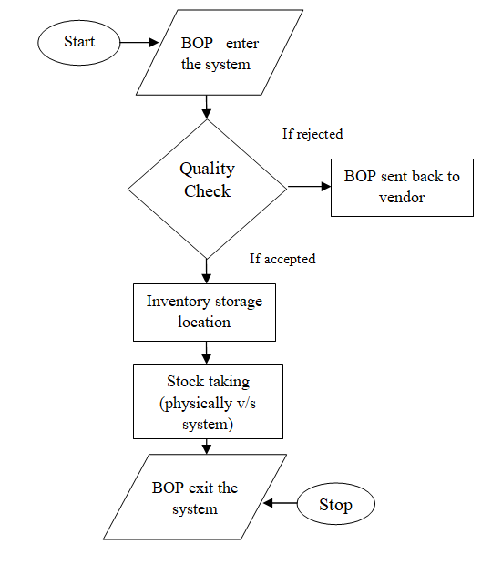
ARCHITECTURE OF THE PROPOSED SYSTEM

Slide 8
LIST OF MODULES
MODULE DESCRIPTION
1.Inventory Management Module
2.Order Management Module
3.Supplier Management Module
4.Reporting and Analytics Module
5.User Authentication and Role Management Module

Slide 9
MERITS
The Stock Management System offers several key merits, including improved accuracy and efficiency in inventory tracking, which reduces human errors and manual work. Real-time updates and automated alerts help prevent stockouts and overstocking, optimizing inventory levels. The system also provides detailed reports and insights, aiding in better decision-making and forecasting. With features like barcode scanning and role-based user access, it enhances operational speed and security. Overall, the system helps businesses reduce costs, improve customer satisfaction, and streamline inventory management processes.

Slide 10
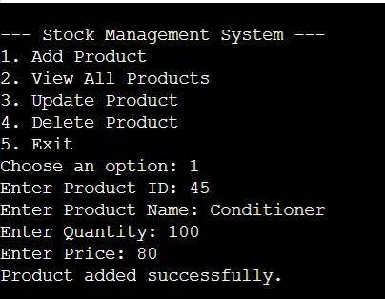
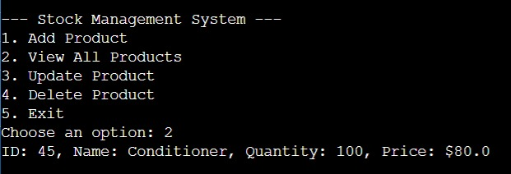
RESULTS AND DISCUSSION

Slide 11
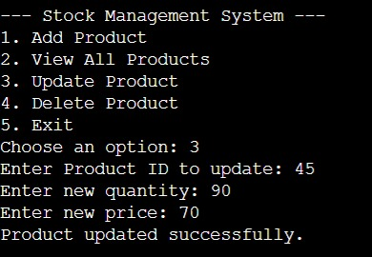
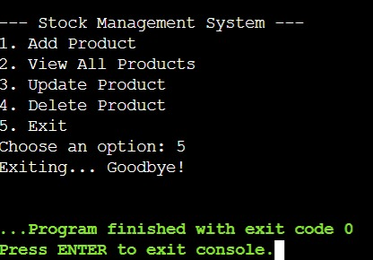
RESULTS AND DISCUSSION

Slide 12
QUERIES ?

