Slide 1

MAHATMA EDUCATION SOCIETY’S PILLAI HOC COLLEGE OF ENGINEERING AND TECHNOLOGY
PROJECT ON
Engineering Campus Network Scenario
2021-2022
UNDER THE GUIDANCE OF
Dr. Divya Y. Chirayil
GROUP MEMBERS
Mr. Ajay Bhoir - 05
Miss. Shibani S. Bose - 10
Miss. Monica Chakraborty - 11

Slide 2
Index
Introduction
Objective
Requirements of an Enterprise Network.
Existing Infrastructure
RFP
Protocols
IP Addressing Plan and Routing of implemented system
Implemented Network Design
conclusion

Slide 3
Introduction
This Campus Network Scenario is about designing a topology of a network that is a LAN (Local Area Network) for a Campus in which various computers of different departments are set up so that they can interact and communicate with each other by interchanging data.
To design a networking scenario for a campus which connect various departments to each other’s, it puts forward communication among different departments.
CNS is used to design a systematic and well-planned topology, satisfying all the necessities of the college (i.e. client).
CNS come up with a network with good performance.
We have implemented wireless connection using access points which will provide mobility to the network.

Slide 4
Objectives
Update the existing network and also enhance its capabilities
Increase the flexibility of the network which will eventually provide good security.
Providing more security by adding Firewall security
To make the network efficient and mobility at the same time.

Slide 5
Requirements of an Enterprise Network
Router (PT Router)
Switches (PT Switch)
PC
Access Point
Copper Straight Wires
Serial DCE wires
Printers
Laptops
Server (Server PT)
The new system should be able to reduce internet downtime. Download and upload links should be maintained above 5 Mbps speed requirement.
Network will be scalable.
The system should support remote access.
Should comprise of data centers with necessary security features and support

Slide 6
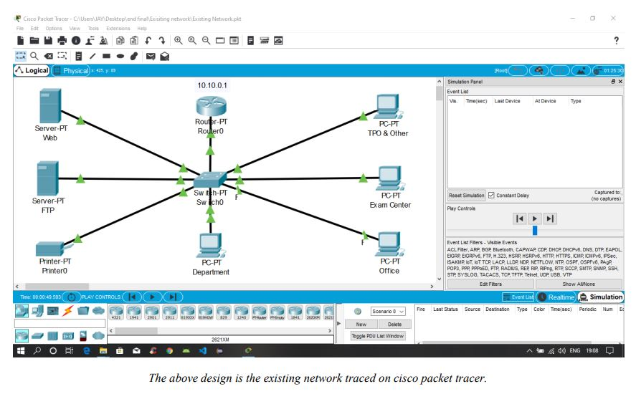
Existing Infrastructure
The existing system is a very basic system. College mainly comprises of three main sections as
TPO & Other
Exam Center
Office

Slide 7
Request for Proposal-RFP
Serial No | Network Devices | Price per unit | Quantity | Total Cost (INR)
1 | The Cisco System Business switches | 17999 | 9 | 1,61,991
2 | Routers | 8000 | 3 | 24,000
3 | Copper straight Cable | 1490 | 55 | 81,950
4 | Serial DCE cable | 7414 | 5 | 37,070
5 | PC | 30000 | 40 | 12,00,000
6 | Printers | 6000 | 13 | 78,000
7 | Server | 50000 | 4 | 2,00,000
8 | Access Point | 7641 | 2 | 15,282
9 | Laptop | 30000 | 4 | 1,20,000
10 | Smartphone | 13000 | 2 | 26,000
 |  |  | Total | 19,44,293/-

Slide 8
IP Addressing Plan of implemented system
Internet Lab (128.168.0.0)
PC-PT PC0 | 128.168.0.1
PC-PT PC1 | 128.168.0.2
PC-PT PC2 | 128.168.0.3
PC-PT PC3 | 128.168.0.4
Printer-PT Printer0 | 128.168.0.5
COMPUTER DEPT (192.168.7.0)
CS HOD CABIN | 192.168.7.1
CS LAB 1 | 192.168.7.2
CS LAB 2 | 192.168.7.3
CS LAB 3 | 192.168.7.4
CS LAB 4 | 192.168.7.5
CS LAB PRINTER 2 | 192.168.7.6
IT Dept (192.168.1.0)
IT HOD Cabin | 192.168.1.1
IT LAB 1 | 192.168.1.2
IT LAB 2 | 192.168.1.3
IT LAB 3 | 192.168.1.5
IT LAB 4 | 192.168.1.4
IT LAB PRINTER 1 | 192.168.1.6
SERVER ROOM (1.0.0.0)
Server-PT FTP | 1.0.0.2
Server-PT WEB | 1.0.0.3
Server-PT DNS | 1.0.0.4
Server-PT DHCP | 1.0.0.6
PC-PT PC9 | 1.0.0.1

Slide 9
Other (192.168.3.0)
OFFICE | 192.168.3.1
PRINTER 4 | 192.168.3.2
EXAM CELL | 192.168.3.3
PRINTER 2 | 192.168.3.4
ENQUIRY | 192.168.3.5
TPO | 192.168.3.7
PRINTER 3 | 192.168.3.6
PRINCIPAL ROOM (192.168.2.0)
LAPTOP-PT LAPTOP 0 | 192.168.2.1
PC-PT PC26 | 192.168.2.2
PRINTER-PT PRINTER 10 | 192.168.2.3
FEES COUNTER (192.168.4.0)
PC-PT PC 21 | 192.168.4.1
PRINTER-PT PRINTER 8 | 192.168.4.2
PC-PT PC 19 | 192.168.4.3
PRINTER-PT PRINTER 7 | 192.168.4.4
LIBRARY (192.168.6.0)
PC-PT PC 14 | 192.168.6.1
PC-PT PC 15 | 192.168.6.2
PC-PT PC 16 | 192.168.6.3
PC-PT PC 17 | 192.168.6.4
PC-PT PC 18 | 192.168.6.5
PRINTER-PT PRINTER 5 | 192.168.6.6

Slide 10
EXTC DEPT (192.168.5.0)
EXTC PC 1 | 192.168.5.1
EXTC PC 2 | 192.168.5.2
EXTC PC 3 | 192.168.5.3
EXTC PC 4 | 192.168.5.4
EXTC HOD CABIN | 192.168.5.7
EXTC PRINTER | 192.168.5.5
Civil DEPT (192.168.8.0)
Civil PC 1 | 192.168.8.2
Civil PC 2 | 192.168.8.3
Civil PC 3 | 192.168.8.4
Civil PC 4 | 192.168.8.5
Civil HOD CABIN | 192.168.8.1
Civil Lab PRINTER | 192.168.8.6
Research Lab (1.0.0.0)
Laptop 1 | 1.0.0.15
Laptop 2 | 1.0.0.16
PC4 | 1.0.0.7
PC5 | 1.0.0.18
Printer | 1.0.0.7
Smartphone | 1.0.0.11

Slide 11
OSPF:
Open Shortest Path First (OSPF) is a link-state routing protocol that is used to find the best path between the source and the destination router using its own Shortest Path First)
RIP:
Used for communicating between 2 networks.
FTP:
Used for file transferring between 2 different networks.
SMTP(Emails):
Used for sending emails.
VLAN:
VLANs allow network administrators to automatically limit access to a specified group of users by dividing workstations into different isolated LAN segments.
DNS:
Used for how computers exchange data on the internet and on many private networks, known as the TCP/IP protocol suite.
PROTOCOL

Slide 12
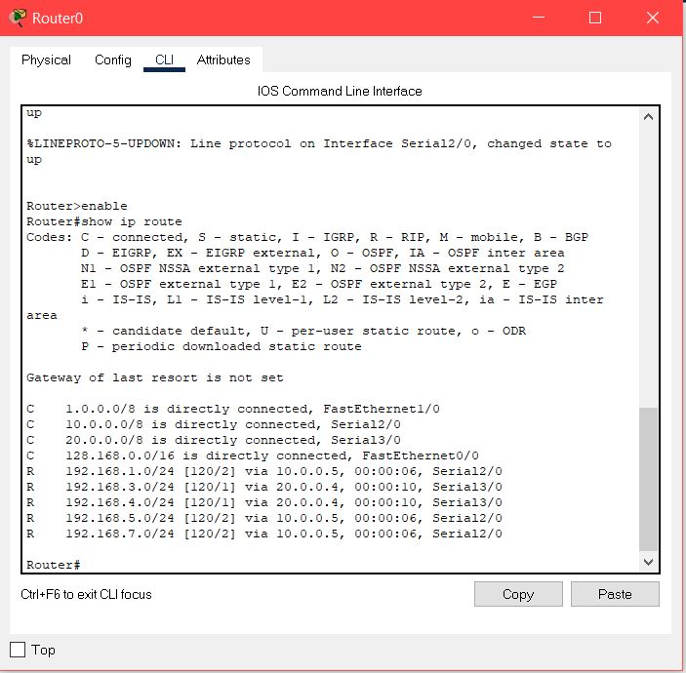
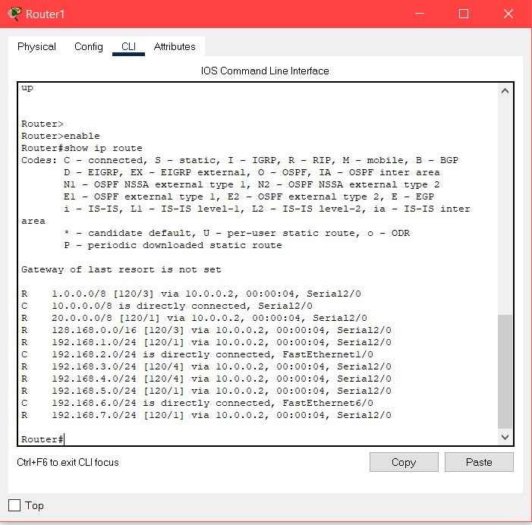
Routing of implemented system
Router 0
Router 1

Slide 13
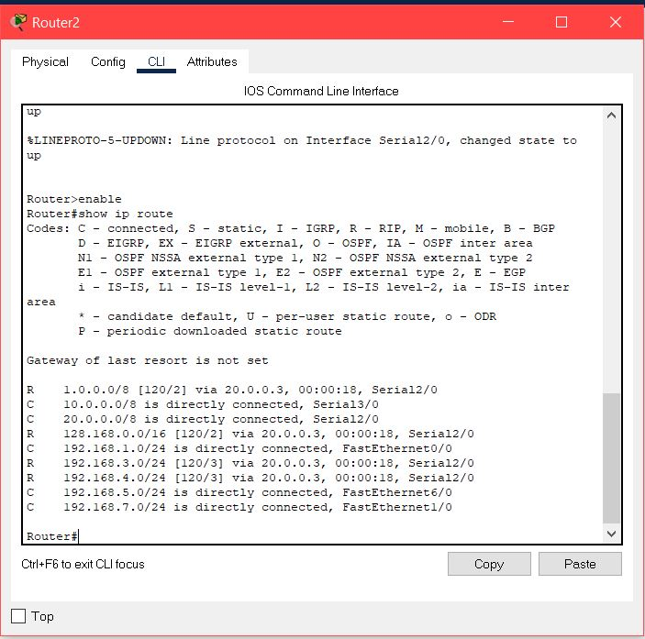
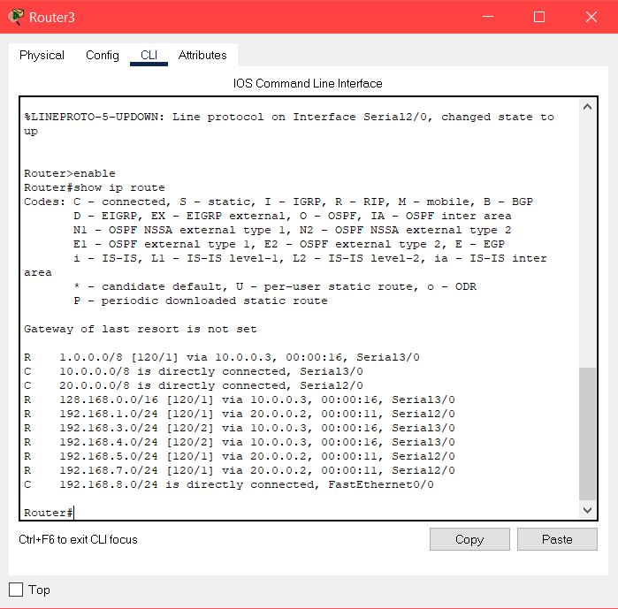
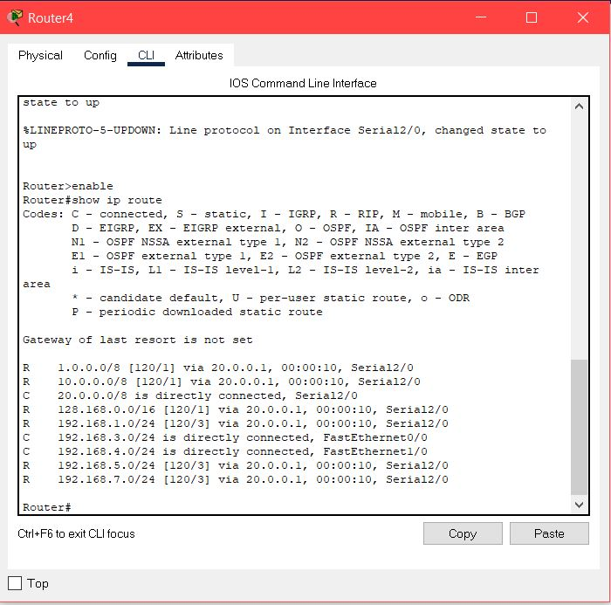
Router 2
Router 3
Router 4

Slide 14
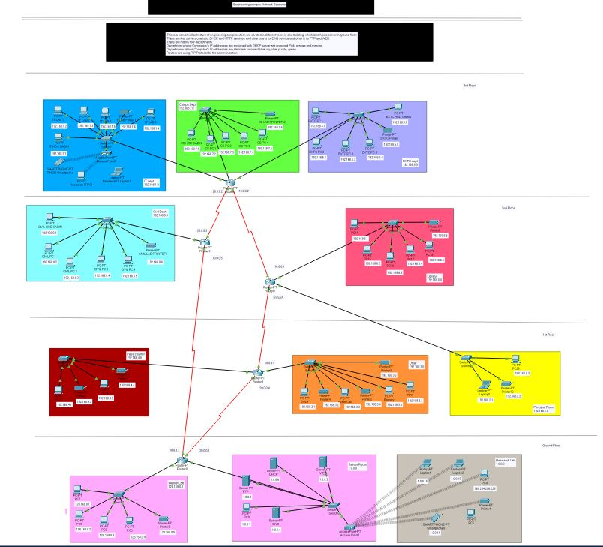
Implemented Network Design

Slide 15
Conclusion
The existing system including TPO, Office, Exam cell is extended in the propose system which includes a whole campus scenario.
Our implemented system consist of IT dept, comps dept, other, server room, principal room, library, fee counter.
We have designed a fail safe system i.e. if a particular system faces failure the remaining system will keep working.
The installed equipment allowed to organize high-speed wired and wireless Internet access throughout the whole complex of Campus buildings as well as providing transfer of all types of data throughout the single optimized network.
It has more security protocols.

