Slide 1
Permutations & Combinations
Faisal Bin Ashraf
Lecturer
Dept. of CSE

Slide 2
Multiplication Rule
If one event can occur in m ways, a second event in n ways and a third event in r, then the three events can occur in m × n × r ways.
Example: Erin has 5 tops, 6 skirts and 4 caps from which to choose an outfit.
In how many ways can she select one top, one skirt and one cap?

Slide 3
Solution:
T1, T2, T3, T4, T5
S1, S2, S3, S4, S5, S6
C1, C2, C3, C4
Tops
Skirts
Caps
T1
T2
……
T5
S1
S2
S3
S4
S5
S6
5 × 6 × 4
= 120
C1
C2
C3
C4

Slide 4
Repetition of an Event
If one event with n outcomes occurs r times with repetition allowed, then the number of ordered arrangements is n^{r}
Example 1:
What is the number of arrangements if a die is rolled?
(a) 2 times ? 6 × 6 = 6²
(b) 3 times ? 6 × 6 × 6 = 6³
(b) r times ? 6 × 6 × 6 × ……. = 6^{r}

Slide 5
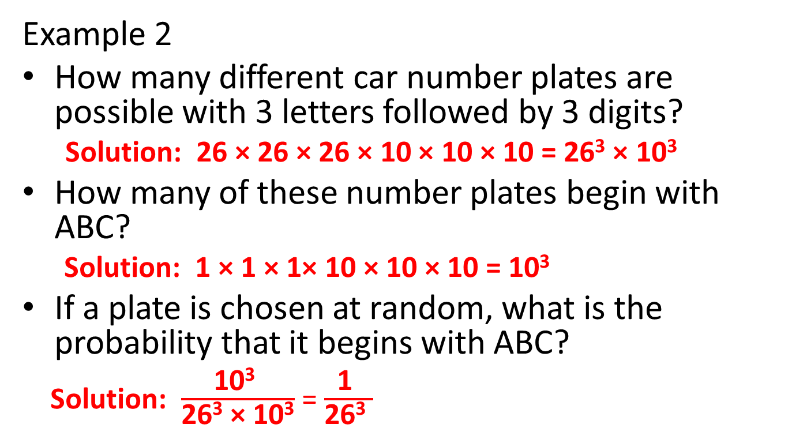
Example 2
How many different car number plates are possible with 3 letters followed by 3 digits?
Solution: 26 × 26 × 26 × 10 × 10 × 10 = 26³ × 10³
How many of these number plates begin with ABC?
Solution: 1 × 1 × 1× 10 × 10 × 10 = 10³
If a plate is chosen at random, what is the probability that it begins with ABC?
Solution: $\frac{\text{10}\text{3} }{\text{26}\text{3}\text{ × 10}\text{3}}$ = $\frac{\text{1} }{\text{26}\text{3} }$

Slide 6
Factorial Representation
n! = n(n – 1)(n – 2)………..3 × 2 × 1
For example 5! = 5.4.3.2.1 Note 0! = 1
In how many ways can 6 people be arranged in a row?
Solution : 6.5.4.3.2.1 = 6!
How many arrangements are possible if only 3 of them are chosen?
Solution: 6.5.4 = 120

Slide 7
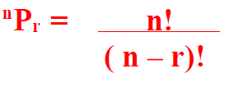
Arrangements or Permutations
Distinctly ordered sets are called
arrangements or permutations.
The number of permutations of n objects taken r at
a time is given by:
n = number of objects
r = number of positions

Slide 8

Ex. A maths debating team consists of 4 speakers.
In how many ways can all 4 speakers be arranged in a row for a photo?
Solution: 4.3.2.1 = 4! Or ⁴P₄
How many ways can the captain and vice-captain be chosen?
Solution: 4.3 = 12 or ⁴P₂

Slide 9

Eg 2. There are 7 horses in a race.
In how many different orders can the horses finish?
Solution: 7.6.5.4.3.2.1 = 7! or ⁷P₇
How many trifectas (1st , 2nd and 3rd) are possible?
Solution : 7.6.5 = 210 or ⁷P₃

Slide 10

Permutations with Restrictions
In how many ways can 5 boys and 4 girls be arranged on a bench if -
there are no restrictions?
Solution : 9! or ⁹P₉
boys and girls alternate?
Solution:
BGBGBGBGB = 5 × 4 × 4 × 3 × 3 × 2 × 2 × 1 × 1
= 5! × 4!

Slide 11

boys and girls are in separate groups?
Solution: Boys & Girls or Girls & Boys
= 5! × 4! + 4! × 5! = 5! × 4! × 2 or ⁵P₅ × ⁴P₄ × 2
Anne and Jim wish to stay together?
Solution: (AJ) _ _ _ _ _ _ _
= 2 × 8! or 2 ×⁸P8

Slide 12
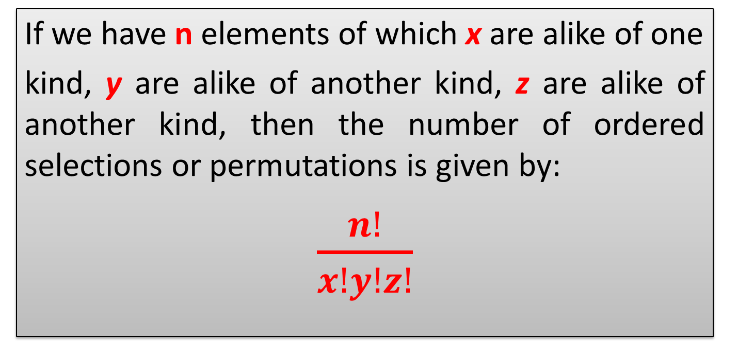
Arrangements with Repetitions
If we have n elements of which x are alike of one
kind, y are alike of another kind, z are alike of another kind, then the number of ordered selections or permutations is given by:
$\frac{n!}{x!y!z!}$

Slide 13
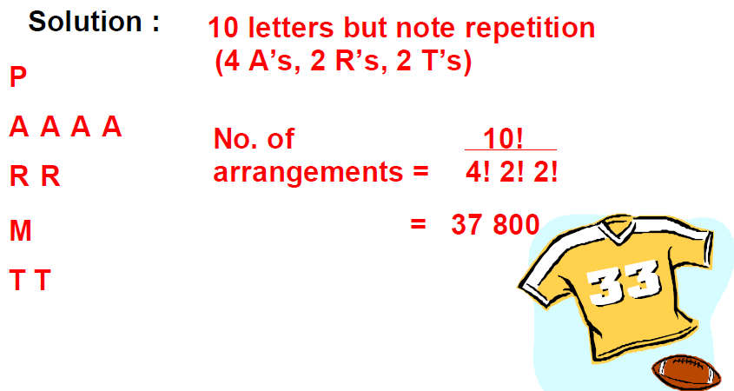
How many different arrangements of the word PARRAMATTA are possible?

Slide 14
Ex. How many arrangements of the letters of the word REMAND are possible if:
There are no restrictions?
⁶P₆ = 720 or 6!
they begin with RE?
R E _ _ _ _ = ⁴P₄ = 24 or 4!
they do not begin with RE?
Total – (begin with RE) = 6! – 4! = 696

Slide 15
Ex. How many arrangements of the letters of the word REMAND are possible if:
they have RE together in order?
(RE) _ _ _ _ = ⁵P₅ = 120 or 5!
they have R,E,M together in any order?
(REM) _ _ _ = ³P₃ × ⁴P₄ = 144
R, E and M are not to be together?
Total – (REM together) = 6! – 144 = 576

Slide 16
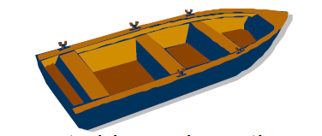
Ex. There are 6 boys who enter a boat with 8
seats, 4 on each side. In how many ways can -
they sit anywhere?
⁸P₆
two boys A and B sit on the port side and another boy W sit on the starboard side?
A & B = ⁴P₂
W = ⁴P₁
Others = ⁵P₃
Total = ⁴P₂ × ⁴P₁ × ⁵P₃

Slide 17
Ex. From the digits 2, 3, 4, 5, 6
how many numbers greater than 4 000 can be formed?
5 digits (any) = ⁵P₅ ,
4 digits ( must start with >= 4) = ³P₁ × ⁴P₃ ,
Total = ⁵P₅ ₊ ³P₁ × ⁴P₃
how many 4 digit numbers would be even?
Even (ends with 2, 4 or 6) = _ _ _ 3P1
= 4P3 × 3P1

Slide 18
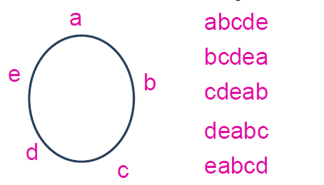
Circular Arrangements
Circular arrangements are permutations in which objects are arranged in a circle.
Consider arranging 5 objects (a, b, c, d, e) around a circular table.
The arrangements are different in line but identical around the circle.

Slide 19
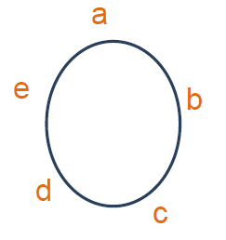
To calculate the number of ways in which n objects can be arranged in a circle, we arbitrarily fix the position of one object, so the remaining (n-1) objects can be arranged as if they were on a straight line in (n-1)! ways.

Slide 20
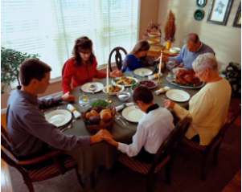
Ex. At a dinner party 6 men and 6 women sit at a round table. In how many ways can they sit if:
there are no restrictions
(12 – 1)! = 11!
men and women alternate
(6 – 1)! × 6! = 5! × 6!
Ted and Carol must sit together
(TC) & other 10 = 2! × 10!
Bob, Ted and Carol must sit together
(BTC) & other 9 = 3! × 9!
Neither Bob nor Carol can sit next to Ted.
Sit 2 of other 9 beside Ted, then, rest of 9 including Bob and Carol = (9 × 8) × 9!

Slide 21
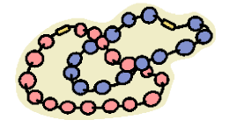
Ex. In how many ways can 8 differently colored beads be threaded on a string?
As necklace can be turned over, clockwise and anti-clockwise arrangements are the same
= (8-1)! / 2
= 7! / 2

Slide 22
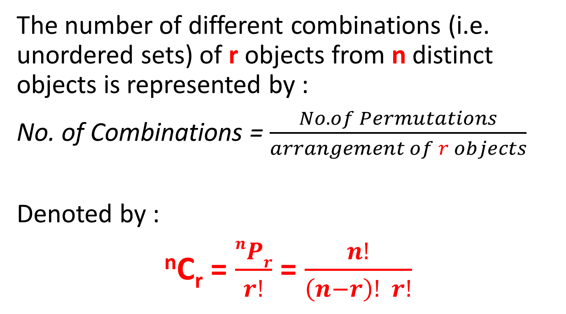
Unordered Selections
The number of different combinations (i.e. unordered sets) of r objects from n distinct objects is represented by :
No. of Combinations = $\frac{No. of Permutations}{arrangement of r objects}$
Denoted by :
^{n}C_{r} = $\frac{nPr}{r!}$ = $\frac{n!}{\left(n−r\right)! r!}$

Slide 23
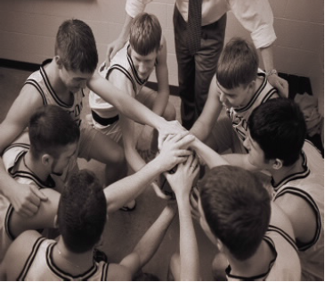
How many ways can a basketball team of 5 players be chosen from 8 players?
Solution:
⁸C₅

Slide 24

Ex. A committee of 5 people is to be chosen from a group of 6 men and 4 women. How many committees are possible if
there are no restrictions?
¹⁰C₅
one particular person must be chosen on the committee?
1 × ⁹C₄
one particular woman must be excluded from the committee?
⁹C₅
there are to be 3 men and 2 women?
Men & Women = ⁶C₃ × ⁴C₂
here are to be men only?
⁶C₅
there is to be a majority of women?
3 Women & 2 men Or 4 Women & 1 man
= ⁴C3 × ⁶C2 + ⁴C4 × ⁶C1

Slide 25
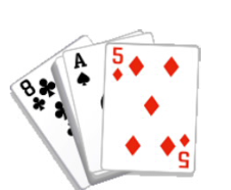
Ex. In a hand of poker, 5 cards are dealt from a
regular pack of 52 cards.
What is the total possible number of hands if there are no restrictions?
⁵²C₅
In how many of these hands are there:
4 Kings?
⁴C₄ × ⁴⁸C₁
2 Clubs and 3 Hearts?
¹³C₂ × ¹³C₃

Slide 26
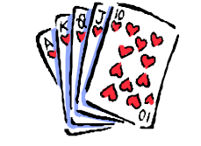

In how many of these hands are there:
all Hearts?
¹³C₅
all the same color?
Red or Black
= ²⁶C₅ + ²⁶C₅
In how many of these hands are there:
four of the same kind?
⁴C₄ × ⁴⁸C₁ × 13
3 Aces and two Kings?
⁴C₃ × ⁴C₂

Slide 27

If 4 Math books are selected from 6 different Math books and 3 English books are chosen from 5 different English books, how many ways can the seven books be arranged on a shelf:
If there are no restrictions?
⁶C₄ × ⁵C₃ × 7!
If the 4 Math books remain together?
= (MMMM) _ _ _
= ⁶P₄ × ⁵C₃ × 4! or ( ⁶C₄ × 4!) × ⁵C₃ × 4!
A Math book is at the beginning of the shelf?
= M _ _ _ _ _ _
= 6 × ⁵C3 × ⁵C3 × 6!
Math and English books alternate
= M E M E M E M
= ⁶P₄ × ⁵P₃
A Math is at the beginning and an English book is in the middle of the shelf.
= M _ _ E _ _ _
= 6 × 5 × ⁵C₃ × ⁴C₂ × 5!

Slide 28
Homework???
Class Test !!!

