Slide 1
HMS
Hospital Management
System
A Microservices-Based Healthcare Platform
Spring Boot | Angular | MySQL | Docker | JWT

Slide 2
Problem Statement & Objectives
Problem
Objectives
Hospitals rely on siloed, paper-based or monolithic systems
No real-time coordination across OPD, Lab, Pharmacy & Billing
Scalability failures during high patient load
Manual processes cause errors in appointments, billing & prescriptions
Poor inter-department communication delays patient care
Build a modular, scalable HMS using microservices
Centralize patient records, appointments, lab & billing
Implement JWT-based role access — Admin, Doctor, Patient
Enable real-time notifications & queue management
Containerize full system with Docker for easy deployment

Slide 3
Technology Stack
Backend
Frontend
Database
Security
Java 17, Spring Boot 3
Spring Cloud, Spring Security
Angular 17, TypeScript
HTTP Interceptors, WebSocket
MySQL 8.0
Separate schema per service
JWT Tokens
Role-Based Access Control
Infra & DevOps
Communication
AOP & Testing
API Gateway
Docker & Docker Compose
Redis (Rate Limiting & Cache)
Netflix Eureka (Discovery)
OpenFeign (Inter-service calls)
Logging, Auditing, Performance
JUnit 5, Mockito, Swagger
Spring Cloud Gateway
JWT Filter, Rate Limiter, CORS

Slide 4
Microservices Overview
Discovery Service
API Gateway
Auth Service
Eureka server — service registration & health (Port 8761)
Single entry point, JWT filter, rate limiting (Port 8080)
Register, login, JWT token issuing & refresh (Port 8082)
Patient Service
Doctor Service
Appointment Service
Patient profile creation and management
Doctor profiles, schedules & specializations
Slot-based booking, conflict detection (Port 8084)
Lab Service
Medical Records
Pharmacy Service
Test requests, result uploads & notifications
Diagnoses & patient history — role-restricted
Prescriptions linked to doctors, medication tracking
Billing Service
Notification Service
Queue / Reporting
Auto invoice generation & payment status tracking
Email + WebSocket real-time alerts
OPD real-time queue management & analytics reports

Slide 5
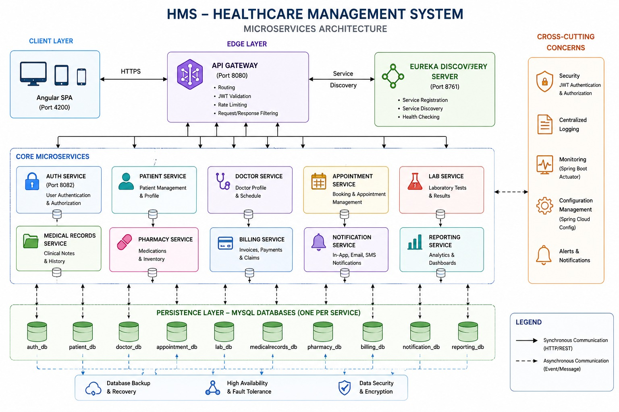
System Architecture Diagram

Slide 6
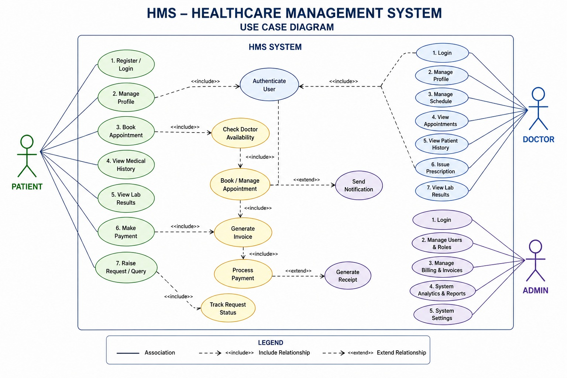
Use Case Diagram
👤 Admin
🩺 Doctor
🏥 Patient
Manage users, verify accounts, view reports & analytics
View schedule, update records, write prescriptions, view lab results
Register, book appointments, view bills and lab reports

Slide 7
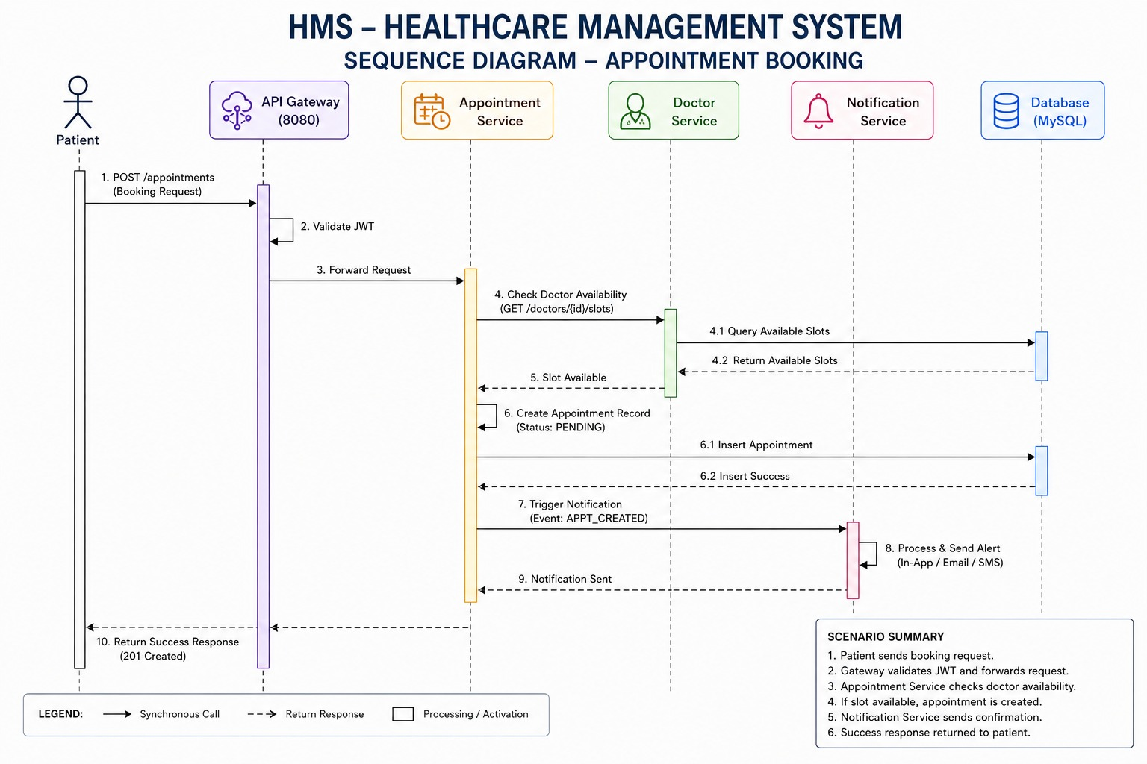
Sequence Diagram
📌 Insert Your Sequence Diagram Here
1. Patient Login
2. JWT Token Issued
3. Book Appointment
4. Lab Test Ordered
5. Result Uploaded
6. Bill Generated

Slide 8
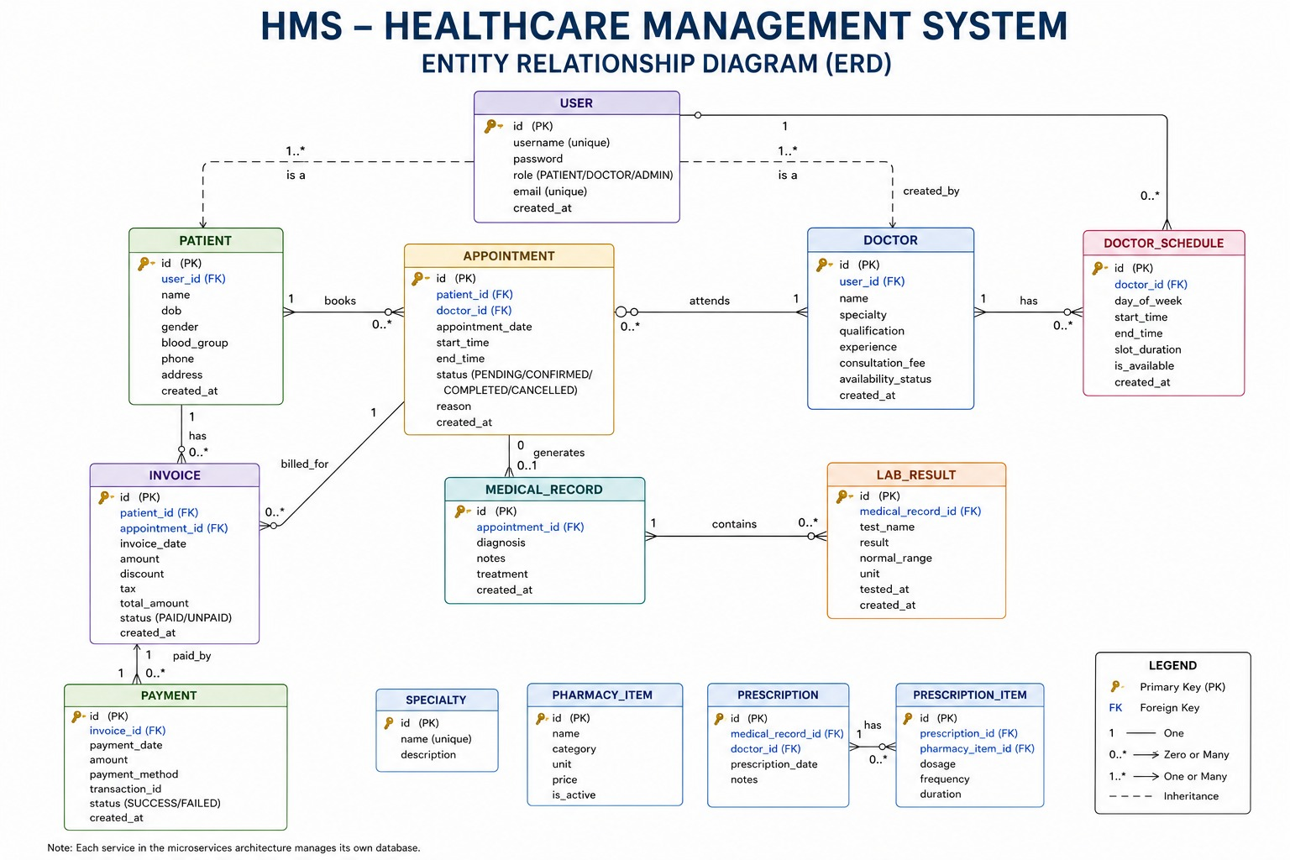
Entity-Relationship Diagram
📌 Insert Your Entity / ER Diagram Here
User
Patient
Doctor
Appointment
TimeSlot
LabResult
MedRecord
Prescription
Invoice
Database-per-service pattern — cross-service data accessed via REST, not foreign keys

Slide 9
API Gateway & Security
Gateway & Rate Limiting
Role-Based Access Control
JWT Filter validates Bearer token on all protected routes
Rate Limiting via Redis — 5 req/sec per IP on /auth/login (burst: 10)
CORS — whitelisted Angular origin (localhost:4200)
Public routes: /auth/login, /auth/register, /auth/verify
Token Refresh — access + refresh token flow supported
ADMIN
Full system access — manage users, verify accounts, all data
DOCTOR
Patient records, appointments, lab results, prescriptions
PATIENT
Own profile, book appointments, view bills & lab reports

Slide 10
Core Module Features
Appointment
Lab
Slot-based booking, conflict detection, auto-billing on completion
Test requests linked to appointments, result upload, auto-notification
Medical Records
Pharmacy
Diagnosis history per patient, role-restricted access
Doctor-linked prescriptions, medication inventory tracking
Billing
Queue
Auto invoice post-appointment, payment status management
Real-time OPD position tracking via WebSocket
Notifications
Reporting
Email + WebSocket alerts for appointments, labs & payments
Hospital analytics — usage stats, billing reports, occupancy

Slide 11
Frontend, Testing & Deployment
Frontend — Angular 17
Testing
Deployment — Docker
Role-based dashboards for Admin, Doctor & Patient
JWT auto-attached via HTTP Interceptors
Real-time queue & notification via WebSocket
Connects to backend through API Gateway (port 8080)
JUnit 5 + Mockito unit tests across all services
Frontend: 359 tests passing — 89% statement coverage, 85% function coverage
Angular tested via Jasmine/Karma with HttpClientTestingModule & RouterTestingModule
Coverage: controllers, services, AOP, exceptions
Spring Boot Test with MockMvc integration tests
Swagger/OpenAPI — auto-generated API docs per service
Docker Compose — single command for full system startup
Healthchecks for MySQL, Redis & Eureka
Secrets externalized via .env (JWT secret, DB credentials)
Each microservice built as independent Docker container

Slide 12
Conclusion & Future Scope
Conclusion
Future Scope
Fully functional HMS with 13 independently deployable microservices
Secure JWT + RBAC enforced across all modules and endpoints
End-to-end patient flow — registration to billing — fully operational
Clean microservices separation with isolated databases per service
Mobile app (Android/iOS) via the same API Gateway
AI-based doctor recommendation & smart scheduling
Kubernetes deployment for production-grade auto-scaling
Integration with insurance providers & third-party labs
Telemedicine / video consultation feature

Slide 13
DEMO
Thank You

