Slide 1
RAG, LLM, API
Module – 2
Khan Md Shibli Nomani
Date: 24-12-2025

Slide 2
RAG (Retrieval Augmented Generation)?
Query
Cosine Similarity
1. RAG Database (Vector Database)
ChromaDB, DuckDB, TinyDB, Pinecone
Knowledge Source. Task Specific
Example: Business Related Query
Apply Cosine Similarity
Embedding
RAG
Data
Knowledge Souce
LLM
Response
Retrieves relevant information from Vector Database.

Slide 3
Simple RAG vs RAG Agent
Simple RAG
Cosine Similarity
Knowledge Source
Query
Embedding
RAG
Data
LLM
Response
Cosine Similarity
Knowledge Source
RAG Agent
Embedding
RAG
Data
LLM
Response
Reasoning
(Think and Decide)
Other Agents
(Search, API)
Query
Other Tools
Simple RAG
User sends a simple query
System performs similarity search in the vector database
Retrieved documents are passed to the LLM
LLM generates the final response
RAG Agent
User sends a query
The agent performs reasoning first
→ decides whether it should retrieve from the vector DB
→ or call another tool/agent (web search, SQL, API)
If it chooses vector DB → it retrieves documents
LLM (as part of the agent) processes all gathered info
Agent generates the final, processed reply

Slide 4
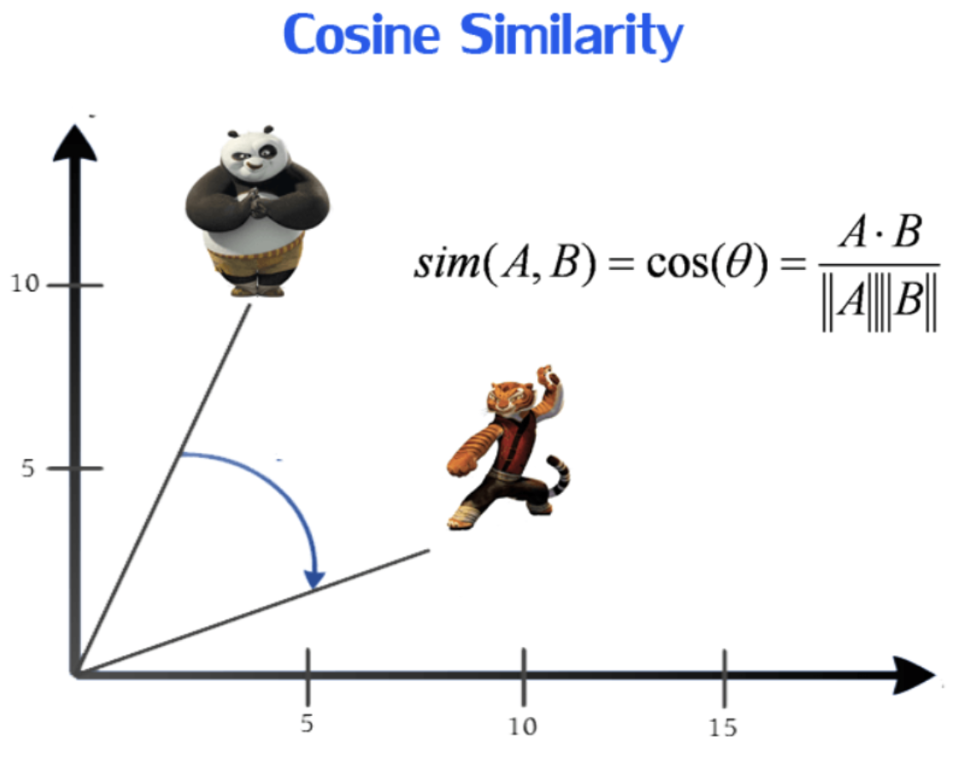
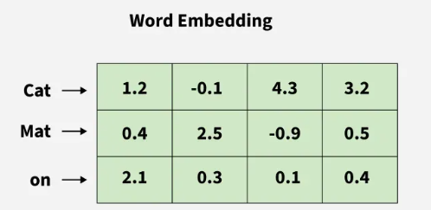
Cosine Similarity
Measuring the cosine of the angle between vector representations of two texts
Smaller angle → higher similarity
Larger angle → lower similarity
Vector and Embedding: Vector is numerical representation of words. This process is known as vector embedding. Similar words are placed close to each other in a vector space and dissimilar one fall far apart.
Tokenization: splits sentences into smaller pieces (words, subwords, or characters.)
N-gram: Sequence of tokens (Unigram, Bigram, trigram)
Numerical Representation Can be Bag of words (frequency of word in a documents), TF-IDF, Embedding (vector)
Special Note: In Bigram [“I Love”, “Love NLP”] 🡪 Count as 1 for each even the Love presents in both unit.

Slide 5
Large Language Model
Trained on massive amount of texts data (Text source: internet, etc..)
Understand and Generate Human Like Text
LLM can predict the next words
Has millions and billions of parameters
Transformer based architecture
Example: Gemini , GPT, LLaMA, BERT, T5
SLM: Small Language Model
Train on smaller scale dataset as compare to LLM
LLM Use case:
Complex, context-aware
Chatbots, summarization, code generation
SLM Use case:
Lightweight, Simple Task
Email Classification, Grammar Checking, Sentiment Analysis
Model | Transformer Type
GPT | Decoder-only Transformer
LLaMA | Decoder-only Transformer
BERT | Encoder-only Transformer
T5 | Encoder-Decoder Transformer

Slide 6
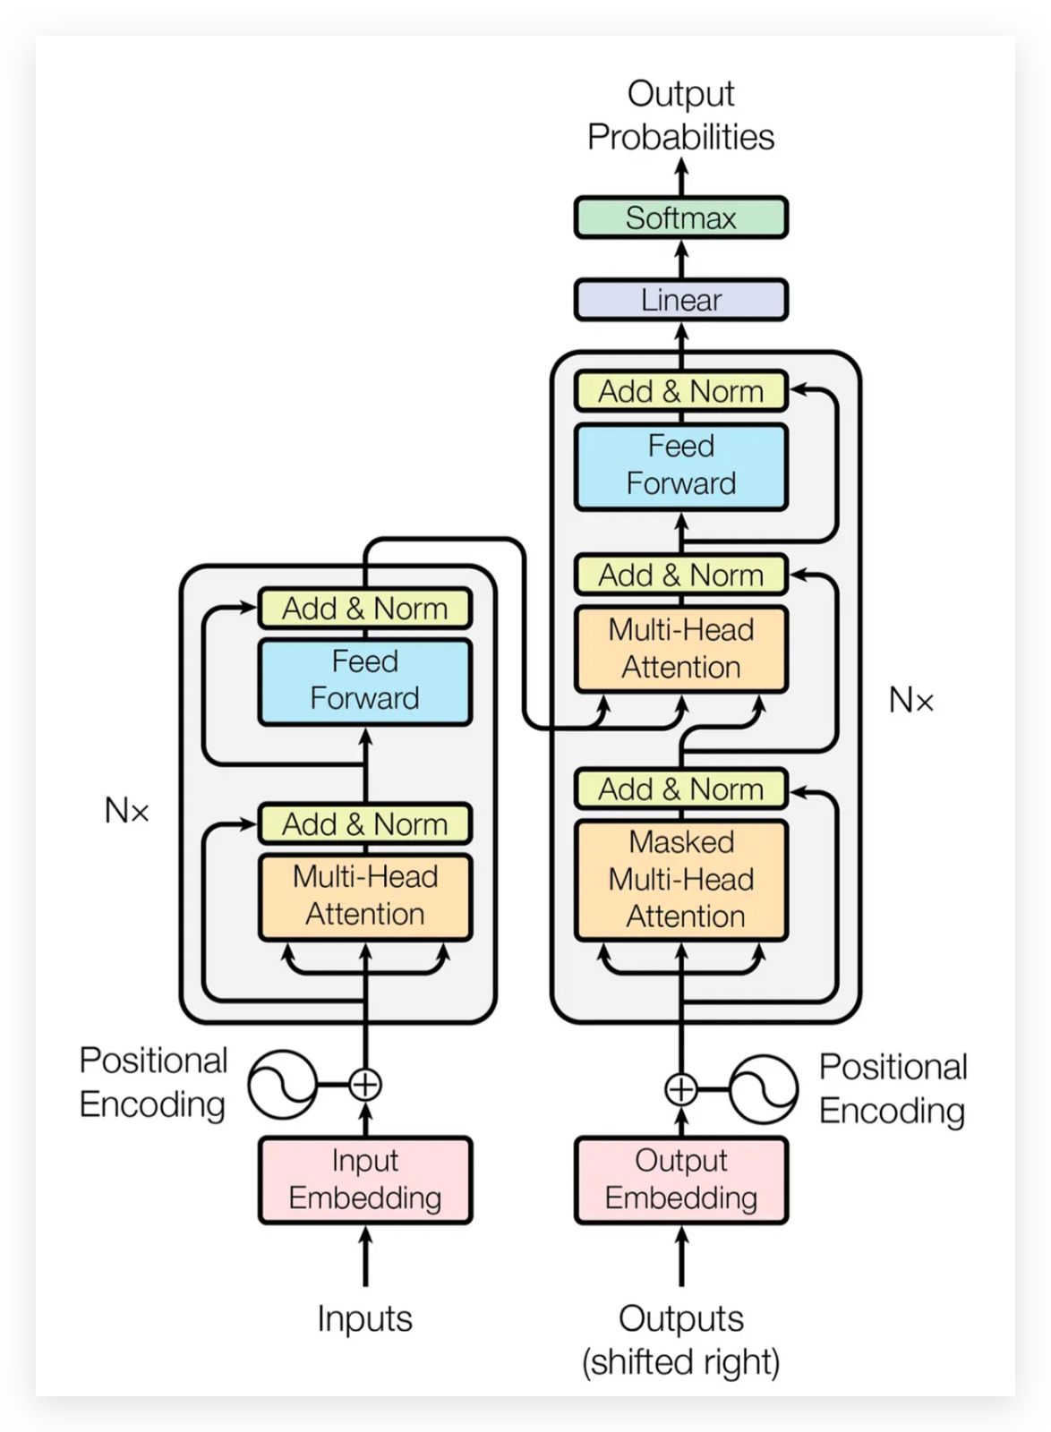
Transformers
Attention Is All You Need
Input Embedding: Numerical representation of words in a vector space
Positional Encoding: Capture the position of each token/words since transformers process tokens in parallel.
Encoder: Understanding the input information.relationships between all tokens in the input sequence.
Multihead Attention Mechanism: Main backbone of transformer based architecture. Find the importance of other words for each word based on contextual meaning, grammar sense, emotion, PoS, etc.
K
V
Q
Single Head Attention: It has only one head. It can only capture one importance like meaning/contextual meaning/grammar.

Slide 7
Transformers
Attention Is All You Need
Q, K, V: Q and K determine attention weights based on dot-product similarity to generate attention scores, which are applied to V to produce context-aware outputs.
Add & Norm: Add & Norm functions as a residual block with layer normalization, preserving input information and stabilizing the output of the multi-head attention mechanism
Feed Forward Network: The FFN processes each token independently, adding nonlinear transformations so the model can learn complex features for each token. As multi-head attention doesn’t transform each token individually.
Add & Norm: Add & Norm keeps information safe and training stable.
K
V
Q
Residual block: A residual block skips over a layer or sublayer by adding the input directly to the output.

Slide 8
Transformers
Attention Is All You Need
About Q, K, V
suppose we have a sentence:
Bank provides loan, because it has fund.
Query (Q): what is “It” here?
Keys (K): “Bank”, “provides”, “loan”, “because”, “it”, “has”, “fund”
Value (V): After computing the dot product between Q and K to generate attention weights, these weights are multiplied with V to produce a context-aware vector for “it,” which is mostly influenced by “Bank.”
K
V
Q
Residual block: A residual block skips over a layer or sublayer by adding the input directly to the output.

Slide 9
Transformers
Attention Is All You Need
Decoder: The decoder is used for generation.
Masked Multi Head Attention: Masked multi-head self-attention ensures that, during word generation, each token can only attend to previous tokens from the decoder input embeddings allows the model to generate the next word step by step without seeing future words, preventing information leakage.
Add & Norm: Add & Norm functions as a residual block with layer normalization, preserving input information and stabilizing the output of the masked multi-head attention mechanism.
Multi Head Attention: Encoder-Decoder Cross attention. K and V from encoder & Q from decoder
Feed Forward Network: The FFN processes each token independently, adding nonlinear transformations so the model can learn complex features for each token. As multi-head attention doesn’t transform each token individually.
Add & Norm: Add & Norm keeps information safe and training stable.
K
V
Q

Slide 10
Transformers
Attention Is All You Need
Linear: The linear layer ranks all vocabulary words by how likely they are to be the next word, based on the decoder's understanding of previous words. Negative values indicate less relevance, while larger positive values indicate higher relevance.
Decoder output vector = [0.4, -1.2, 2.1, ...] (512 numbers)
Vocab List = ["cats", "dogs", "pizza", "bank", "running"]
Output:
cats → 5.8
dogs → 5.1
pizza → 6.3
bank → -2.4
running → -1.8
Softmax: Softmax normalizes the score into probability. And generate predicted text outcome with probabilistic value. Best one will be chosen.
cats → 0.28
dogs → 0.19
pizza → 0.45
bank → 0.02
running → 0.06
K
V
Q

Slide 11
LLM Model, Finetuning, and Quantization (LoRA, QLoRA, GGUF, Llama.cpp)
Base Model / Foundation Model:
LLM trained on large-scale data with billions of parameters to learn general language representations.
Fine Tuning:
Adapts a foundation model for task-specific work. Model weights may be fully fine-tuned or kept frozen while adding adapters (such as LoRA/QLoRA) to efficiently learn new task-specific knowledge.
Quantization:
Reduces model weight precision (e.g., FP16 to INT8 or INT4) to lower memory usage and computational cost, enabling faster inference in resource-constrained environments with minimal accuracy loss.

Slide 12
LLM Model, Finetuning, and Quantization (LoRA, QLoRA, GGUF, Llama.cpp)
Step | Stage | Precision | Tool | Purpose / Key Details
1️⃣ Base Model (Frozen) | Base Model | FP16 | Hugging Face | Store general pretrained knowledge. Weights are frozen — no gradient updates.
2️⃣ Quantize Base Model | Quantization | INT4 | BitsAndBytes | Reduce GPU memory usage for fine-tuning. Stored as INT4, but dynamically dequantized to FP16 for computation. Base model remains frozen.
3️⃣ Train LoRA Adapters | Fine-Tuning | FP16 | PEFT / Transformers | Learn task-specific updates. Only LoRA adapter weights are trainable; base model remains frozen.
4️⃣ Merge Base + LoRA | Merge | FP16 | merge_lora.py | Base model (INT4) temporarily dequantized → LoRA FP16 deltas added → full FP16 merged model. Ensures consistency between base + adapter.
5️⃣ Re-Quantize Final Model | Re-Quantization | INT4 | quantize.py | Merge FP16 model re-quantized to INT4 for memory-efficient inference. Aligns quantization scales.
6️⃣ Convert to GGUF | Format Conversion | INT4 | convert-hf-to-gguf.py | Convert final INT4 model to GGUF binary format — portable, runtime-efficient for llama.cpp.
7️⃣ Inference | Deployment | INT4 | llama.cpp | Lightweight, fast deployment on CPU, GPU, or laptops. INT4 ensures minimal memory and compute usage.

Slide 13
Groq and Hugging Face API
Base Model / Foundation Model:
LLM trained on large-scale data with billions of parameters to learn general language representations.
Fine Tuning:
Adapts a foundation model for task-specific work. Model weights may be fully fine-tuned or kept frozen while adding adapters (such as LoRA/QLoRA) to efficiently learn new task-specific knowledge.
Quantization:
Reduces model weight precision (e.g., FP16 to INT8 or INT4) to lower memory usage and computational cost, enabling faster inference in resource-constrained environments with minimal accuracy loss.
Why Tuning with Frozen Layer of Foundation Model:
1. Preserves general knowledge learned by the foundation model and avoids catastrophic forgetting.
2. Reduces training cost and memory usage by updating only a small number of parameters.
3. Prevents overfitting when task-specific data is limited.
4. Enables faster and practical fine-tuning on resource-constrained hardware.

