Slide 1
Langchain and Langgraph
Module – 1
Khan Md Shibli Nomani
Date: 25-11-2025

Slide 2
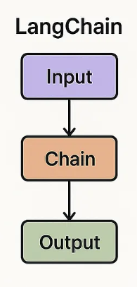
Langchain
Query
It’s a framework
Perform LLM Task
Langchain is known for Sequential Task
Use to build AI Agent
Example: RAG, Chabot
Cosine Similarity
Embedding
RAG
Data
LLM
PDF → Chunk → Embed → Store → Retrieve → Answer
Response

Slide 3
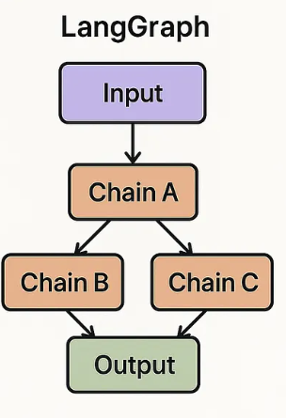
LangGraph
Query
It’s a framework
Perform LLM Task
LangGraph is known for Parallel Task
Use to build AI Agent
Conditional Logic & Loop
Parallel nodes
State management
Example: RAG, Chabot
Cosine Similarity
Embedding
RAG
Data
LLM
Not Found
Conditional Edge
Response

Slide 4
Node & Edges
Query
Node: Performs Specific task
Node contains:
Function, Logic,
Tools (optional), LLM (optional)
3. Edge: Connects nodes to maintain task flow
Cosine Similarity
Embedding
RAG
Data
Edge
Answer Not Found
Node
LLM
Conditional Edge
Response

Slide 5
State, StateGraph, MemorySaver, Start, End, Tools
Age Database
Query
DataBase
State Class: Store the query and pass through different state. It stores current Query & Response. Reset in every run.
StateGraph: Builds workflow steps
MemorySaver:
  Save the response with query of 1st Run. And store next run as well details.
  All communication until session/kernel reset (In memory)
Start: Entry point of Graph
End: Closing point of Graph
Tools: Task executor
Conditional
START
Topic VectorDB
Node
RAG
Data
ToolNode
LLM Node
Edge
tools = [summary, male_female_avg_age]
llm_with_tools = llm.bind_tools(tools)
END
In Memory: Store in Ram. Remains Until Python running session. Remove once it stops.
Short Term Memory
Persistent Memory: all communication store in disk, database or files. History remains even session ended.
Long Term Memory
Response

Slide 6
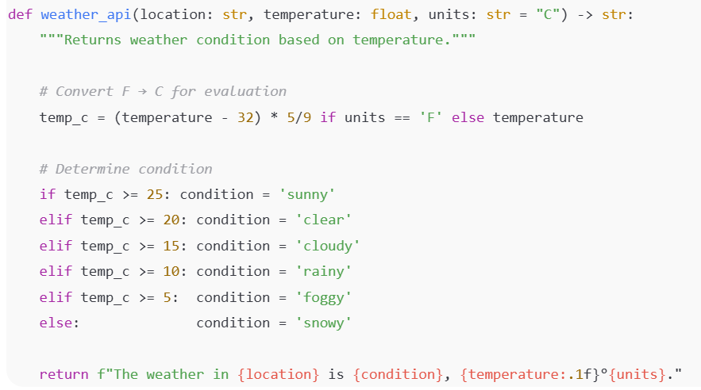
How to Design Tools to define Name, DocString, Processing Logic
Tool Name/function Name: relavant with tool work
Docstrings: Arguments. detailed information of tool
Processing Logic: work code

Slide 7
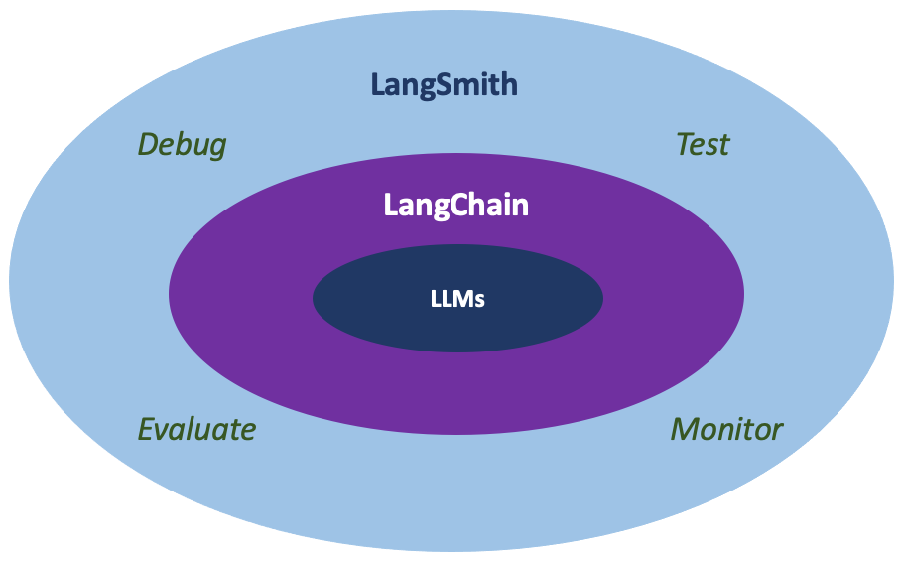
LangSmith
A debugging and monitoring platform for AI apps built with LangChain and LangGraph.
Tracks every LLM call, tool call, input, output, and error.
Helps evaluate model performance using tests, datasets, and metrics.
Provides dashboards to see latency, cost, and failures.
Improves reliability by letting developers observe and optimize agents/chains.
Works with any LLM, not only LangChain models.

Slide 8
Chunking, CoT (Chain of Thought), Human in the Loop
Chunking — “Breaking large content into smaller pieces
Imagine you have a 50-pages PDF of company policies
AI struggles to read
Break into small sections (500 words / 2 pages)
add overlap (like 1–2 sentences repeated between chunks)
Overlap prevents missing context when chunks are read separately.
Chunking — “Breaking large content into smaller pieces
Imagine you have a 50-pages PDF of company policies
AI struggles to read
Break into small sections (500 words / 2 pages)
add overlap (like 1–2 sentences repeated between chunks)
Overlap prevents missing context when chunks are read separately.
Chunking — “Breaking large content into smaller pieces
Imagine you have a 50-pages PDF of company policies
AI struggles to read
Break into small sections (500 words / 2 pages)
add overlap (like 1–2 sentences repeated between chunks)
Overlap prevents missing context when chunks are read separately.
CoT (Chain of Thought) — “Step-by-step reasoning”
CoT means breaking a complex problem into smaller reasoning steps.
Example: A math problem → The AI solves it step by step using rules like BODMAS instead of jumping directly to the answer.
This step-by-step reasoning reduces hallucinations because the AI follows logic, not guesses.
It gives more accurate and reliable answers by showing the reasoning path.
Human in the Loop — “A human supervises or approves AI work”
A company uses AI to screen job applications.
AI ranks the candidates. But a human manager makes the final decision, ensuring fairness and accuracy.
AI writes product descriptions → a human editor approves before publishing.

Slide 9
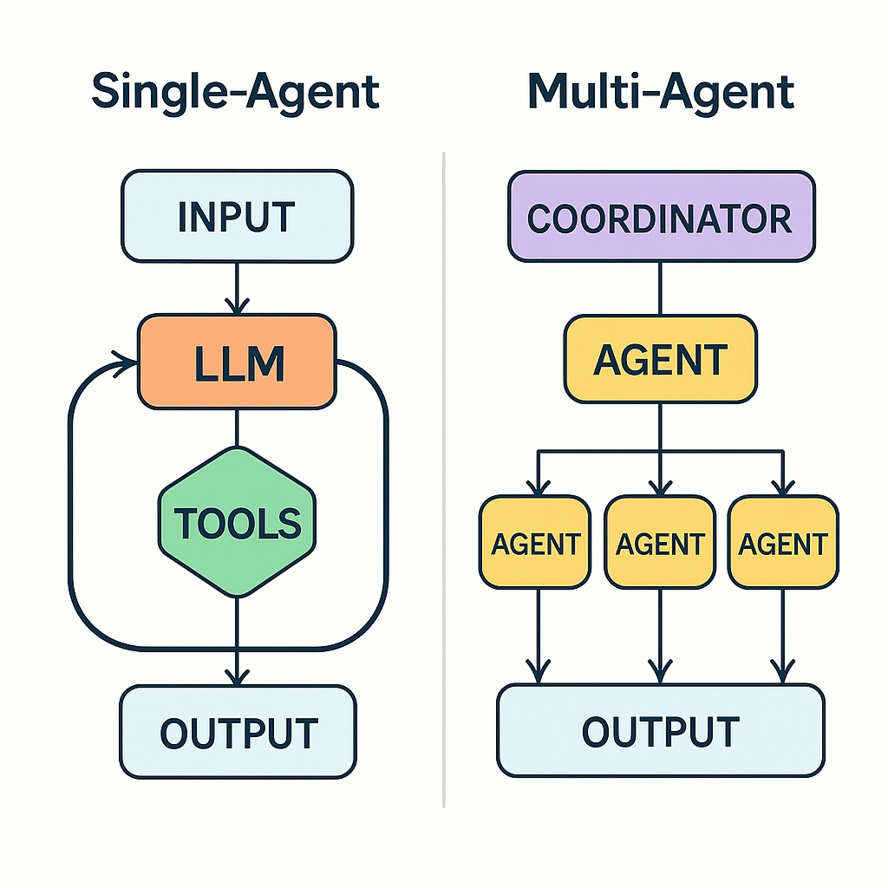
Agent vs Multi Agent?
Agent — Short Definition
An Agent is an AI system that can think, decide, and act using tools to complete a task.
Think: Understand the query or task.
Decide: Choose the most relevant agent or tool to handle it.
Act: Use the LLM to generate the final response based on the chosen action.
Single Agent: A Single Agent is one AI agent that handles the entire task from start to finish.
Why it’s useful
Simple setup
Good for small or straightforward tasks
Less coordination required
Limitations
One agent tries to do everything → can become slow or inaccurate
Harder to scale
Not good for complex workflows
Multi-Agent — Short Definition
A Multi-Agent uses several specialized agents, each with a specific role, working together like a team.
Why it’s useful
Each agent focuses on one skill (research, planning, writing, checking)
Less hallucination and tasks split across agents
Works like microservices: easy to add or remove agents Changes don’t break other agents → flexible and scalable
Why Multi-Agent is good
Large or complex tasks no longer depend on one overloaded agent

Slide 10
WHY AI Agent? Why Not Regular ML Process
Feature | AI Agent | Regular ML
Purpose | Solve complex tasks automatically | Perform one specific task
Reasoning | Can think step by step (Chain of Thought) | Gives direct output, no reasoning
Tools | Can use APIs, search engines, calculators | Limited to what it was trained on
Decision Making | Chooses actions based on context | Static output, no choice
Flexibility | Can combine skills and add new ones easily | Must retrain or redesign for new tasks
Interaction | Can communicate, follow instructions | Just outputs predictions or classifications

Slide 11
Prompting, Hallucination, LLM Poisoning
1. Prompting
Definition: Giving instructions or questions to an AI model to get a response.
Why Important: The quality of the output depends heavily on how you prompt the AI. Good prompts = accurate, relevant results.
What to Avoid:
Unclear instructions
Ambiguous wording (conflicting)
Too much or too little context
2. Hallucination
Definition: When an AI makes up facts or information that are not true. Made up it’s own answer.
Why Important: Hallucinations can lead to wrong or misleading answers, especially in critical tasks (medical, legal, financial).
What to Avoid:
Relying solely on AI for facts without verification
Asking AI outside its knowledge domain
When Happen:
Ambiguous instruction
lack accurate information
No prompt restriction. Overgeneralization
Asking about topics outside of LLM knowledge
3. LLM Poisoning
Meaning: When someone gives bad or tricky instructions to an AI, it can give wrong or unsafe answers.
Why it matters: AI can mislead people or make mistakes if poisoned.
What to avoid:
Accepting false or harmful instructions
Letting users give misleading prompts repeatedly
Not checking the AI’s answers

