Slide 1
Build AI Health Agent
Module – 3
Khan Md Shibli Nomani
Date: 03-01-2025

Slide 2
Ubuntu Command use in Here
Purpose | Command | Remarks
Create Folder / Directory | mkdir folder_name
Change Directory | cd folder_name
Create file | touch data-insert.py
Edit File | nano data-insert.py
Write and Save | Ctrl + O | Write your details and then ctrl + O and then Enter
Exit | Ctrl + X | To exit

Slide 3
Docker Command use in Here
Purpose | Command | Remarks
Prepare Docker Compose YML |  | docker-compose-mongo.yml
To check docker version | docker version
Build the MongoDB in Docker Container | docker compose -f docker-compose-mongo.yml up --build
To see MongoDB container status in Docker | docker ps
To stop docker compose | docker compose -f docker-compose-mongo.yml down
To run the docker container for MongoDB in detach mode | docker compose -f docker-compose-mongo.yml up -d

Slide 4
Create Virtual Environment in Project Directory
Purpose | Command | Remarks
Install Virtual Env | python -m pip install virtualenv | docker-compose-mongo.yml
Create Virtual Env | pip -m venv env
Drag and Drop the activation in terminal / use that command | env\Scripts\activate.bat | Active virtual Name: env
Active pyenv | pyenv shell 3.10.8
Install pymongo in virtual Env | pip –m install pymongo Or, pip install pymongo | Installthe pymongo version as per Docker Compose script
Install all libraries with requirements.txt | pip install -r requirements.txt | Most important: pip install langchain langgraph langsmith langchain-groq langchain_community pymongo

Slide 5
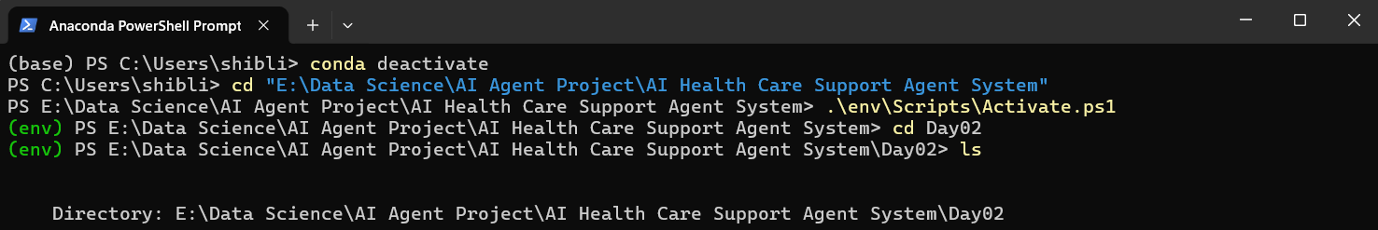
Anaconda Powershell Prompt / Terminal
Purpose | Command | Remarks
To get out of base | conda deactivate
Go to Anaconda Powershell Terminal (no admin) and Change Directory to project directory | cd “E:\Data Science\AI Agent Project\AI Health Care Support Agent System” | Your drive (E/D/whatever)) Then the project path (\Data Science\AI Agent \....”)
Active Virtual Env in Anaconda Terminal | .\env\Scripts\Activate.ps1
Change Directory where python data insert script exist | cd Day02
Insert Data into MongoDB running inside docker container | python ./data-insert.py | Make sure pymongo install properly in virtual env

Slide 6
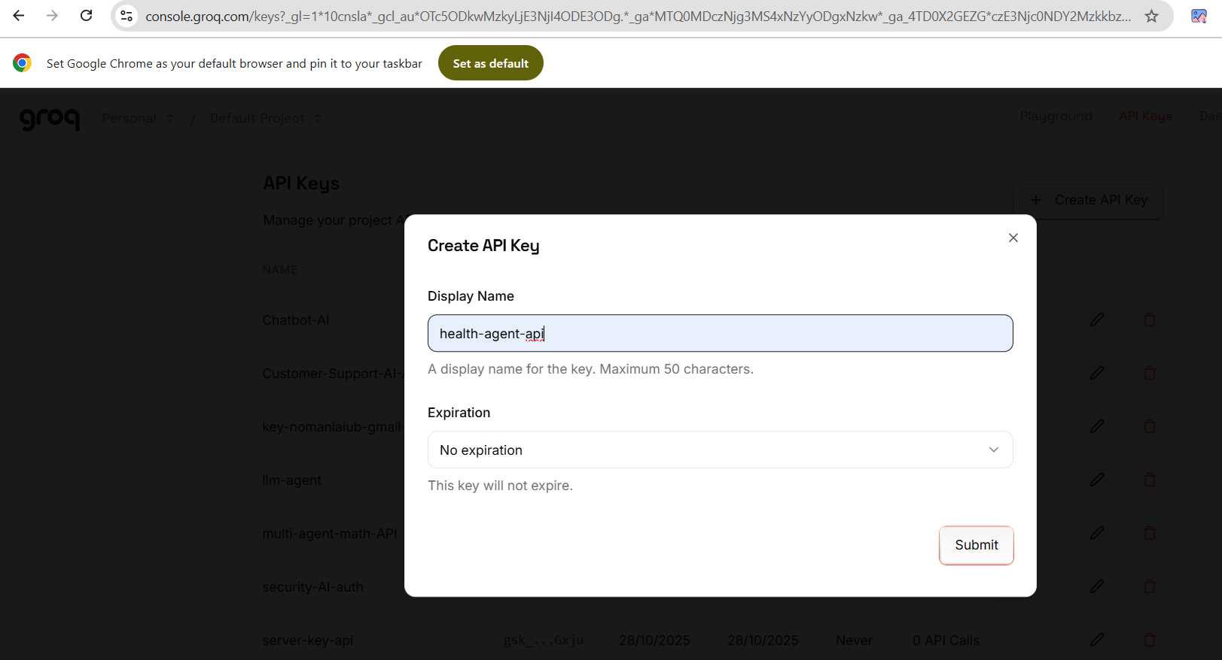
Groq API Create and Choose LLM

Slide 7
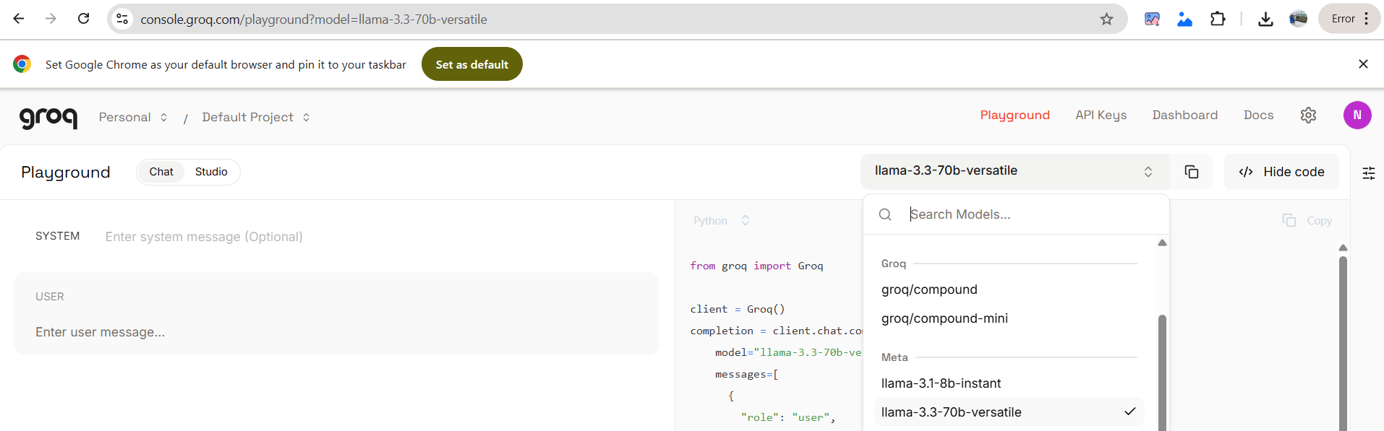
Groq API Create and Choose LLM

Slide 8
How To Perform Data Insertion in MongoDB
Python Script to insert dummy data
Docker-Compose
MongoDB
Anaconda-Powershell Terminal (inserting the data)
Jupyter Notebook to create Agent
VSCODE is used to build the dockercompose of mongoDB

Slide 9
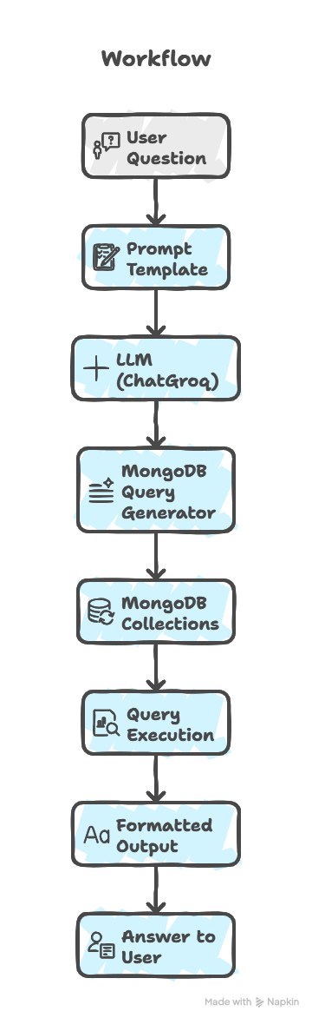

Slide 10
1. Import Libraries
2. MongoDB Connection
client = MongoClient("mongodb://localhost:27017/")
db = client["health_system"]
patients_col = db["patients"]
appointments_col = db["appointments"]
prescriptions_col = db["prescriptions"]
insurance_col = db["insurance"]
Key imports explained
os, re, json → Basic Python utilities
datetime → Handle date and time
TypedDict → Defines structure of data clearly
ChatGroq → Connects AI model (LLM)
PromptTemplate → Helps format AI prompts
MongoClient → Connects to MongoDB database
Connects to MongoDB
Selects one database: health_system
Accesses four collections
3. State Definition (TypedDict)
class State(TypedDict):
question: str
mongo_pipeline: str
parsed_pipeline: list
query_results: list
answer: str
error: str
retry_count: int
4. Prompt Template (AI Instruction)
prompt = PromptTemplate(
input_variables=["question"],
template="""
Convert the following natural language question into a MongoDB aggregation pipeline...
"""
)
question – Stores the user’s current question
mongo_pipeline – Raw MongoDB query as string
parsed_pipeline – Parsed query steps as list
query_results – Results returned from database query
answer – Final answer to the user
error – Error message if query fails
retry_count – Number of times query retried
Tells AI how to behave
Converts English question → MongoDB query
State Class: Store the query and pass through different state. It stores current Query & Response. Reset in every run.
Class State acts as a “workflow container” in LangGraph.

Slide 11
2. parse_mongo_pipeline(pipeline)
Checks the query is in the right format.
Makes sure it’s a list.
Prepares it for MongoDB execution.
3. generate_pipeline(state)
Creates a MongoDB query from your question.
Checks if the query is valid.
Gives the query or an error message.
1. Clean_mongo_query(pipeline)
Fixes the query so MongoDB can read it.
Makes $unwind simpler if needed.
Returns a clean query ready to use.
Clean query ensures run it without error.
4. execute_query(state)
Checks for previous errors.
Chooses the right database collection based on question.
Executes the query and gets results.
Returns results and debug info, or error if failed.
5. format_answer(state)
Turns MongoDB results into simple text.
Summarizes data like patient, doctor, medicine.
Handles errors and gives final answer.
chain = mongo_prompt | llm | StrOutputParser() | clean_mongo_query
“Question → AI generates query → format it → clean it → ready to use.”
parsed_pipeline = parse_mongo_pipeline(state["mongo_pipeline"])

