Slide 1


Prediction of Extreme Weather Events: Machine Learning Models Trained on Multivariate Meteorological Data
Name：Wang Shibo
Matric Number: 23111363
Supervisor : HANNYZZURA BINTI PAL AFFAL

Slide 2
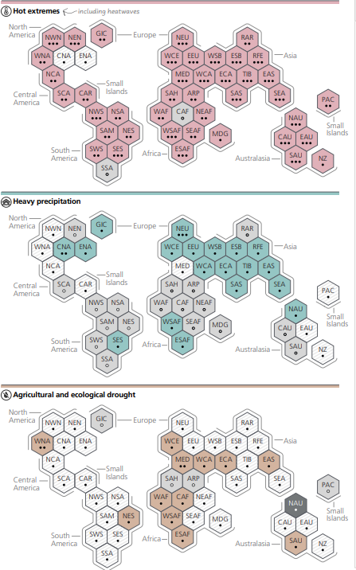
Introduction- Background
►
►Global warming and human activities worsen weather conditions
Extreme weather like drought and floods, is increasing due to global warming.
According to the Intergovernmental Panel on Climate Change (IPCC)’s Sixth Assessment Report released in 2021, the human-caused rise in greenhouse gases has increased the frequency and intensity of extreme weather events.
One study in Nature Medicine estimated that over 47,000 excess deaths occurred in Europe due to drought in 2023
Notes:
Nowadays, Global warming is making the weather more dangerous. Heatwaves, floods, and droughts are happening more often.
So, why does this happen？ Human actions since the Industrial Revolution, have caused greenhouse gases to rapidly rise in the atmosphere.
As carbon dioxide and other gases increase, they act as a blanket, trapping heat and warming the planet.
In response, Earth’s air and ocean temperatures warm.
This warming affects the water cycle, shifts weather patterns, and melts land ice
— all impacts that can make extreme weather worse.
drought events, in particular, caused massive death and disease in various locations
One study in Nature Medicine estimated that over 47,000 excess deaths occurred in Europe due to heat in 2023

Slide 3
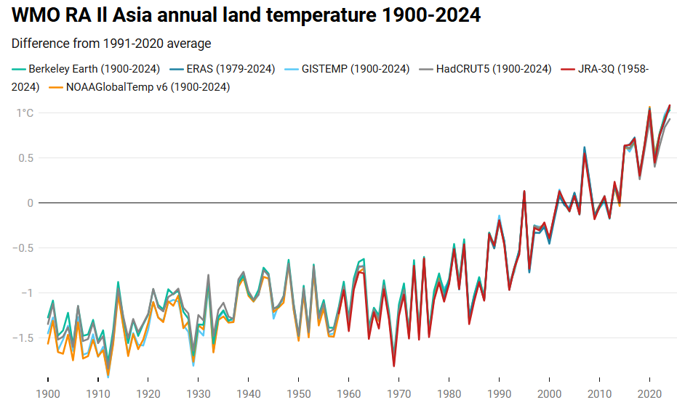
Introduction- Background
►
►Asia Faces Greater Risks from Climate Disasters
Asia’s warming rate is higher than the global average, nearly twice as fast as the global average (WMO).
In 2021, Asia had 4000 deaths and US$36B in losses from weather disasters.
Floods were the most damaging, especially in China and Malaysia.
Notes:
Asia is more affected than other regions. Its warming rate is faster. That makes Asia more affected by extreme weather.
In 2021 alone, Asia experienced hundreds of major meteorological disasters, causing losses of approximately US$36 billion and approximately 4,000 deaths.
The economic losses caused by floods in China that year were approximately US$18.4 billion

Slide 4

Introduction- Background
►
►Limitations of Traditional Forecasting Methods：Traditional extreme weather forecasting methods often struggle to model the nonlinear and temporal complexities of climate systems. Many rely on linear assumptions, such as statistical models, which limit their ability to handle long-term dependencies and multivariate interactions. These models are also sensitive to outliers and may generalize poorly.
Notes:
However, traditional weather forecasting methods struggle to capture complex, nonlinear and long-term climate patterns.
They often fail to predict extreme events accurately. This is why we need better, smarter models to help us forecast these disasters early and reduce their impact.

Slide 5

Research Problem Statement
►
1. Prediction Gap in Asia - Urgent need for more accurate forecasting in Asia due to frequent and severe extreme weather events. 2. Limitations of Traditional Methods - Conventional meteorological models struggle with nonlinear, high-dimensional climate patterns. - Inadequate handling of missing data, spatial-temporal variability, and complex interdependencies. 3. Persistent Complexity Despite More Data - Even with increased climate datasets and advanced computing, the intrinsic complexity of climate systems limits accurate prediction. 4. Machine Learning as a Strategic Solution - Integration of machine learning (ML) with multi-source climate data shows promise for improving forecast accuracy and early warning systems.

Slide 6

Question and Objective
►
1.To design and evaluate the predictive performance of a hybrid CEEMDAN-LSTM and CEEMDAN-CNN-LSTM model for forecasting two major types of extreme weather events—droughts and floods—using monthly climate indicators from eight Asian countries spanning 1950 to 2023.
2.To identify and assess the most influential meteorological variables contributing to the prediction of extreme weather events through correlation analysis, feature selection techniques.
3.To validate the robustness and generalizability of the CEEMDAN-LSTM and CEEMDAN-CNN-LSTM model by benchmarking its forecasting accuracy and stability against LSTM models.
1.How to utilize historical multivariate climate data to predict the occurrence of droughts and floods in Asian countries?
2.For each type of extreme weather problem, what are the most influential meteorological characteristics (e.g., cdd, pr, rx1day, tasmax, hours)?
3. What are the advantages of the CEEMDAN-LSTM and CEEMDAN-CNN-LSTM model over the traditional LSTM model in predicting weather data with multi-time scale characteristics such as seasonality and periodicity?

Slide 7

Scope and Contribution
►
Scope of Study
Time: 1950–2023 for training, 2024+ for prediction
Location: 8 Asian countries (e.g., China, Malaysia, India...)
Data: 15 climate variables (e.g., pr, cdd, rx1day, tasmax)
Source: World Bank Climate Portal
Techniques: CEEMDAN + CNN+ LSTM
Key Contributions
New Method: Hybrid CEEMDAN-LSTM and CEEMDAN-CNN-LSTM model for non-stationary, multi-scale data
Research Value: Covers multiple events (droughts, floods) and regions
SDG 13: Supports early warning, reduces loss, aids policy decisions

Slide 8


LITERATURE
REVIEW
What you need to consider:

Slide 9
Study | Contributions | Model | Data | Strength | Weakness
Islam et al. (2024)[9] | Predict Aman rice yield using 52 years of climate | Random Forest | Temp, rainfall, humidity, wind (1970–2022) | High accuracy (R²=0.964), handles complex data well | Not time series; misses long-term trends
Kumar et al. (2023)[10] | Predict daily rainfall in Delhi for flood warning | XGBoost | Daily rainfall (1980–2021) | Very accurate (R²≈0.99), good at time series features | Only tested in Delhi; lacks generalization
Wang et al. (2023)[11] | Drought prediction in Dongjiang River | LSTM | 10 weather + environment variables | Uses multi-source data | No model comparison; only tested in one region
Zhang et al. (2019)[12] | Drought level classification using SPEI in Shaanxi | XGBoost | SPEI at 32 weather stations | High prediction and classification accuracy | Other models (ANN, DLNM) unstable or weak
Li et al. (2024)[13] | Flood forecast using mixed real + simulated | LSTM | NAM + real flood events, 1–6 hr lead | Mixed data improves model | No comparison with other models

Slide 10
Shafiq et al. (2025) [14] | Heatwave prediction in Lahore using deep learning | LSTM (compared with ANN, CNN) | Max temp, humidity + XAI | Best accuracy (96.2%); interpretable | Small dataset; only for one city
Essa et al. (2022)[15] | Thunderstorm prediction in South Africa | CNN-LSTM | 240-hour lightning + weather data | Best at capturing time + space info | No noise data; possible overfitting
Dikshit et al. (2021)[16] | SPEI drought prediction in Australia | LSTM vs ARIMA | 100+ years of climate data (1901–2018) | Good at long-term, extreme drought prediction | Lacks variable explanation tools
Xie et al. (2024) [17] | Flood forecasting using vector directions | VD-LSTM | Flood stage vectors (rise/fall/stable) with other environment variables | Sensitive to flood process changes | Peak flood simulation not accurate
Frifra et al. (2024) [18] | Storm prediction in coastal France | LSTM + XGBoost | Wind, wave data from buoy station | Combines prediction + classification | LSTM underestimates extreme values

Slide 11

Findings from the literature
Various models used: XGBoost, RF, LSTM, CNN-LSTM, VD-LSTM
Model performance varies by event type:
XGBoost better for storm classification
LSTM is more suitable for capturing long-term climate trends dominated by time series such as droughts and heat waves.
Hybrid LSTM models show better accuracy and recall
Therefore, for the long-term climate characteristic trends dominated by time series such as precipitation, temperature, and humidity involved in this project, the project will optimize on the basis of LSTM and build CEEMDAN-LSTM amd CEEMDAN-CNN-LSTM model.

Slide 12
Literature review: Data Decomposition for Forecasting
Traditional time series methods struggle with non-stationary and complex climate data.
In 1998, Huang et al. proposed the EMD (Empirical Mode Decomposition) method, which can adaptively decompose time series. However, it has the problem of mode mixing, and the physical meaning of the decomposition result will be lost.
In 2009, Wu and Huang proposed EEMD, which introduced white noise to alleviate mode mixing, but left residual noise.
In 2011, Torres et al. proposed CEEMDAN, which introduced adaptive noise at each step, effectively solved the reconstruction error problem, and improved the stability and efficiency of decomposition.

Slide 13
Literature gap
Single-focus models: Most existing studies target only one weather type (e.g., flood or drought).
Limited geography: Models are often built for only one region or city.
Time-series limitations: LSTM captures long-term trends but misses short-term changes and multi-scale patterns.
Solution:
CEEMDAN-LSTM / CEEMDAN-CNN-LSTM
Multi-scale decomposition
Improved short-term and long-term forecasting
Support prediction for floods and droughts
Support prediction for different Asian countries

Slide 14


Slide 15
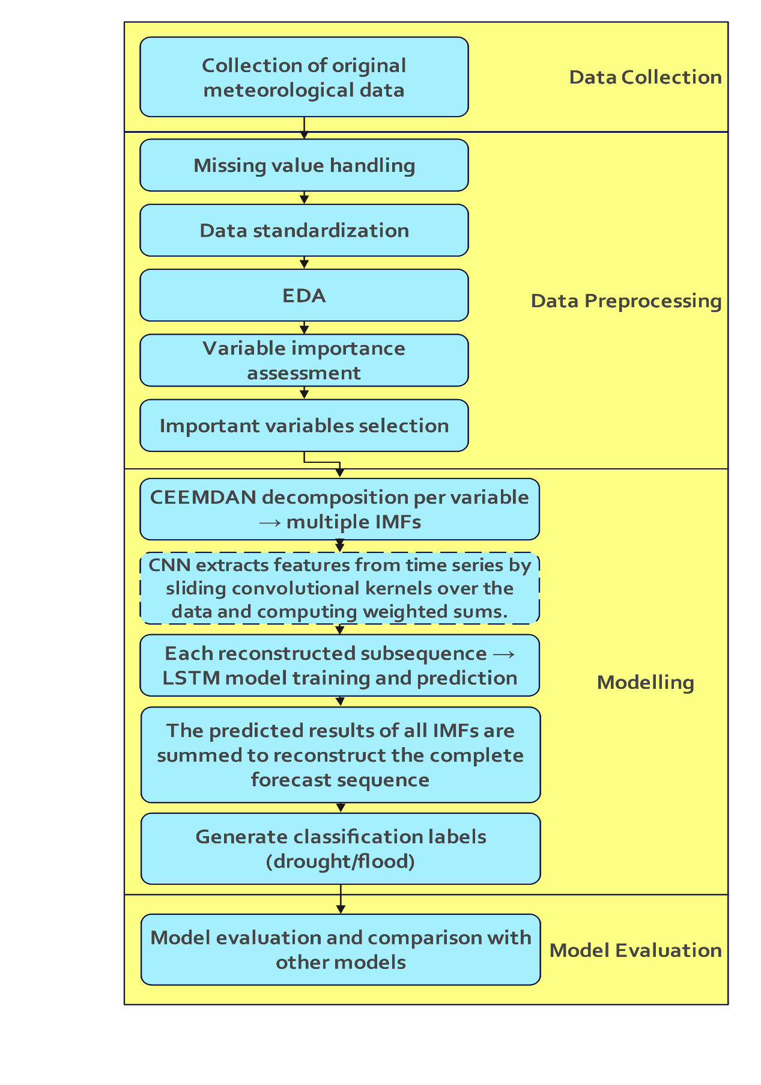
Research Workflow
This research workflow consists of four main phases:
Data Collection
Data Preprocessing
Modelling
Model Evaluation

Slide 16
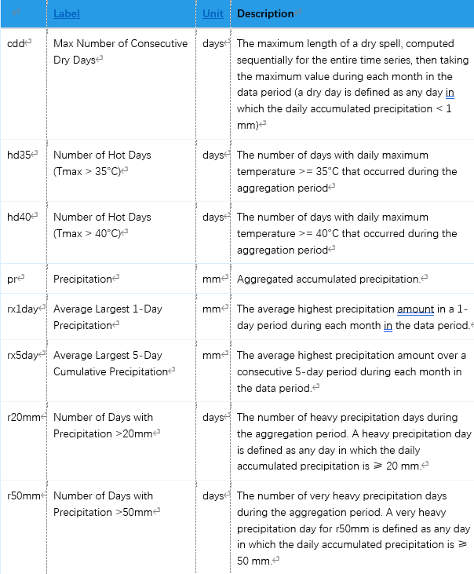
Data Collection
Source: World Bank Climate Change Knowledge Portal
Scope: 8 Asian countries (1950–2023)
Frequency: Monthly data
Variables: 15 key climate indicators (e.g., pr, cdd, tasmax, rx1day, hurs, hi35...)

Slide 17
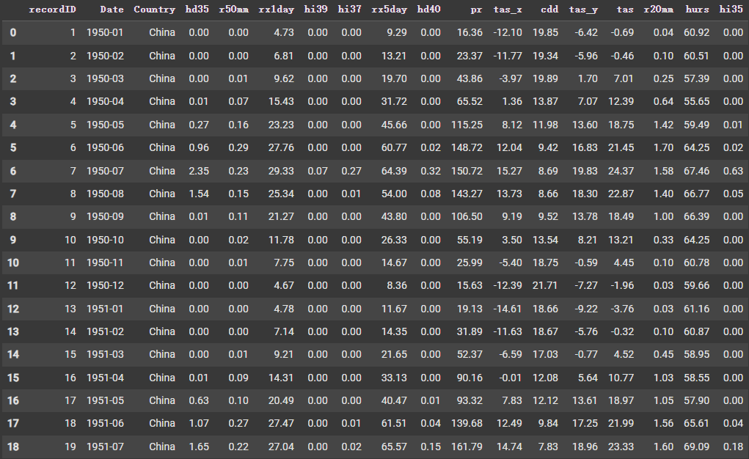
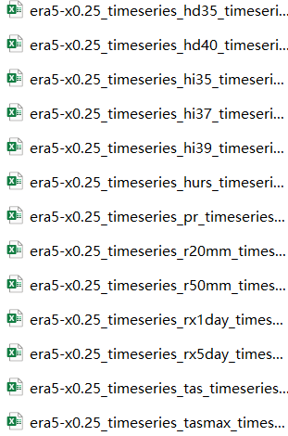
Data Collection
Notes:
climate data in separate CSV format for each variable is collected from WBCC,
Then merge these datasets using country and timestamp as key identifiers,
resulting in a single time series dataset containing all variables,
8 countries , 74 years , 12 months , 15 variables

Slide 18

Missing Value Handling • Linear interpolation (≤3 months) • Monthly historical average (>3 months)
Standardization • Min-Max scaling to [0,1] per country
EDA • Distribution, trends, anomalies • Bar charts, line charts, etc
Variable Importance Assessment • Random Forest + SHAP
Key Variable Selection • heat map, correlation coefficient
Data Preprocessing

Slide 19
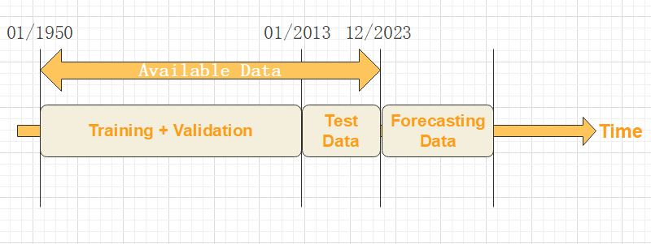
Modelling
Data Split: • Train/Validation: January 1950 – January 2013 (85%) • Test: Jan 2013 – Dec 2023 (20%) • Prediction Target: Jan 2024 forwards

Slide 20
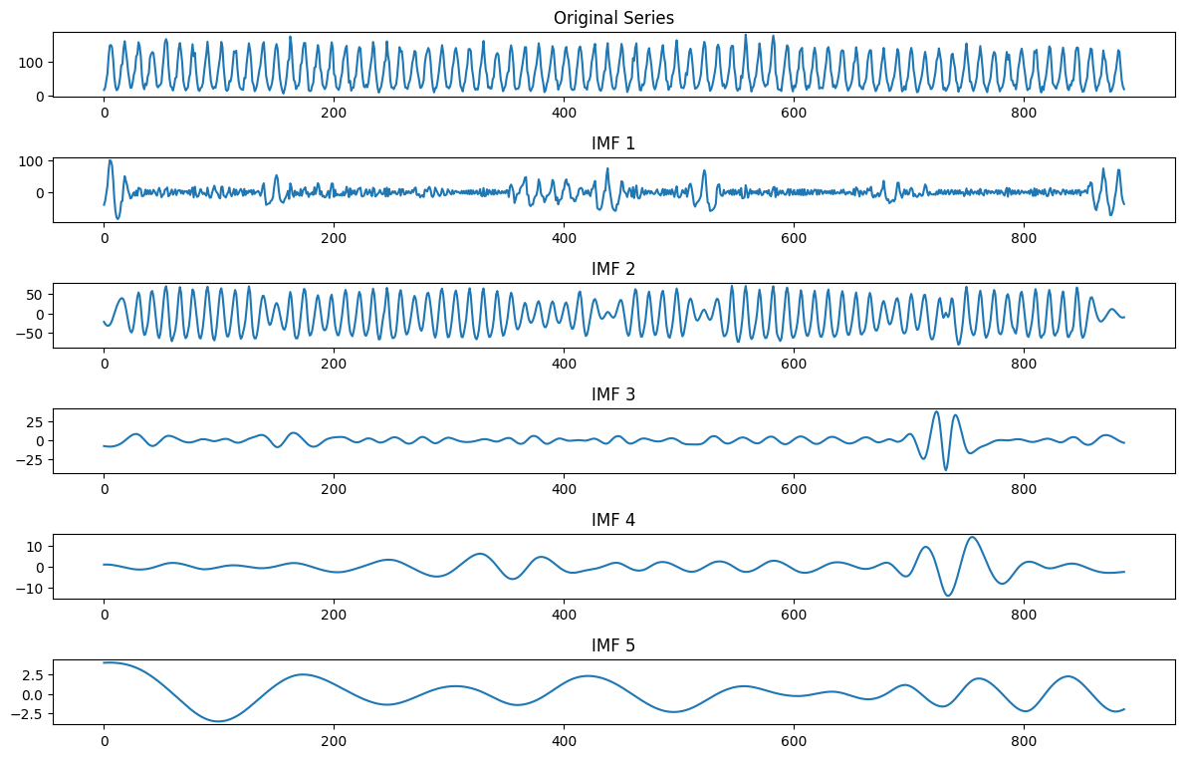
Modelling
Step 1: CEEMDAN Decomposition
Each important variable (e.g., cdd, tasmax, rx1day) is decomposed using CEEMDAN.
CEEMDAN produces multiple IMFs (Intrinsic Mode Function) across different time scales (e.g., seasonal, annual, multi-year).
Helps convert complex, non-stationary signals into regular, analyzable components.
Step 2: Per-IMF Prediction with CEEMDAN-(CNN-)LSTM
For each IMF, train a separate model: LSTM or CNN-LSTM.
Inputs: rolling windows of original meteorological predictors (the target).
Output: next-step value of that IMF (supervised, one-step-ahead).Preserves high/low-frequency patterns without manual grouping; learn IMFs independently.

Slide 21
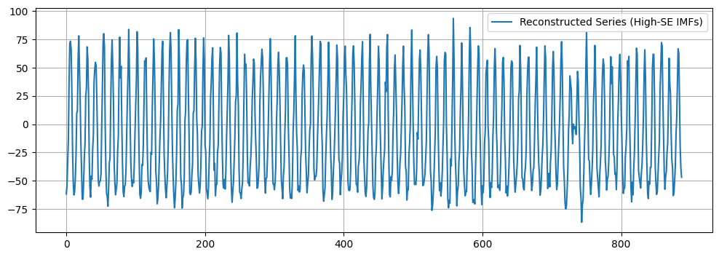
Modelling
Step 3: Model Training per IMF
CEEMDAN-CNN-LSTM: 1D CNN extracts local temporal patterns, then LSTM captures long-term dependencies.CEEMDAN-LSTM: Directly inputs IMF subsequence into LSTM to learn sequential patterns.Captures both short-term fluctuations and long-term trends in IMF series.
Step 4: Forecast Reconstruction
Forecast each IMF → sum across all IMFs to rebuild target sequence.
Combines signals at quarterly, annual, multi-year scales.
Final forecast balances abrupt extremes + slow background shifts → higher accuracy & stability.

Slide 22
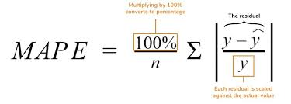
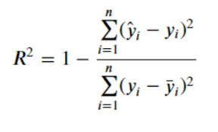
Model Evaluation
Evaluation Setup
Two-stage: regression → classification.
Targets: continuous CDD/Rx5Day → then discretized (e.g., Non, Slight, Drought by thresholds).
Compare LSTM (baseline) vs CEEMDAN-LSTM vs CEEMDAN-CNN-LSTM.
Stage 1 — Regression
MSE / RMSE / MAE / MAPE / R² (lower is better; higher R² better).
Shows fit quality and error magnitude.
Stage 2 — Classification (discretized)
Accuracy, Macro-Precision, Macro-Recall, Macro-F1, Confusion Matrix.
Focus on minority class detection and overall balance.
Visualization
Performance tables (per country & average).
Confusion matrices (3 classes).
Time-series plots: true vs. reconstructed forecasts.

Slide 23

EXPERIMENT

Slide 24
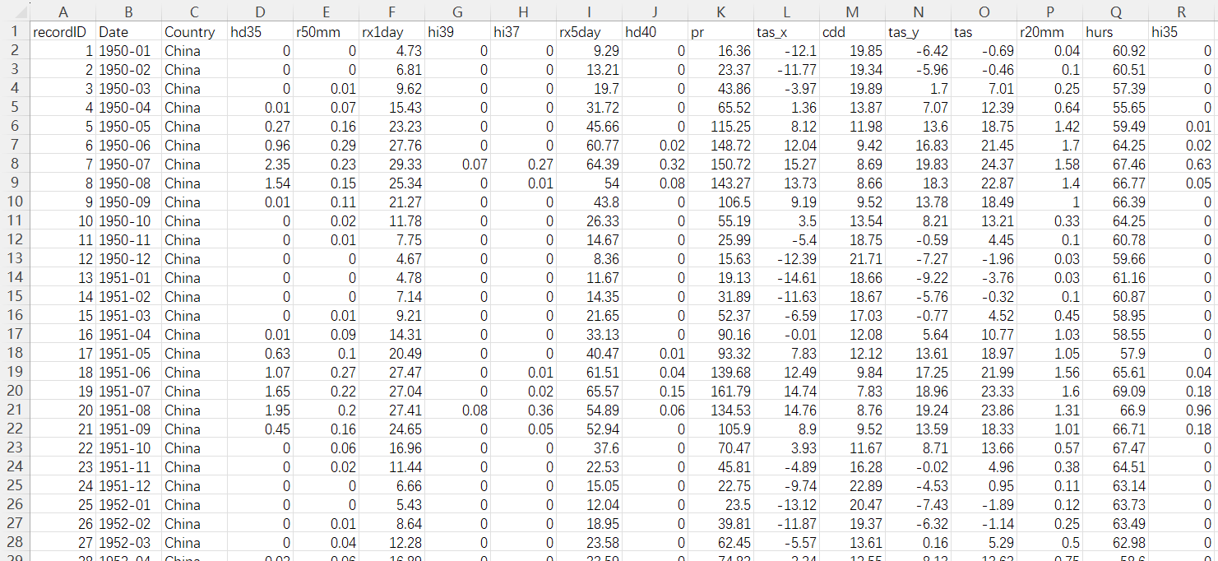
Data collection
Source: World Bank CCKP
Vars (15): precip (pr, rx1/5day, r20/50mm), dryness (cdd), temp (tasmax/min, hd35/40), humidity/heat (hurs, hi35/37/39)
Coverage: 8 countries, 1950–2023, monthly
Build: CSV per variable → merge on country + year-month
Final: 8×74×12×15 multivariate time series

Slide 25
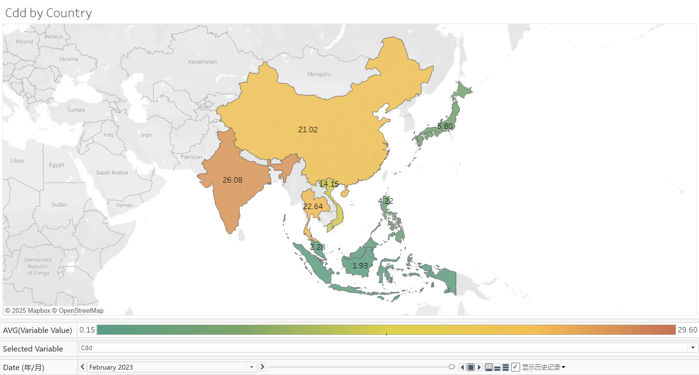
Data preprocessing (EDA)
Notes:
After handling the missing valve and data standardization, turn to EDA part to understand data quality & patterns before modelling
Tools: Tableau visualizations.

Slide 26
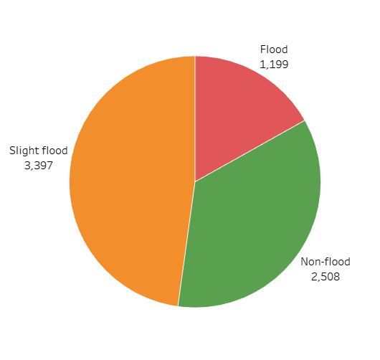
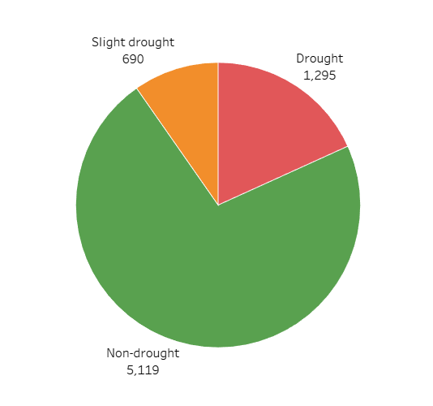
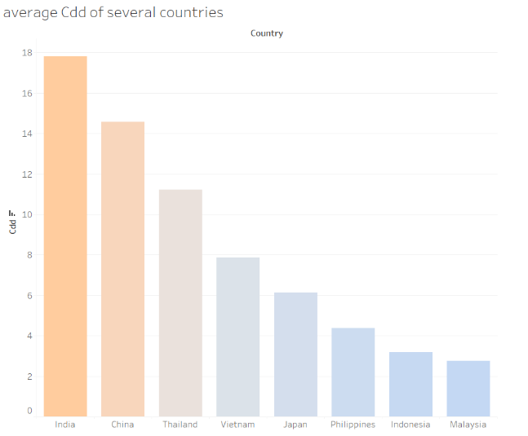
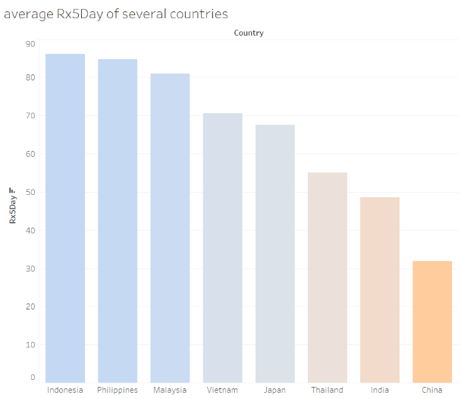
Data preprocessing (EDA)
Figure 4.2.3.3: Event Classification Distribution
Drought Events (CDD)
Non-drought (<11 days): >70%
Slight drought (11-15 days): ~20%
Drought (≥16 days): <10%
Precipitation Events (Rx5Day)
Slight flood (50-99mm): Highest frequency
Non-flood (<50mm): Moderate frequency
Flood (≥100mm): Lowest frequency
Figure 4.2.3.2: Cross-Country Climate Indicators
CDD: India, China show higher drought levels
Rx5Day: Indonesia, Philippines have higher precipitation
Pattern: Clear regional climate differentiation
Notes:
After handling the missing valve and data standardization, turn to EDA part to understand data quality & patterns before modelling
Tools: Tableau visualizations.

Slide 27
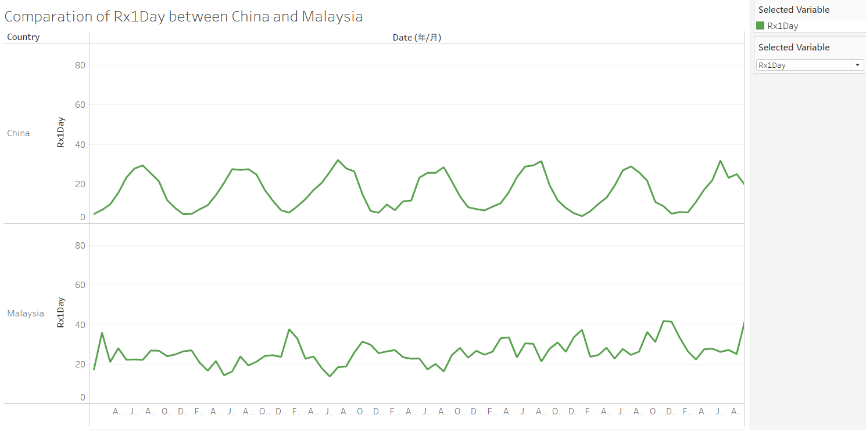
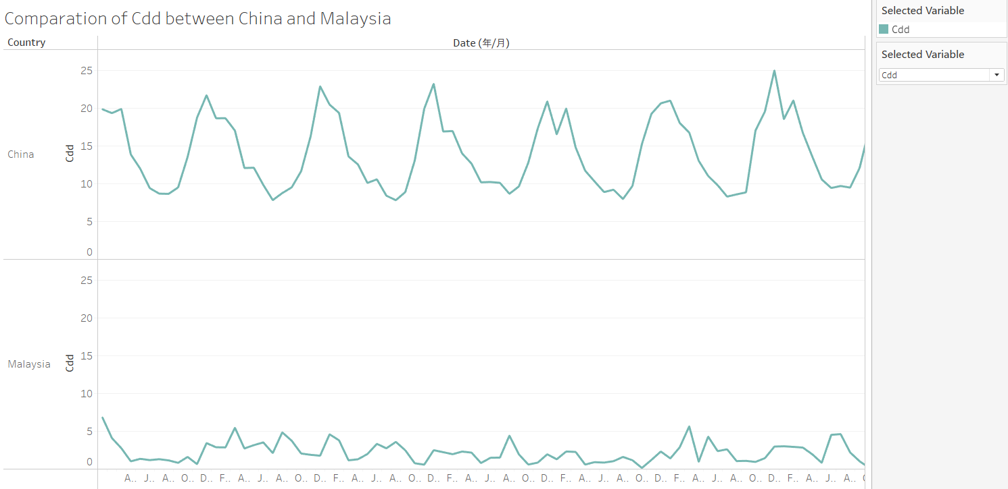
Data preprocessing (EDA)
Figure 4.2.3.4: China vs Malaysia Temporal Patterns
Consecutive Dry Days (CDD)
China:
Strong seasonal pattern: High in winter/spring, low in summer
Clear monsoon influence on drought cycles
Malaysia:
Consistently low and stable values
Minimal drought occurrence
Maximum 5-Day Precipitation (Rx5Day)
China:
Pronounced summer peaks (East Asian monsoon)
High seasonal variability
Malaysia:
Stable annual pattern with frequent intense events
Typical tropical monsoon characteristics
Notes:
After handling the missing valve and data standardization, turn to EDA part to understand data quality & patterns before modelling
Tools: Tableau visualizations.

Slide 28
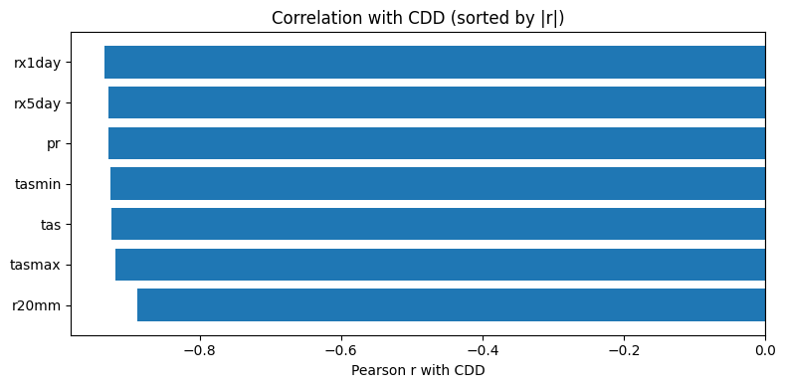
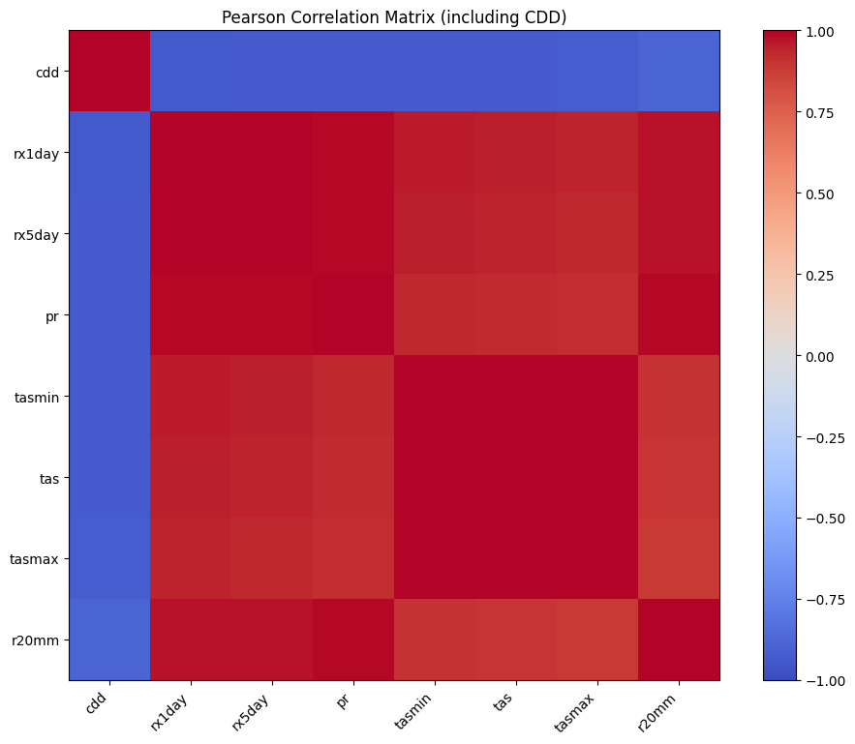
Data preprocessing (Variable Importance Assessment)
Identifies most predictive meteorological factors
Quantitative ranking for model input selection
Visual representation of variable relationships
Supports feature selection strategy

Slide 29


CEEMDAN Decomposition Principle
Method Overview
Full Name: Complete Ensemble Empirical Mode Decomposition with Adaptive Noise
Improvement: Advanced version of EMD and EEMD
Key Innovation: Adaptive noise reduces mode aliasing
Application: Nonlinear, nonstationary meteorological time series
Target Variables
CDD: Consecutive dry days (drought metric)
Rx5Day: Maximum 5-day precipitation (extreme rainfall metric)
Decomposition Process
Step 1: Noise Addition
Add Gaussian white noise to original signal
Create multiple noisy signals for ensemble processing
Step 2: EMD & Averaging
Apply EMD to each noisy signal
Calculate mean of first IMF components
Compute residual for next iteration
Step 3: Iterative Decomposition
Add adaptive noise to residual
Extract subsequent IMF components
Update residual for next round
Step 4: Termination
Continue until monotonic condition met
Obtain all IMF components and final residual
Step 5: Signal Reconstruction
Formula: Original signal = Σ(IMF components) + Final residual
Enables multi-scale feature extraction
$$c_{j+1}\left(t\right)=\frac{1}{N}\sum_{i=1}^{N}{E_{1}\left(r_{j}\left(t\right)+ε_{j}E_{j}\left(ω^{i}\left(t\right)\right)\right)}$$
$$y\left(t\right)=\sum_{m=1}^{M}{c_{m}\left(t\right)}+r_{M}\left(t\right)$$

Slide 30
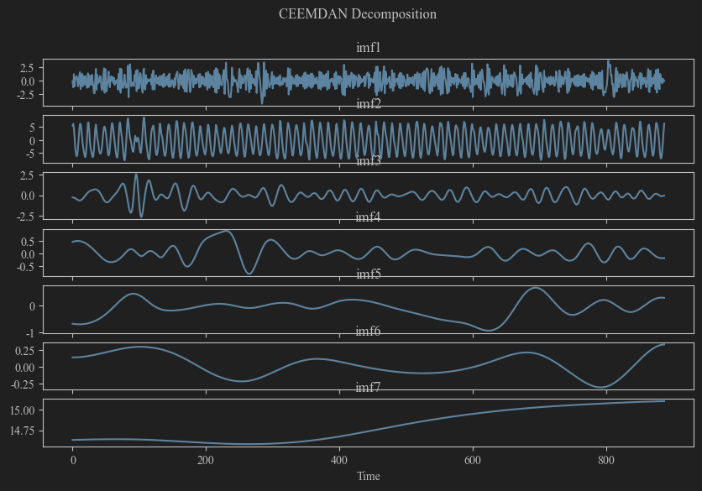
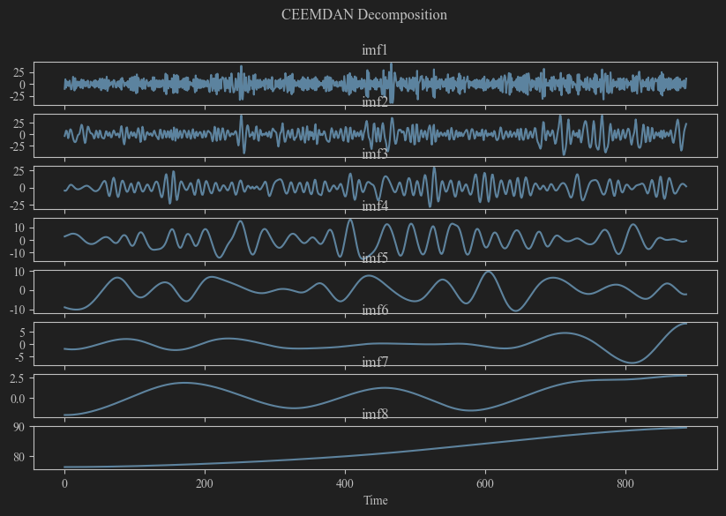
Climate target variable decomposition implementation
The original complex climate signal is decomposed into multiple intrinsic mode functions (IMFs) and a single residual trend term, with each IMF representing oscillations at distinct temporal scales.
High-frequency IMFs (imf1 - imf3):
Short-term climate fluctuations (months to 1 year)
Mid-frequency IMFs (imf4 - imf6):
Interannual variability (2-5 years)
Low-frequency IMFs (imf7 and above):
Long-term trends and large-scale patterns
Figure 4.3.2.1 CEEMDAN Decomposition for Cdd of China
Figure 4.3.2.2 CEEMDAN Decomposition for Rx5day of Malaysia

Slide 31
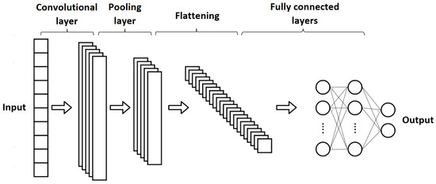
CNN 1D Principle & Structure
Why CNN for Time Series?
Local Pattern Detection: Captures short-term dependencies
Parameter Efficiency: Sharing mechanism reduces complexity
Computational Advantage: Improved performance
Core Components
Conv1D Layer
Slides kernel along time dimension
Extracts local temporal features
Pooling Layer
Downsampling with feature preservation
Max pooling highlights key patterns
Activation (ReLU)
Non-linearity: f(x) = max(0, x)
Prevents gradient vanishing
Architecture Flow
Input → Conv1D → Pooling → Flatten → Dense → Output

Slide 32

CNN Application in Extreme Climate Prediction
Implementation Steps
1. Input Preprocessing
Variables: pr, tasmax, tasmin, tas → 3D tensor
Time Steps: 5 (short-term patterns)
2. Convolution Layer
32 kernels, kernel size = 2
ReLU activation
Extracts adjacent time step patterns
3. Max Pooling
Pool size: 2
Enhances extreme feature sensitivity
4. Reshaping
Output: [batch_size, time_steps, features]
Dimension: (-1, 32)
Prepares input for LSTM
$$y_{i}=σ\left(\sum_{j=0}^{k−1}{w_{j}}⋅x_{i+j}+b\right)$$

Slide 33
Model Training and Optimization
Architecture：
End-to-end: CNN → LSTM sequential connection
Training Configuration
Optimizer
Adam algorithm
Adaptive learning rate adjustment
Training Parameters
Batch size: 32 (efficiency-stability balance)
Epochs: 100 (full pattern capture)
Hierarchical Learning Strategy：
CNN Module
Extracts short-term meteorological fluctuation patterns
Provides refined feature representations
LSTM Integration
Receives enhanced CNN features
Processes temporal dependencies
Key Advantages
Effective feature extraction: Short-term pattern capture
Enhanced accuracy: Improved extreme climate event prediction
Hierarchical learning: Multi-level feature processing

Slide 34
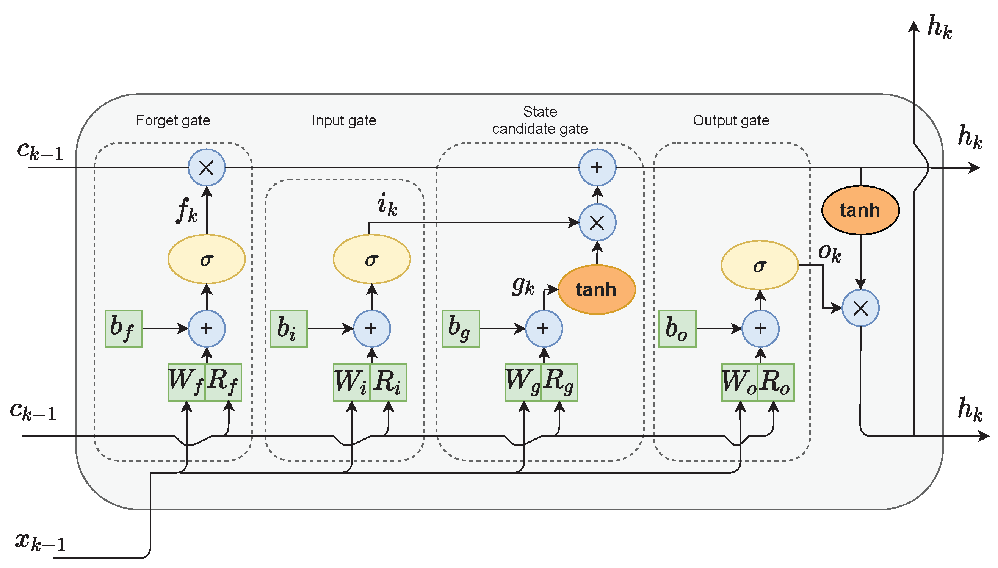
LSTM Modeling in CEEMDAN-CNN-LSTM
Implementation Process
1. Feature Reception
Input: CNN pooling layer output
Dimension: (-1, 32) after Reshape layer
Feature count: 32 (matches CNN kernels)
2. LSTM Configuration
Architecture: Single-layer LSTM
Hidden units: 128
Activation: SELU (Scaled Exponential Linear Unit)
Advantage: Self-normalizing, stable gradient propagation
3. Sequence Processing
Setting: return_sequences=False
Function: Returns final time step output only
Output: (batch_size, 128)
Purpose: Single-step prediction tasks
4. Output Mapping
Layer: Fully connected (Dense)
Output dimension: 1 (single IMF component prediction)
Final step: Aggregate all IMF predictions → complete target variable
Key Benefits
Effective temporal dependency capture
Stable training with SELU activation
Optimized for meteorological nonlinear patterns
Notes:
Step 1: Feature Reception The LSTM layer receives feature output from the CNN pooling layer. After dimensionality adjustment through the Reshape layer, the feature dimension becomes (-1, 32), where 32 corresponds to the number of CNN convolution kernels.
Step 2: LSTM Configuration A single-layer LSTM architecture with 128 hidden units is employed. The SELU activation function is used for its self-normalizing property, enabling stable gradient propagation and effective capture of nonlinear meteorological patterns.
Step 3: Sequence Processing Setting return_sequences=False ensures the LSTM returns only the final time step output, compressing temporal dependencies into the final hidden state. This configuration suits single-step prediction tasks with output dimension (batch_size, 128).
Step 4: Output Mapping The LSTM output is mapped through a fully connected Dense layer to dimension 1, corresponding to a single IMF component prediction. All IMF predictions are then aggregated to reconstruct the complete target variable.

Slide 35
LSTM Modeling in CEEMDAN-LSTM
Implementation Process
1: Feature Input
CEEMDAN-LSTM: 3D tensor [batch_size, time_steps, features] directly
CNN-LSTM: CNN pooling output → Reshape → (-1, 32)
2: LSTM Configuration
CEEMDAN-LSTM: 128 units, tanh/sigmoid activation
CNN-LSTM: 128 units, SELU activation
3: Sequence Processing
Return_sequences=False, final time step output
4: Output Strategy
CEEMDAN-LSTM: Individual models per IMF component, parallel training
CNN-LSTM: Single model, Dense layer mapping
Key Advantages
Computational efficiency: No CNN preprocessing overhead
Divide-and-conquer: Independent IMF modeling reduces complexity
Direct feature learning: Temporal dependencies from raw data
Notes:
Step 1: Direct Feature Reception Unlike the CNN-LSTM approach, the LSTM layer directly receives original multidimensional meteorological features structured as 3D tensor [batch_size, time_steps, features]. No CNN pooling layer or Reshape operations are required, with time steps set to 5 for optimal feature capture.
Step 2: Standard LSTM Configuration A single-layer LSTM architecture with 128 hidden units is employed. Instead of SELU activation, standard tanh activation is used for cell state transformation with sigmoid functions controlling gate mechanisms. This simpler configuration offers higher computational efficiency.
Step 3: Sequence Processing Setting return_sequences=False ensures the LSTM returns only the final time step output, compressing temporal dependencies into the final hidden state. This configuration remains identical to the CNN-LSTM approach, suitable for single-step prediction tasks.
Step 4: Multi-Component Output Mapping Rather than processing CNN-extracted features, individual LSTM models are constructed for each IMF component with parallel training. Each model outputs dimension 1 predictions, and all IMF predictions are aggregated to reconstruct the complete target variable through divide-and-conquer strategy.

Slide 36
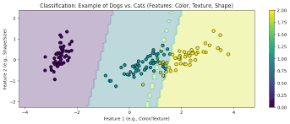
Classification
Continuous predictions → Discrete risk categories Purpose: Evaluate extreme climate event classification performance
CDD Drought Classification
Threshold Rules
Non-drought (Class 0): <11 days
Mild drought (Class 1): 11-15 days
Drought (Class 2): ≥16 days
Rx5Day Flood Classification
Threshold Rules
Non-flood (Class 0): <50 mm
Minor flood (Class 1): 50-100 mm
Flood (Class 2): ≥100 mm

Slide 37

RESULT AND INSIGHT

Slide 38
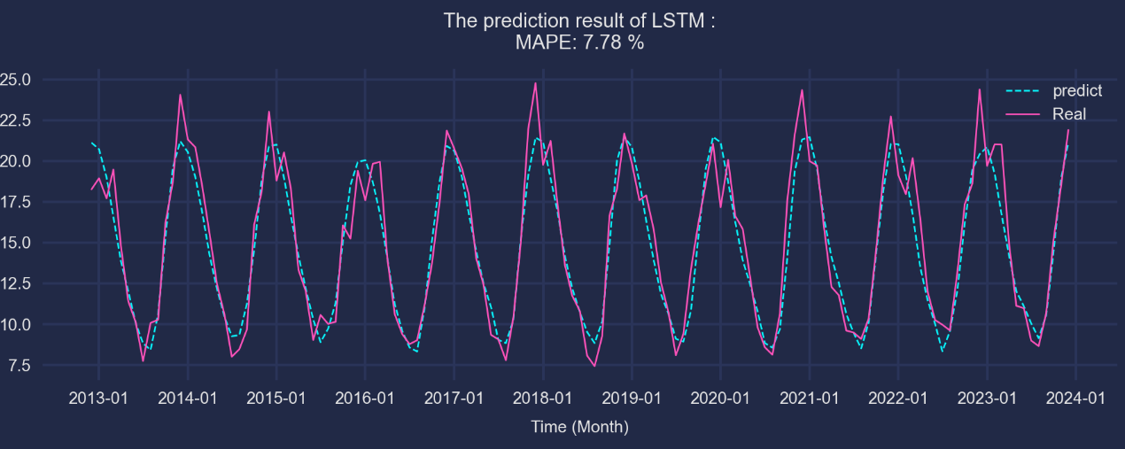
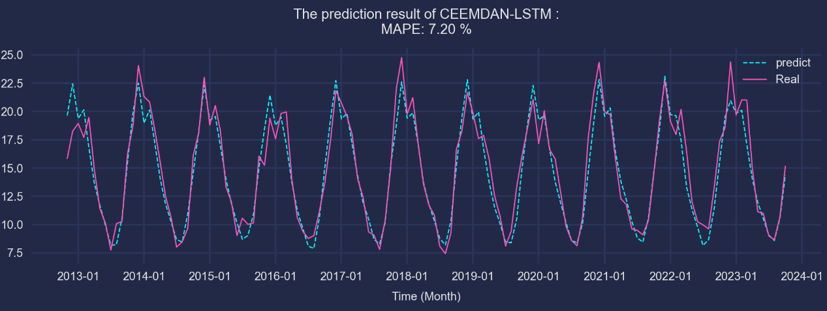
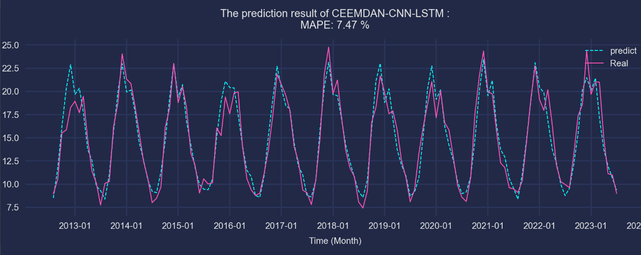
Regression result - Drought
Evaluation Framework
Regression metrics: MSE, RMSE, MAE, MAPE, R²
Classification metrics: Accuracy, F1-score, precision, recall
Comparison: Hybrid models vs baseline LSTM
Overall Findings
CEEMDAN-based models generally outperform standalone LSTM
Strong performance in China, India, Indonesia, Philippines, Thailand, Vietnam
Regional variations due to data correlation differences
China Drought Prediction Results (MAPE)
CEEMDAN-LSTM: 7.20% (Figure 5.3) – Best
CEEMDAN-CNN-LSTM: 7.47% (Figure 5.2)
LSTM: 7.78% (Figure 5.1) - Baseline

Slide 39
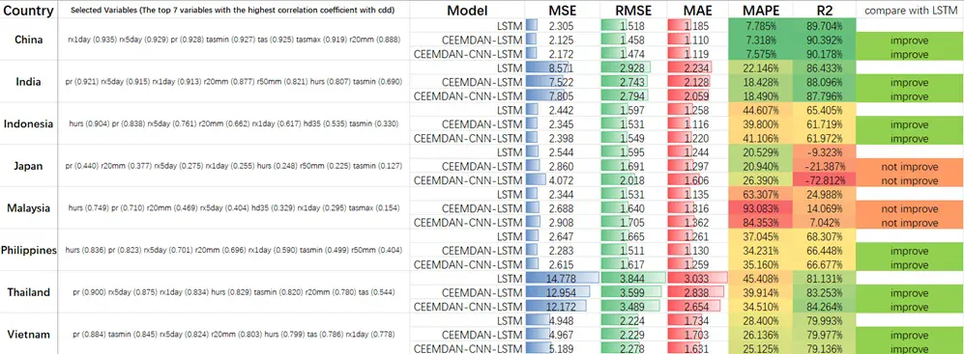
Regional Performance Analysis - Drought
High Performance Countries
China & India: Strong correlation → High accuracy
China: CEEMDAN-LSTM MAPE 7.20% vs LSTM 7.78%
India: CEEMDAN-LSTM MAPE 18.43% vs LSTM 18.94%
Thailand & Vietnam: Satisfactory results
Thailand: CEEMDAN-CNN-LSTM R² 84.26% (+3% vs LSTM)
Vietnam: CEEMDAN-CNN-LSTM MAPE 25.12% vs LSTM 26.14%
Moderate Performance Countries
Indonesia & Philippines: Better than Japan/Malaysia but high MAPE
Challenge: Tropical humid regions → high nonlinearity (MAPE ~37-44%)
Improvement: CEEMDAN models reduce MAPE by 3-5%
Poor Performance Countries
Japan & Malaysia: CEEMDAN models failed to improve
Japan: LSTM R² -9.32% → CEEMDAN-CNN-LSTM R² -72.81%
Malaysia: Significant R² decrease, MAPE increase

Slide 40
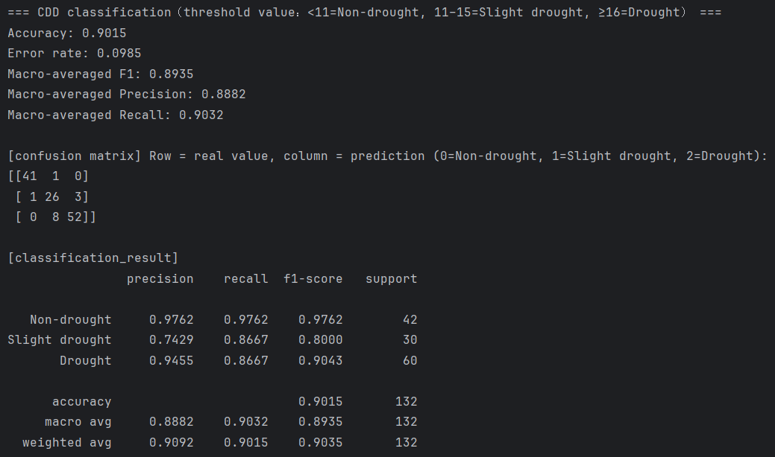
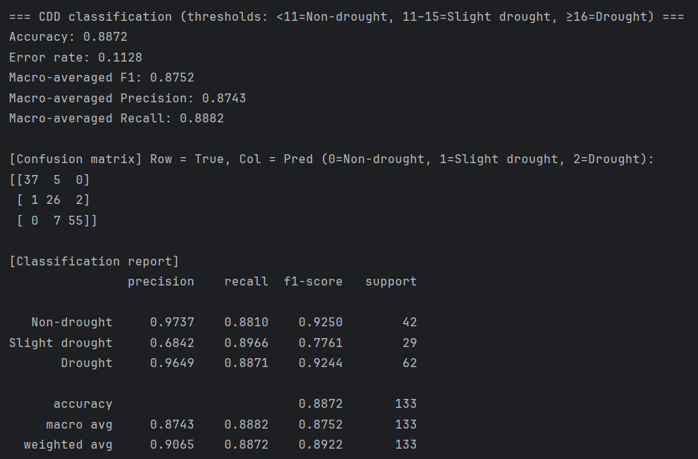
Classification result - Drought
Overall Classification Accuracy
CEEMDAN-CNN-LSTM: 90.15% (Figure 5.5) - Best
CEEMDAN-LSTM: 89.39% (Figure 5.6)
LSTM: 88.72% (Figure 5.7) – Baseline
Macro-Averaged Metrics
CEEMDAN-CNN-LSTM: F1 score = 0.8935
Superior performance across all evaluation metrics
Enhanced stability in multi-class classification
Figure 5.5 CEEMDAN-CNN-LSTM Classification Results (China Drought)
Figure 5.7 LSTM Classification Results (China Drought)

Slide 41
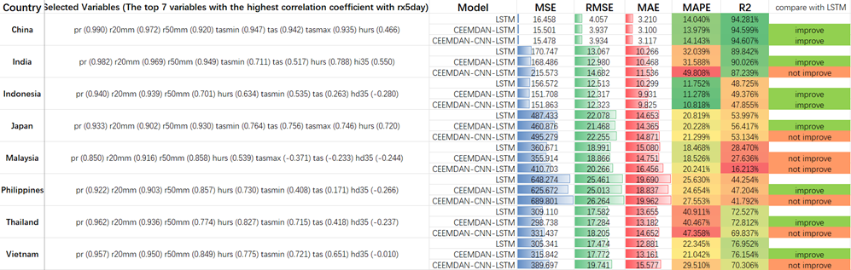
Regional Performance Analysis - Flood
CEEMDAN Models Outperform LSTM
China: Marginal improvement
LSTM: 14.04% MAPE, CEEMDAN-LSTM: 13.98% MAPE, R² ~94%
Indonesia: Best hybrid performance
CEEMDAN-CNN-LSTM: 10.82% MAPE vs LSTM: 11.75% MAPE
India, Japan, Vietnam: CEEMDAN-LSTM shows improvements
LSTM Outperforms CEEMDAN Models
Malaysia: Significant decline
LSTM performs better, CEEMDAN models: MAPE 20.24%, R² 16.21%
Philippines & Thailand: Standard LSTM superior
Convective systems and typhoons → high unpredictability

Slide 42
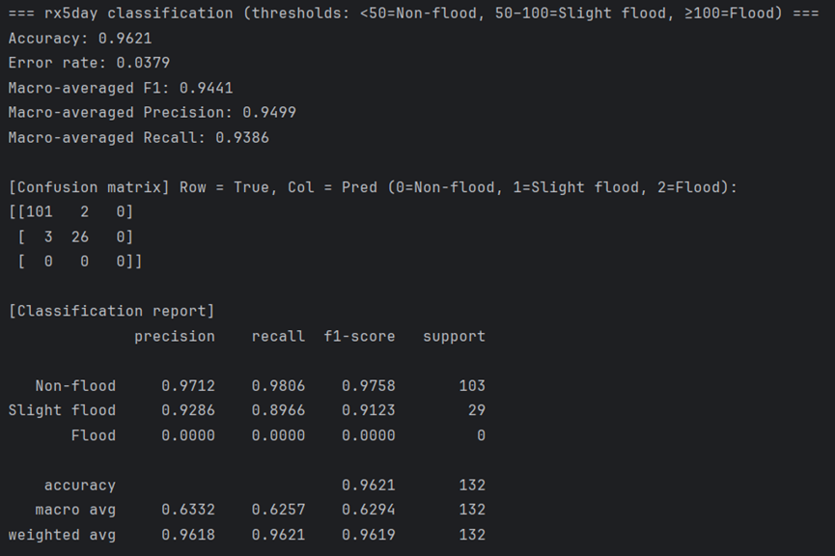
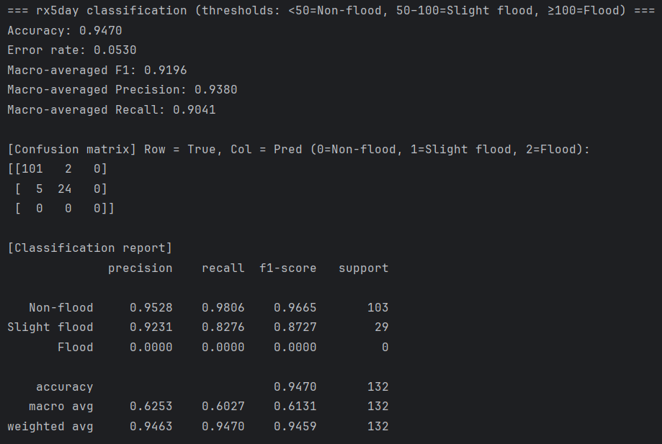
Classification result - Flood
China Performance Ranking - CEEMDAN-LSTM Best
1. CEEMDAN-LSTM (Best Performance)
Accuracy: 0.9621, Macro-F1: 0.9441
Slight flood recall: 0.8966 (+6.9% vs LSTM)
Precision: 0.9286
2. CEEMDAN-CNN-LSTM
Accuracy: 0.9549, Macro-F1: 0.9321
Slight flood recall: 0.8621
Outperforms LSTM but below CEEMDAN-LSTM
3. LSTM (Baseline)
Accuracy: 0.9470, Macro-F1: 0.9196
Slight flood recall: 0.8276
Main issue: Misclassifies slight flood → non-flood
Indonesia Results - CEEMDAN Models Outperform LSTM
CEEMDAN-LSTM: Accuracy 0.7348, Weighted-F1 0.7274 (Best overall)
CEEMDAN-CNN-LSTM: Accuracy 0.7218, Strong extreme flood recall
LSTM: Lower performance across metrics
Figure 5.10 CEEMDAN-LSTM Classification Results (China Flood)
Figure 5.11 LSTM Classification Results (China Flood)

Slide 43
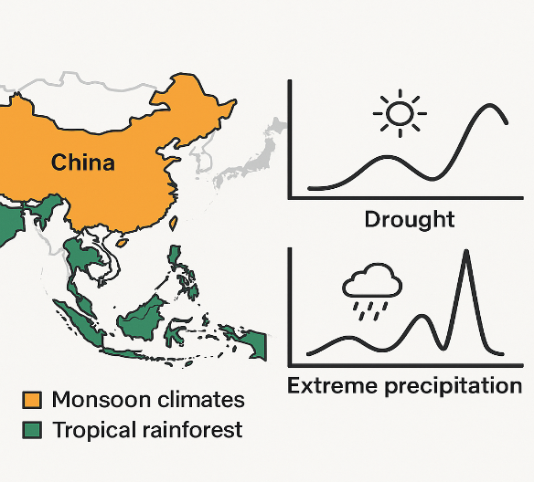
Model Architecture Adaptability (Insight 1)
Core Finding
CEEMDAN decomposition improves LSTM performance, but effectiveness varies by geography and event type.
Geographic Patterns
CEEMDAN-based models perform better in monsoon climates (China, India) than tropical rainforest regions due to stronger periodic components in monsoon systems.
Event Type Performance
Cumulative events like drought show stronger improvements with CEEMDAN models. Extreme precipitation events show mixed results: CEEMDAN-LSTM improved in 5/8 countries while CEEMDAN-CNN-LSTM improved in only 2/8 countries.
Physical Mechanism
Drought's slowly developing cumulative nature with trend and periodic characteristics enables effective multi-scale feature extraction. Extreme precipitation's randomness and suddenness from convective systems and typhoons limit signal decomposition advantages.
Implication
Model selection should consider regional climate characteristics and target event types.

Slide 44
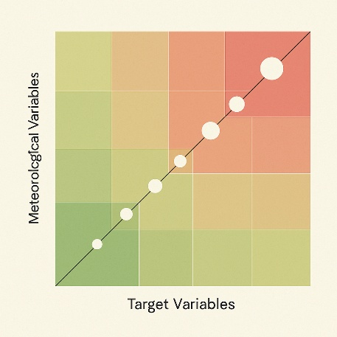
Data Correlation and Model Performance (Insight 2)
Core Finding
Correlation strength between meteorological variables and target variables critically determines model performance.
High Correlation Regions (>0.75)
China and India demonstrate strong correlations, enabling CEEMDAN to effectively extract meaningful IMFs and enhance prediction accuracy through successful multi-scale feature decomposition.
Weak Correlation Regions (0.44-0.75)
Japan and Malaysia show weaker correlations, where decomposed IMFs introduce additional noise and degrade model performance. CEEMDAN processes signals with "white noise"-like characteristics, generating spurious modal components.
Error Amplification Effect
Japan's drought prediction illustrates cumulative error problems: R² declined from -9.32% (LSTM) to -72.81% (CEEMDAN-CNN-LSTM). Independent IMF modeling in LSTM stages allows individual prediction errors to accumulate during final summation, causing significant error amplification.
Practical Recommendations
Compute correlation coefficient matrix before applying CEEMDAN. Use decomposition techniques only when maximum correlation coefficient exceeds 0.70. For moderate correlation cases, consider using only dominant IMF components rather than all decomposed components to minimize noise introduction and improve model robustness.

Slide 45
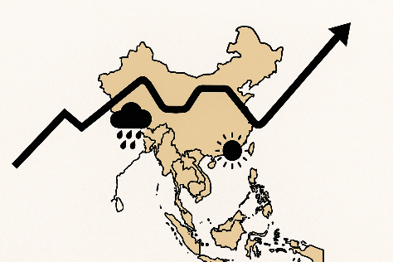
Regional Variability Analysis (Insight 3)
Core Finding
Notable regional differences in predictive performance reveal systematic patterns across different climate zones.
High Performance Regions
East Asian monsoon region (China) and South Asian monsoon region (India) exhibit higher prediction accuracy compared to maritime climate regions in Southeast Asia (Malaysia, Philippines).
Performance Difference Factors
Climate System Complexity
Monsoon-dominated regions feature relatively stable and predictable seasonal climate cycles. Maritime climate regions face multiple interacting climatic factors including ENSO (El Niño–Southern Oscillation), IOD (Indian Ocean Dipole), and tropical cyclones, which collectively increase climate prediction complexity and uncertainty.
Topographic Effects
Island nations such as Indonesia and the Philippines feature complex topography with mountainous terrain and fragmented landforms. These geographical features amplify local climate variability and atmospheric instability, reducing the effectiveness of regional-scale climate prediction models.
Implications
Regional climate characteristics and topographic complexity should be considered when selecting prediction models. Monsoon-dominated continental regions provide more favorable conditions for decomposition-based prediction approaches than complex maritime environments.

Slide 46

PRACTICAL VALVE

Slide 47
Practical Valve
Climate Risk Management Applications
Study findings provide valuable guidance for climate risk management practices. Prediction strategies should be tailored to regional climate characteristics and event types rather than adopting one-size-fits-all modeling approaches.
Early Warning System Design
Cumulative climate events such as droughts are particularly well-suited for CEEMDAN-LSTM models due to strong periodicity and trend characteristics, enabling effective multi-scale information extraction.
Model Application Cautions
For sudden precipitation events in tropical maritime climate regions, complex hybrid models should be applied with caution. Multiple stochastic factors may cause forced decomposition to introduce noise and degrade model performance.
Computational Resource Optimization
In regions with weak data correlation, simpler LSTM models may offer better cost-benefit trade-offs. This finding is particularly relevant for meteorological agencies with limited resources, demonstrating that computationally intensive models are not always necessary.
Decision-Making Framework
Evaluate local meteorological data quality and correlation structure before selecting model complexity. This approach ensures prediction accuracy while avoiding unnecessary computational overhead.

Slide 48

LIMITATIONS AND FUTURE RESEARCH DIRECTIONS

Slide 49

Research Limitations
Data Constraints
Missing climate oscillations: No ENSO, IOD integration
Historical focus: Limited to meteorological observations
Model Architecture Issues
Spatial neglect: Temporal modeling only, missing spatial correlations
Computational burden: CEEMDAN overhead affects real-time applications
Prediction Scope
Deterministic output: No uncertainty quantification
Short-term focus: Limited long-term forecasting validation
Practical Deployment
Complex maintenance: Multiple IMF models increase operational complexity

Slide 50

Future Research Directions
Data Enhancement
Climate oscillations: Integrate ENSO, IOD systems
Multi-source fusion: External signal incorporation
Model Architecture
Spatial modeling: Graph neural networks, spatial attention
Efficiency optimization: Parallel computing, faster algorithms
System Intelligence
Adaptive selection: Automated architecture optimization
Intelligent frameworks: Data-driven model configuration

Slide 51

REFERENCE LIST

Slide 52
Reference list
[1] Intergovernmental Panel on Climate Change (IPCC). (2023). Climate change 2023: Synthesis report – Summary for policymakers. https://www.ipcc.ch/report/sixth-assessment-report-synthesis-report/
[2] Muhammad, M. K. I., Hamed, M. M., Harun, S., & Mohd, N. (2024). Heatwaves in Peninsular Malaysia: A spatiotemporal analysis. Scientific Reports, 14, 4255. https://doi.org/10.1038/s41598-024-42911-1
[3] World Meteorological Organization (WMO). (2022, November 11). Economic losses from extreme weather rocket in Asia. https://public.wmo.int/en/media/press-release/economic-losses-extreme-weather-rocket-asia-wmo
[4] World Bank. (2021). Climate risk country profile: Malaysia. https://climateknowledgeportal.worldbank.org/country/malaysia/climate-data-projections
[6] Camps-Valls, G., Fernández-Torres, M. Á., Cohrs, K. H., Höhl, A., Castelletti, A., Pacal, A., … Williams, T. (2025). Artificial intelligence for modeling and understanding extreme weather and climate events. Nature Communications, 16, 1919. https://doi.org/10.1038/s41467-025-56573-8
[7] World Meteorological Organization (WMO). (2024, April 23). Climate change and extreme weather impacts hit Asia hard [Press release]. https://public.wmo.int/en/media-centre/press-release/climate-change-and-extreme-weather-impacts-hit-asia-hard
[8] Verma, S., Srivastava, K., Tiwari, A., & Verma, S. (2023). Deep learning techniques in extreme weather events: A review. arXiv preprint arXiv:2308.10995. https://arxiv.org/abs/2308.10995
[9] Islam, T., Mazumder, T., Roni, M. N. S., & Nur, M. S. (2024). A comparative study of machine learning models for predicting Aman rice yields in Bangladesh. Heliyon, 10(23), e40764. https://doi.org/10.1016/j.heliyon.2024.e40764
[10] Kumar, V., Kedam, N., Sharma, K. V., Khedher, K. M., & Alluqmani, A. E. (2023). A comparison of machine learning models for predicting rainfall in urban metropolitan cities. Sustainability, 15(18), 13724. https://doi.org/10.3390/su151813724

Slide 53
[11] Wang, T., Tu, X., Singh, V. P., Chen, X., Lin, K., & Zhou, Z. (2023). Drought prediction: Insights from the fusion of LSTM and multi-source factors. Science of The Total Environment, 902, 166361. https://doi.org/10.1016/j.scitotenv.2023.166361
[12] Zhang, R., Chen, Z.-Y., Xu, L.-J., & Ou, C.-Q. (2019). Meteorological drought forecasting based on a statistical model with machine learning techniques in Shaanxi province, China. Science of The Total Environment, 665, 338–352. https://doi.org/10.1016/j.scitotenv.2019.01.431
[13] Li, J., Wu, G., Zhang, Y., & Shi, W. (2024). Optimizing flood predictions by integrating LSTM and physical-based models with mixed historical and simulated data. Heliyon, 10(13), e33669. https://doi.org/10.1016/j.heliyon.2024.e33669
[14] Shafiq, F., Zafar, A., Khan, M. U. G., Iqbal, S., Albesher, A. S., & Asghar, M. N. (2025). Extreme heat prediction through deep learning and explainable AI. PLOS ONE, 20(3), e0316367. https://doi.org/10.1371/journal.pone.0316367
[15] Essa, Y., Hunt, H. G. P., Gijben, M., & Ajoodha, R. (2022). Deep learning prediction of thunderstorm severity using remote sensing weather data. IEEE Journal of Selected Topics in Applied Earth Observations and Remote Sensing, 15, 4004–4013. https://doi.org/10.1109/JSTARS.2022.3172785
[16] Dikshit, A., Pradhan, B., & Huete, A. (2021). An improved SPEI drought forecasting approach using the long short-term memory neural network. Journal of Environmental Management, 283, 111979. https://doi.org/10.1016/j.jenvman.2021.111979
[17] Xie, T., Liu, C., Hu, C., Li, W., & Li, R. (2024). Study on long short-term memory based on vector direction of flood process for flood forecasting. Scientific Reports, 14, 21446. https://doi.org/10.1038/s41598-024-72205-5
[18] Frifra, A., Maanan, M., Maanan, M., & Rhinane, H. (2024). Harnessing LSTM and XGBoost algorithms for storm prediction. Scientific Reports, 14, 11381. https://doi.org/10.1038/s41598-024-62182-0
[19] Huang, N. E., Shen, Z., Long, S. R., Wu, M. C., Shih, H. H., Zheng, Q., ... & Liu, H. H. (1998). The empirical mode decomposition and the Hilbert spectrum for nonlinear and non-stationary time series analysis. Proceedings of the Royal Society of London. Series A: Mathematical, Physical and Engineering Sciences, 454(1971), 903–9095. https://doi.org/10.1098/rspa.1998.0193
[20] Torres, M. E., Colominas, M. A., Schlotthauer, G., & Flandrin, P. (2011, May). A complete ensemble empirical mode decomposition with adaptive noise. In 2011 IEEE International Conference on Acoustics, Speech and Signal Processing (ICASSP) (pp. 4144–4147). IEEE. https://doi.org/10.1109/ICASSP.2011.5947265
[21] Wu, Z., & Huang, N. E. (2009). Ensemble empirical mode decomposition: A noise-assisted data analysis method. Advances in Adaptive Data Analysis, 1(01), 1–41. https://doi.org/10.1142/S1793536909000047

Slide 54


