Slide 1
CS 2520: Wide Area Networks (and Internet Services)
Lecture 3: Congestion Control
Dr. Amy Babay, Fall 2021

Slide 2
Reliable Data Transfer - Recap
Stop-and-wait
Send 1 packet, wait until it is acknowledged to send the next
Go-Back-N
Sender can have up to N unacknowledged packets at any time
Receiver discards out of order packets and sends cumulative ACKs
Upon timeout for oldest unacknowledged packet, sender resends ALL unacknowledged packets
Selective Repeat
Sender can have up to N unacknowledged packets at any time
Receiver buffers out of order packets (that fall within window) and sends selective ACKs
Upon timeout for a specific packet, sender resends that packet

Slide 3
Reliable Data Transfer - Recap
Selective Repeat Variation – Project 1
Sender can have up to N unacknowledged packets at any time
Receiver buffers out of order packets (that fall within window) and sends cumulative ACKs and explicit NACKs
Cumulative ACKs allow sender to slide window forward (send new data)
Receiver can detect that a packet is missed when it sees a gap in the received sequence numbers. Explicit NACK tells sender to resend immediately.
A good way to think about design:
What events can happen? (message receipt, timeout)
What action should be taken on each event?

Slide 4
Reliable Data Transfer - Recap
Some design questions:
What data structures do the sender and receiver need?
What message types are needed?
Do we need timeouts? If so, when?
How exactly do you decide when to send a NACK?
Consider that I receive pkt 1, pkt 2, pkt 7, pkt 8, pkt 9. What action do I take on each pkt receipt?
How exactly do you decide when to send an ACK? every packet receipt?
How does the receiver know when it can close the file? – NOTE: should not rely on knowing file size up front
How does the sender know when it can exit?

Slide 5
Reliable Data Transfer Recap: Selective Repeat Variation
Sender buffer:
next_seq
sendbase
N
Sent and ACK’d
Sent but not ACK’d
sequence number →
Not yet sent
Receiver buffer:
recvbase
N
Received and ACK’d
ARU
Not received (but expected)
sequence number →
Not received

Slide 6
New topic for this week: congestion control

Slide 7
Finding the “right” sending rate: flow and congestion control
Some applications have a fixed ideal sending rate (e.g. video encoded at a particular bitrate)
Others want to send “as fast as possible” (e.g. file transfer)
How do we know how fast it’s possible to send?
What affects how fast it’s possible to send?
Speed at which the receiver can process incoming data
Transmission rate of the links involved (specifically the “bottleneck” link)
Competing network flows

Slide 8
Finding the “right” sending rate: flow and congestion control
Some applications have a fixed ideal sending rate (e.g. video encoded at a particular bitrate)
Others want to send “as fast as possible” (e.g. file transfer)
How do we know how fast it’s possible to send?
What affects how fast it’s possible to send?
Speed at which the receiver can process incoming data – Flow Control
Transmission rate of the links involved (specifically the “bottleneck” link)
Competing network flows
Congestion Control

Slide 9


Flow Control
Flow Control key idea: sender should not transmit faster than the receiver can process!

Slide 10
Flow Control
Recall our discussion from last week on reliable data transfer
Receiver maintains a buffer that stores received but not-yet-delivered data
Buffers have finite storage space, so what would happen if sender sends more data than the receiver can fit in its buffer?
recvbase
N
Received and ACK’d
Not received (but expected)
sequence number →
Not received

Slide 11
Flow Control
We saw a limited form of flow control in the Go-Back-N and Selective Repeat protocols we looked at:
Receiver maintains a buffer that can hold N packets
Sender is allowed to have up to N unacknowledged packets out at any time
N
Sent and ACK’d
Sent but not ACK’d
sequence number →
Not yet sent
N
Received and ACK’d
Not received (but expected)
sequence number →
Not received

Slide 12
TCP Flow Control
More flexible, but same basic idea: sender only sends as much data as it knows receiver can accept
Receiver uses an “Advertised Window” (RWND) to tell the sender how many bytes it can accept
Receiver indicates value of RWND in ACKs
Sender ensures that the total number of bytes in flight <= RWND
32 bits
Source port
Destination port
Sequence number
Acknowledgment
HdrLen
0
Flags
Advertised window
Checksum
Urgent pointer
Options (variable)
Data

Slide 13
TCP Flow Control
Advertised window limits rate: Sender can send no faster than RWND/RTT bytes/sec
Receiver only advertises more space when application has consumed old arriving data
Edge case: What happens when RWND=0?
Sender keeps probing by sending segments with one byte of data
Receiver can ACK, but won’t increase RWND until application reads some data and buffer space opens up

Slide 14

Summary: Flow Control
Sender
Receiver
Problem:
New data arriving at a receiver with a full buffer will be dropped
To provide reliable transfer, it will need to be retransmitted…
Sender needs to do a lot of extra work, and we waste bandwidth transmitting the same data multiple times
Solution:
Flow control!
Receiver tells sender how much new data it can accept, and sender agrees not to send more than that
Results in “speed matching” of sending and processing/delivering data

Slide 15
Congestion Control
But, buffers at the receiver aren’t the only ones we need to worry about…
Sender
Receiver

Slide 16
Congestion Control
…and many senders may “compete” for the same network resources
Sender
Receiver

Slide 17
Congestion Control vs Flow Control
Both try to limit sending rate to avoid overwhelming finite resources
Flow control aims to avoid overwhelming the receiver
Congestion control aims to avoid overwhelming the network
Flow control benefits an individual source->destination flow
Congestion control is (mainly) for the general benefit of the network

Slide 18
Congestion Control
Goal: allow senders to transmit as fast as possible without overloading the network

Slide 19
Congestion Control Challenges
Consider an extremely simple scenario:
A
100 Mbps
B
Sending Host
Buffer in Router
Receiving Host
Can we experience congestion in this case?
Yes, if A sends at a rate > 100 Mbps
How can we avoid congestion in this case?
A needs to send at < 100 Mbps…but how does it know what the available bandwidth is??

Slide 20
Congestion Control Challenges
Consider a slightly more complex (but still simple) scenario:
A1
B1
A2
100 Mbps
B2
A3
B3
How can we avoid congestion?
A1, A2, A3 need to collectively send at a rate of at most 100 Mbps
But none of them knows that the bottleneck link is 100 Mbps, how many other senders there are, or how fast the others want to send…

Slide 21
Congestion Control Challenges
And reality looks more like this:
1Gbps
1Gbps
600Mbps
Congestion control is a resource allocation problem involving many flows, many links, and complicated global dynamics

Slide 22
What can we do?
(0) Give up – let everyone send as fast as they want
Many packet drops, delays, retransmissions, potential for congestion collapse

Slide 23
What can we do?
(0) Give up – let everyone send as fast as they want
(1) Massively overprovision – throw money at the problem
Build network infrastructure to accommodate all possible demands, avoiding congestion
Extremely expensive, extremely low utilization (most of the time, resources will be idle)

Slide 24
What can we do?
(0) Give up – let everyone send as fast as they want
(1) Massively overprovision – throw money at the problem
(2) Require reservations (virtual circuits)
Pre-arrange bandwidth allocations
Requires negotiation before sending packets
Low utilization

Slide 25
What can we do?
(0) Give up – let everyone send as fast as they want
(1) Massively overprovision – throw money at the problem
(2) Require reservations (virtual circuits)
(3) Dynamically adjust sending rates
Hosts infer level of congestion; adjust rates
Simple to implement but suboptimal, messy dynamics

Slide 26
What can we do?
(0) Give up – let everyone send as fast as they want
(1) Massively overprovision – throw money at the problem
(2) Require reservations (virtual circuits)
(3) Dynamically adjust sending rates
Hosts infer level of congestion; adjust rates
Simple to implement but suboptimal, messy dynamics
But, provides a very general solution: doesn’t assume infrastructure properties, traffic characteristics, application requirements; maintains layered model
But, requires good citizenship!

Slide 27
Congestion Control: Dynamic Adaptation
Two key questions:
How do senders infer that there is congestion?
How do senders adjust their sending rates in response?
High-level answers:
Many possibilities…traditionally, for TCP, assume loss implies congestion
Maintain a window that shrinks whenever congestion is detected (and increases when no congestion is detected)

Slide 28
Congestion Window: Adjusting the Sending Rate
Congestion Window: CWND
Bytes that can be sent without overflowing routers
Computed by sender using congestion control algorithm
Flow control window: RWND
Bytes that can be sent without overflowing receiver
Determined by the receiver and reported to the sender
Sender-side window = min {CWND, RWND}
Assume for this lecture that RWND >> CWND
Recall: sending rate ~ Window/RTT

Slide 29
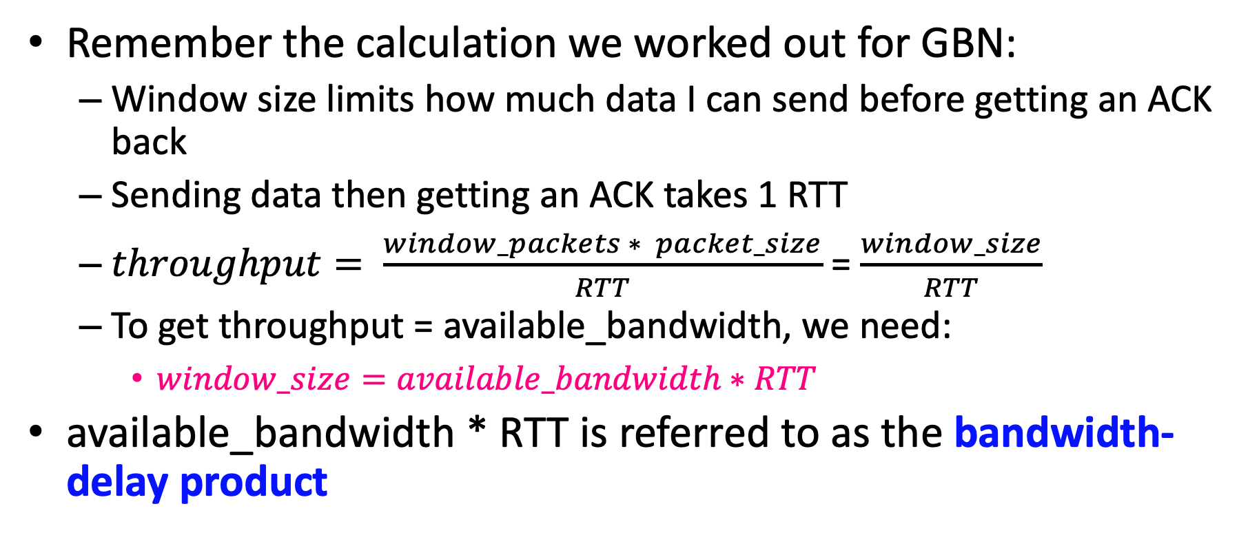
An ideal window size
Remember the calculation we worked out for GBN:
Window size limits how much data I can send before getting an ACK back
Sending data then getting an ACK takes 1 RTT
$throughput= \frac{window_packets ∗ packet_size}{RTT}$ = $\frac{window_size}{RTT}$
To get throughput = available_bandwidth, we need:
$window_size=available_bandwidth∗RTT$
available_bandwidth * RTT is referred to as the bandwidth-delay product

Slide 30
Bandwidth Delay Product: Pipe Model
Delay
Think of the link as a pipe
BDP is the volume of the pipe in bits (i.e. how much data it can “hold”, or how much data can be ”in flight” at any time)
Bandwidth
Delay * Bandwidth

Slide 31
Congestion Control Challenges
But remember this picture! We don’t know the available bandwidth and RTT in advance…so, how can we infer the right rate?
1Gbps
1Gbps
600Mbps

Slide 32
TCP Reno: Adjusting the Window
Basic idea:
Probing for available bandwidth
ACK: segment received → network is not congested → increase sending rate (increase window size)
Lost segment: (timeout or 3 duplicate ACKs) → network is congested → decrease sending rate (decrease window size)
ACKs being received,
so increase rate
X
loss, so decrease rate
X
X
X
sending rate
X
time
TCP’s
“sawtooth”
behavior

